Slide 1

UNLOCKING SALES POTENTIAL THROUGH DATA:VISUAL JOURNEY
BY, Pavitha p ragasudha b

Slide 2
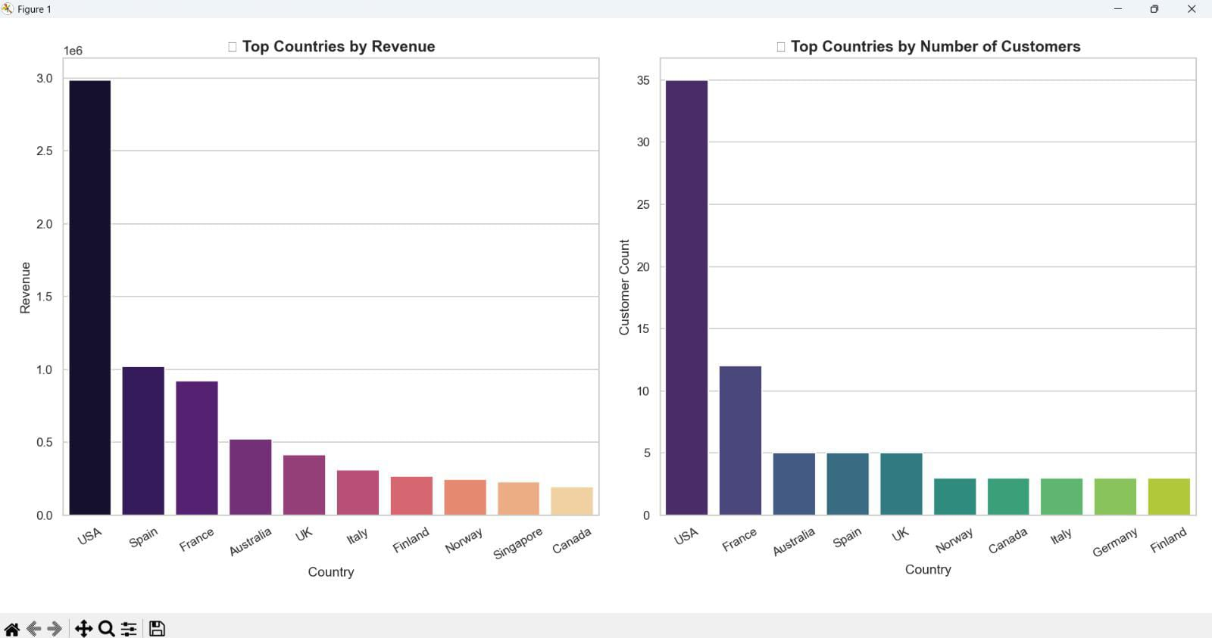
Geographic analyses-where our market lives

Slide 3
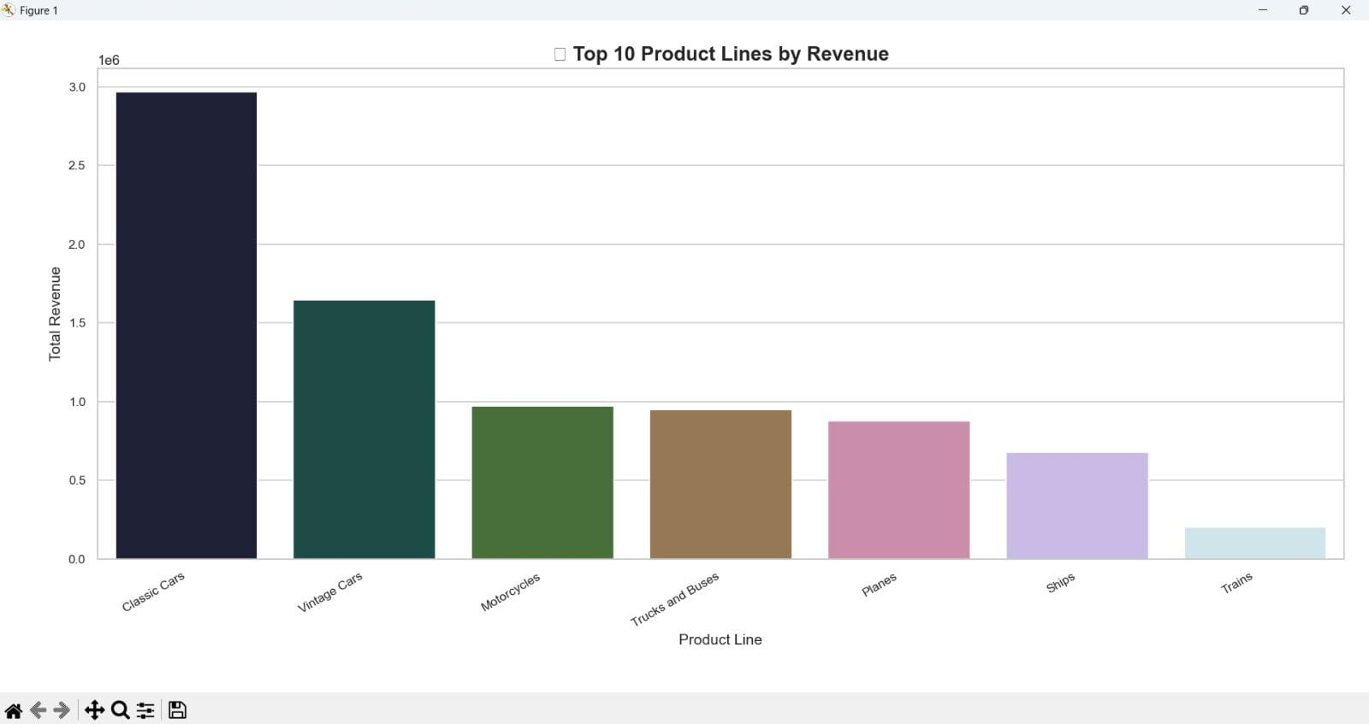
Revenue drivers- What really sells

Slide 4
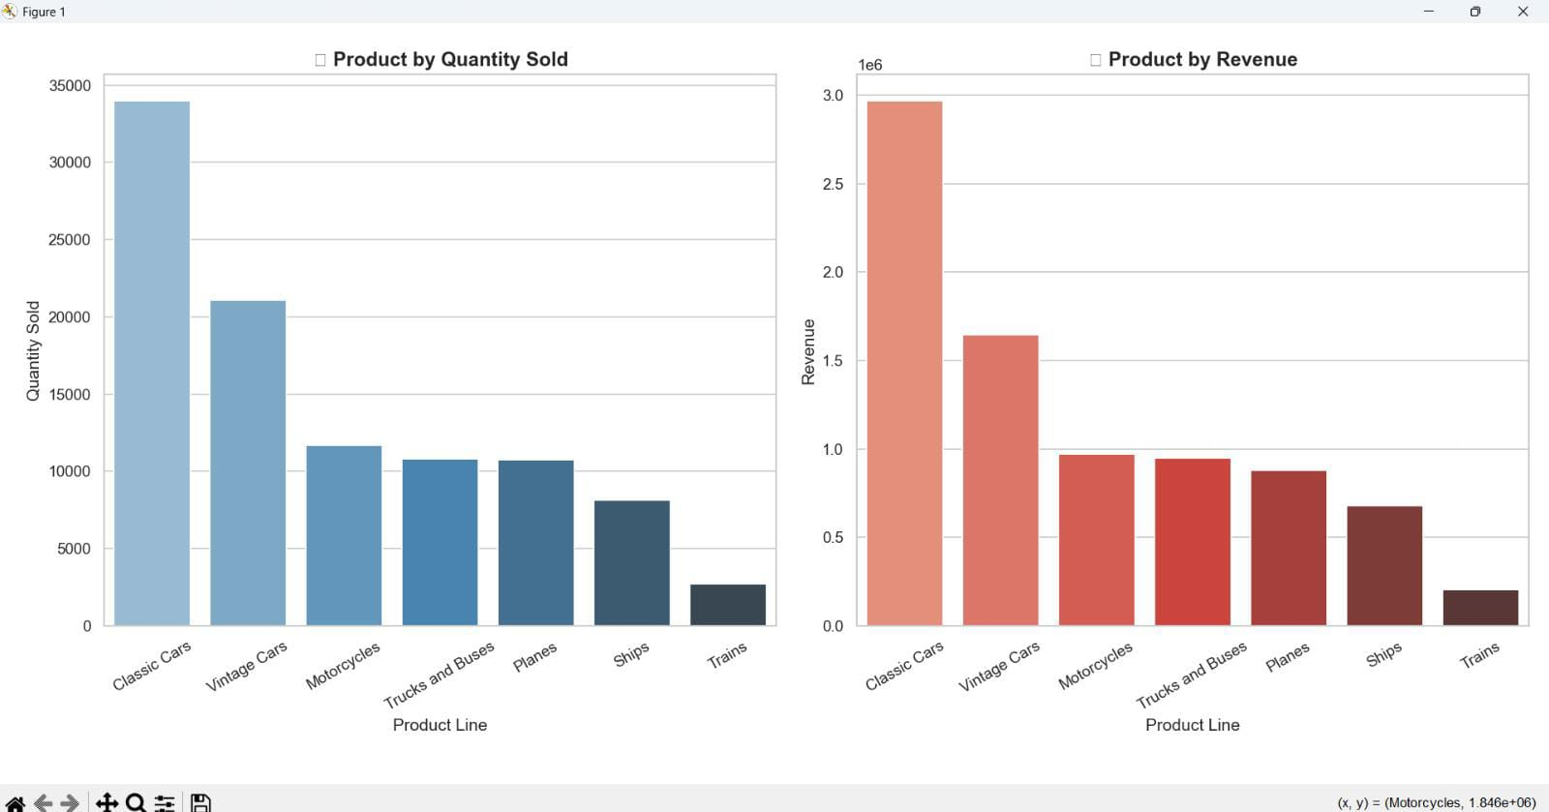

Slide 5
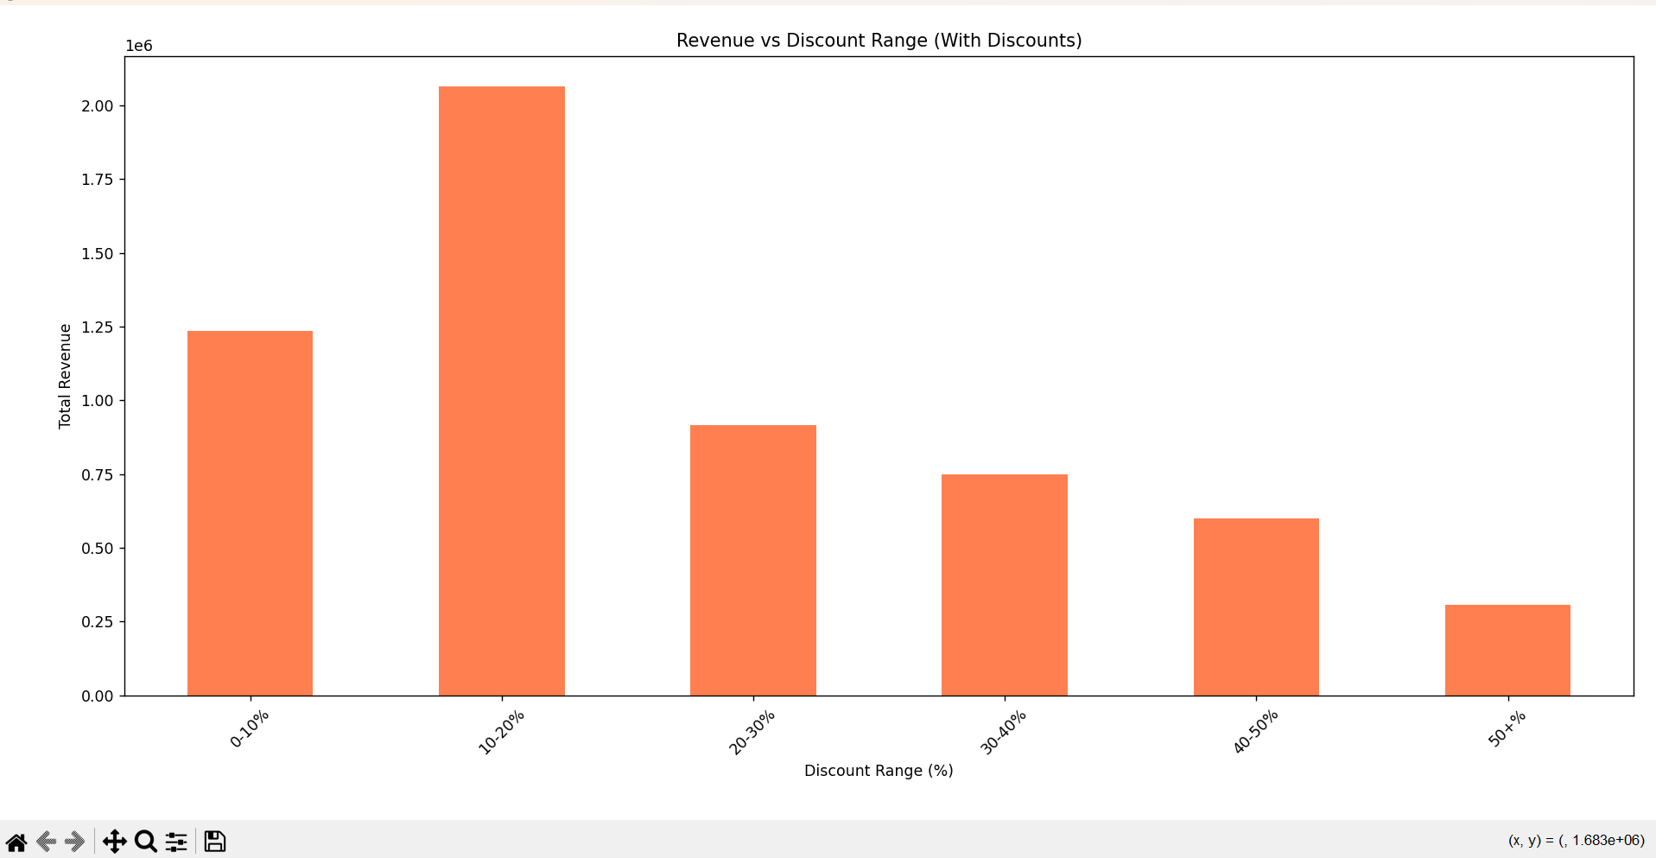
DISCOUNT ANALYSIS ( BOON OR CURSE)

Slide 6
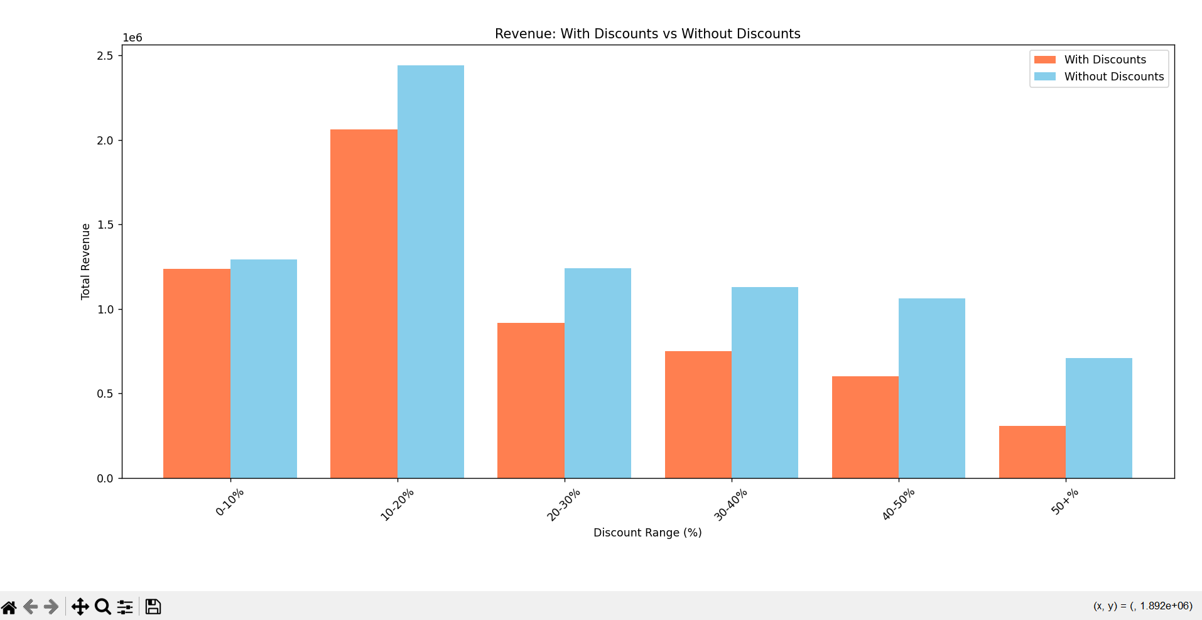

Slide 7
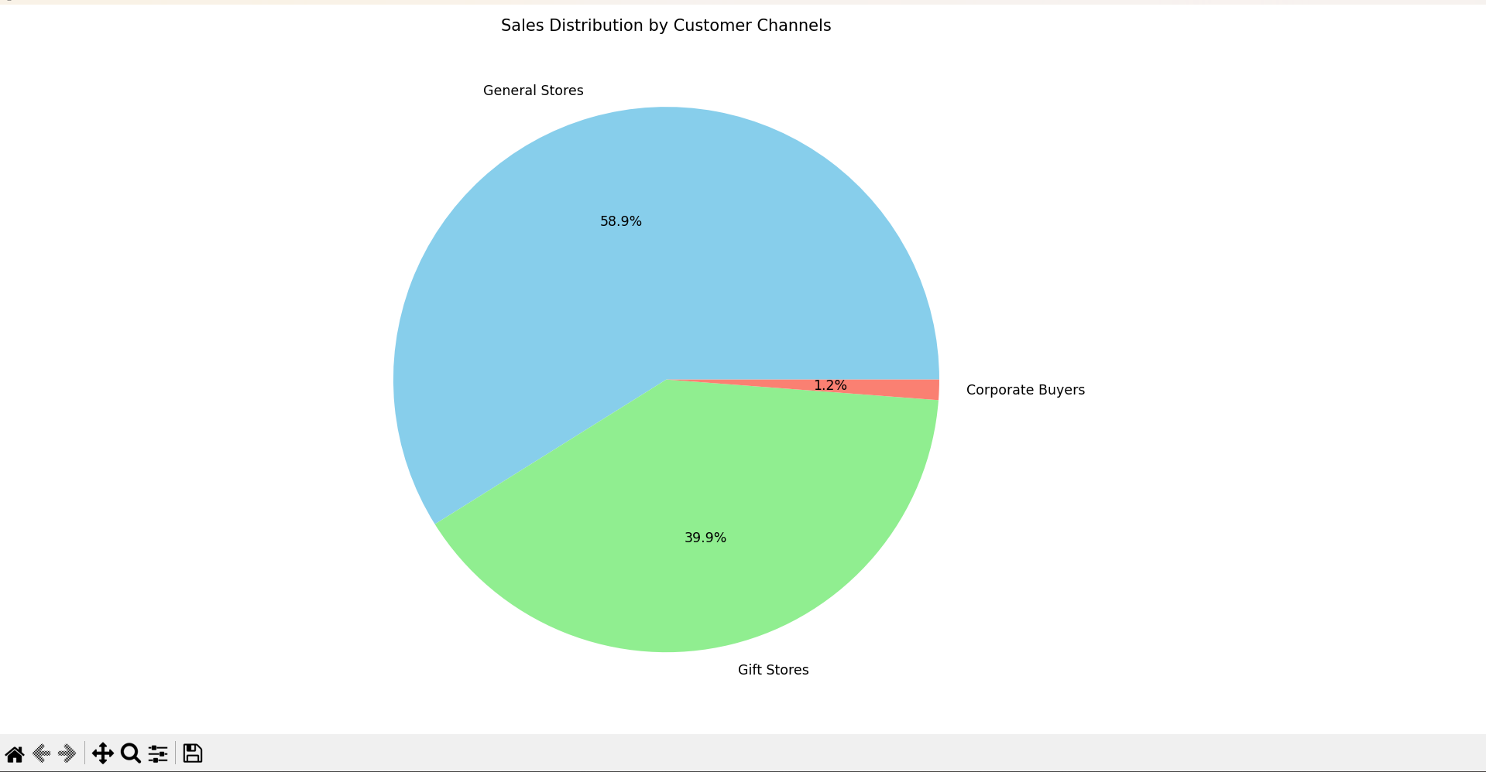
CUSTOMER ANALYSIS

Slide 8
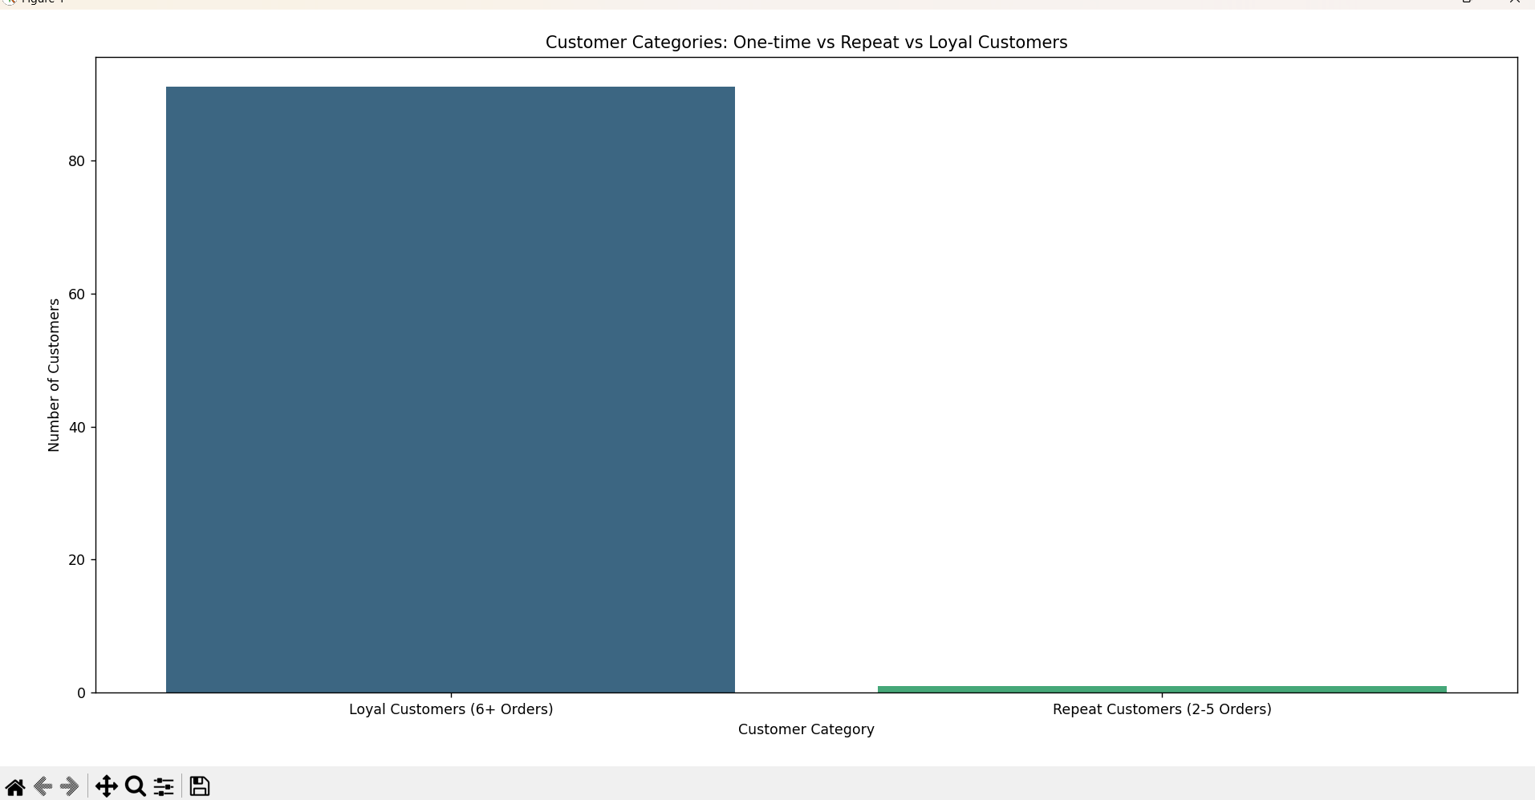

Slide 9
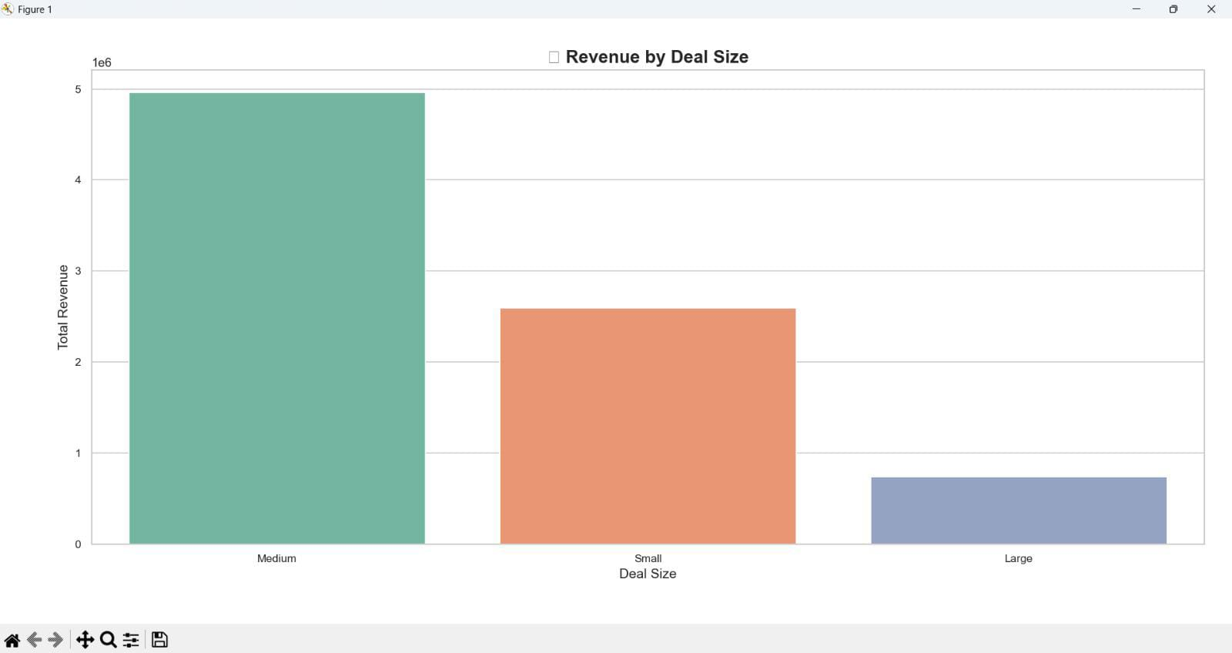

Slide 10
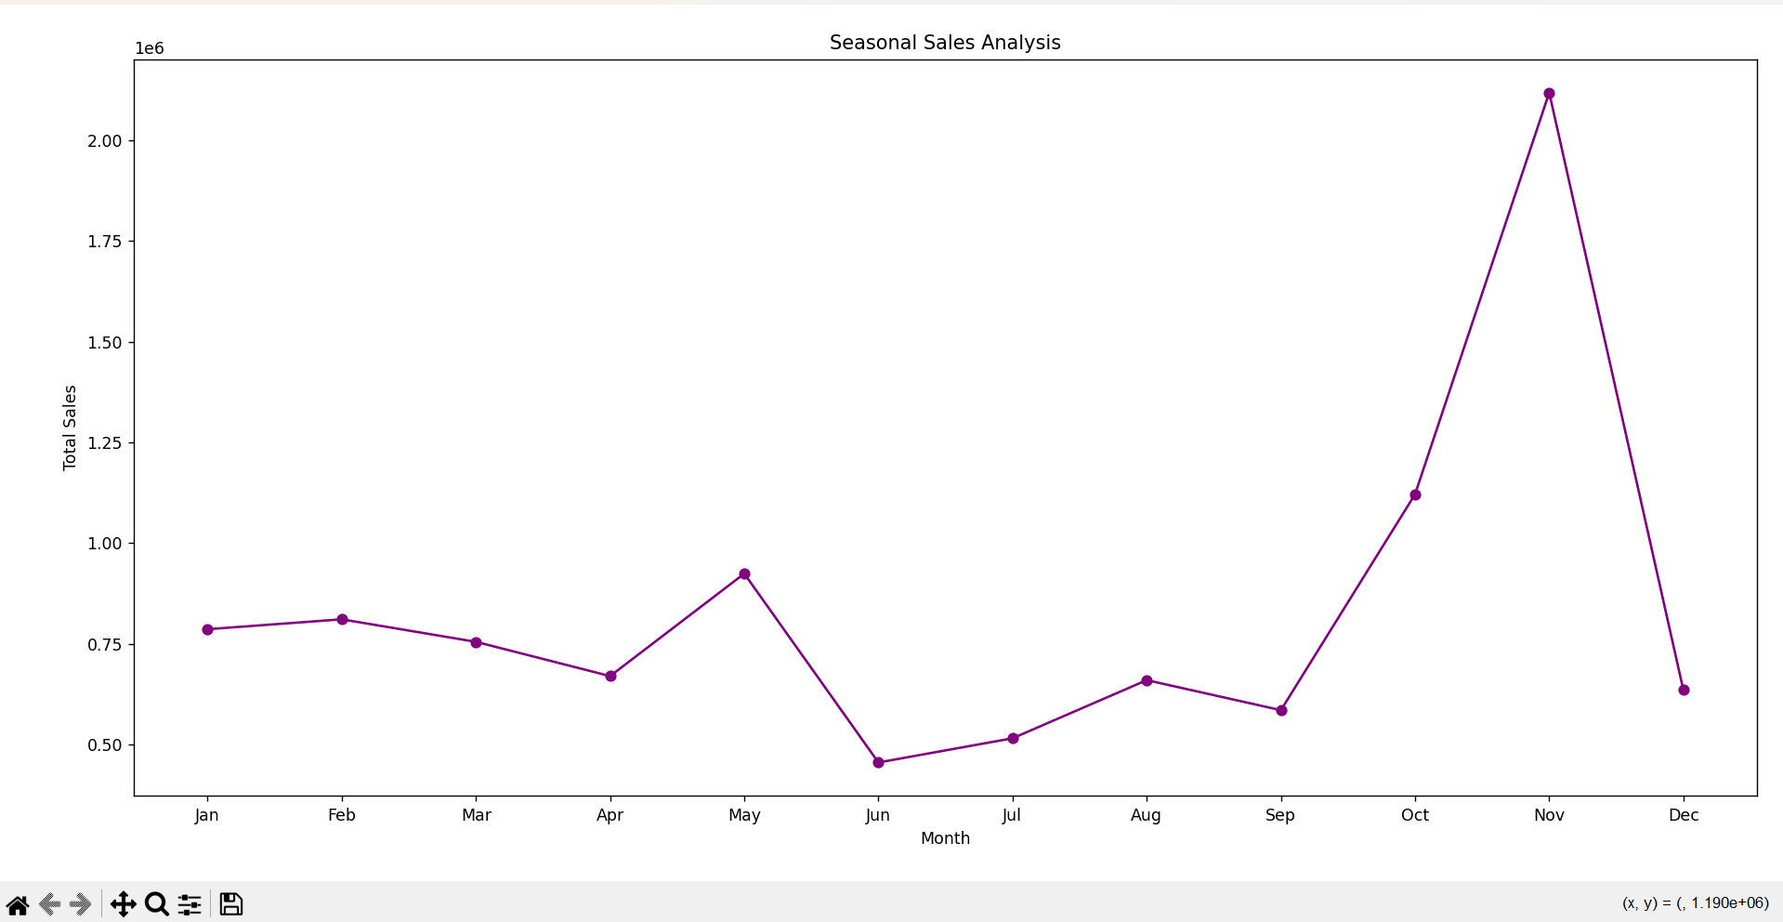
SEASONAL ANALYSIS

Slide 11
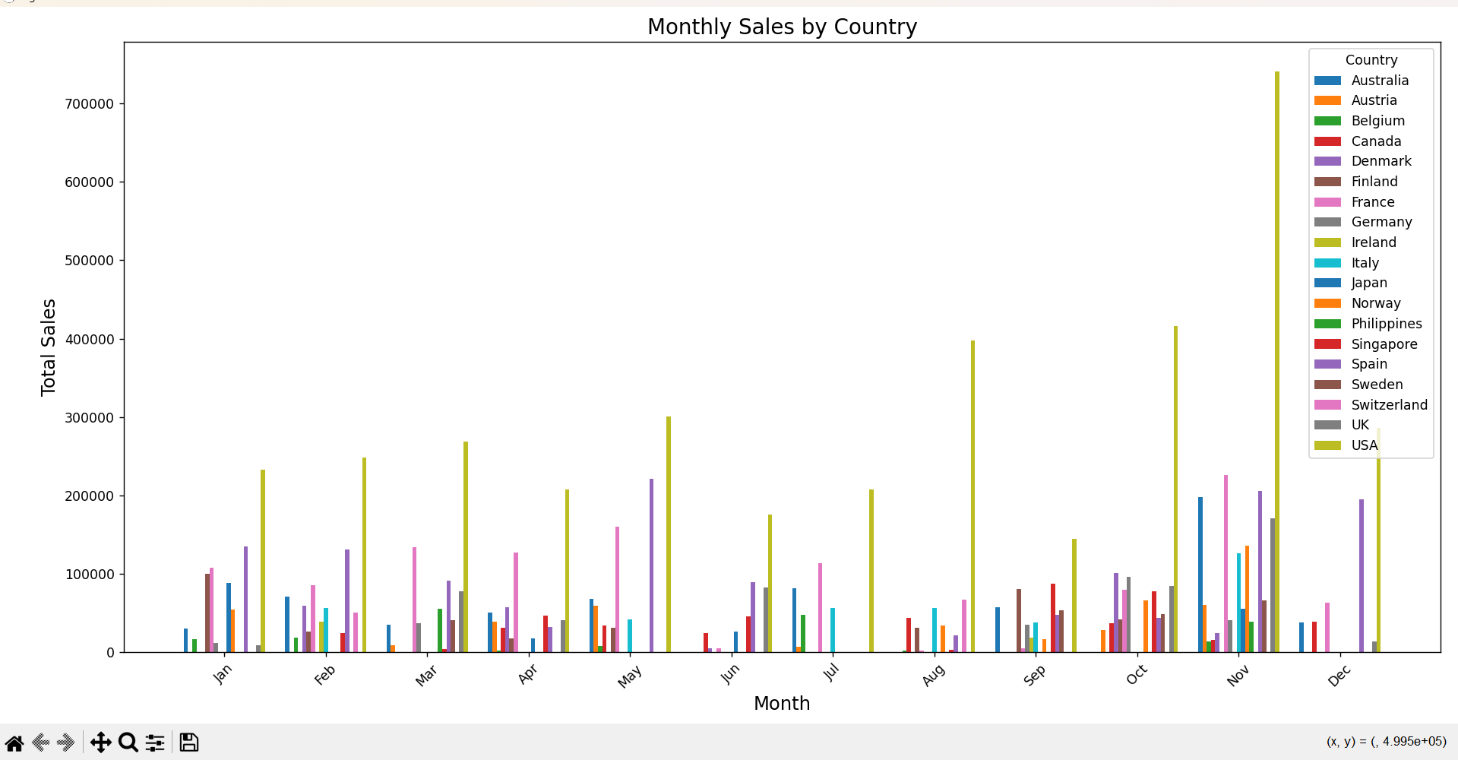

Slide 12
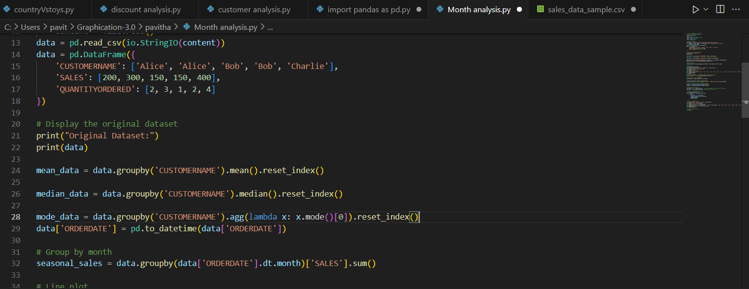

Slide 13
Topics we missed to speak in our presentation:
1.From the given data set we identified that the dataset is about toy based mnc like Hasbro
For preprocessing we have eliminated the missing value field with mean, median mode concepts and also included revunue column by using . QUANTITY ORDERED AND PRICE EACH.
2.We have made three analysis
1.Geographical analysis 2.Revenue analysis 3. Monthly analysis 4.Customer analysis
Our insights
Usa ranked both revenue and number of products consumed so we have focus on the production more on that region
Classic cars is the product which is liked best and also we want to increase the marketing in the poor sold countries
According to the seasonal analysis November was the peak month as it is Christmas previous month
From the discount analysis it is found that discount helps to increase the revenue especially in the range of 20 to 30 percentage.
Deal size medium was the most revenued and most of the companies customers were bought more than once
Tools used:
Copilot Ai for code correction and learning some basic concepts
Python numpy, panda,matplot modules for the extracting and visualizing the code
Our request:
We are first year students and we made this attempt to get a basic start in this field we expect a single congrats from you it would be a great boost for us. Thanks again for this wonderful event.. We would like to hear honest feedback and guidance from you ☺

