Slide 1
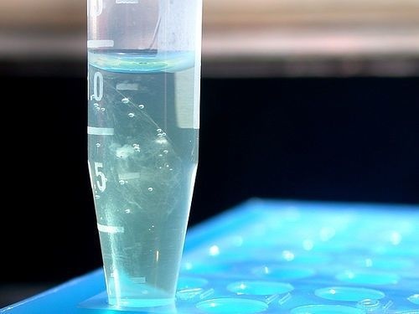
Sample preparation
Kirstyn Brunker
SCENE, University of Glasgow
26-30th June 2023

Slide 2
Sample preparation
Collection and storage
Preservation
Make sample safe
Biosafety
Extract nucleic acid
Physical/chemical/enzymatic disruption
Make a sequence library
Enrich?
Contamination
Input material -type and amount
Contamination
Improve abundance/sensitivity
Contamination
Contamination
Quality check
Contamination
RNA /DNA shield, RNAlater
Freeze/thaw
Consider what you are doing at each step to optimize your desired sequence data output!
Affects read length & concentration
Pros and cons of different methods
Determines library kit choice

Slide 3
Approaches
Sample
Considerations
Pathogen
Host background
• Time
• Cost
• Sensitivity
• Detection power
• Readiness/portability
Culture enrichment
Target enrichment
Metagenomics/transcriptomics
PCR
Bait capture

Slide 4
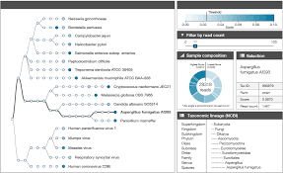
Metagenomics
Pros
Gold standard
Pathogen agnostic
Unbiased
Cons
Lower sensitivity
More expensive
Complex
Imaeg: Oxford Nanopore
Notes:
the most complete/real picture of what is in your sample

Slide 5
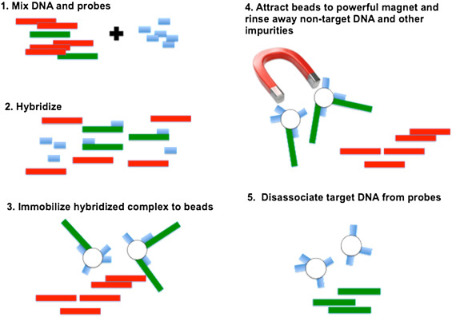
Bait capture
Pros
Tolerant of diversity
Cons
A priori knowledge
Expensive
Slow & complex
Winters et al (2017) Forensic Science International: Genetics
Notes:
captured using long, biotinylated oligonucleotide baits (probes)

Slide 6
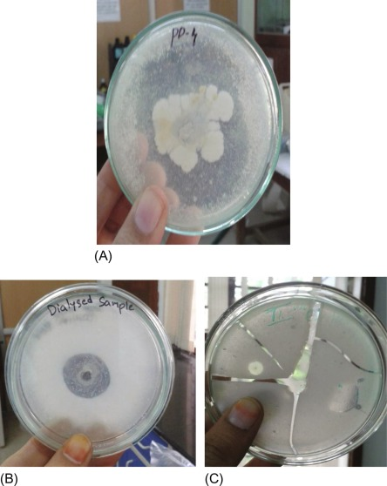
Culture enrichment
Pros
Cheap
Sensitive
Cons
A priori knowledge
Slow
Specific expertise

Slide 7
PCR enrichment
Why did we choose this?
Sample
Pathogen
Host background
Enriches samples with low viral material
Helps with poor quality sampled (fragmented RNA)
Cost-effective
High sensitivity
Caveats:
Requires a priori knowledge of pathogen
Tolerant of limited diversity
Potential for contamination
Target enrichment
PCR

Slide 8
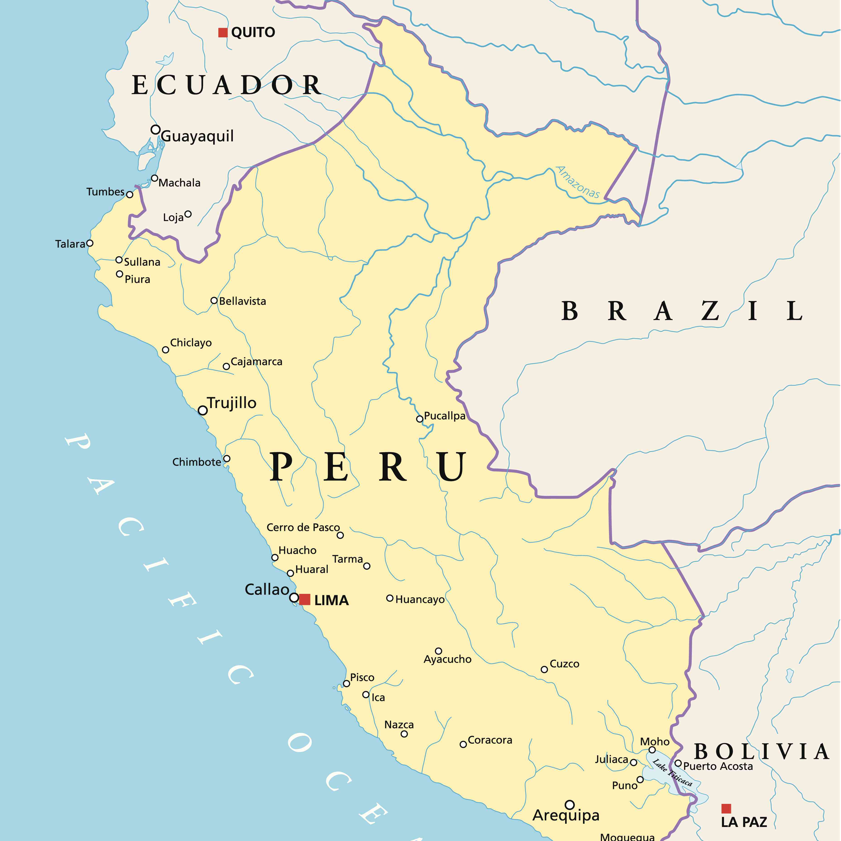
Designing primers
What do I want to capture?
What pathogen
Location
Host variant
Whole or partial genome
What a priori knowledge is available?

Slide 9
Challenges & potential solutions
There is no existing data for study area
Solution: do some preliminary metagenomic sequencing to get a reference
There are only partial genomes
Solution: use to get minor clade assignments, then use most closely related public sequences as a reference
Diversity is too great
Solution: create multiple primer sets or try probes
Note: This is just advice not a hard set of rules!

Slide 10
Practical
Day 1: Designing primers practical

