Slide 1


Bioinformatics in action: Current Techniques and Tools Used in Our Lab
Sandeep Kasaragod Bioinformatician University of Glasgow
February 14, 2024

Slide 2
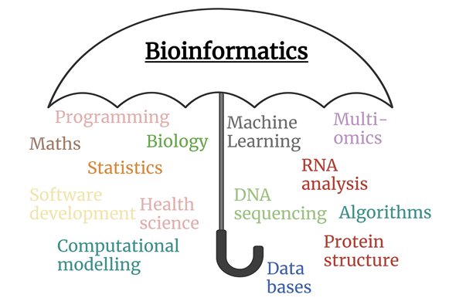
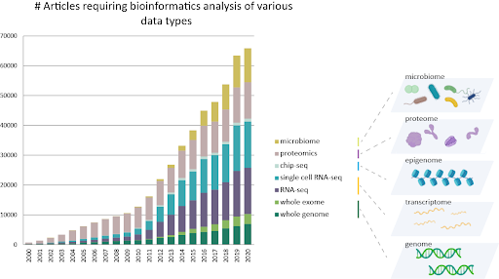
Introduction
Coined in 1970 by Paulien Hogeweg and Ben Hesper
Utilization of computational tools and analytical methods for capturing and interpreting biological data
Biological data (genomics, transcriptomics, proteomics and metabolomics)
Plays a crucial role in modern biology and medicine, facilitating the understanding of complex biological processes
https://portlandpress.com/biochemist/article/45/2/11/232831/A-beginner-s-guide-to-bioinformatics
,https://evnreport.com/creative-tech/genomics-and-bioinformatics-challenges-and-opportunities/

Slide 3
Bioinformatics during the pandamic
Rapid Genome Sequencing and Analysis
Tracking Virus Evolution and Spread
Vaccine Development
Therapeutic Targets
Understanding Host Response
Public Health and Epidemiological Studies

Slide 4

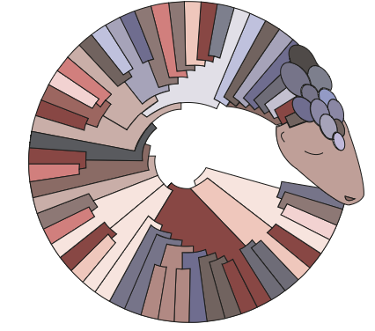


Bioinformatics tools gained popularity during the pandemic
Pangolin (Phylogenetic Assignment of Named Global Outbreak Lineages)
ARTIC network
Nextstrain
GISAID (Global Initiative on Sharing Avian Influenza Data)
Bioconductor and COVID-19 Data Portal

Slide 5
Computation facility at UofG
MARS
RAM: 2TB
Processing cores: ~200
GPU’s: ~120 GB
Alpha2
RAM: 4TB
Processing cores: ~250
GPU’s: 4 x 32 GB
HPC cluster
RAM: 300GB
Processor: ~100
GPU’s: 2 x 32 GB

Slide 6
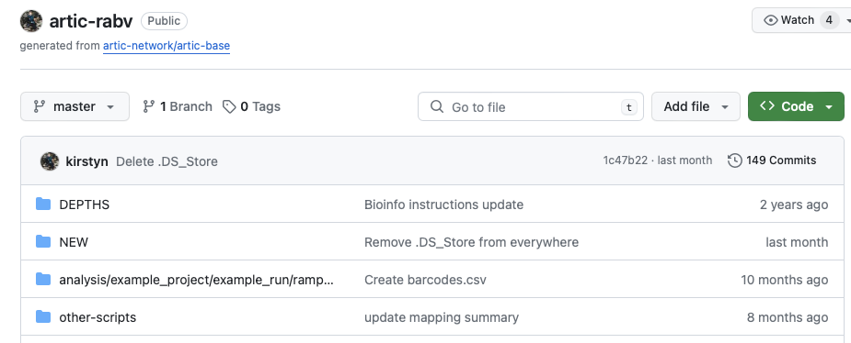
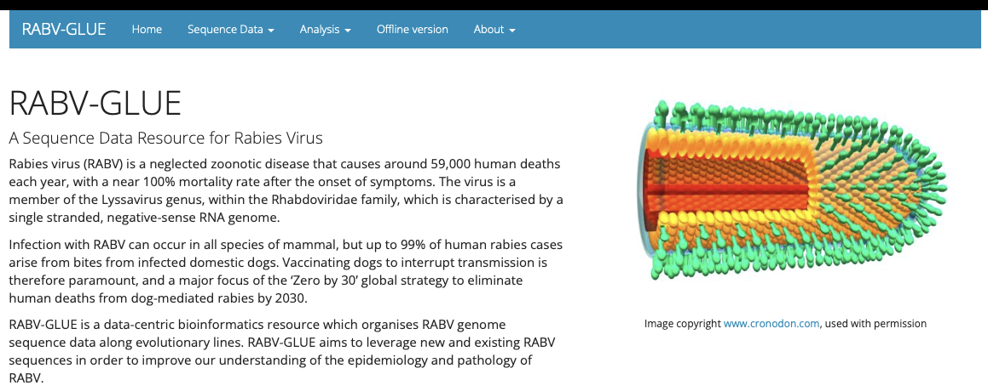




Current bioinformatics practice
Shell/Python/R
Pipelines (Snakemake)
Web-based resources

Slide 7
Current challenges at our lab
Tools and the complexities (execution, parameters)
Internet issues at field work (remote location)
Intermediate/advanced bioinformatics skills
Hardware facilities to run massive informatics

Slide 8


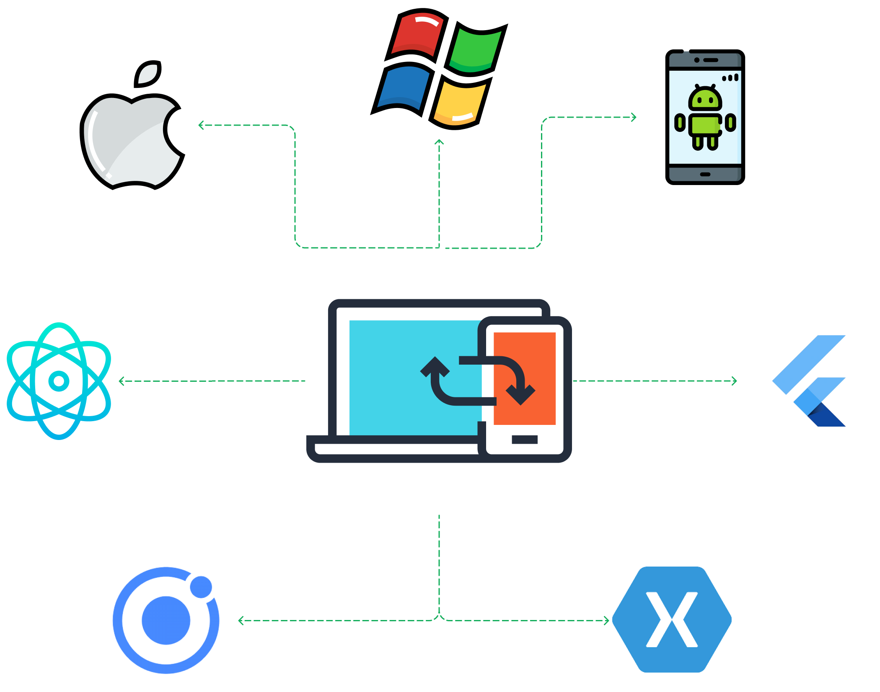






Future implementation
AWS implementation
Pipeline developments
GUI’s to develop and support cross platform

Slide 9

Thank you

Slide 10
Reference to images
https://www.google.com/imgres?imgurl=https%3A%2F%2Fcdn.cleancommit.io%2Fblog%2F2022%2F12%2Fcross-app.png&tbnid=j2tSYQPnvfFiHM&vet=12ahUKEwjC2MmphYWEAxUaY6QEHW4LBdEQMygAegQIARB0..i&imgrefurl=https%3A%2F%2Fcleancommit.io%2Fblog%2Fcross-platform-app-development-developing-an-application-for-maximum-exposure%2F&docid=oa58cqL08VOPeM&w=2100&h=1653&q=cross%20platform%20&client=safari&ved=2ahUKEwjC2MmphYWEAxUaY6QEHW4LBdEQMygAegQIARB0
https://www.google.com/imgres?imgurl=https%3A%2F%2Fupload.wikimedia.org%2Fwikipedia%2Fcommons%2F9%2F93%2FAmazon_Web_Services_Logo.svg&tbnid=FB3B89WhUh9TUM&vet=12ahUKEwij262GhoWEAxXTUaQEHe1SCeQQMygAegQIARB0..i&imgrefurl=https%3A%2F%2Fen.wikipedia.org%2Fwiki%2FAmazon_Web_Services&docid=JSgXJbxN-7t0-M&w=800&h=479&q=aws&client=safari&ved=2ahUKEwij262GhoWEAxXTUaQEHe1SCeQQMygAegQIARB0
https://www.google.com/imgres?imgurl=https%3A%2F%2Fpbs.twimg.com%2Fmedia%2FFSAb7PKXoAESLD-.jpg&tbnid=_IJYS0uLZZaL1M&vet=12ahUKEwjg3JeShoWEAxUIVaQEHaZ_B_kQMygBegQIARBS..i&imgrefurl=https%3A%2F%2Ftwitter.com%2Fnanopore%2Fstatus%2F1522247380225171458&docid=Sb0NLDZkz9O8JM&w=1134&h=567&q=EPI2ME&client=safari&ved=2ahUKEwjg3JeShoWEAxUIVaQEHaZ_B_kQMygBegQIARBS
https://www.google.com/url?sa=i&url=https%3A%2F%2Fgithub.com%2Fnextflow-io%2Fnextflow&psig=AOvVaw3IYb3JzwwTbLUvr1aPMisi&ust=1706702040282000&source=images&cd=vfe&opi=89978449&ved=0CBMQjRxqFwoTCNjSxNiGhYQDFQAAAAAdAAAAABAE
https://www.google.com/imgres?imgurl=https%3A%2F%2Fwww.aztek.co.il%2Fwp-content%2Fuploads%2F2022%2F05%2FIntelliJ_IDEA_Icon.svg_.png&tbnid=2NuIbSxGDsNzMM&vet=12ahUKEwiK396ph4WEAxWpU6QEHciUDPsQMygFegQIARB-..i&imgrefurl=https%3A%2F%2Fwww.aztek.co.il%2F2022%2F05%2F15%2Ffirst-microsoft-partner-in-israel-achieved-the-microsoft-advanced-specialization-in-analytics-on-microsoft-azure%2F&docid=gKieZgeOEVsJGM&w=1200&h=1200&q=IntelliJ&client=safari&ved=2ahUKEwiK396ph4WEAxWpU6QEHciUDPsQMygFegQIARB-
https://www.google.com/url?sa=i&url=https%3A%2F%2Fgluonhq.com%2Fproducts%2Fscene-builder%2F&psig=AOvVaw2qiAoewNzv2AtsMixYbSio&ust=1706702378828000&source=images&cd=vfe&opi=89978449&ved=0CBMQjRxqFwoTCOjJ8vmHhYQDFQAAAAAdAAAAABAE
https://www.google.com/imgres?imgurl=https%3A%2F%2Fwww.rstudio.com%2Fwp-content%2Fuploads%2F2018%2F10%2FRStudio-Logo-Flat.png&tbnid=D3NscTpijpzW_M&vet=12ahUKEwikpoX-iIWEAxV-XqQEHdwbDDoQMygBegQIARB2..i&imgrefurl=https%3A%2F%2Fwww.rstudio.com%2Fabout%2Flogos%2F&docid=5Fx4wIzHt0GmGM&w=3534&h=1241&q=R%20Studio&client=safari&ved=2ahUKEwikpoX-iIWEAxV-XqQEHdwbDDoQMygBegQIARB2

Slide 11
Reference to images
https://www.google.com/imgres?imgurl=https%3A%2F%2Fupload.wikimedia.org%2Fwikipedia%2Fcommons%2Fthumb%2Fc%2Fc3%2FPython-logo-notext.svg%2F800px-Python-logo-notext.svg.png&tbnid=5ggbZuzNrIq8KM&vet=12ahUKEwjos6u1iYWEAxUiVKQEHb4vAakQMygAegQIARB0..i&imgrefurl=https%3A%2F%2Fen.wikipedia.org%2Fwiki%2FPython_(programming_language)&docid=3wRBXLyvECcz0M&w=800&h=877&q=Python&client=safari&ved=2ahUKEwjos6u1iYWEAxUiVKQEHb4vAakQMygAegQIARB0
https://www.google.com/url?sa=i&url=https%3A%2F%2Fwww.linkedin.com%2Fpulse%2Fday-5-task-advanced-linux-shell-scripting-omkar-khedkar&psig=AOvVaw3y-OZAHPXVblq6ObosOb_d&ust=1706702841088000&source=images&cd=vfe&opi=89978449&ved=0CBMQjRxqFwoTCLCYq9aJhYQDFQAAAAAdAAAAABAE
https://www.google.com/imgres?imgurl=https%3A%2F%2Fdocs.crc.nd.edu%2F_images%2Fconda.png&tbnid=Xk5KATz_faFUEM&vet=12ahUKEwjpmf7nj4WEAxWXY6QEHTzVC6wQMygAegQIARB0..i&imgrefurl=https%3A%2F%2Fdocs.crc.nd.edu%2Fpopular_modules%2Fconda.html&docid=xO4bFXqfwTRlUM&w=1200&h=482&q=conda&client=safari&ved=2ahUKEwjpmf7nj4WEAxWXY6QEHTzVC6wQMygAegQIARB0
https://www.google.com/imgres?imgurl=https%3A%2F%2Fd1.awsstatic.com%2Facs%2Fcharacters%2FLogos%2FDocker-Logo_Horizontel_279x131.b8a5c41e56b77706656d61080f6a0217a3ba356d.png&tbnid=-E_GwcqZTPS54M&vet=12ahUKEwiC9vaCkIWEAxUxUKQEHbaoCfwQMygCegQIARB4..i&imgrefurl=https%3A%2F%2Faws.amazon.com%2Fdocker%2F&docid=ZjA7s1uTdFZzRM&w=279&h=131&q=docker&client=safari&ved=2ahUKEwiC9vaCkIWEAxUxUKQEHbaoCfwQMygCegQIARB4

