Slide 1
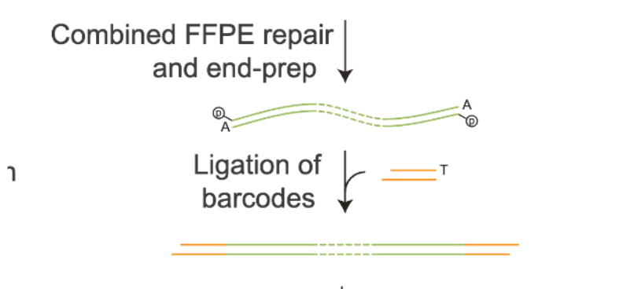
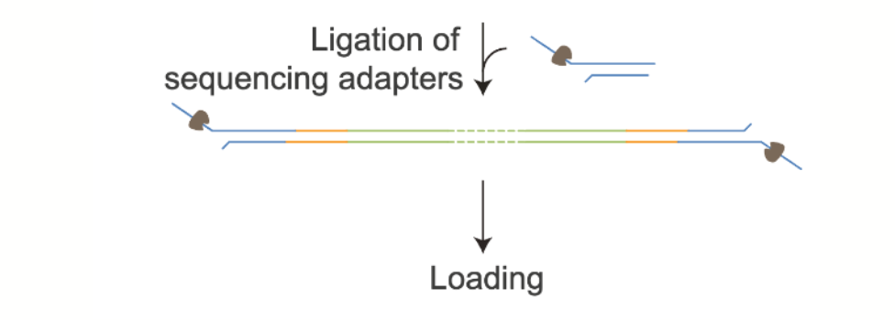
What we did
(Normalisation)
End preparation
Barcode ligation
SPRI clean up
Quantification
What’s next?

Slide 2
DNA quantification
Groups | DNA | ng/ul
1 | ‘Dirty’ | 0.165
2 | Normalised | 0.646
3 | ‘Dirty’ | 0.312
4 | Normalised | 0.208
DNA recovery | Instructor
19 % | 43%
76%
37%
24%
Amount of DNA into EP rx
50ng into a 10ul end prep ligation= 5 ng/ul
Amount of DNA taken into barcode rx
0.75 ul taken into barcode ligation = 3.75 ng
3.75 ng*5 samples (+1 negative control) = 18.75 ng
18.75ng in 22ul elution volume = 0.85 ng/ul expected concentration (if 100% recovery!)

Slide 3
What affects recovery?
Inexperience
Pellet overdries
Ethanol not correct % or not used at room temp
SPRI beads not at room temp or not properly mixed
Incorrect SPRI ratio
Not using low bind tubes
Inaccurate quantification
Not as much input material as you thought

