Slide 1
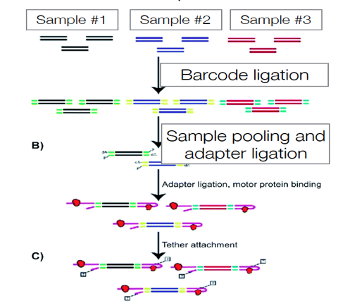
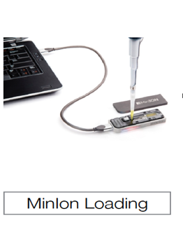
Before starting library preparation we have to NORMALISE the amplicons
Pool 1
Pool 2

