Slide 1

What is Conda
Kirstyn Brunker

Slide 2
Package management and environment management system

Slide 3
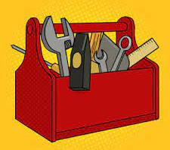
Imagine you have a toolbox with different tools for different jobs
Each tool has its own purpose and works best with certain tasks

Slide 4

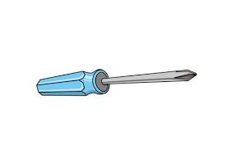
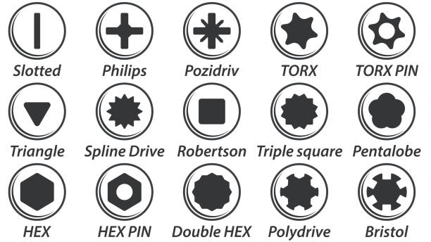
Let’s say you have different projects to work on
Fix your bicycle
Build a bookcase…
You need the right tools for the job
Type and version of tool

Slide 5
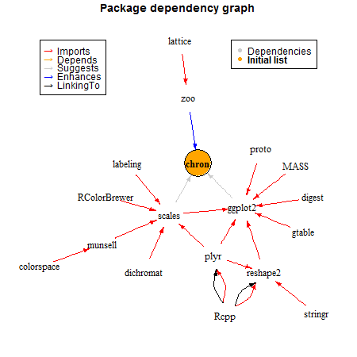
Package management
Conda is like a tool manager for your computer.
It helps you organize and keep track of all the software tools (packages) you need for different projects.
Notes:
Easily install, update, and manage these software packages
Helps to make sure you have the right versions and there are no compatibility issues

Slide 6
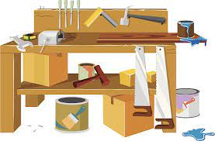
Environment management
Create isolated environments for different projects
Each project has its own set of packages without having to worry about conflicts
It's like having separate workbenches for building the bookshelf and fixing the bicycle.

Slide 7

Makes it easier to start new projects, switch between projects, and share your work with others.
Keeps everything organized and efficient.

Slide 8
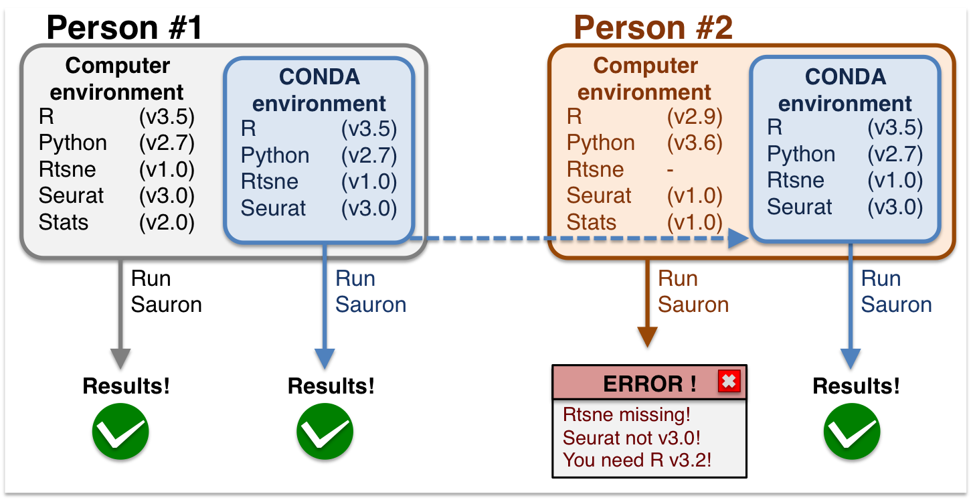

Slide 9
Summary
As a package manager, Conda can install, update and remove packages.
As an environment manager, it can manage virtual environments.
“Self-contained” environments for different projects
Reproducible and easier to share and collaborate on projects

Slide 10

A quick note on mamba
mamba : a drop-in replacement for conda, offering higher speed and more reliable environment solutions
For example, to create the conda environment we will use later today (artic-rabv) takes half the time with mamba compared to conda:
Mamba = 2m 34s
Conda = 5m 11s

