Slide 1
Sequence data
Kirstyn Brunker
RAGE workshop, NCDC, Abuja
12-16th Feb 2024

Slide 2
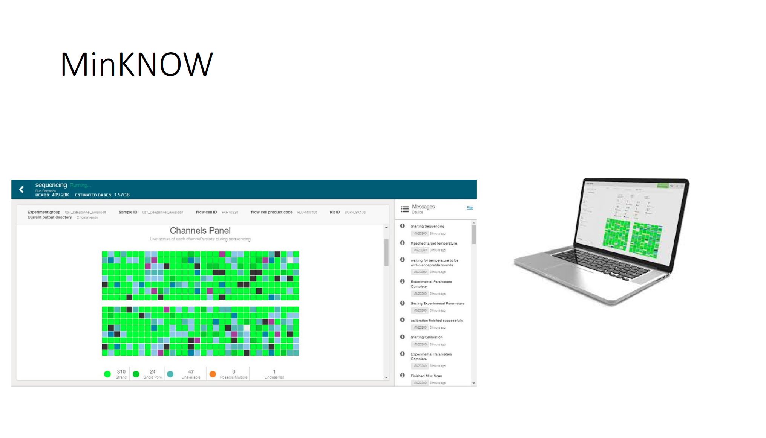

Slide 3
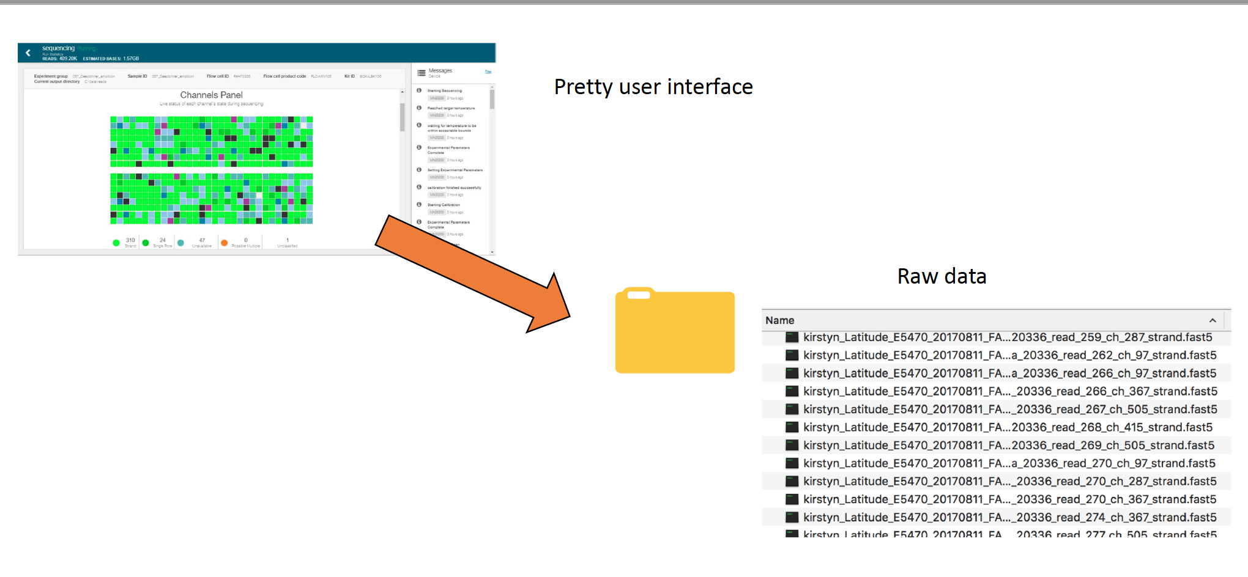
Each fast5 file generated contains 4000 reads

Slide 4
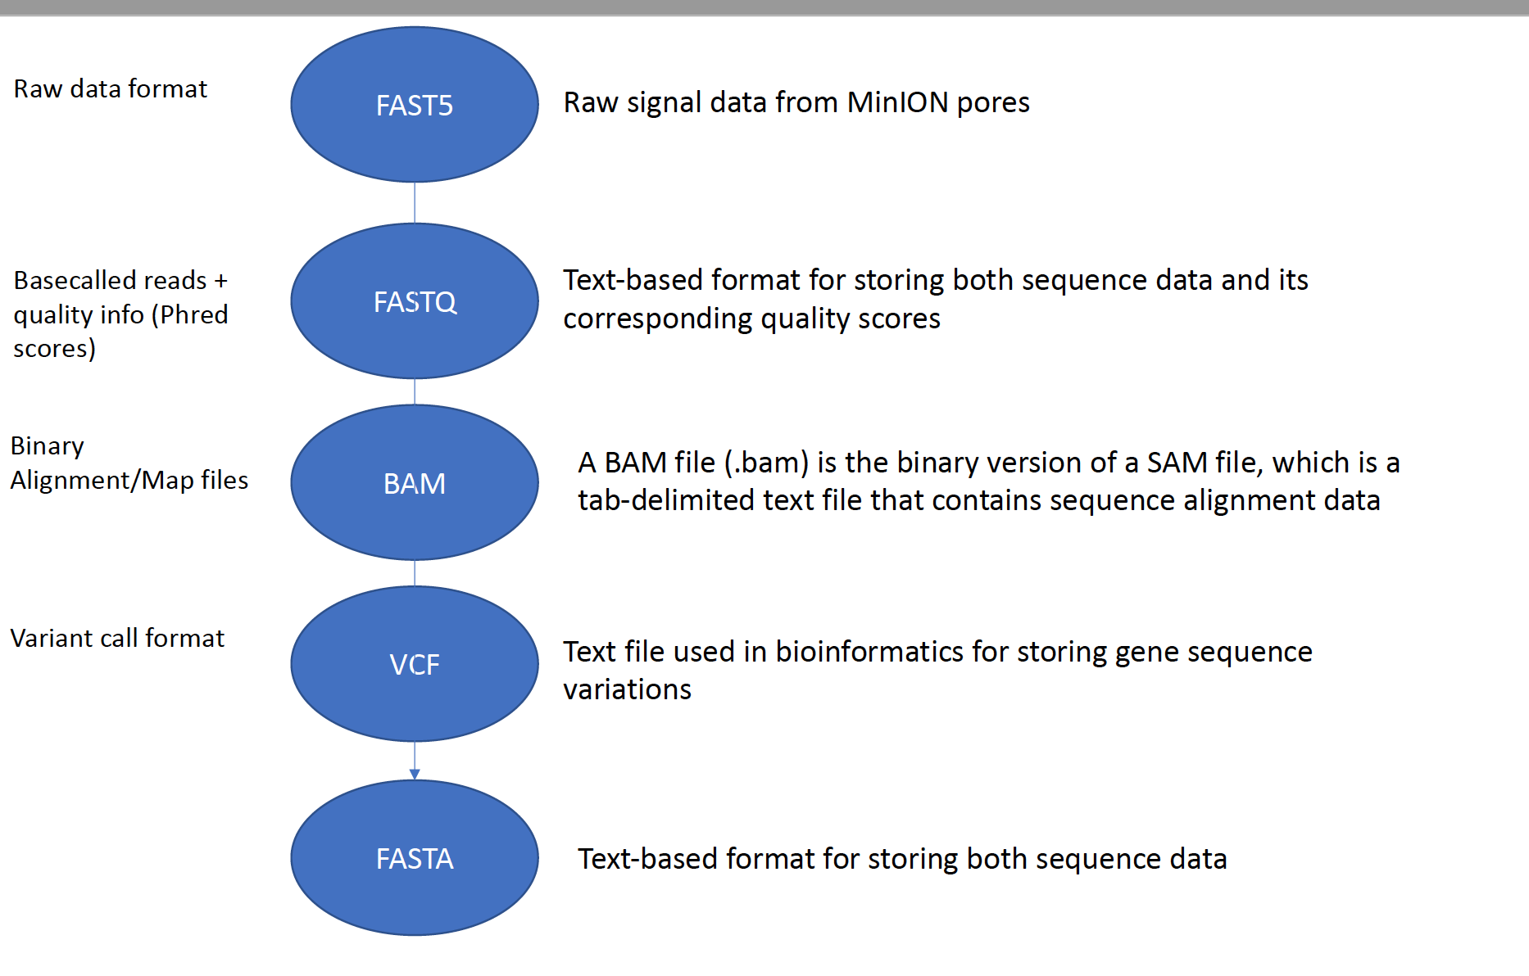

Slide 5

Fast5
Raw electical signal data, i.e. squiggle data
HDF5 format: storage and organization of large amounts of heterogeneous data, using a hierarchical structure.
Needs “basecalled”
ATTGCCGTAAT….

Slide 6
Fastq
Common NGS format
It contains a series of records, where each record represents a single sequence read obtained from the sequencing machine.
Each record in the FASTQ file consists of four lines:
sequence identifier
raw DNA sequence
a separator line
quality scores corresponding to each base in the DNA sequence, representing the confidence or accuracy of the base call.

Slide 7
Each record in the FASTQ file consists of four lines:
sequence identifier
raw DNA sequence
a separator line
quality scores corresponding to each base in the DNA sequence, representing the confidence or accuracy of the base call.
IMPORTANT: Lines 2 and line 4 must have the same length or the sequence record is not valid.

Slide 8
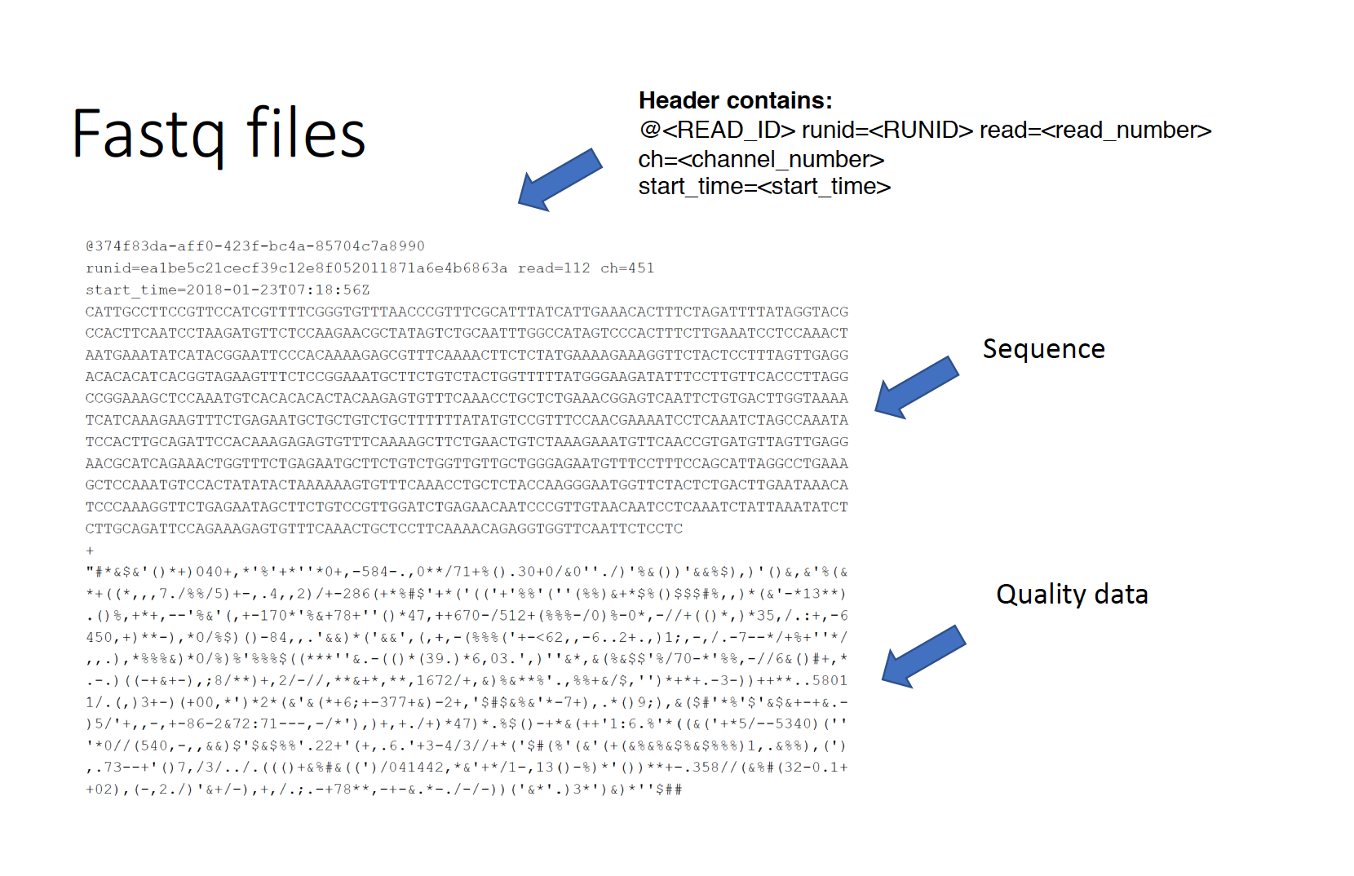
Separator

Slide 9
BAM files
Binary file format commonly used in genomics to store DNA sequence alignment data obtained from NGS
It contains aligned reads, which are short DNA sequences from the original sample, along with information about their mapping locations to a reference genome
The files are compressed and structured- so efficient for storage and analysis of large-scale sequencing data
Allow various bioinformatics tools and algorithms to work with the aligned data efficiently

Slide 10
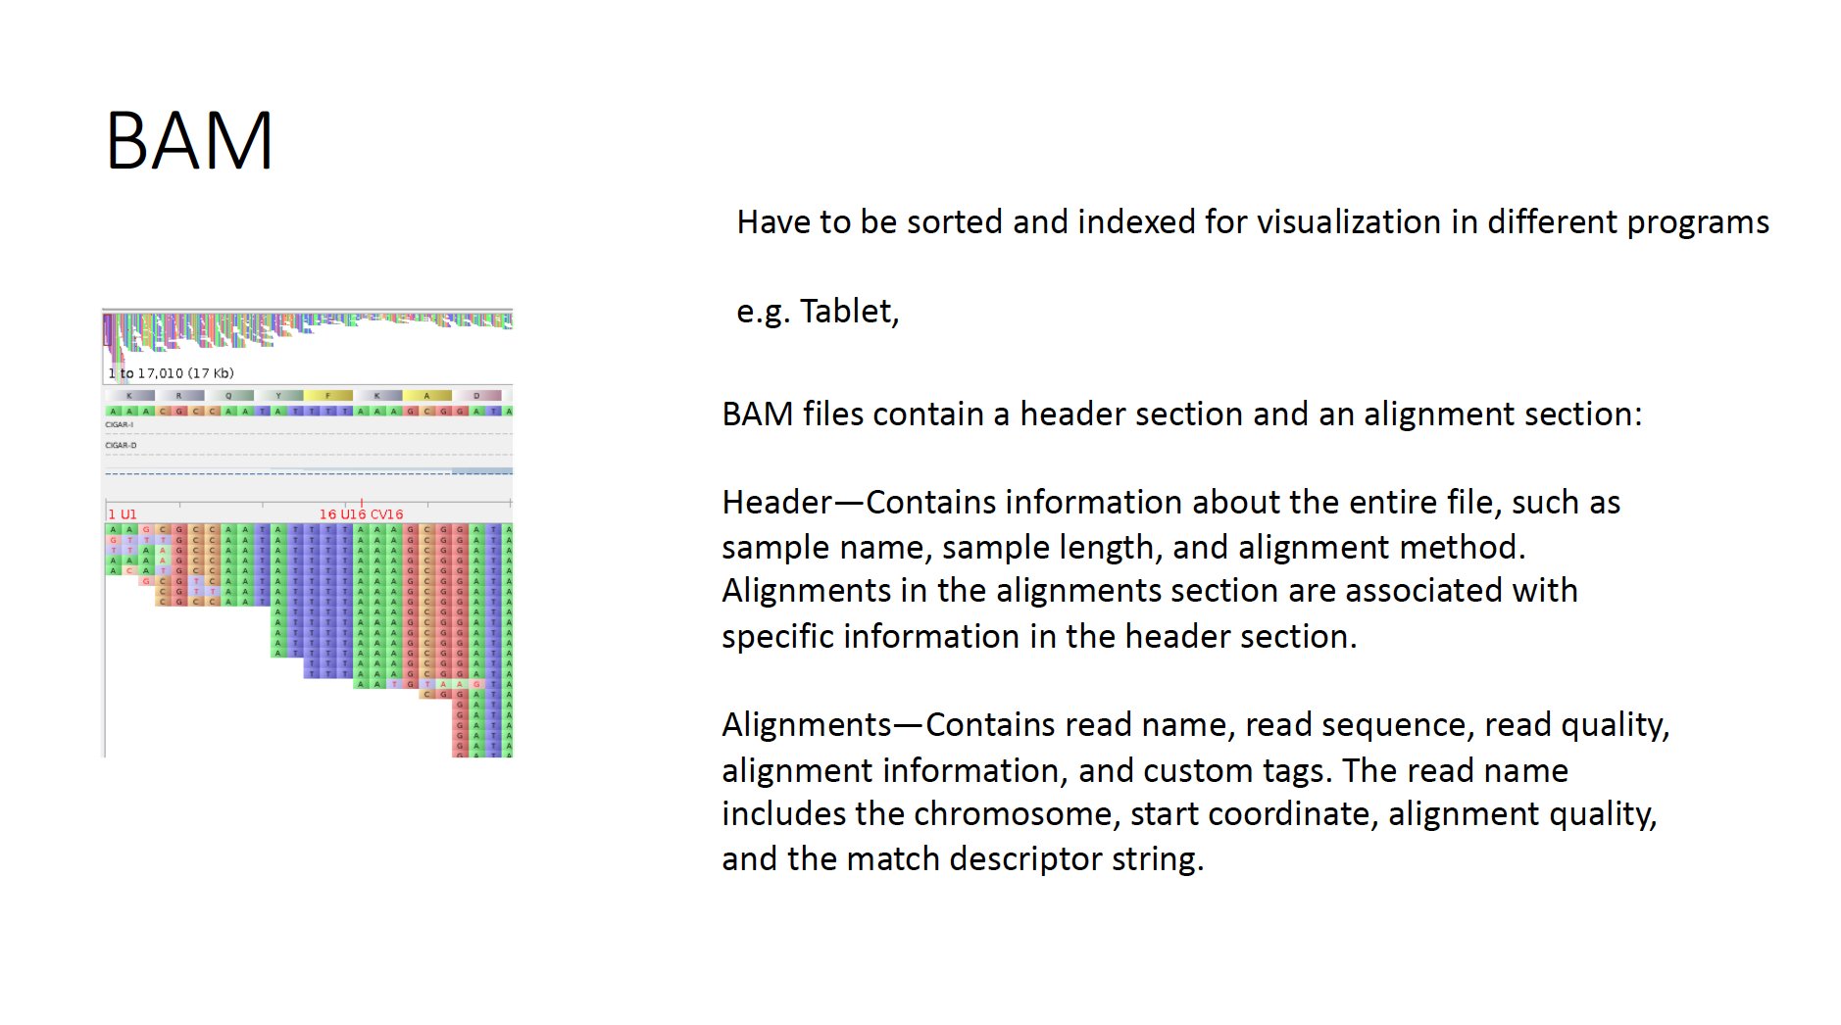

Slide 11
VCF (Variant Call Format)
Represent genetic variations identified in DNA sequencing data.
Information about genetic variants such as single nucleotide polymorphisms (SNPs), insertions, deletions (INDELS)
Used for variant analysis, genotyping, and variant calling

Slide 12
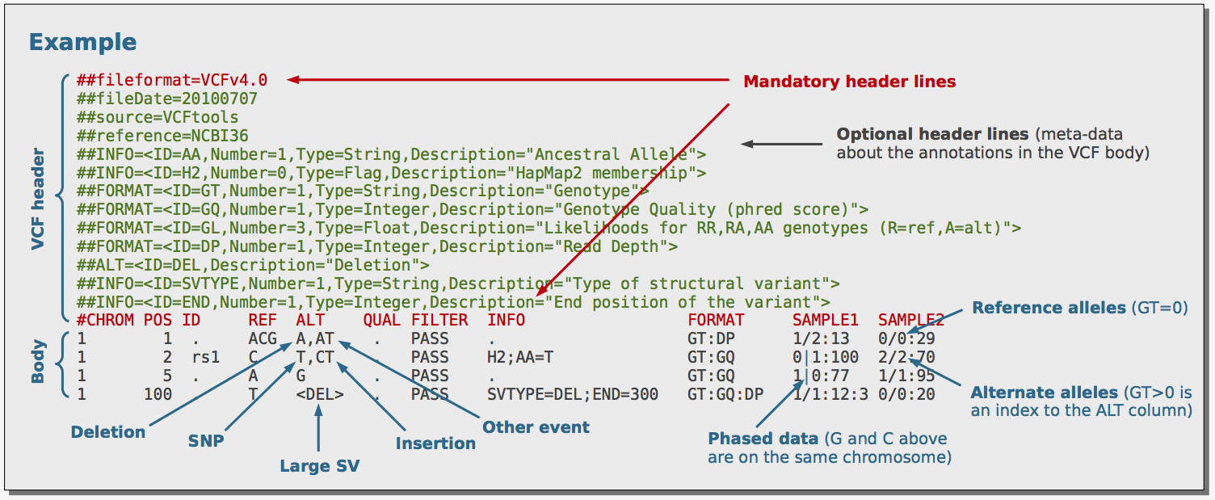

Slide 13
Getting to a consensus
Think about what you did to prepare your DNA for the MinION
Added barcodes and adaptors

Slide 14
Getting to a consensus
Convert
Convert raw nanopore signal data into nucleotide sequence data.
Filtering
Remove low-quality or noisy reads from the dataset.
Align
Align filtered reads to a reference genome or a previously assembled consensus sequence.
Consensus
Generate a consensus sequence by combining the aligned reads.
Refine
Refine the consensus sequence through additional error correction steps.
Assess
Assess the accuracy and quality of the consensus sequence using various metrics and tools.

Slide 15
Advice
Get an understanding of how the data needs to be processed
Learn the basics in command line
Use validated tools
But unless you want to be a bioinformatician
Use a validated and trusted pipeline
Get help from a bioinformatican (easier said than done!)
Hand over to a bioinformatician for this part

