Slide 1
Day 5 recap

Slide 2
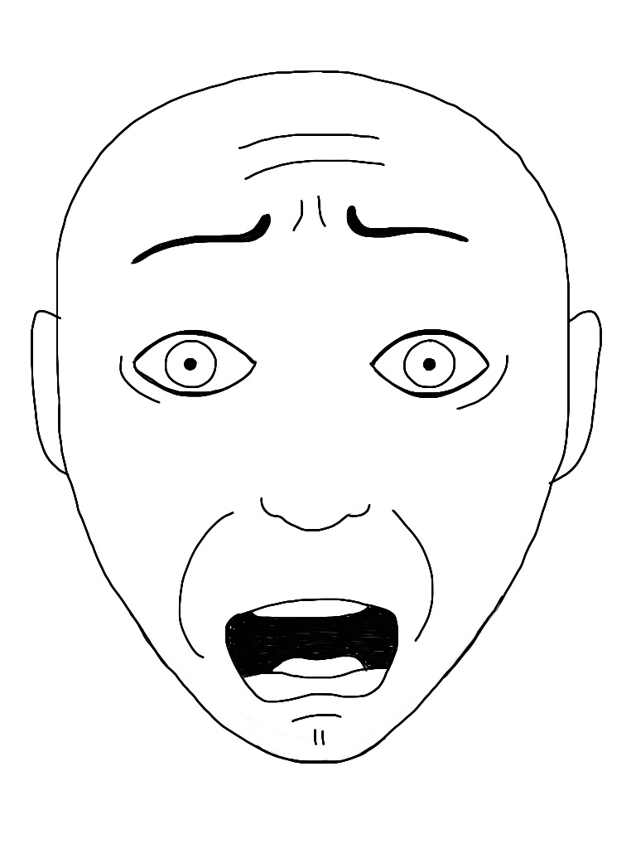

Command line: friend or foe?

Slide 3
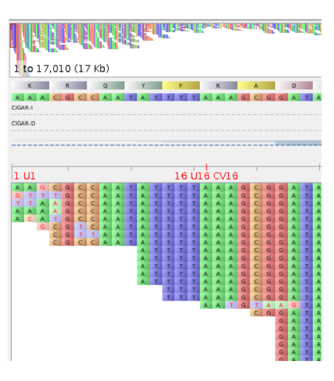
Using a pipeline to process data
An existing a pipeline
Range of data files and formats
Quality steps, alignment, filtering, variant calling

Slide 4
Alignments
Important to have an accurate alignment. If it is not and you haven’t checked:
Wrong tree
Wrong inference
Wrong result
WRONG
ATGCCTGGAAAAATTACTT
ATGCCTGGAAA - -TTACTT
ATGCCTGGAAAAATTGCTT
ATGCCTGGAAAAATTGCTT

Slide 5
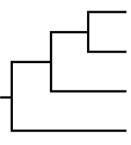
Phylogenetics
Key terminology and interpretation

Slide 6
Today’s plan
830-1030 | Phylogenetics: building and annotating trees
1030-1200 | Molecular clocks explainer & practical
1200-1220 | Clades and lineages explainer
1220-1230 | RABV-GLUE demo
LUNCH
130-230 | MADDOG practical
230-430 | Discussion groups
PHOTOS?

