Slide 1
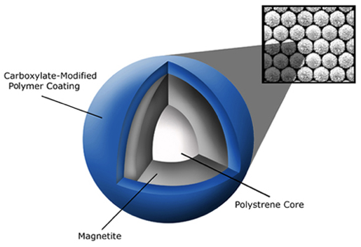
SPRI Bead Cleanup
Solid Phase Reversible Immobilization
Paramagnetic (magnetic only in a magnetic field = magnetic rack) prevents them from clumping and falling out of solution
Coated with carboxyl molecules that reversibly bind DNA in the presence of “crowding agent”
Crowding agent (polyethylene glycol (PEG) and salt) causes negatively-charged DNA to bind with the carboxyl groups on the bead surface
SPRI bead anatomy
https://www.beckman.com/resources/technologies/spri-beads

Slide 2
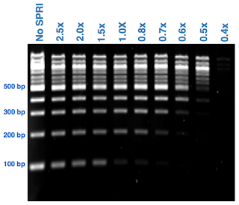
SPRI Bead Cleanup
Used for isolation, purification and cleanup of nucleic acids
SPRI beads selectively bind nucleic acids by type and size, leaving contaminants in solution
SPRI is good for low concentration DNA clean up
Size of fragments eluted determined by concentration of “crowding agent” and mix of beads
The lower ratio of SPRI: DNA, the higher the final fragments eluted
AmpureXP for DNA, RNACleanXP for RNA
http://enseqlopedia.com/2012/04/how-do-spri-beads-work/

Slide 3
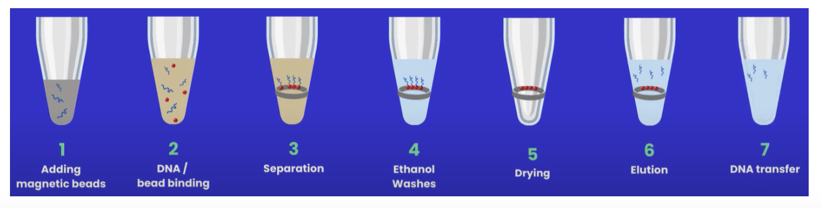
Protocol description
Vortex beads thoroughly before use
Add required volume of beads to sample (ratio of sample to beads varies depending on cleanup required; see slide on size selection)
Incubate sample + beads for 5 minutes off magnet. Some protocols have you continuously mix the sample at this stage, some do not.
If sample was mixed or if there are any droplets of beads on tube sides, spin down briefly before placing on magnet.
Incubate 5 minutes on magnet, or until beads have pelleted and supernatant is clear
Remove supernatant carefully to avoid disturbing bead pellet. If beads are disturbed, return supernatant to sample and re-pellet.
Add 200uL (or larger volume if working with 1.5mL tubes and the pellet is not covered) of fresh 80% ethanol to the tube. Some protocols use 70% ethanol.
https://nonacus.com/blog-spri-technology-tips-for-dna-size-selection-and-effective-cleanup-in-ngs-workflows/

Slide 4
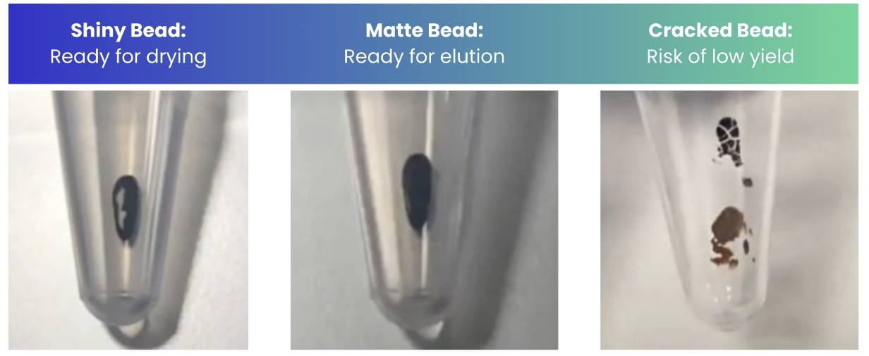
Protocol description
8. Carefully remove and discard ethanol without disturbing the bead pellet. Some protocols incubate the beads with ethanol or mix the sample at this stage.
9. Repeat ethanol wash a second time.
10. Following the second ethanol wash, use a smaller pipette (10uL) to remove all remaining ethanol from the tube. Can also use pipette to spread out drops of ethanol remaining on the sides of the tube. Some protocols spin down the sample.
11. With tube lid open, allow beads to dry. This step is tricky and takes practice. All ethanol should be evaporated but the bead pellet should not be allowed to crack.
12. Resuspend pellet in required volume of buffer, adding slightly more volume than needed for the next step (1-2uL extra). Mix by flicking, pipetting or vortexing. Incubate for 2 minutes.
13. Replace sample on magnet and incubate for 2 minutes, or until supernatant is clear.
14. Transfer required volume to a fresh tube.
https://nonacus.com/blog-spri-technology-tips-for-dna-size-selection-and-effective-cleanup-in-ngs-workflows/

Slide 5
Size selection guidelines
https://research.fredhutch.org/content/dam/stripe/hahn/methods/mol_biol/SPRIselect%20User%20Guide.pdf

Slide 6
Tips for working with SPRI beads
Really do vortex thoroughly before use - at least 30 seconds, maybe 1 minute if beads have settled
Aliquot larger volumes of beads into working volumes if possible (500uL or 1mL)
Store beads at 2-8ºC, freezing is not recommended
Always bring beads to room temperature for at least 30 minutes before use
Precise volumes are important – incorrect ratio of beads can lead to loss of sample. Use well calibrated pipettes and visually check volumes.
Always make fresh 80% ethanol for wash steps, ideally on the same day. If ethanol is not freshly made, it may be at a lower concentration than anticipated which could lead to loss of sample.
Make sure your ethanol is warmed to room temperature prior to use.

Slide 7
Tips for working with SPRI beads
Removing initial supernatant from beads can be the step most likely to have bead disturbance. It can help to set your pipette volume slightly lower (5-10uL) than the total estimated volume of supernatant and leave a small amount of liquid behind.
Letting beads dry before elution is a careful balance:
Overdrying beads can make them difficult to resuspend and lead to loss of material. If there are cracks in the pellet, it is too dry
At the same time, not drying the beads enough can lead to ethanol carryover which can affect downstream reactions
Possibly helpful guidance: wait until the pellet appears “matte" not “shiny”
For bead cleanups which might be less familiar (e.g. reverse SPRI), do not discard anything (save both supernatant and beads) until confirming that the protocol has been successful.

