Slide 1



MINI-LANG
AN OPEN-SOURCE CUSTOM
PROGRAMMING LANGUAGE
& INTERPRETER
TEAM MEMBERS -
1) RAGHAV SHARMA 992501030068
2) KASHVI BHATIA 992501030086
3) YASHIKA KHANDELWAL 992501030088
4) SIDDHI GOEL 992501030061
5) SUHAANI SINGH 992501030136
SLIDE NUMBER 1

Slide 2
THE PROBLEM
• Interpreter concepts are often learned theoretically.
• Real interpreters such as Python/JavaScript engines are highly complex.
• We wanted a small interpreter whose internal stages could be understood and implemented.
• The project also provided hands-on experience with Git, GitHub and collaborative open-source practices.
OUR GOAL
  Build a lightweight command-based programming language interpreter in C++.
  While applying professional version-control, documentation, branching, pull-request and release practices.
SLIDE NUMBER 2

Slide 3
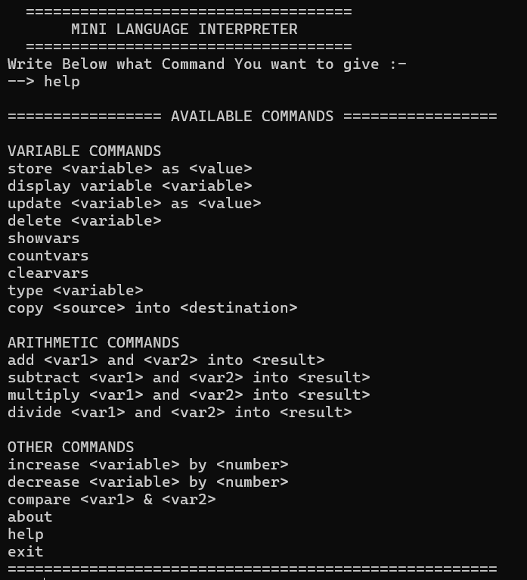
WHAT IS MINILANG ?
1) MiniLang is a lightweight command-based programming language .
2) The project aims to demonstrate the fundamental concepts of interpreter design while following modern Open-Source Software Development practices using Git and GitHub.
3) The interpreter allows users to execute custom commands through a command-line interface.
4) The project has been designed using Object-Oriented Programming principles such as abstraction, encapsulation,
inheritance, and polymorphism, resulting in a modular and maintainable architecture.
5) Apart from software implementation, the project emphasizes collaborative software development using Git and GitHub. The complete development workflow includes repository management, version control, branching strategies, pull requests, issue tracking, documentation, releases, and collaborative code reviews.
AVAILABLE COMMANDS OF MINI-LANG
SLIDE NUMBER 3

Slide 4
HOW THE INTERPRETER WORKS ?
The overall execution flow is as follows:
1. The user enters a command.
2. The tokenizer converts the command into tokens.
3. The parser validates the command syntax.
4. A corresponding command object is created.
5. The command is inserted into the execution queue.
6. The interpreter executes the queued command.
7. Variables are created, updated, compared, or deleted.
8. The result or error message is displayed on the console.
OBJECT - ORIENTED DESIGN
MiniLang has been implemented using Object-Oriented Programming principles.
• Encapsulation is used by storing variable information inside the Variable class.
• Inheritance is implemented through the abstract Command class.
• Polymorphism enables different command classes to implement their own version of the execute() function.
• Abstraction simplifies command execution by hiding implementation details from the user
SLIDE NUMBER 4

Slide 5
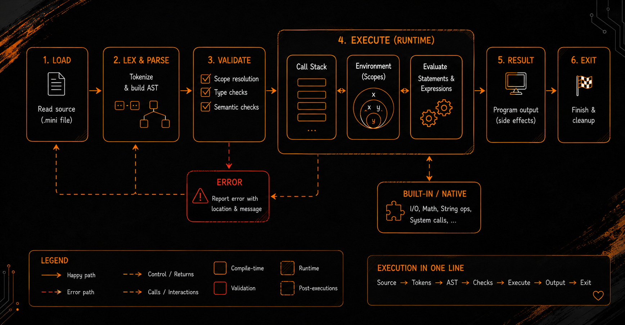
SYSTEM ARCHITECTURE DIAGRAM
SLIDE NUMBER 5

Slide 6
V
Technology Stack
C++
The interpreter has been completely developed in C++. The language was selected because it supports Object-Oriented Programming, Standard Template Library (STL), exception handling, and efficient memory management. C++ also provides high execution speed and extensive support for implementing custom data structures and algorithms.
GitHub
GitHub was used as the remote repository for hosting the project. It provided collaboration features such as forks, pull requests, releases, repository documentation, and version management.
Git
Git was used for local version control. Throughout the project, Git was used to:
Track changes in source code, Create commits after implementing new features, Maintain different project versions, Merge changes into the main branch, Maintain project history.
VS Code
Visual Studio Code was used as the primary code editor for writing, debugging, and managing the project. It provides syntax highlighting, IntelliSense, Git integration, and extension support, making development more efficient.
SLIDE NUMBER 6

Slide 7
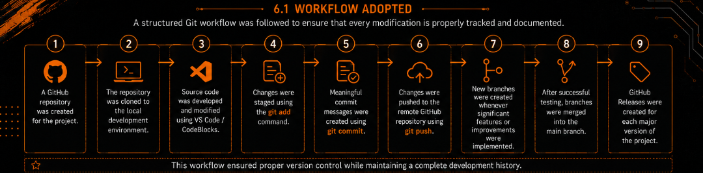
GITHUB WORKFLOW MANAGEMENT
BRANCHING STRATEGY
The project primarily used the following branches:
• main – Stable production-ready version of the project.
• feature branches – Used for implementing new commands and improvements before merging into the main branch.
Feature branches allowed independent development without affecting the stable codebase.
SLIDE NUMBER 7

Slide 8
Version Evolution
v1.0.0
v1.1.0
v2.0.0
The initial release implemented the core functionality of the MiniLang Interpreter, including –
1) variable management,
2) arithmetic operations,
3) comparison operations,
4) command execution,
5) exception handling.
This version focused on improving usability by introducing:
• Help command
• About command
• Clear command
• Improved startup banner
• Enhanced user interface
• Better command guidance
The major release extended the interpreter with additional variable management features, including:
• Count Variables
• Clear All Variables
• Type Command
• Copy Variable
SLIDE NUMBER 8

Slide 9
Repository Structure
MiniLang/
│
├── MINI-LANG 2.0.0.cpp
├── README.md
├── LICENSE
├── CONTRIBUTING.md
├── CHANGELOG.md
├── CODE_OF_CONDUCT.md
├── INSTALL-USE.md
└── ARCHITECTURE.md
WHY THESE FILES MATTER ?
WHY DOCUMENTATION NEEDED ?
DOCUMENTATION IS NEEDED SO AS TO MAKE THE USERS WHO VISIT THE REPOSITORY UNDERSTAND INFORMATION ABOUT THE REPOSITORY.
• README → overview, features & usage
• LICENSE → permissions and limitations
• CONTRIBUTING → contribution & PR rules
• CHANGELOG → release history
• ARCHITECTURE → system design
• INSTALL-USE → setup and usage
• CODE_OF_CONDUCT → contributor expectations
Repository Link
https://github.com/RAGHAV4056/MiniLang-Interpreter.git
SLIDE NUMBER 9
11

Slide 10
CHALLENGES FACED
9.1 Command Parsing
Designing a parser capable of recognizing multiple command formats while maintaining simplicity required careful planning. Different commands had different syntax, making validation an important aspect of the interpreter.
9.2 Managing Multiple Data Types
Supporting Integer, Float, Boolean, and String variables required proper datatype identification and storage. Ensuring correct arithmetic and comparison operations across different datatypes was one of the key implementation challenges.
9.3 Error Handling
The interpreter needed to detect invalid commands, missing variables, unsupported operations, and division by zero without terminating unexpectedly. Exception handling was implemented to improve reliability.
9.4 Version Control
Learning Git and GitHub workflows, including branching, merging, pull requests, releases, and commit management, required additional effort but significantly improved project organization.
9.5 Documentation
Preparing professional documentation, including the README, contribution guidelines, changelog, architecture diagrams, and the final report, required careful planning to ensure consistency and completeness. Despite these challenges, the project was completed successfully and provided practical experience in software development, version control, and documentation.
SLIDE NUMBER 11
13

Slide 11
FUTURE SCOPE
Although MiniLang currently supports basic command execution and variable manipulation, it has significant potential for future enhancement. Possible future improvements include:
• Support for user-defined functions.
• Conditional statements such as if, else, and switch.
• Loop constructs including for and while.
• Expression evaluation with operator precedence.
• Arrays and collection data types.
• File handling commands for reading and writing data.
• Saving and loading interpreter sessions.
• Command history and auto-completion.
• Interactive shell with syntax highlighting.
• Graphical User Interface (GUI).
• Cross-platform packaging and installer support.
• Modular parser capable of supporting more advanced language syntax.
Future development can transform MiniLang from a simple educational interpreter into a more complete scripting language suitable for learning compiler and interpreter design concepts.
SLIDE NUMBER 12

Slide 12
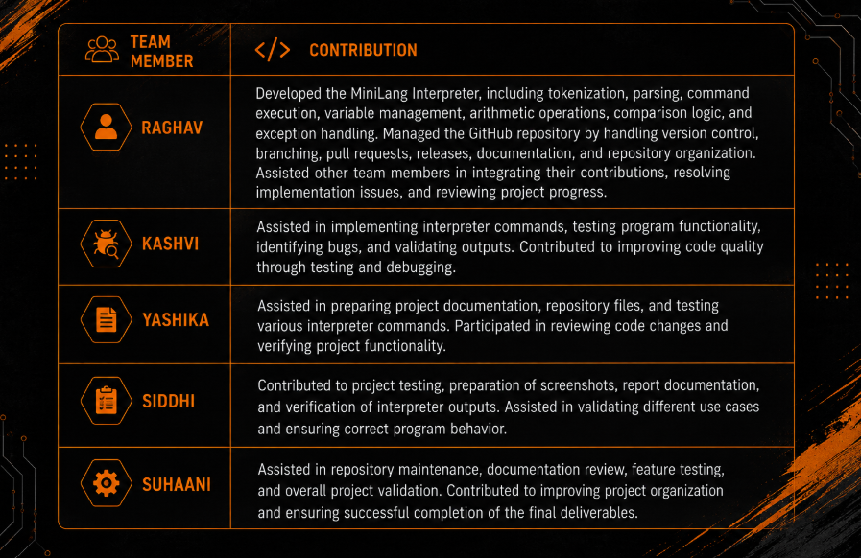
TEAM MEMBERS & THEIR CONTRIBUTION
SLIDE NUMBER 10

Slide 13
REFERENCES
Books
  Bjarne Stroustrup, The C++ Programming Language (4th Edition), Addison-Wesley Professional, 2013.
  Stanley B. Lippman, Josée Lajoie, and Barbara E. Moo, C++ Primer (5th Edition), Addison-Wesley Professional, 2012.
Git, GitHub and Interpreter Documentation
  Git Documentation. Git Reference Manual. Available at: https://git-scm.com/docs
  GitHub Documentation. GitHub Docs. Available at: https://docs.github.com
  Ruslan Spivak, Let’s Build A Simple Interpreter. Available at: https://ruslanspivak.com/lsbasi-introduction/
Development Tools Documentation
  Microsoft. Visual Studio Code Documentation. Available at: https://code.visualstudio.com/docs
  GNU Project. GNU C++ Compiler (G++) Documentation. Available at: https://gcc.gnu.org/onlinedocs/
  cppreference.com. C++ Standard Library Reference. Available at: https://en.cppreference.com/
Open-Source Repositories Studied
  The Algorithms – C++ Repository. Available at: https://github.com/TheAlgorithms/C-Plus-Plus
  Git Project Source Repository. Available at: https://github.com/git/git
  LLVM Project Repository. Available at: https://github.com/llvm/llvm-project
SLIDE NUMBER 13
7

Slide 14
MINILANG
Build. Version. Collaborate.
THANK YOU !!!
HOPE YOU LIKED THE PRESENTATION.
SLIDE NUMBER 14
15

