Slide 1



BIKESTORE DATA ANALYSIS
By
Raghdan Ramadan

Slide 2

Outlines
This project involves the analysis of the BikeStore Database provided through SQL queries. The main objective is to extract critical insights about the store's performance, products, customers, sales, and staff using specific SQL queries to answer business-related questions. The project was executed using My SQL/
The database includes several key tables such as products, categories, customers, stores, orders, order_items, and staffs, all essential for answering various business questions regarding BikeStore's operations.
The presentation outlines the following aspects:
Data Model
Data Exploration
SQL Queries Execution
Answers to the Guide Questions
Key and Business Insights

Slide 3

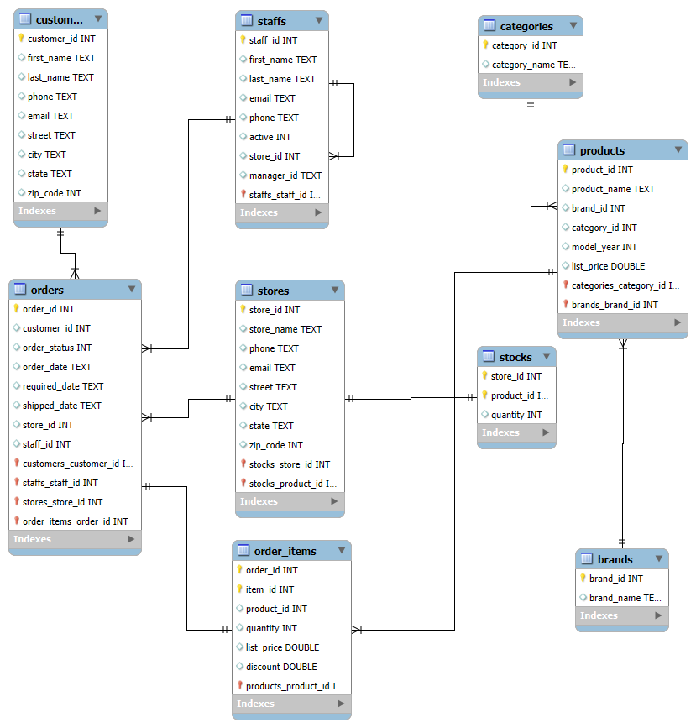

Data Model

Slide 4
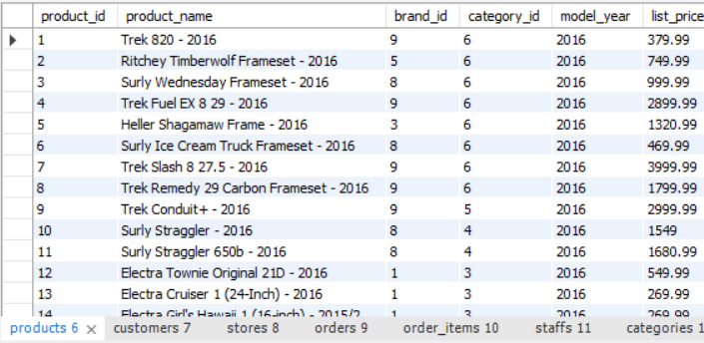
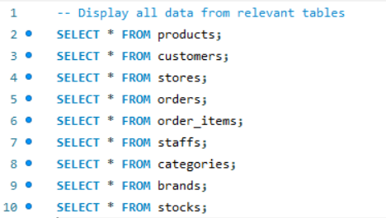
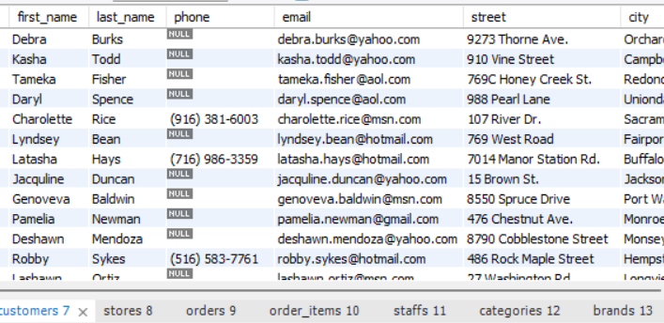
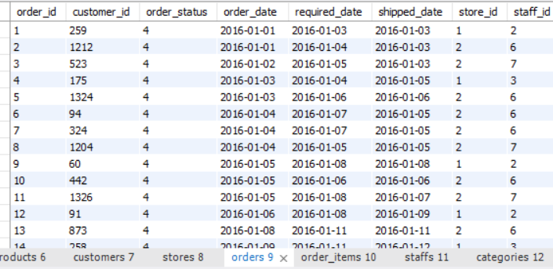
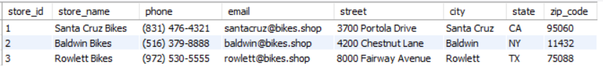
Data exploration

Slide 5
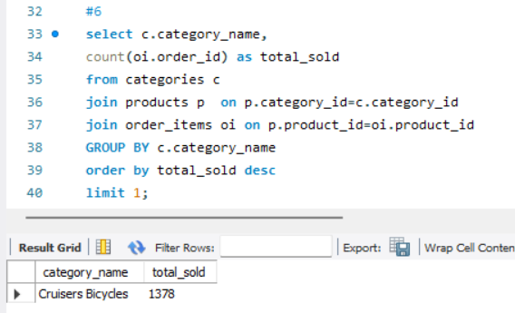
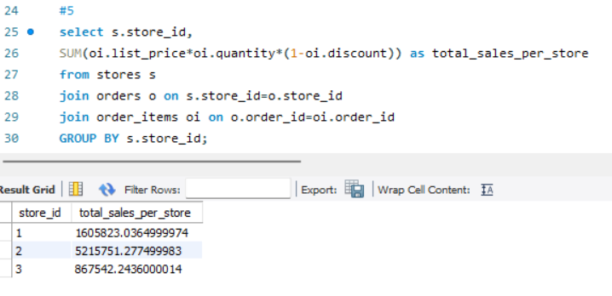
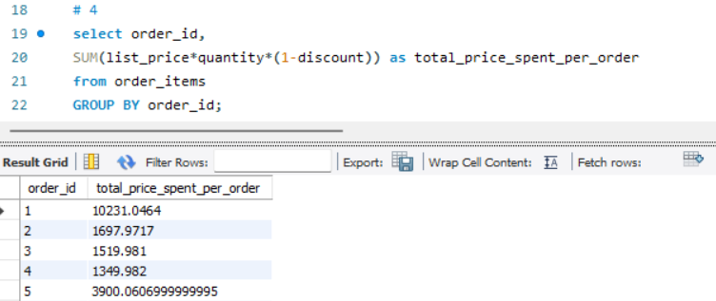
Key Analytical Queries
Total Price Per Order: Calculated the total price per order by considering factors like list price, quantity, and discounts to get a clearer picture of customer spending patterns.
Sales per Store: Measured revenue generation across different stores to understand the overall financial contribution of each location.
Category Analysis: Evaluated which product categories are selling the most and which have the highest rejection rates, giving insights into customer preferences and potential inventory issues.
The Data used for this project from a Bike store data base that can be accessed here
First you Create new Database
Then Create Tables using the Create Object.sql file
Then you can load data using Load data.sql file

Slide 6
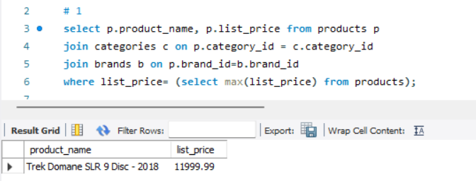
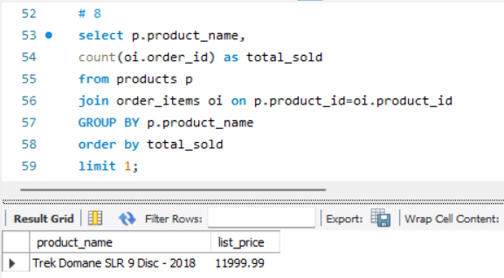
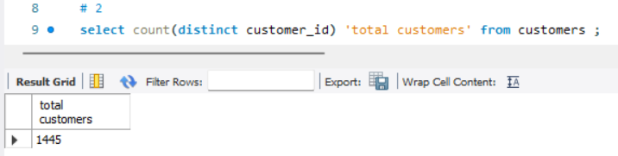
Key Analytical Queries
Most Expensive Bike: Identified the highest-priced bike in the catalog and explored potential reasons for its premium pricing, such as brand reputation, quality, or special features.
Least Sold Bike: Identified the bike with the lowest sales, providing an opportunity to explore reasons for low demand (e.g., pricing, design, or lack of marketing).
Customer Count: Calculated the total number of customers, with a differentiation between active customers (who completed orders) and inactive ones (e.g., those with rejected orders).
The Data used for this project from a Bike store data base that can be accessed here
First you Create new Database
Then Create Tables using the Create Object.sql file
Then you can load data using Load data.sql file

Slide 7
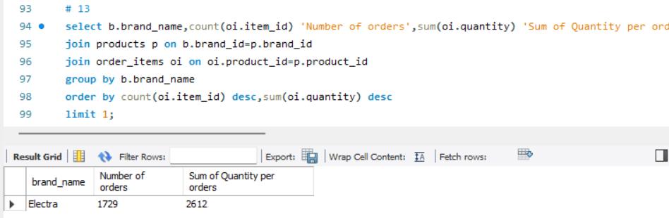
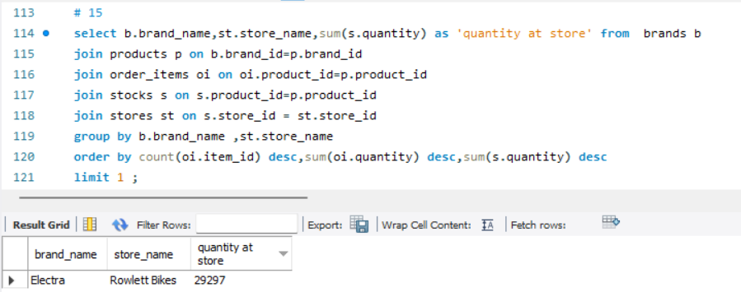
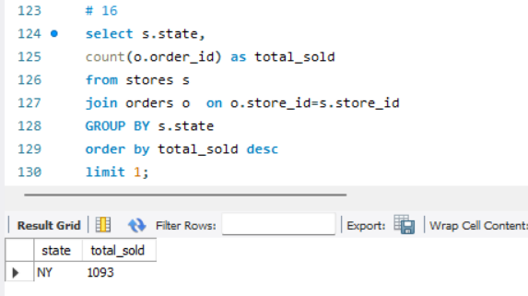
Business Insights
Most Liked Brand: Highlighted the most popular bike brand, helping the company focus on products that resonate most with customers.
Most Liked Brand: Highlighted the most popular bike brand, helping the company focus on products that resonate most with customers.
Inventory Analysis: Determined which stores still have a high inventory of popular products, guiding stock replenishment strategies and preventing stockouts.
Top Performing States: Identified which states are generating the most revenue, allowing for region-specific marketing or expansion strategies.
The Data used for this project from a Bike store data base that can be accessed here
First you Create new Database
Then Create Tables using the Create Object.sql file
Then you can load data using Load data.sql file

Slide 8

Thank you

