Slide 1
Automated Data Pipeline Scraping Mobile
E- Commerce Data

Slide 2
Our Team, consisting of :
Youssef Khalaf Abdullatief Hassan
Raghdan Ramadan Mohamed Abdelghany
Ahmed Ibrahim Dewedar
Amr AlAlwani

Slide 3
Project Introduction and Objectives
Project Scope
Team Structure
Technical Challenges
Our project aims to create a robust data pipeline for scraping mobile product information from Amazon and Noon. This data is crucial for understanding market trends, pricing strategies, and consumer preferences in the rapidly evolving mobile technology sector.
We divided our efforts into two specialized teams: Team 1 focused on Amazon's mobile section, while Team 2 concentrated on Noon. This division allowed for platform-specific expertise development and efficient problem-solving.
A key objective was to implement OCR technology to overcome CAPTCHA barriers, ensuring continuous and uninterrupted data collection. This innovative approach sets our project apart in the realm of e-commerce data scraping.

Slide 4

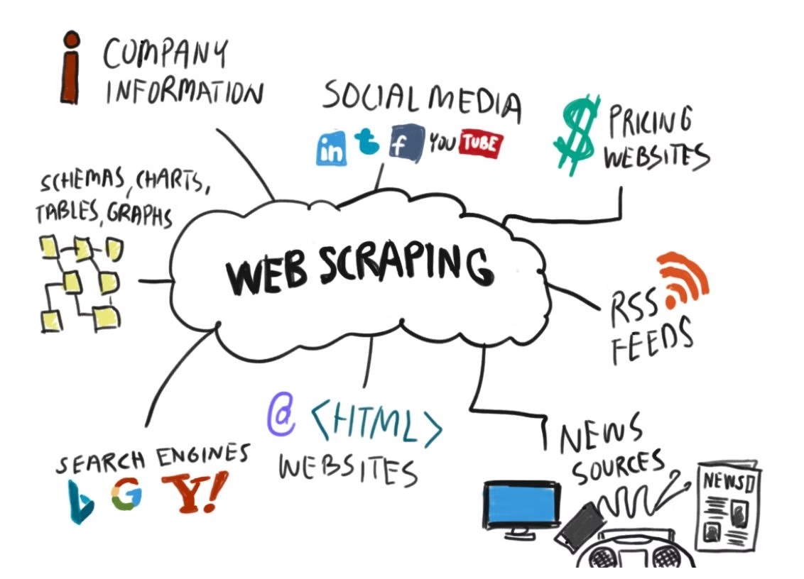
Data Scraping Process and Challenges
1
Initial Setup
We began by utilizing Python libraries such as BeautifulSoup and Requests to create our scraping framework. These powerful tools allowed us to navigate web pages and extract crucial data points including product specifications, prices, and customer reviews.
2
CAPTCHA Hurdles
During the scraping process, we encountered significant CAPTCHA challenges, particularly on Amazon. These security measures initially hindered our access to valuable data, requiring us to develop innovative solutions.
3
Time Constraints
Our initial scraping attempts were time-consuming, with the process taking approximately 1.5 hours for both teams combined. This highlighted the need for optimization to make our data collection more efficient and scalable.

Slide 5
Code Optimization Strategies
Bottleneck Identification
Asynchronous Programming
We meticulously analyzed our original scraping code to identify performance bottlenecks. This involved profiling our code and examining areas where execution time was significantly high.
To address the performance issues, we implemented asynchronous programming techniques using sync and ioh libraries. This allowed for concurrent execution of I/O-bound operations, significantly reducing wait times.
Optimization Results
Continuous Refinement
Our optimization efforts paid off dramatically, reducing the total scraping time from 1.5 hours to just 10 minutes. This 9x improvement in speed greatly enhanced the efficiency of our data collection process.
We implemented a process of continuous refinement, regularly reviewing and updating our code to maintain optimal performance as we scaled our scraping operations.

Slide 6




Data Transformation and Cleaning
Raw Data Collection
Cleaning Process
Data Validation
Final Dataset
After the initial cleaning, we implemented rigorous data validation checks to ensure the integrity and accuracy of our dataset. This included range checks, format validations, and cross-referencing with known valid values.
The result of our cleaning and transformation process was a high-quality, consistent dataset ready for analysis and modeling. This clean data formed the foundation for our subsequent data warehouse design and analytics efforts.
Our scraping process yielded a large volume of raw data from both Amazon and Noon. This unprocessed data contained various inconsistencies, missing values, and duplicates that needed to be addressed.
We utilized Python's Pandas library to clean and transform the raw data. This involved handling missing values through imputation or deletion, removing duplicate entries, and ensuring consistency in data formats across different fields.

Slide 7

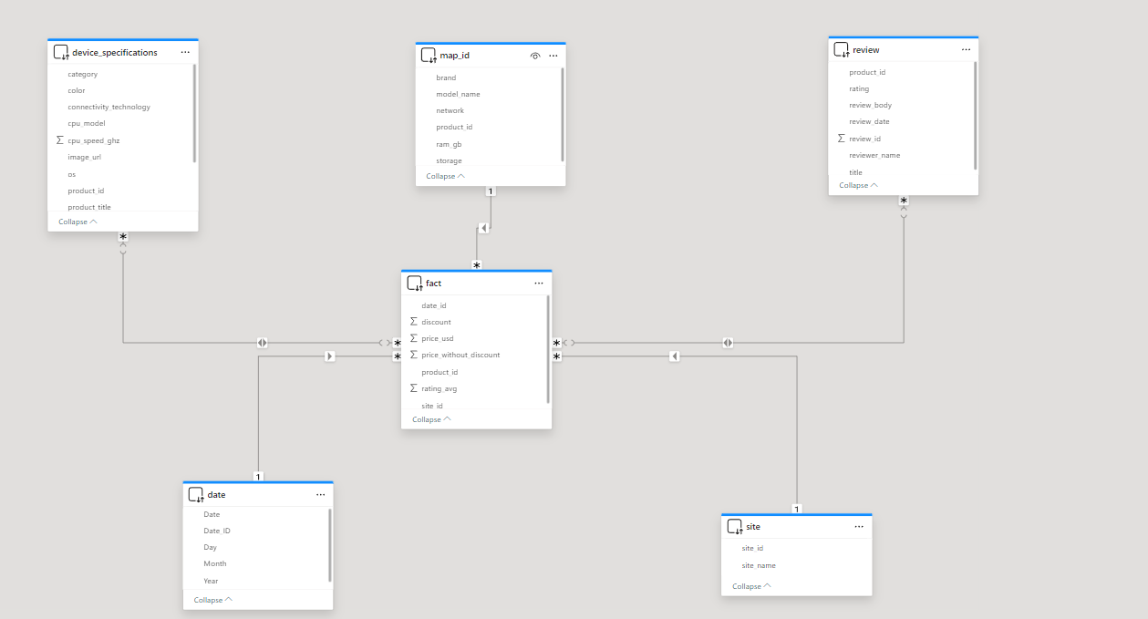
Data Modeling: Star Schema Design
Fact Table
Dimension Tables
- product_id (FK)
Dim_DeviceSpecifications
- site_id (FK)
Dim_Site
- date (FK)
Dim_Review
- review_id (FK)
Dim_Date
- price_usd
- discount
- price_without_discount
- rating_avg
- review_count

Slide 8

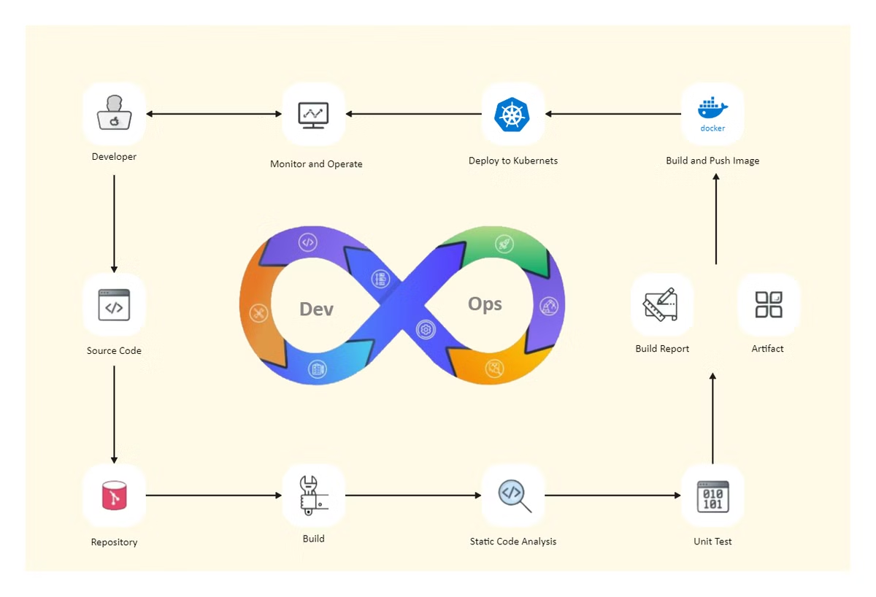
Data Pipeline Automation Journey
1
Initial Azure Exploration
We began by exploring Azure Synapse Analytics as a potential solution for automating our data processing pipeline. This powerful platform offered comprehensive data integration, enterprise data warehousing, and big data analytics capabilities.
2
Spark Pool Consideration
Initially, we considered using Spark pool notebooks for each section of our pipeline. While this approach offered robust processing capabilities, we quickly realized it would be a costly solution for our project's scale.
3
Cost-Effective Alternative
After careful consideration, we pivoted to developing a custom app function. This approach allowed us to automate the scraping and transformation processes more efficiently and at a lower cost, aligning better with our project's resources and requirements.

Slide 9
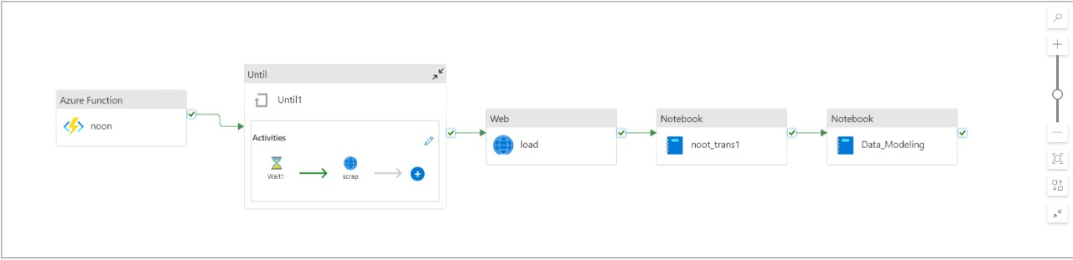

Slide 10
Overcoming Implementation Challenges
1
Local Development Environment
2
Azure Synapse Integration
We utilized Visual Studio Code as our primary development environment, leveraging its powerful debugging tools and extensions to streamline our coding process. This local setup allowed for rapid iteration and testing of our scraping and transformation scripts.
Connecting our local development environment to Azure Synapse presented initial challenges. We had to navigate complex authentication processes and ensure seamless data flow between our local scripts and the cloud-based data warehouse.
3
GitHub Actions Implementation
4
Continuous Improvement
To further optimize our workflow, we integrated GitHub Actions into our development process. This allowed us to automate our entire pipeline using a Jupyter notebook, significantly reducing manual intervention and potential errors.
Throughout the implementation process, we maintained a focus on continuous improvement. Regular code reviews, performance testing, and iterative refinements helped us overcome challenges and optimize our pipeline for efficiency and reliability.

Slide 11
Data Storage and Visualization Strategies
Serverless Data Lake Architecture
External Tables in Data Warehouse
Power BI Visualization
For data visualization, we leveraged Power BI's robust capabilities. We developed interactive dashboards that pulled data directly from our data warehouse, enabling real-time insights into mobile product trends, pricing patterns, and customer sentiments across both Amazon and Noon platforms.
We implemented a serverless data lake architecture to store our cleaned and transformed data. This approach provided scalable, cost-effective storage that could easily accommodate our growing dataset. The serverless model allowed us to focus on data processing without worrying about infrastructure management.
To facilitate efficient data access, we created external tables in our data warehouse. These tables acted as a bridge between our data lake and the analytics layer, allowing for seamless querying of large datasets without data duplication.

Slide 12
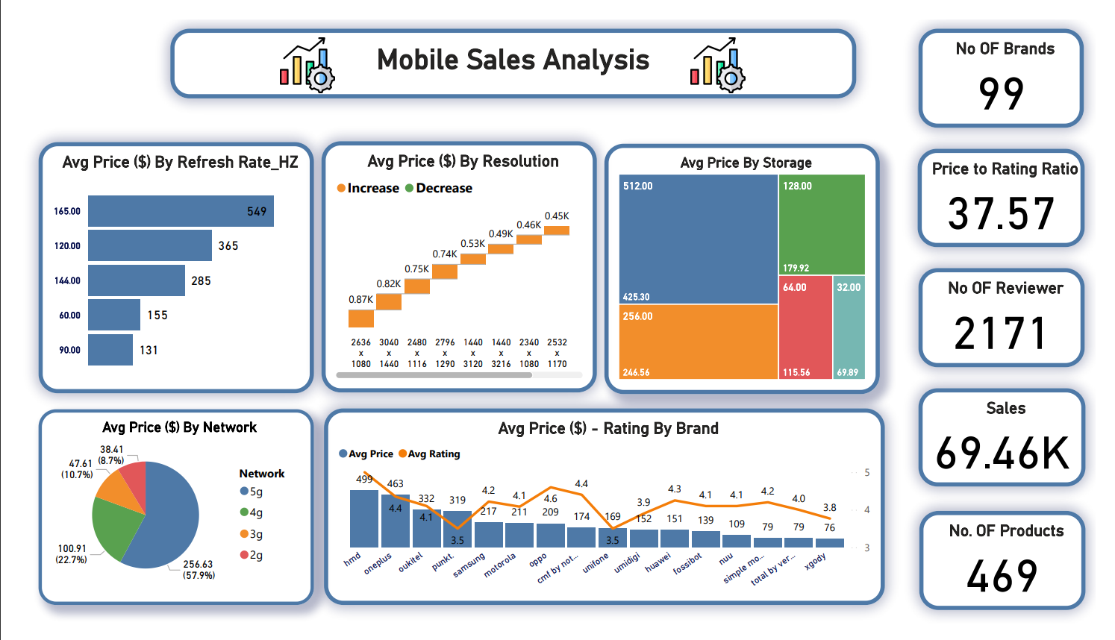

Slide 13




Conclusion and Future Directions
Project Success
Scalability
Advanced Analytics
Cloud Optimization
We successfully developed an automated data pipeline that efficiently scrapes, cleans, and transforms mobile product data from Amazon and Noon. Our cost-effective solution significantly reduced processing time and improved data quality.
Moving forward, we plan to expand our data sources to include additional e-commerce platforms, providing a more comprehensive view of the mobile market. This scalability will enhance the value of our insights for stakeholders.
We aim to integrate advanced analytics and machine learning techniques into our pipeline. This will enable predictive modeling for price trends, demand forecasting, and sentiment analysis, offering deeper insights into market dynamics.
Continuous optimization of our cloud infrastructure will be a priority, ensuring our solution remains cost-effective and performant as we scale. We'll explore emerging cloud technologies to further enhance our data processing capabilities.

