Slide 1
CHARGER

Slide 2
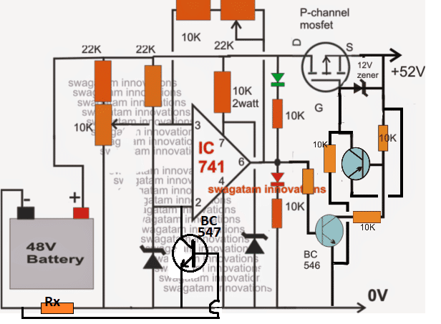
Things learnt as apart of the project Simple Charger that can charge battery till 65%

Slide 3
This is an automatic charger which takes cares of discharge due to internal resistance /circuit of battery.
This charger can charge battery with constant current upto 65% i.e it gets cutoff when it reaches 54.6V.
This can’t charge battery to it’s full capacity.
Battery needs to be charged at constant voltage for some more time, to reach it’s full capacity .

Slide 4
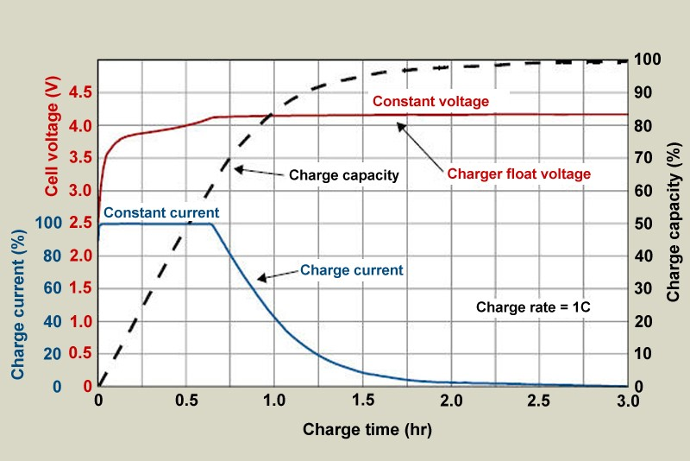
li-ion battery characteristic

Slide 5
Stages of charging battery
The battery needs to be charged at constant current(CC) for approx 1 hr and at constant voltage(CV) for more than 1 and half hour.
During CC the battery gets charged upto 65% and remaining during CV.
The charging should be stopped during CV when current reaches 3% of CC
The battery can’t be charged on constant current for full time as it can’t sustain the stress and releases high amount of heat.

Slide 6
charging cycles of battery v/S CHARGING TIME
This is the main part when we look at battery, as we need long life of battery and charging time.
The no. of charging cycles of battery and charging time mainly depends on CC.
Increasing CC decreases the charging time but also decreases the no. of charging cycles. Generally there is a trade of between this two. So it’s preferable to charge at 0.8C in CC mode.
1C = current required to charge battery in 1 hour
For fast/dash charging we have to increase the value of CC but this doesn't have much effect in time to charge in CV mode.
Thus fast charging just indicates that how fast we reach 65% of battery.

Slide 7
Objectives and timeline
From 16 sept to 29 sept we would be learning about different charging IC’s and circuits of commonly used li-ion chargers and simulate them.
By 8 oct we will make the feasibility report and cost estimation after discussing with team members and the finalize the circuit.
Post quiz 2 we will start the hardware implementation of the circuit and try and complete it before the endsem.

