Slide 1
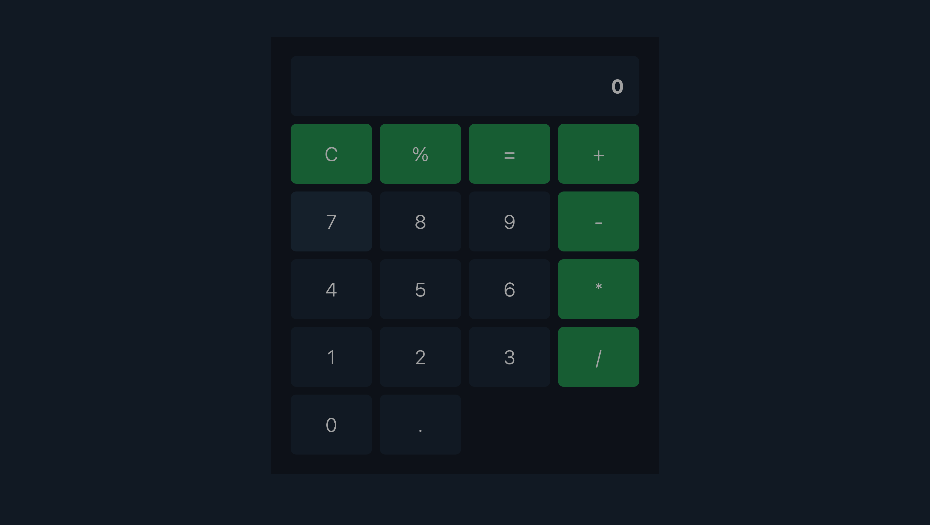
Calculator
Modern Scientific Calculator
(HTML, CSS & JavaScript)
RAGHUL B

Slide 2
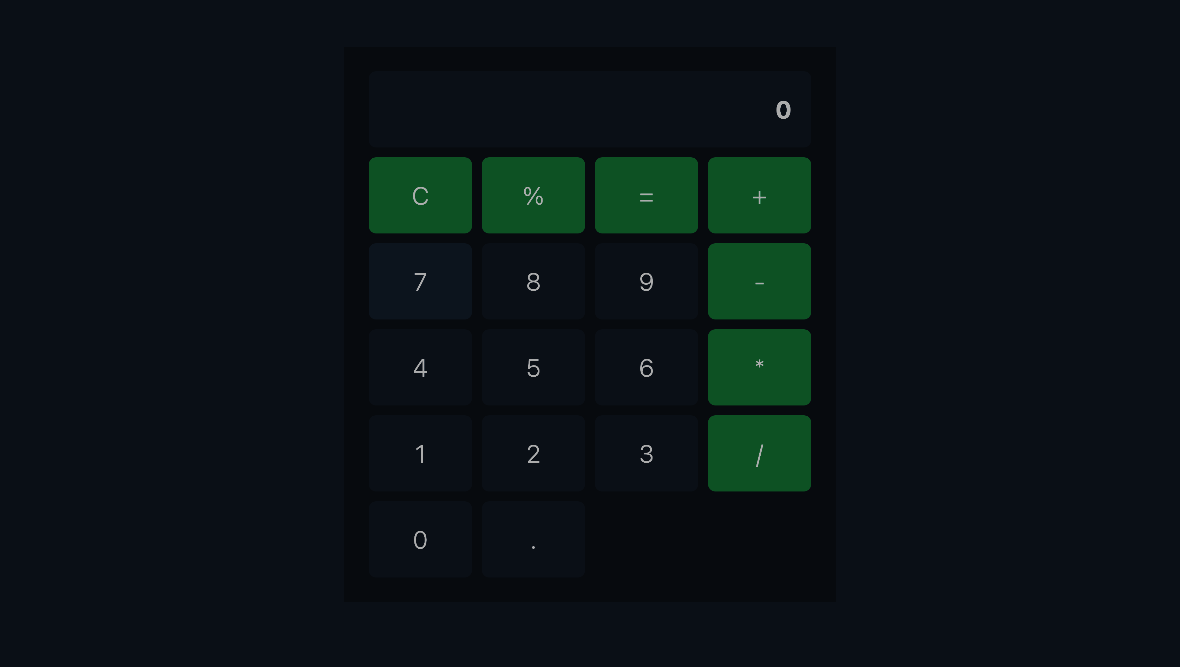
Project Overview
Goal: Build a browser‑based scientific calculator with a dynamic gradient background.
Technologies: HTML for structure, CSS for styling & animation, JavaScript (with Math.js) for logic.
Features: Advanced math functions, responsive layout, animated background.

Slide 3
HTML Structure
<main class="calculator"> – wrapper for entire app.
<input id="display" readonly /> – output screen.
<div id="buttons"> – grid for digits & function buttons.
Math.js CDN included via <script> for scientific operations.

Slide 4
LayCSSout & Dynamic Background
CSS Grid arranges buttons in four columns for clean alignment.
Calculator card styled with rounded corners and subtle shadow.
Animated gradient created with @keyframes shifting a 4‑color diagonal background.
Responsive centering using flexbox on body element.

Slide 5
JavaScript Logic & Math.js
Single 'click' listener on button container drives all input.
Switch‑case processes digits, operators, functions, and commands (C, DEL, =).
Math.js evaluate() parses and computes complex expressions (sin, log, √, !).
Sanitize helper converts ln( to log( for natural‑log support.

Slide 6
Key Functions & Controls
'=' evaluates current string and shows result or 'Error'.
'C' clears the display; 'DEL' removes last char.
Scientific keys append functions: sin(, cos(, tan(, sqrt(.
Factorial (!) and exponent (^) handled inline in expression string.

Slide 7
Highlighted Code Snippets
CSS Gradient: background: linear-gradient(-45deg, #1e3c72, #2a5298, #753a88, #cc2b5e); animation: gradientShift 16s ease infinite;
Math.js Script Tag: <script src="https://cdnjs.cloudflare.com/ajax/libs/mathjs/10.6.4/math.min.js"></script>
JS Evaluate Call: display.value = math.evaluate(sanitize(display.value));

Slide 8
Extensions & Enhancements
Add keyboard support for quicker input.
Dark/light mode toggle with CSS variables.
Additional functions: asin, acosh, constants like π and e.
Export calculation history to file or local storage.

Slide 9
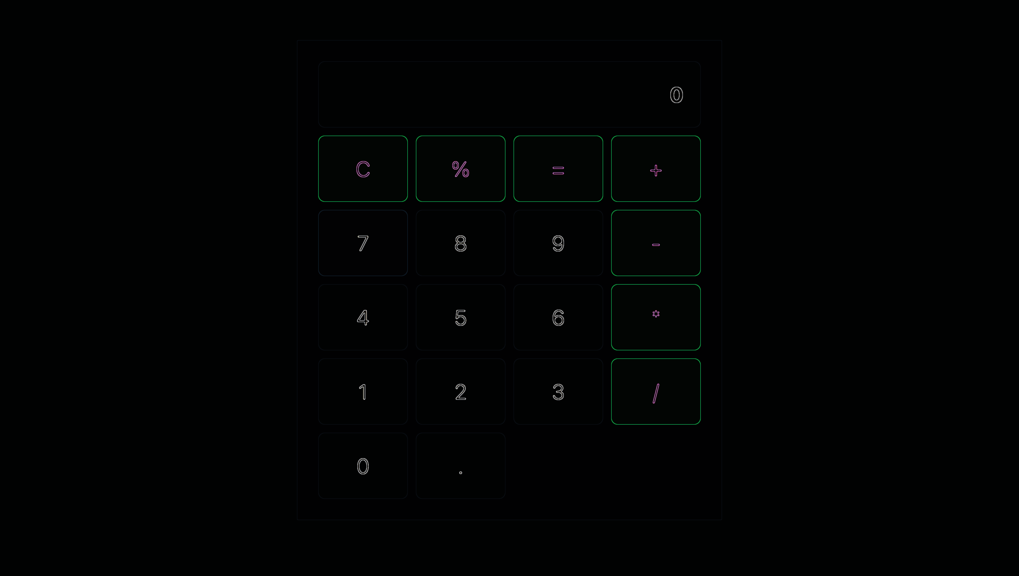
Thank You

