Slide 1

DEPARTMENT OF ARTIFICIAL INTELLIGENCE
20AM6203-DESIGN PROJECT-II
BATCH - 08
Presented By:
Guided By:
BHAGAVANTH . A -811722001006
PRASANNA.J -811722001038
RAGHURAM . K -811722001040
Mrs.A.SUMATHI ,M.E.,
Assistant Professor/AI

Slide 2
AI - POWERED ADAPTIVE LEARNING SYSTEM

Slide 3
OBJECTIVE
Develop an AI-powered adaptive learning system that transforms traditional educational content into interactive, personalized, and engaging experiences through interactive edu , textbook conversion, and AI-generated flashcards.

Slide 4
EXISTING SYSTEM
In the educational systems are a blend of traditional and modern approaches. Many institutions still rely on conventional classroom teaching, where educators deliver content through lectures, textbooks, and written assignments. Modern learning methods emphasize personalized, interactive, and technology-enhanced approaches, shifting away from traditional lecture-based instruction.
Demerits
Lack of Interactivity
Manual Effort for Note-Taking
Low Engagement and Motivation

Slide 5
PROPOSED SYSTEM
The proposed system replaces the comprehensive AI-powered adaptive learning platform that integrates three key modules interactive edu, textbook content conversion, and flashcard generation, with additional features to enhance engagement and personalization. It dynamically adjusts the difficulty level of content, recommends tailored study materials, and supports continuous improvement.
Merits
Interactive Learning Experience.
Automated Content Generation and Personalized Content Delivery.
Enhanced Comprehension and Retention and Time-Efficient Learning.

Slide 6
LITERATURE SURVEY
S.NO | TITLE | AUTHOR | PUBLISHED YEAR | TECHNOLOGY USED | DEMERITS
1 | AI-Powered Smart Book: Enhancing Arabic Education In Palestine With Augmented Reality | Murad Al Rajab, Suhail Odeh, Sherin Hazboun & Emran Alheeh | 2023 | AI&ML Augmented Reality (AR) Computer Vision Cloud computing | High Development and Maintenance Costs Limited Accessibility
2 | Integration Of Generative AI Techniques And Applications In Student Behavior And Cognitive Achievement In Arab Higher Education | Mohammed Jaboob, Manar Hazaimeh & Abdullah M. Al-Ansi | 2024 | NLP,LLM ML & Deep Learning Gen AI Computer Vision | Over-Reliance on AI & Reduced Critical Thinking. Data Privacy and Security Risks

Slide 7
S.NO | TITLE | AUTHORS | PUBLISHED YEAR | TECHNOLGY USED | DEMERITS
3 | ChatGeppetto - An AI-Powered Interactive Education | Bruno Feijó Edirlei Soares de Lima Marco A. Casanova | 2023 | NLP | Limited Creativity and Repetition. Lack of Emotional Depth
4 | Innovative AI-Powered Image Generator: Converting Text Into Images With OpenAI | G. Soma Shiva Sai Babu & K. S. Rekha | 2024 | (GANs) and Diffusion Models. LLM | Lack of Artistic Intent and Nuance. Inconsistencies and Artifacts
5 | Ai Powered Flashcard And Exam Generators | K.Ahmetasevic S.Ilic ,V.Job,R.Telesko | 2024 | NLP OCR | Lack of Contextual Accuracy Limited Creativity

Slide 8

DATA FLOW DIAGRAM
AI Content Analyzer
AI Processing Unit
User Input
Extraction Process
Student Upload textbook
Personalized Education
Static textbooks to interactive Modules
Provide Interactive
Quizzes
Adaptive Learning

Slide 9
SYSTEM & SOFTWARE SPECIFICATION
HARDWARE REQUIREMENTS
Processor (CPU)
Graphics Processing Unit (GPU)
RAM:64GB
Input / Output Device : Monitor
Microphone

Slide 10
SOFTWARE SPECIFICATION
SOFTWARE REQUIREMENTS
Operating System: Window OS
Programming Language : Python
Development Environment : IDE/Code Editors
Used Language/Library:
1.Python
2.Pytesseract
3.Pillow
4.GPT-4

Slide 11
MODULES
Interactive Edu Module
Textbook Conversion Module
Flashcard Generation Module

Slide 12
MODULE 1 INTERACTIVE EDU MODULE
PURPOSE
The Interactive edu module serves as a core component designed to enhance student engagement, comprehension, and retention by transforming complex textbook content into personalized, interactive education. Its primary purpose is to make learning more accessible, enjoyable, and effective, especially for young learners or students who struggle with traditional reading-based instruction.
FUNCTIONS
The interactive edu module plays a central role in transforming academic content into interactive, engaging narratives that cater to different learning styles and emotional states.
It begins with a text extraction function that retrieves raw content from textbooks or PDFs, even handling scanned documents using OCR.

Slide 13
ALGORITHMS USED
Text Summarization (Transformers-based)
It is the process of generating a concise and coherent version of a longer text while preserving its key information.
Natural Language Generation (NLG)
NLG is a subfield of Natural Language Processing (NLP) focused on automatically generating coherent and meaningful text from structured or unstructured data.
PACKAGES USED
openai
langchain

Slide 14
MODULE 2 TEXTBOOK CONVERSION MODULE
PURPOSE
The textbook conversion module plays a foundational role in transforming traditional, static textbook content into interactive, structured digital learning materials. It extracts text from PDFs or scanned books using OCR
FUNCTIONS
The textbook conversion module serves as a foundational component in an AI-powered adaptive learning system, with the primary function of transforming static textbook or PDF content into structured, digital, and interactive learning material. It begins with text extraction, using OCR techniques to extract content from scanned documents, images, or PDFs.

Slide 15
ALGORITHMS USED
Optical Character Recognition (OCR)-Extract text from scanned textbook images or PDF files. It converting images of typed, handwritten, or printed text into machine-encoded text.
Text Segmentation -Break the extracted text into structured units like headings, paragraphs, definitions, and diagrams. enabling accurate downstream NLP tasks such as machine translation, summarization, question answering, and personalized learning systems.
PACKAGES USED
Nltk
Graphviz

Slide 16
MODULE 3 FLASHCARD GENERATION
PURPOSE
The flashcard generation module is designed to enhance student learning by converting textbook content into interactive, concise, and easily reviewable flashcards. It will uses to generate a quizes, questions and answer by using the given PDF.
FUNCTIONS
The flashcard generation module performs several key functions that collectively transform textbook content into effective learning aids designed for quick revision and long-term retention. First, it uses keyword extraction and named entity recognition to identify essential concepts, definitions, formulas, dates, and terminology from the input text.

Slide 17
ALGORITHMS USED
Question Generation Algorithm: Automatically generate quiz-style questions from sentences. It designed to take a given context or passage and automatically formulate relevant questions based on its content
Flashcard Pair Generation : Structure the content into flashcard formats (Q–A or concept–definition pairs). It processing a given input text, such as a textbook paragraph, to identify key concepts and facts.
PACKAGES USED
PyPDF2
Pdf plumber

Slide 18
ADVANTAGES
Personalized Learning Paths
Real-Time Feedback
Improved Engagement
Time Efficiency
Supports Diverse Learners
Scalable and Flexible

Slide 19
APPLICATIONS
Test Preparation
Online Learning Platforms
Special Education
Homeschooling
Higher Education

Slide 20
CONCLUSION
The AI-Powered Educational System revolutionizes traditional learning by making it interactive, adaptive, and engaging. Unlike conventional PDFs and static learning materials, this AI-driven approach personalizes content, adapts to student needs, and ensures a dynamic learning experience.

Slide 21
REFERENCES
Lee, K., Narang, S., Raffel, C., Shazeer, N. ”Exploring The Limits Of Transfer Learning With a Unified Text-To-Text Transformer”. Journal of Machine Learning Research, 21-140, 1–67. 2022.
Chang, M.-W., Devlin, J., Lee, K., Toutanova, K. BERT: “Pre-Training Of Deep Bidirectional Transformers For Language Understanding”. arXiv preprint arXiv:1810.04805. 2022.
Baird, M.D., Hamilton, L.S. ,Pane, J.F., Steiner, E.D. “Informing Progress: Insights On Personalized Learning Implementation And Effects”. RAND Corporation 2022.
Woolf, B.P.―Building Intelligent Interactive Tutors:”Student-Centered Strategies For Revolutionizing E-Learning”. Morgan Kaufmann Publishers. 2021.
Khan, S., and Jawaid. A “AI-Powered Learning Systems: Review and Future Research Directions”. International Journal of Educational Technology in Higher Education. 2020.

Slide 22
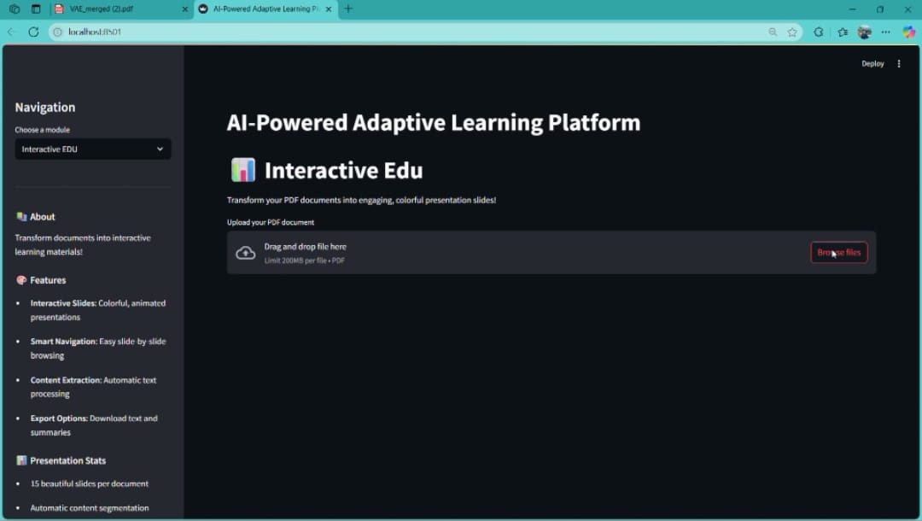
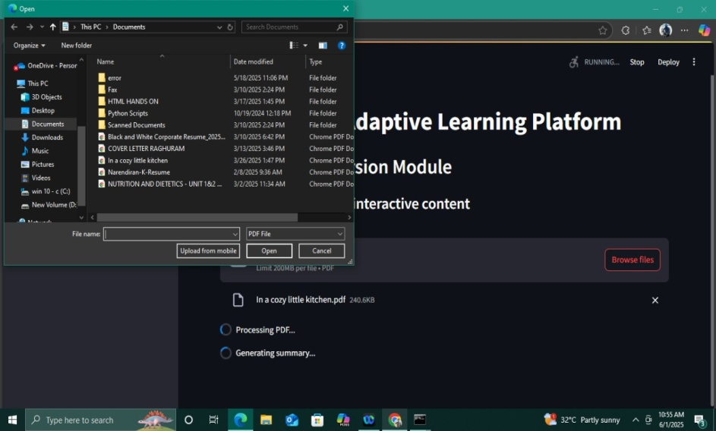
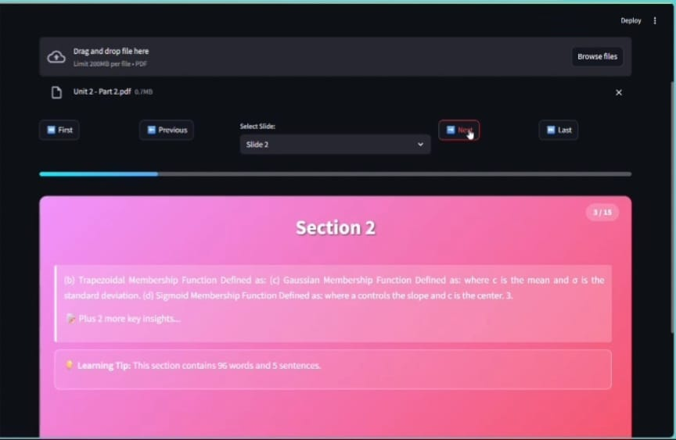
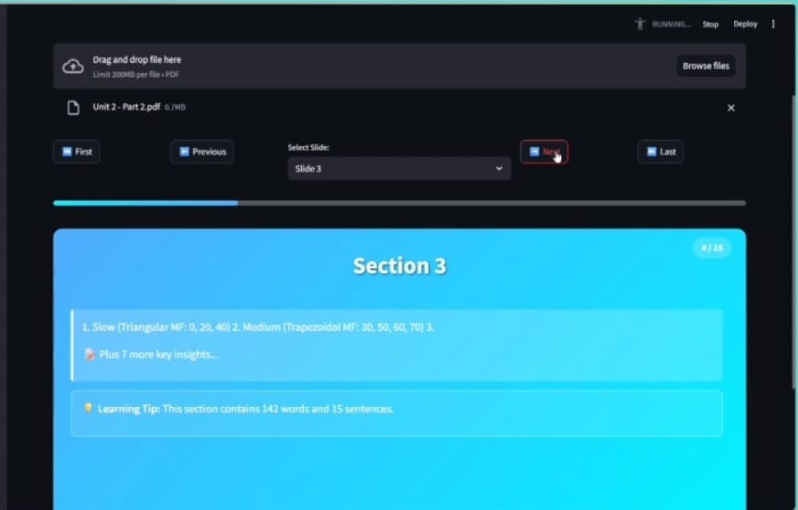
SCREENSHOTS INTERACTIVE EDU

Slide 23
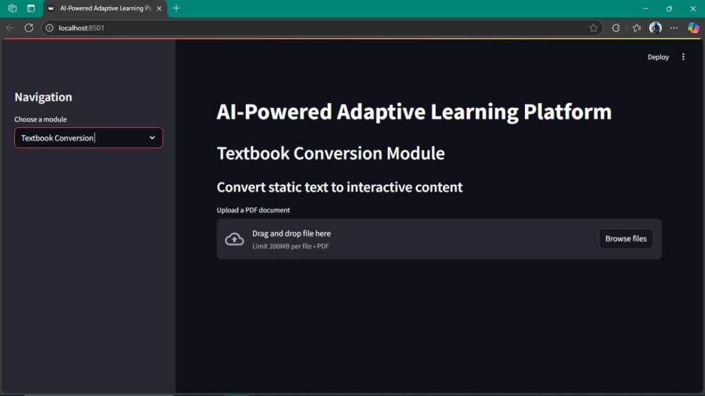

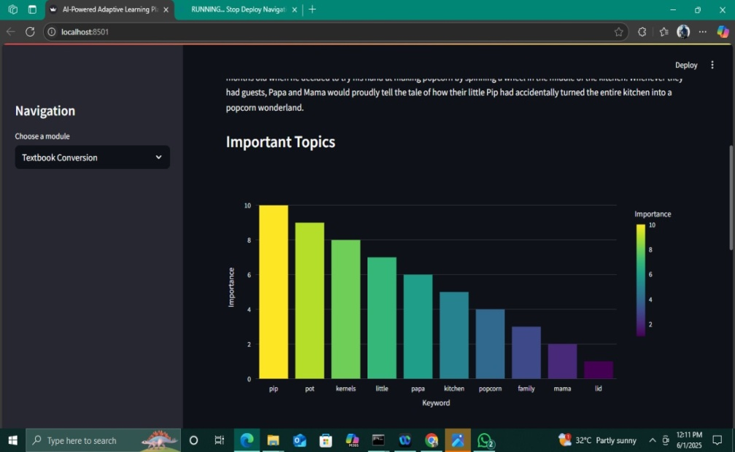
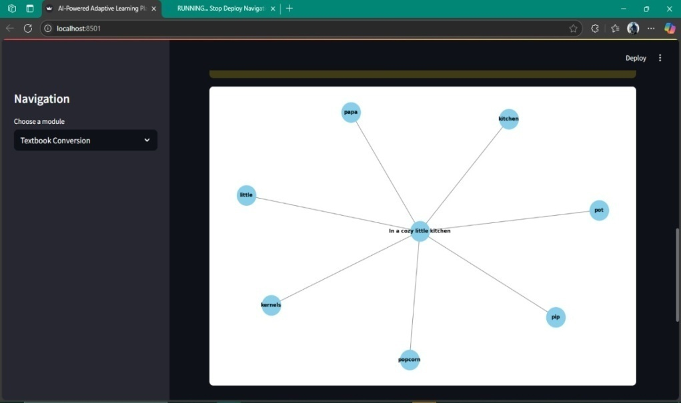
TEXTBOOK CONVERSION

Slide 24
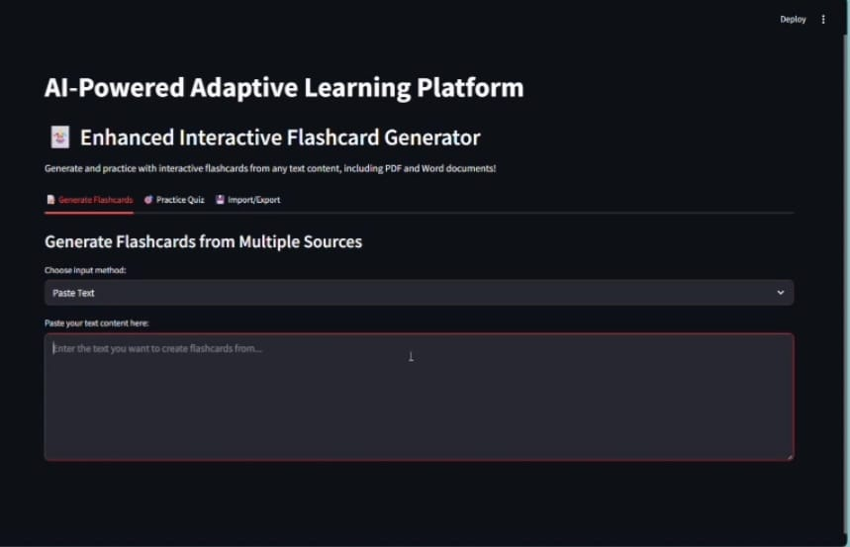
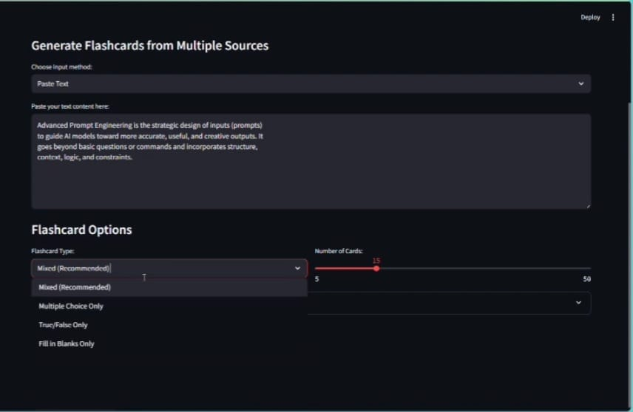
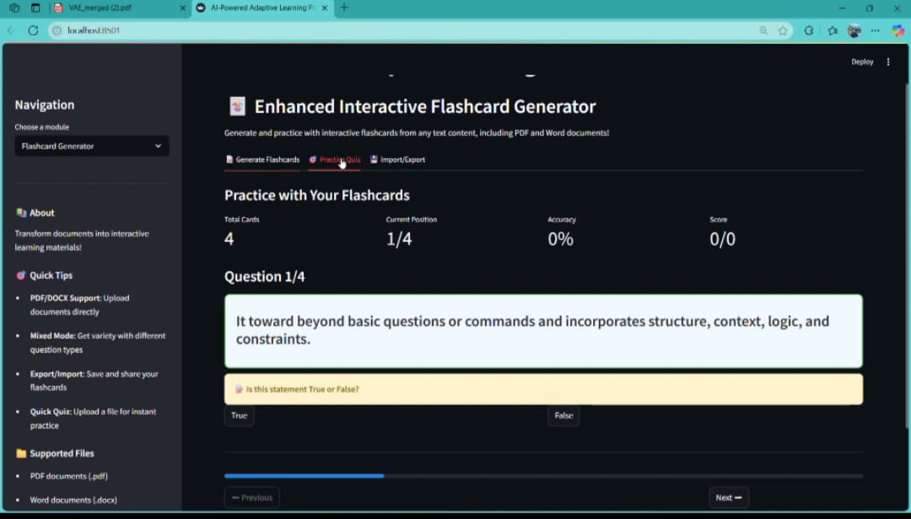
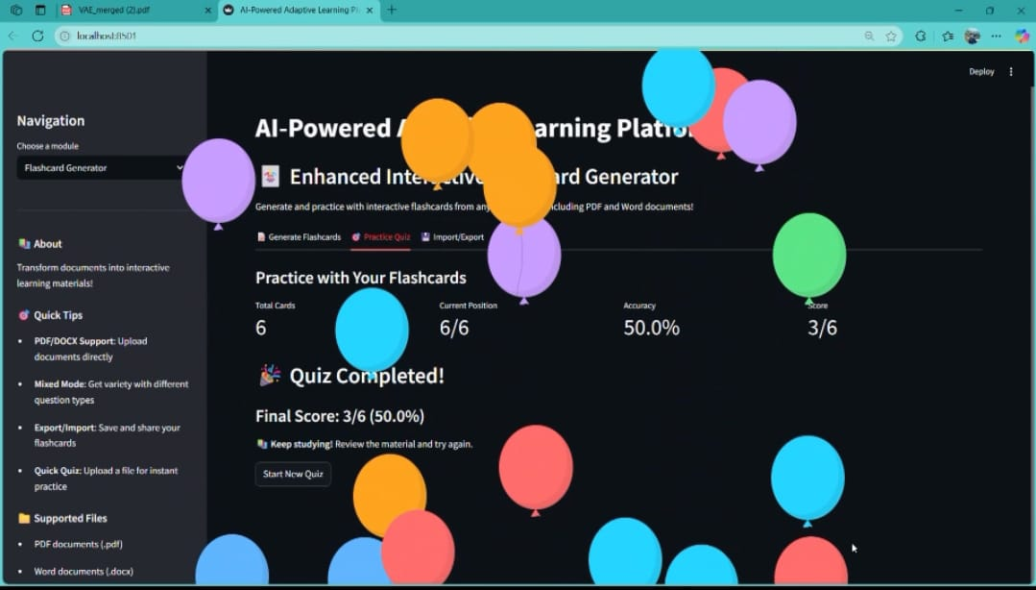
FLASHCARD GENERATION

