Slide 1

COER TECH WARRIORS
SIH-2022

Slide 2
REGISTER
At first the new user will have to enter the required fields to sign up in our website.
On Register we first verify the credentials which are provided by the user :
E-mail Id
Phone No.
Strong Password
Role of the user(Investor, Mentor, Student, Other)

Slide 3
LOGIN
EDIT IN GOOGLE SLIDES

Slide 4
HOW STARTUP INITIATE :
To Initiate a Startup one must follow the given instruction so that the Startup can be successful :
Start with a Great Idea
Make team of Right Persons
Start Implementing your Idea at Basic Level
Raise funds from Investors
Hire the best talents from the industry

Slide 5
Success Stories :
1
This page tells about the successful Startup that,
How do they start
What is the gap that they are subtracting in the society
How the founder’s execute their Idea
What about the financial situation of the company

Slide 6
Startup Incubators :
Our Website has Tie-ups with some incubators :
CIIC
Second One
Third One

Slide 7
Incubation Center
These Incubation Centers track the progress of the Startup’s at the initial stage and provide them all possible help to make them successful.

Slide 8
Startup Register
To register your startup with us, You must go through some valid and security checks by filling a form which require some details about your Startup like :
Company Name
Founder’s Name
Current Valuation
Funding Round
Domain of the Startup

Slide 9
Startup India

Slide 10
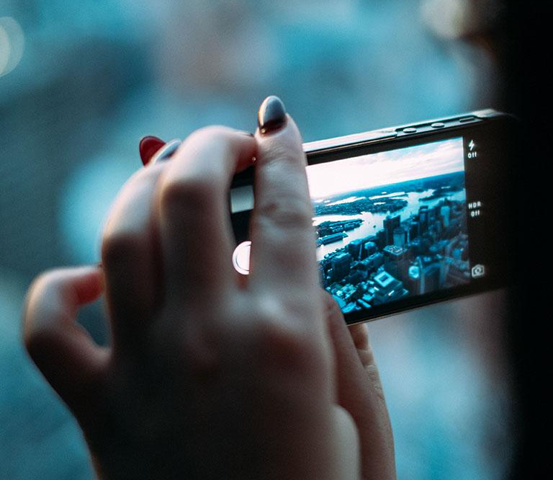
Startup State

Slide 11
Details about Trioex :
Ujjawal Pant
(Team Leader)
Yash Mittal
(Team Member-2)
Piyush Saini
(Team Member-3)
Ragini Joshi
(Team Member-4)
Utkarsh Gupta
(Team Member-5)
Praful Gupta
(Team Member-6)

Slide 12
Thanks!
For Feedback:
You can find me at:
ujjawalpant04@gmail.com
+91-7240573122

Slide 13
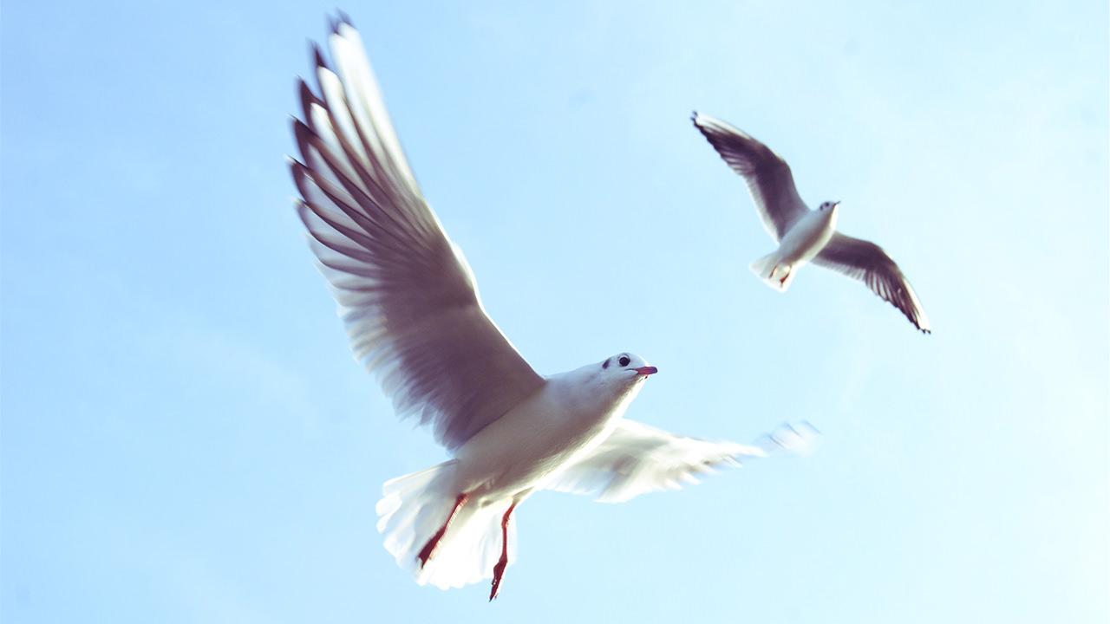

Slide 14
Use charts to explain your ideas
White
Gray
Black

Slide 15
And tables to compare data
 | A | B | C
Yellow | 10 | 20 | 7
Blue | 30 | 15 | 10
Orange | 5 | 24 | 16

Slide 16
Maps
our office

Slide 17
89,526,124
Whoa! That’s a big number, aren’t you proud?

Slide 18
89,526,124$
185,244 users
100%
That’s a lot of money
And a lot of users
Total success!

Slide 19
Our process is easy
first
second
last

Slide 20
Our sales funnel
20%
40%
60%
80%
100%

Slide 21
Let’s review some concepts
Yellow
Is the color of gold, butter and ripe lemons. In the spectrum of visible light, yellow is found between green and orange.
Blue
Is the colour of the clear sky and the deep sea. It is located between violet and green on the optical spectrum.
Red
Is the color of blood, and because of this it has historically been associated with sacrifice, danger and courage.
Yellow
Is the color of gold, butter and ripe lemons. In the spectrum of visible light, yellow is found between green and orange.
Blue
Is the colour of the clear sky and the deep sea. It is located between violet and green on the optical spectrum.
Red
Is the color of blood, and because of this it has historically been associated with sacrifice, danger and courage.

Slide 22
4000
3000
2000
1000
0
You can copy&paste graphs from Excel and Google Sheets

Slide 23

Mobile project
Show and explain your web, app or software projects using these gadget templates.

Slide 24

Tablet project
Show and explain your web, app or software projects using these gadget templates.

Slide 25

Desktop project
Show and explain your web, app or software projects using these gadget templates.

