Slide 1
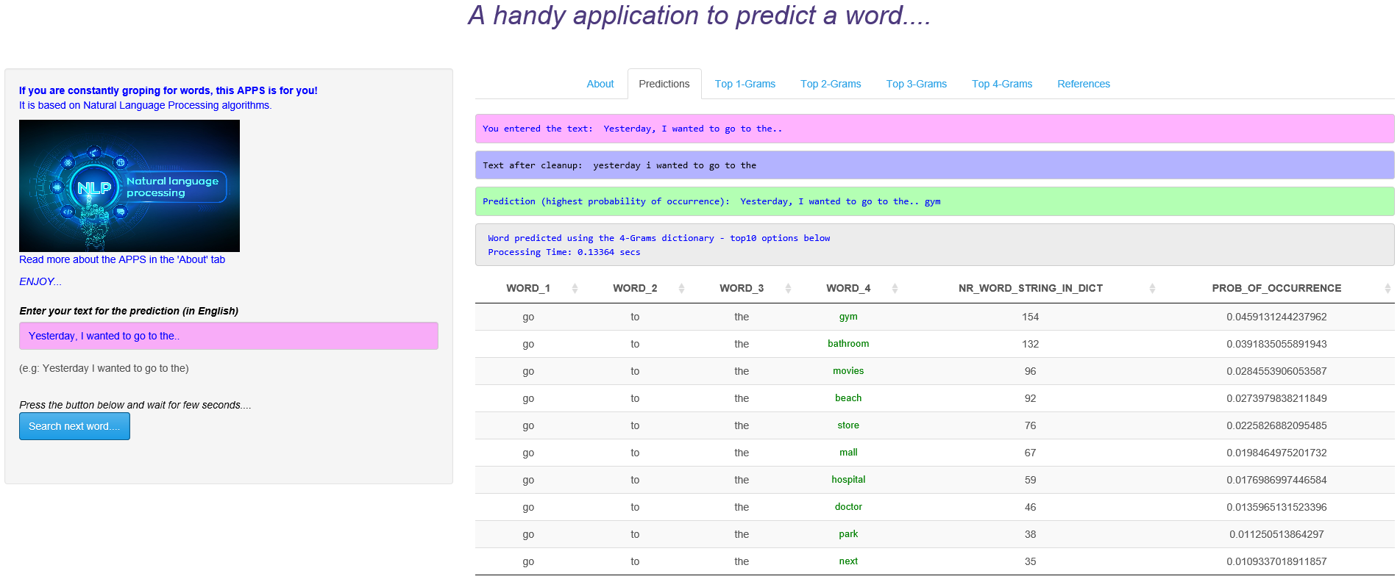
3
4
7
5
1
6
2
1
Input box to enter the text
2
Submit button to launch the search

Slide 2
3
Displays, as-is, the text you entered
4
The text entered is transformed to lowercase and cleaned: e.g. removal punctuation, special characters, numbers, emoticons, URLs, extra white spaces....replacement of contractions (e.g. I’ll to I will)
5
Indicates which n-Grams directory is used for the prediction:
4-Grams: if length of the entered text is >=3 (the algorithm is taking the last 3 words of your text to predict the subsequent word)
3-Grams: if length of the entered text is = 2 (the algorithm is taking the last 2 words of your text to predict the subsequent word)
2-Grams: if length of the entered text is = 1
Gives the time necessary to run the algorithm
6
Lists the possible next words (in green) with the highest probability of occurrence (applies to the string combination: word_1 to word_4 in case of a 4-Grams). 10 options maximum are shown.
7
Returns the text you entered, extended with the predicted word with the highest probability.

Slide 3
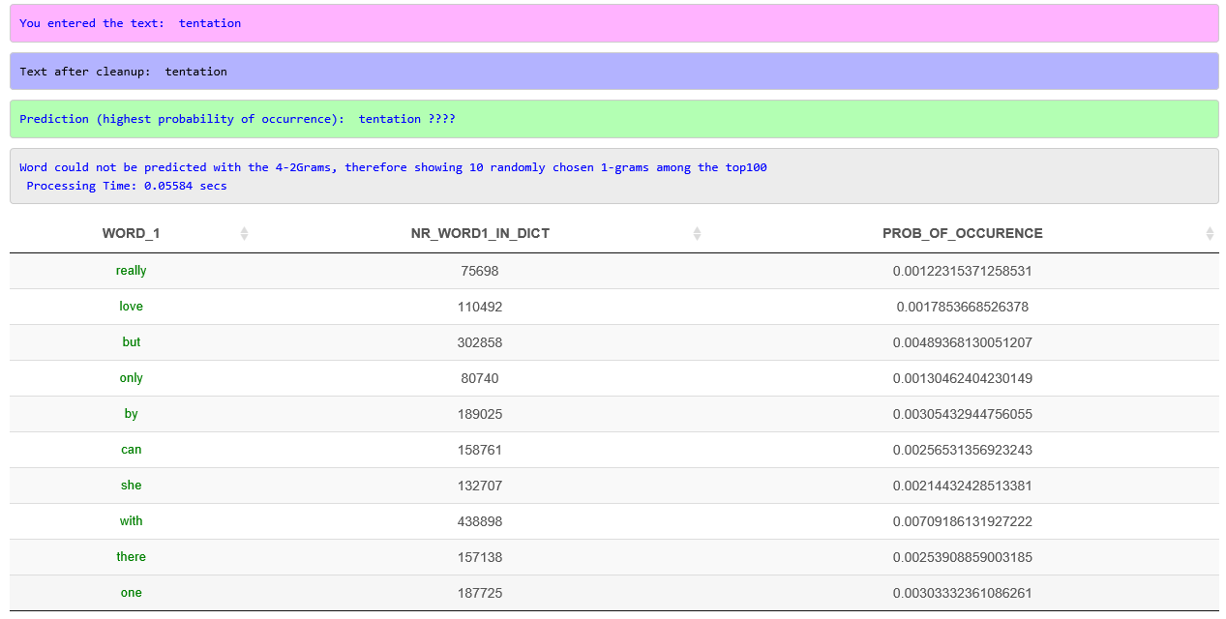

Slide 4
DownloadFiles.R
Data Acquisition
FREQUENCY DICTIONARIES
1-GRAM dictionary
SampleCreation.R
Data Sampling & Basic Cleanup
2-GRAMS dictionary
PredictWord.R
Create Predictive Text Product
(Shiny Application)
Build Predictive Text Model
NGrams.R
3-GRAMS dictionary
Corpus Creation
Corpus Data Cleanup
N-Grams Tokenization
Construct Document Feature frequency matrix
4-GRAMS dictionary
NGramsFreq.R
Build Dictionary files using NLP N-Grams Model with Kneser-Ney smoothing

Slide 5

Input
Sentence
(min. 1 word)
Load N_GRAMS Frequency Dictionary files
Extract last 3 words of the sentence
Clean Input Text
Nr words >=3
Search prediction in 4-GRAMS dictionary
Found ?
YES
YES
NO
Back-off to 3-Grams
NO
Nr words =2
Search prediction in 3-GRAMS dictionary
Found ?
YES
YES
Output
List of possible words with highest probability
NO
Back-off to 2-Grams
NO
Nr words =1
Search prediction in 2-GRAMS dictionary
Found ?
YES
YES
Output
List of randomly selected 1-Grams among top100 words
Back-off to 1-Gram

