Slide 1

Electro-Voice
FOUNDATIONS IN ELECTRICAL AND ELECTRONIC ENGINEERING (24EEE101)
SAHANA R - CB.AI.U4AIM24037
SIDDHARTH P -CB.AI.U4AIM24043
RAGUL U - CB.AI.U4AIM24036
SAIPRANAVI - CB.AI.U4AIM24035
THANUSHIKA SRI - CB.AI.U4AIM24034
PROJECT GUIDES
Mrs. Snigdhatanu Acharya
Mrs. Nalni D

Slide 2

01
INTRODUCTION
Overview of Deaf-Mute Communication Challenges
Communication Barriers​
Limitations of Traditional Systems
Need for Innovative Solutions

Slide 3
02
Problem Statement
How can we develop an effective solution to bridge the communication gap for deaf-mute-blind individuals, particularly in scenarios where visual methods like sign language or lip reading are impractical, or when the communication recipient is unfamiliar with sign language or has visual impairments, to enable seamless interaction and understanding ?

Slide 4
03
Objectives of Electro-Voice
Develop an accurate real-time speech-to-vibration translation system
Captures spoken words and converts them into distinct vibration patterns for tactile communication
Gets input from the impaired individual as morse code and converts it to text.
Promote Social Inclusion and Independence
Raise Awareness of Vibrotactile Technology

Slide 5

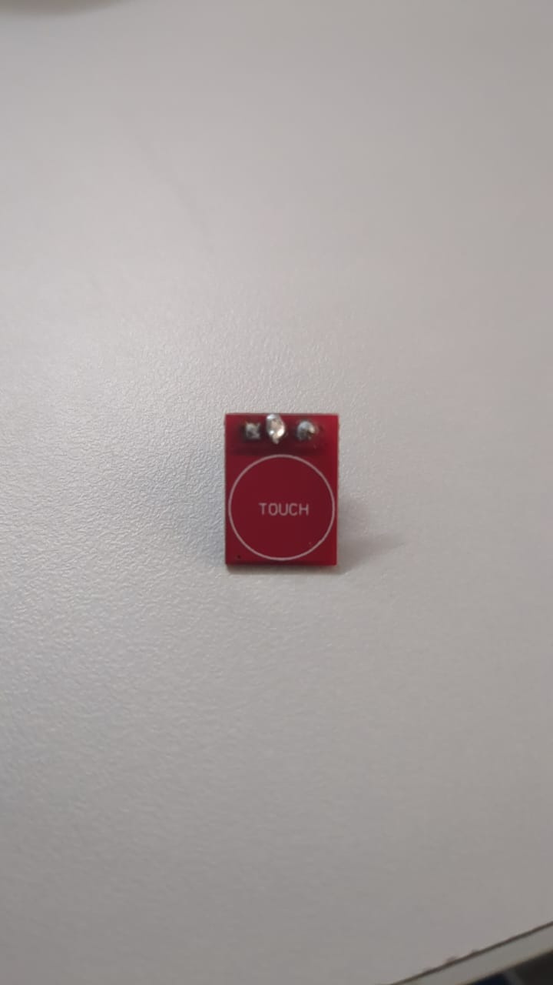
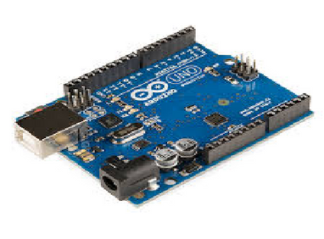
Methodology
04
Speech
(O/P)
Text
Button
(I/P)
Morse Code

Slide 6
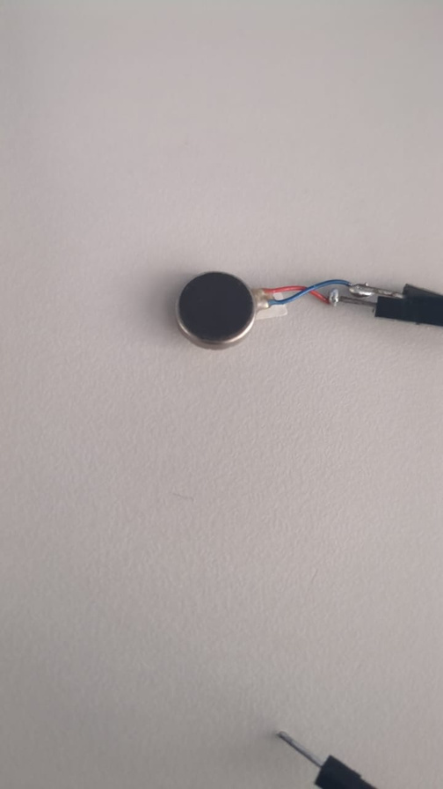
Methodology
05
Vibrations
(O/P)
Text
Speech
(I/P)
Morse Code

Slide 7
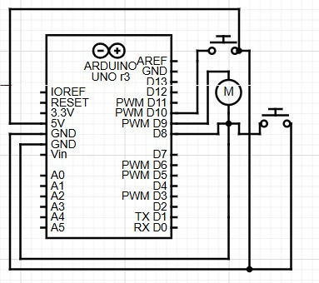
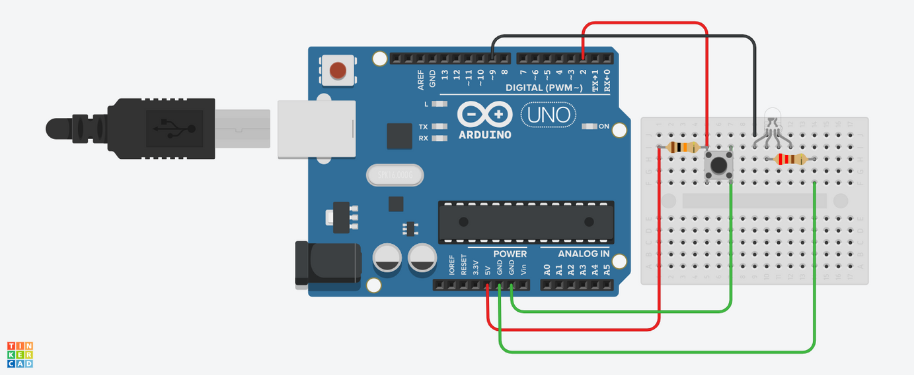
06
Circuit

Slide 8
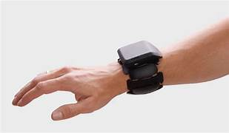
07
Future Scope
Integrate two features into one code
Improved Portability and Design : A compact wearable device
Use wireless connection to have the microcontroller elsewhere
Multi - Language support
Customization and Personalization

Slide 9
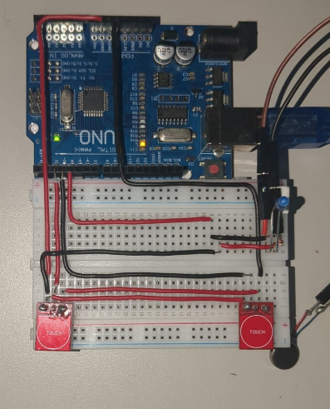
Prototype and Codes
08
Convert Audio to Vibrations
Touch to Audio
Arduino UNO

Slide 10
Thank you!

