Slide 1

Privacy-Preserving AI for Crowd Density Monitoring Capstone Project DANL 490 Mahdin Rahman, Heavyn Harper, Julian Flemons

Slide 2
Problem Statement
Public-health spaces struggle to monitor crowding and congestion.
Manual methods are inconsistent and resource‑intensive.
Goal: Develop a real-time, privacy-preserving crowd-density system.

Slide 3
Literature Review
Decentralized, privacy-aware CV models (Chen & Li, 2024).
Attention-based crowd counting (Lien et al., 2024).
AI in hygiene + infection control (Singh 2020; Hao 2023).

Slide 4
Data Sources
ShanghaiTech Crowd Counting Dataset (non-identifying).
UCF-QNRF (conceptual reference).
All datasets contain no facial recognition or PII.

Slide 5
Methodology
TinyCSRNet model for density-map regression.
PyTorch training with MSE loss, LR scheduling.
Streaming inference pipeline with no video retention.

Slide 6
Data Pipeline
Image preprocessing & normalization.
Density-map training.
Time-series conversion + rolling averages + MAD thresholds.

Slide 7
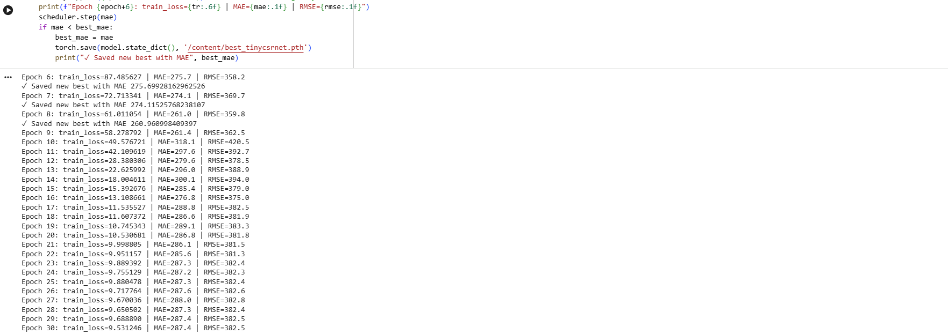
Model Results
MAE stabilized around ~260–300.
Predicted density maps align with GT structure.
Occupancy estimates fluctuate realistically across time.

Slide 8
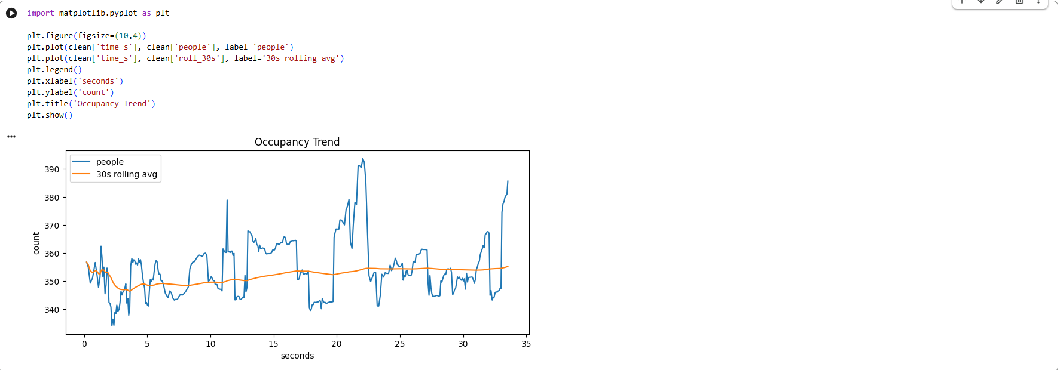
Python Visualization
Occupancy Trend Line Chart included.

Slide 9
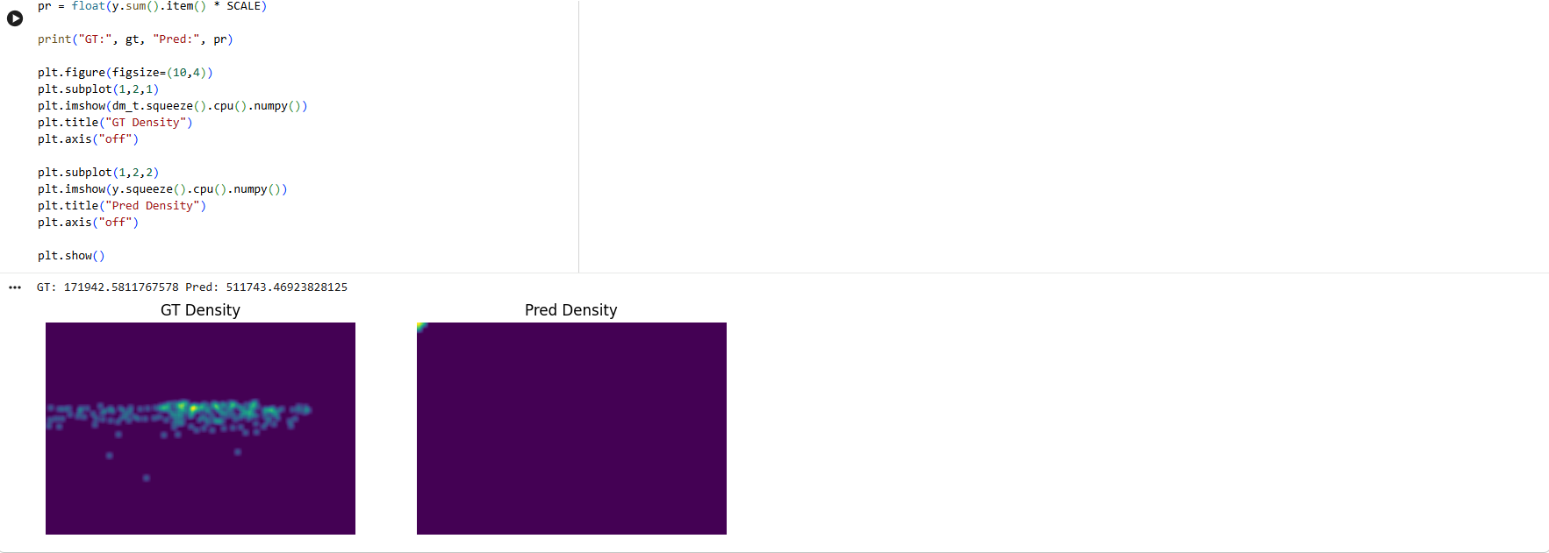
Density Map Comparison
GT vs Pred Density Maps included.

Slide 10
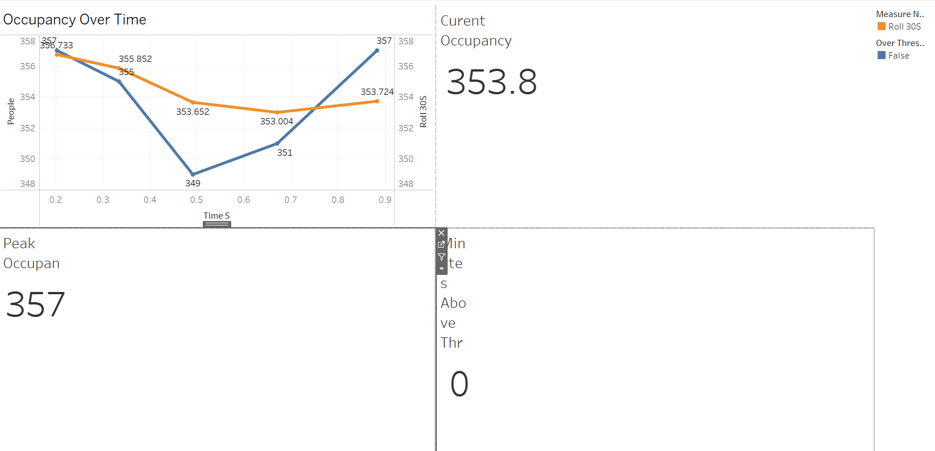
Tableau Dashboard
KPIs: Current Occupancy, Peak Occupancy, Alert State.
Trend lines + threshold detection.
Supports public‑health operational awareness.

Slide 11
Ethical Framework
No video storage, no faces, no identity inference.
NIST Privacy Framework + HIPAA-aligned handling.
Bias review + model documentation.

Slide 12
Conclusion
Prototype demonstrates feasibility.
Supports infection‑prevention readiness.
Future work: transfer learning, more datasets, deployment.

