Slide 1
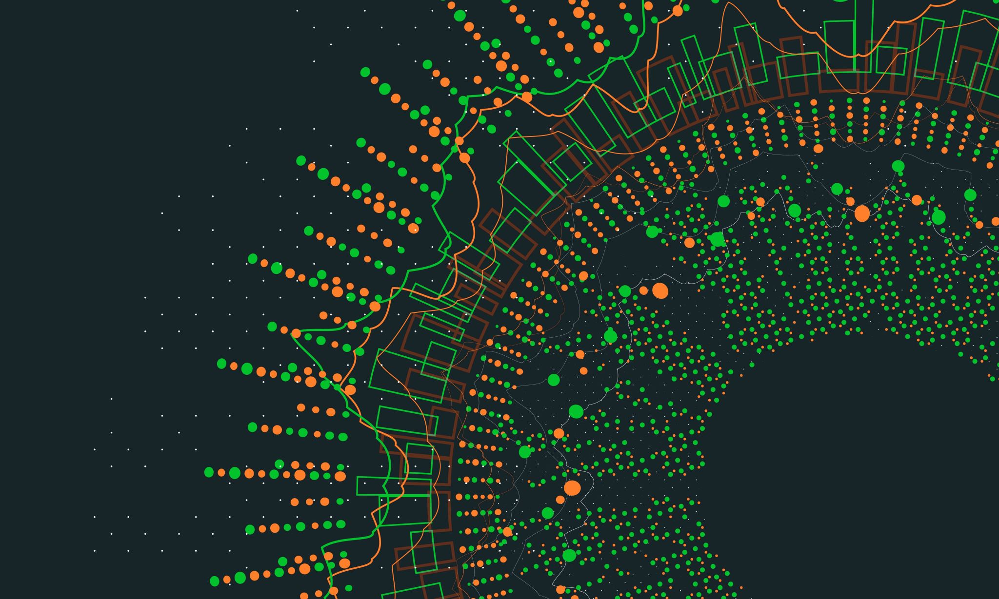
Ethereum
UNIT-5

Slide 2
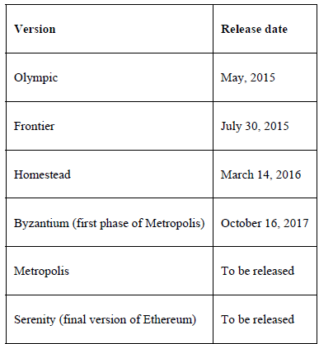
Introduction
The critical idea proposed was the development of a Turing-complete language that allows the development of arbitrary programs (smart contracts) for blockchain and decentralized applications. This concept is in contrast to Bitcoin, where the scripting language is limited in nature and allows only necessary operations. The different versions of Etherium are given in the table.

Slide 3
Ethereum – bird's eye view
In this section, we will see how Ethereum works from a user's point of view. There are several steps involved in this process, which are described here:
1. First either a user requests money by sending the request to the sender, or the sender decides to send money to the receiver. The request can be sent by sending the receivers Ethereum address to the sender.

Slide 4
2. Once the sender receives this request, he will either scan this QR code or copy the Ethereum address in the Ethereum wallet software and initiate a transaction. This process is shown in the following screenshot, where the Jaxx Ethereum wallet software on iOS is used to send money.
The following screenshot shows that the sender has entered both the amount and destination address for sending Ether. Just before sending the Ether, the final step is to confirm the transaction, which is also shown here:

Slide 5
3. Once the request (transaction) of sending money is constructed in the wallet software, it is then broadcast to the Ethereum network. The transaction is digitally signed by the sender as proof that he is the owner of the Ether.
4. This transaction is then picked up by nodes called miners on the Ethereum network for verification and inclusion in the block. At this stage, the transaction is still unconfirmed.
5. Once it is verified and included in the block, the PoW process starts.
6. Once a miner finds the answer to the PoW problem, by repeatedly hashing the block with a new nonce, this block is immediately broadcast to the rest of the nodes, which then verify the block and PoW.
7. If all the checks pass then this block is added to the blockchain, and miners are paid rewards accordingly.
8. Finally, Irshad gets the Ether, and it is shown in her wallet software.

Slide 6
The Ethereum network
The Ethereum network is a peer-to-peer network where nodes participate in order to maintain the blockchain and contribute to the consensus mechanism. Networks can be divided into three types, based on requirements and usage.
Mainnet
Mainnet is the current live network of Ethereum. The current version of the mainnet is Byzantium (Metropolis), and its chain ID is 1. Chain ID is used to identify the network. A block explorer that shows detailed information about blocks and other relevant metrics is available at https://etherscan.io. This can be used to explore the Ethereum blockchain.
Testnet
Testnet is also called Ropsten and is the widely used test network for the Ethereum blockchain. This test blockchain is used to test smart contracts and dApps before deployment to the production blockchain. Moreover, being a test network, it allows experimentation and research. The main Testnet is called Ropsten and includes all the features of other smaller, specialized Testnets created for specific releases.

Slide 7
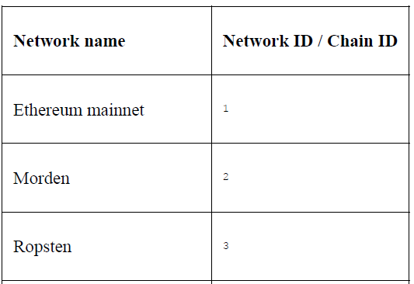
Private net
As the name suggests, this is the private network that can be created by generating a new genesis block. This is usually, the case in private blockchain distributed ledger networks, where a private group of entities starts their blockchain and uses it as a permissioned blockchain.
The following table shows the list of Ethereum network with their network IDs.

Slide 8
Components of the Ethereum ecosystem
The Ethereum blockchain stack consists of various components. At the core, there is the Ethereum blockchain running on the peer-to-peer Ethereum network. Secondly, there's an Ethereum client (usually Geth) that runs on the nodes and connects to the peer-to-peer Ethereum network from where the blockchain is downloaded and stored locally. It provides various functions, such as mining and account management. The local copy of the blockchain is synchronized regularly with the network. Another component is the web3.js library that allows interaction with the geth client via the Remote Procedure Call (RPC) interface.
This architecture can be visualized in the following diagram:

Slide 9
A formal list of all high-level elements present in the Ethereum blockchain is presented here:
Keys and addresses
Accounts
Transactions and messages
Ether cryptocurrency/tokens
The EVM
Smart contracts

Slide 10
Keys and addresses:
Keys and addresses are used in the Ethereum blockchain mainly to represent ownership and transfer of Ether. Keys are used in pairs of private and public types. The private key is generated randomly and is kept secret, whereas the public key is derived from the private key. Addresses are derived from the public keys, which are a 20-byte code used to identify accounts.
The process of key generation and address derivation is described here:
1. First, a private key is randomly chosen (256-bit positive integer) under the rules defined by the elliptic curve secp256k1 specification (in the range [1, secp256k1n − 1]).
2. The public key is then derived from this private key using the ECDSA recovery function. We will discuss this later in the next section, Accounts in the context of digital signatures.
3. An address is derived from the public key, which is the right-most 160 bits of the Keccak hash of the public key.

Slide 11
Accounts
Accounts are one of the main building blocks of the Ethereum blockchain. Ethereum, as a transaction-driven state machine, updates the state in response to account interactions and transaction execution. Operations performed between and on the accounts represent state transitions. The state transition is achieved using what's called the Ethereum state transition function, which works as follows:
1. Confirm the transaction validity by checking the syntax, signature validity, and nonce.
2. The transaction fee is calculated, and the sending address is resolved using the signature. Furthermore, the sender's account balance is checked and subtracted accordingly, and the nonce is incremented. An error is returned if the account balance is not enough.
3. Provide enough Ether (gas price) to cover the transaction cost. We will cover gas and the relevant concept shortly in this chapter. This is charged per byte, incrementally proportional to the transaction size. In this step, the actual transfer of value occurs. The flow is from the sender's account to the receiver's account. The account is created automatically if the destination account specified in the transaction does not exist yet. Moreover, if the destination account is a contract, then the contract code is executed. This also depends on the amount of gas available. If enough gas is available, the contract code will be executed fully; otherwise, it will run until it runs out of gas.
4. In cases of transaction failure due to insufficient account balance or gas, all state changes are rolled back except for fee payment, which is paid to the miners.
5. Finally, the remainder (if any) of the fee is sent back to the sender as change, and the fee is paid to the miners accordingly. At this point, the function returns the resulting state which is also stored on the blockchain.

Slide 12
Types of accounts
Two kinds of accounts exist in Ethereum:
Externally Owned Accounts (EOAs)
Contract Accounts (CAs)
The first type is EOAs, and the other is CAs. EOAs are similar to accounts in Bitcoin controlled by a private key. CAs are the accounts that have code associated with them, along with the private key.
Various properties of each type of account are described here:
EOAs has ether balance
They are capable of sending transactions
They have no associated code
They are controlled by private keys
Accounts contain a key-value store
They are associated with a human user

Slide 13
CAs:
CAs have Ether balance.
They have associated code that is kept in memory/storage on the blockchain.
They can get triggered and execute code in response to a transaction or a message from other contracts. It is worth noting that due to the Turing-completeness property of the Ethereum blockchain, the code within contract accounts can be of any level of complexity. The code is executed by the Ethereum Virtual Machine (EVM) by each mining node on the Ethereum network.
Also, CAs can maintain their permanent state and can call other contracts. It is envisaged that in the serenity release, the distinction between externally owned accounts and contract accounts may be eliminated.
They are not intrinsically associated with any user or actor on the blockchain.
CAs contain a key-value store.

Slide 14
Transactions and messages
A transaction in Ethereum is a digitally signed data packet using a private key that contains the instructions that, when completed, either result in a message call or contract creation.
Transactions can be divided into two types based on the output they produce:
Message call transactions: This transaction simply produces a message call that is used to pass messages from one contract account to another.
Contract creation transactions: As the name suggests, these transactions result in the creation of a new contract account. This means that when this transaction is executed successfully, it creates an account with the associated code.
Both of these transactions are composed of some standard fields:

Slide 15
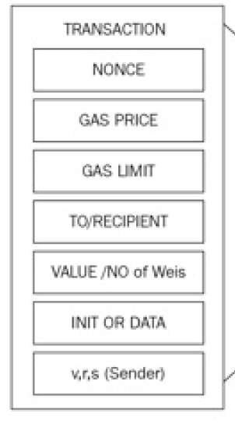
Nonce: Nonce is a number that is incremented by one every time a transaction is sent by the sender. It must equal the number of transactions sent and serve as a unique identifier for each transaction. A nonce value can only be used once. This is used for network replay protection.
Gas price: The gas price field represents the amount of Wei required to execute the transaction. In other words, this is the amount of Wei you are willing to pay for this transaction.
Gas limit: The gas limit field contains the value that represents the maximum amount of gas that can be consumed to execute the transaction.
To: As the name suggests, the to field is a value that represents the address of the recipient of the transaction. This is a 20-byte value.
Value: Value represents the total number of Wei to be transferred to the recipient; in the case of a contract account, this represents the balance that the contract will hold.
Signature: Signature is composed of three fields, namely v, r, and s. These values represent the digital signature (R, S) and some information that can be used to recover the public key (V).
Init: The Init field is used only in transactions that are intended to create contracts, that is, contract creation transactions. This represents an unlimited-length byte array that specifies the EVM code to be used during account initialization.
Data: If the transaction is a message call, then the data field is used instead of init, which represents the input data of the message call. It is also unlimited in size and is organized as a byte array.

Slide 16
Contract creation transaction (Parameters)
There are a few essential parameters that are required when creating an account. These parameters are listed as follows:
Sender
Original transactor (transaction originator)
Available gas
Gas price
Endowment, which is the amount of ether allocated
A byte array of an arbitrary length
Initialization EVM code
Current depth of the message call/contract-creation stack (current depth means the number of items that are already there in the stack)

Slide 17
Message call transaction (parameters )
A message call requires several parameters for execution, which are listed as follows:
The sender
The transaction originator
Recipient
The account whose code is to be executed (usually same as the recipient)
Available gas
Value
Gas price
Arbitrary-length byte array
Input data of the call
Current depth of the message call/contract creation stack

Slide 18
Messages
A message is a data packet passed between two accounts. This data packet contains data and value (amount of ether). It can either be sent via a smart contract (autonomous object) or from an external actor (externally owned account) in the form of a transaction that has been digitally signed by the sender.
Contracts can send messages to other contracts. Messages only exist in the execution environment and are never stored. Messages are similar to transactions; however, the main difference is that they are produced by the contracts, whereas transactions are produced by entities external to the Ethereum environment (externally owned accounts).
A message consists of the components mentioned here:
The sender of the message
Recipient of the message
Amount of Wei to transfer and message to the contract address
Optional data field (Input data for the contract)
The maximum amount of gas (startgas) that can be consumed
The following diagram shows the segregation between two types of transactions (contract creation and Message call) :

Slide 19
Calls
A call does not broadcast anything to the blockchain; instead, it is a local call to a contract function and runs locally on the node. It is almost like a local function call. It does not consume any gas as it is a read-only operation.
Transaction validation and execution
Transactions are executed after verifying the transactions for validity. Initial tests are listed as follows:
A transaction must be well-formed and RLP-encoded without any additional trailing bytes
The digital signature used to sign the transaction is valid
Transaction nonce must be equal to the sender's account's current nonce. Gas limit must not be less than the gas used by the transaction
The sender's account contains enough balance to cover the execution cost.

Slide 20
The Ethereum Virtual Machine (EVM)
EVM operation
Ethereum Virtual Machine (EVM) – Summary
The Ethereum Virtual Machine (EVM) is a stack-based execution environment that runs smart contract bytecode to change the blockchain state. It uses a 256-bit word size and a LIFO stack with a maximum of 1024 elements.
EVM is Turing-complete, meaning it can execute any computation, but execution is limited by gas, preventing infinite loops and denial-of-service attacks. It also supports exception handling, halting execution on errors like insufficient gas or invalid instructions.
EVM operates in a secure, sandboxed environment, with no access to external systems like networks or file systems. This ensures deterministic and secure execution of untrusted code.
There are two types of storage:
Memory: Temporary, cleared after execution (like RAM)
Storage: Permanent, stored on blockchain as a key-value store
Program code is stored in virtual ROM and copied to memory using the CODECOPY instruction. Execution is controlled by a program counter, and instructions are processed step by step using the stack.

Slide 21
Smart Contracts
A smart contract is a secure and unstoppable computer program representing an agreement that is automatically executable and enforceable.
Dissecting this definition further reveals that a smart contract is, in fact, a computer program that is written in a language that a computer or target machine can understand. Also, it encompasses agreements between parties in the form of business logic. Another fundamental idea is that smart contracts are automatically executed when certain conditions are met.
In summary, a smart contract has the following four properties:
Automatically executable
Enforceable
Semantically sound
Secure and unstoppable

Slide 22
Thank you

