Slide 1
Data loading in React.js
Repo: https://github.com/deepammi/LocofyFE
Framework: React.js
Sample data: table_from_database.csv (part of github repo) – please move this into a PostgreSQL table
3 Project tasks
User login creation
Data loading from PostgreSQL database (use csv file provided)
Make screens responsive – bonus effort

Slide 2
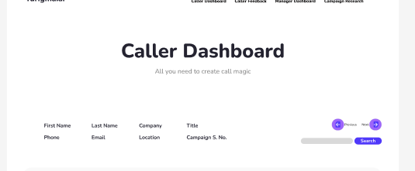
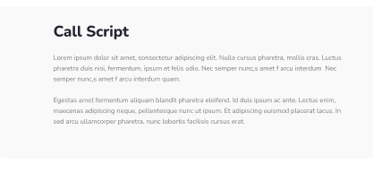
Record Display Menu
Using these arrows, pull different records (rows) from the database and display results in the fields shown including Call Script (last column in database)
Feel free to change the UX (left and right arrows) if they are not designed properly. I need arrows to move through the different records in the database.
Advanced feature: I want to be able to search the last name of the person and display the resulting record

Slide 3
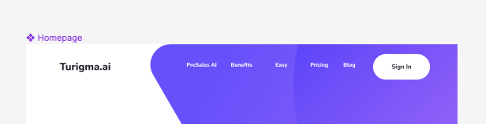
User Login
Create a simple Login feature that allows users to sign in.
Allow users to create a new login. It is ok to keep it very simple (no email verification etc.)
Allow users to reset their password

Slide 4
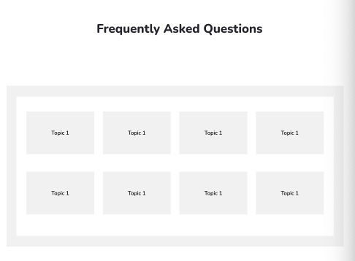
Populate each box with Q and A
Design each of these grey boxes like a button. By clicking them, we launch a text popup box. The title of the box is the Question and the popup box will show answers (from the selected row in the database)
For any given record selected (in the previous page), replace the title of these grey boxes from “Topic 1” to the text in Columns M, O, Q, S,U and W (q1 to q6). Leave last two boxes empty (as there are only 6 Q&A in the database but 8 boxes in the design – we will add more Q&A later)
The popup text box should show the answer from the columns N, P, R, T, V and X. Each popup box should have a close button to delete after reading.

Slide 5
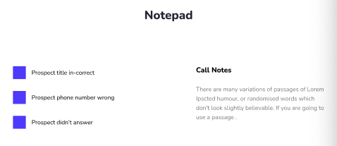
Notes fields
Add new columns in the database to store all the user entered data from this page
Each blue box is a check box with Y/N answer. If user checks the box, change database entry to Y. Else leave as N
Create data entry field with free form notes (up to 1000 characters). Add these to a new field called CallerNotes
Add a new button to this page called SAVE to force save all the notes to the database (this button is missing the current design). However try to make the save automatic also even if the user does not press SAVE
SAVE

Slide 6
Responsive Display
Some of the screen features (specially on Homepage) are not displaying properly when the width of the browser is reduced. Please try to see if you can display them properly so that the product looks professional.

