Slide 1
EMPLOYEE DATASET USING EXCEL
STUDENT NAME :RAHUL.B
REG NO :422200656
NAAN MUDHALVAN ID :ASUNM1429422200656
DEPARTMENT :B.COM(ISM)
SHIFT : 1
COLLEGE :ALPHA ARTS AND SCIENCE COLLEGE

Slide 2
TITLE : EMPLOYEE’S DATA FROM VARIOUS COMPANIES USING EXCEL.

Slide 3
AGENTA :
PROBLEM STATEMENT
PROJECT OVERVIEW
END USERS
OUR SOLUTION AND PROPOSITION
DATASET DESCRIPTION
MODELLING APPROACH
RESULTS AND DISCUSSION
CONCLUSION

Slide 4
PROBLEM STATEMENT:
THIS PROJECT STATE THE DETAILS OF EMPLOYEE’S DATA FROM VARIOUS COMPANIES ANALYSIS WITH USING OF EXCEL.

Slide 5
PROJECT OVERVIW:
THIS PROJECT SHOWS THE EMPLOYEE’S
DATA FROM DIFFERENT COMPANIES USING EXCEL.

Slide 6
WHO ARE THE END USERS:
ORGANISATION PEOPLES ARE THE EBND USERS OF THIS ANALYSIS WHICH NAMED AS EMPLOYEE’S DATA FROM DIFFERENT INDUSTRIES WITH USING EXCEL.
EXAMPLE: MANAGERS,EMPLOYERS,EMPLYEES.

Slide 7
Our solution and its valie proposition
Filtering-remove ,missing values.
Sorting-smallest to biggest.
Conditional formatting-remove blank values.
Pivot table-summary of employee’s salary.
Groups-final reports.

Slide 8
Dataset description
Kaggle-employee datasaet
36 features
Considering features are below;
Profession
Industries
Business
Gender
Way
Grey wages
Annual income,etc.,

Slide 9
The “wow” in our solution
Employee’s data has been calculated using excel is considered.

Slide 10
Modeling :
Step :1: dataset collection
Step:2: dataset preparation:
Cleaning
Filtering
Conditional formatting
Insert pivot table
Insert graphs for final result
Step:3:employee’s data calculated

Slide 11
modeling
Step: 4:insert pivot tavble for given dataset
Step:5:insert graph chart for showing final report of employee’s data
Step:6:summarization of employee’s data based on their way, grey wage, education, gender…..data visualization using bar chart.

Slide 12
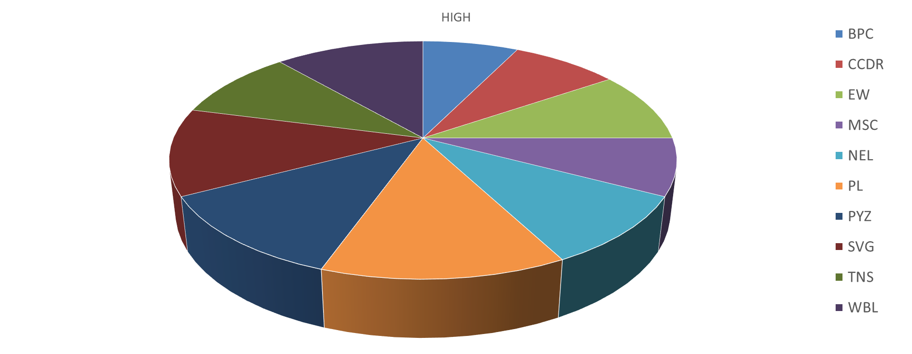
Pie chart result

Slide 13
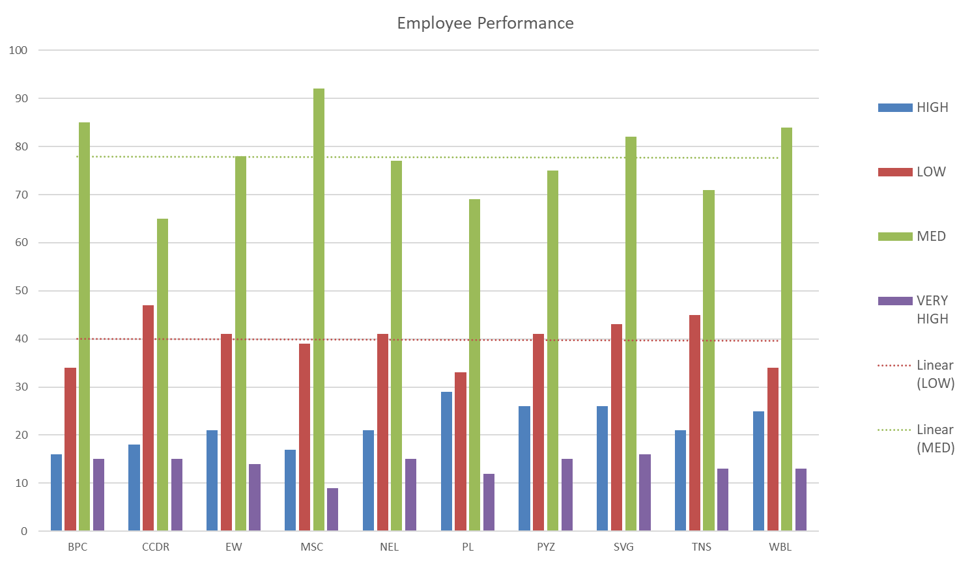
Graph result

Slide 14
conclusion
This project explain the employee’s from different data industries like way, grey wages, education, gender, data visualization ,etc., with using of excel.
This is benefit for organization growth and employee’s work improvement.

