Slide 1

Factors which lead the young talents to leave India and the future consequences of it.
Rahul ELDHO BIJOY
Date of Defense:13/12/2023
Name of Supervisor: Saeed VARASTEH YAZDI

Slide 2



INTRODUCTION
India is projected to experience a yearly economic growth rate of 7.2% in 2022, positioning it as one of the world's fastest-growing economies, recognized for its technological, healthcare, and educational advancements, which can be attributed to its cultural heritage, growth of the middle class, and a business environment that encourages innovation and success.
India’s startup ecosystem has experienced growth over the years,
with the number of startups increasing from 200 in 2010 to over 100,000 in
2022 “Indian Tech Startup Funding Report 2021”. Furthermore, India currently boasts a countof 100 unicorns as of May 2022
STILL…………
Despite successes, India faces the challenge of "brain drain.“
Brain drain is the departure of educated or professional people from one country, economic sector, or field for another usually for better pay or living conditions.

Slide 3



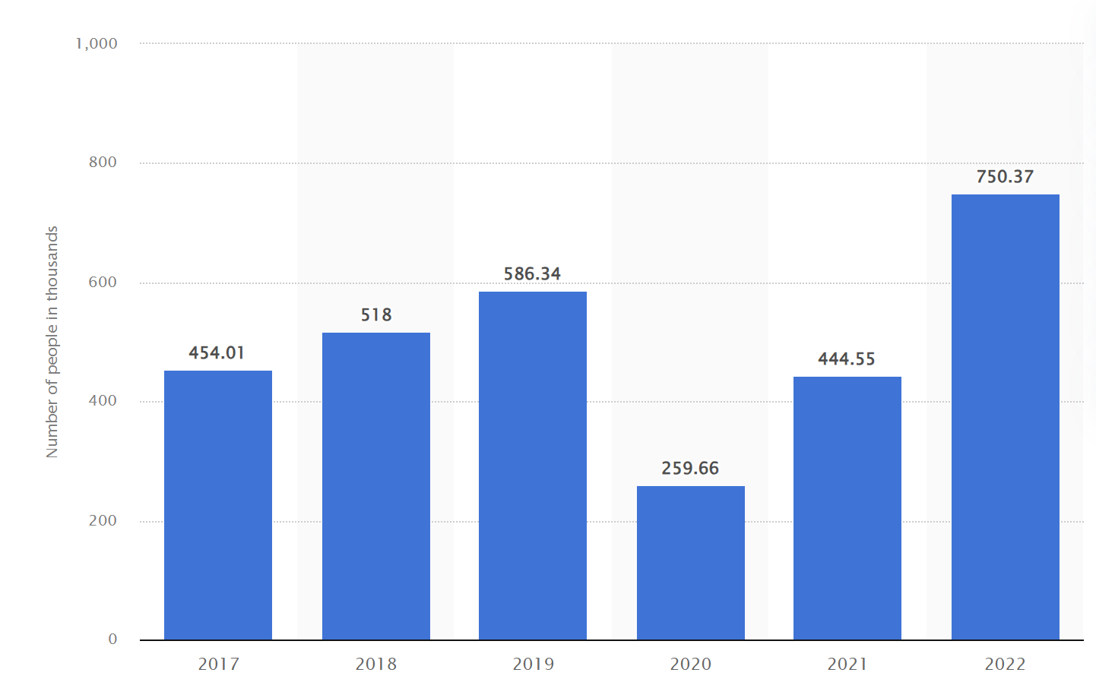
MOTIVATION AND SIGNIFICANCE FOR CHOOSING THE TOPIC
MOTIVATION
As an international student, I witnessed a noticeable surge in individuals relocating abroad and opting for permanent residency, with many relinquishing their Indian citizenship.
Personal Observations: Through personal experiences, observed instances where friends and family members decided to migrate to countries like Canada, the UK,USA sparking curiosity about the underlying factors propelling this trend.
SIGNIFICANCE OF THIS TOPIC
Global Migration trends : United Nations findings reveal that 3.25% of individuals currently reside in foreign lands, primarily driven by gainful occupation—a figure expected to rise to 3.6% by 2020.
Indian Student Emigration: Statista data for 2022 highlights a significant trend, with 750,000 Indian students leaving their country to pursue education.
Remittances inflow to India: Understand how the remittances of the india affect the economic development of India
Figure: The number of students studying abroad from 2017 to 2022 Source: Statista

Slide 4


OBJECTIVES OF MY THESIS
Understanding Motivations for Migration: Investigating the fundamental motivations and push factors that lead individuals to leave their home country provides insights into the factors influencing migration decisions.
Analyzing human capital’s role in the Indian economy: Understand the role of human capital in Indian economic growth through literature review.
Understanding the pull factors and implementing brain gain strategies: Analyze the reasons behind the departure of Indian expats, and institute strategies to enhance brain gain by bolstering educational opportunities, fostering entrepreneurship, and improving work-life balance.
Apply analytical skills to understand the factors of brain drain: Apply the skills learned in MSc and explore the options in the methodological section.

Slide 5


LITERATURE REVIEW – Determinants of Brain Drain Phenomenon
OVERVIEW
Migration is influenced by factors like inadequate institutions, policies, disparities, and limited opportunities in developing nations.
Addressing brain drain requires a comprehensive strategy involving education, employment opportunities, and facilitating the return of skilled professionals.
Institutions, policies, and social capital play a crucial role in encouraging or discouraging migration. Poor institutional structures and government policies contribute to brain drain, hindering the potential of skilled workers.
Developing effective policies requires an understanding of the dynamic features involved, referencing substantial academic research

Slide 6


LITERATURE REVIEW – Determinants of Brain Drain Phenomenon
Institutions
Governmental establishments, governing corruption and economic progress, significantly influence brain drain. Weaknesses in these institutions can make India less attractive for highly skilled laborers, prompting them to seek opportunities elsewhere.
Insubstantial economic establishments, including limited access to venture capital, pose challenges for skilled laborers in establishing and expanding businesses.
Informal/Private establishments, such as corruption and systemic biases, obstruct highly skilled laborers from realizing their full potential. Issues like corruption, increase business costs, impeding success, while biases like racial or tribal discrimination limit equal opportunities, driving skilled individuals away.
Policies
Weak institutional quality contributes to brain drain, with policies playing a crucial role in shaping a country's economic trajectory.
Henry and Miller's analysis* emphasizes that macroeconomic policies can impact a nation more than the broader institutional framework.
Brain drain is influenced by wage disparities between countries of origin and destination. Policies have an equal impact on a country's wealth as institutions, emphasizing that unfavourable policies can hinder economic growth and drive skilled individuals to seek better prospects elsewhere.
*Ernst, S. (2015). The paradox of high-skilled migration: Is the brain drain the best antidote to the brain drain?

Slide 7


LITERATURE REVIEW – Determinants of Brain Drain Phenomenon
Social Capital Analysis
Ronald Land S Young* emphasizes social capital as a crucial factor in the brain drain phenomenon and evaluation metrics include the Freedom House Score, Human Development Index, and GDP Purchasing Power Parity.
Social capital, in this context, refers to resources acquired through interpersonal connections. Inadequate global connections pose challenges for businesses to meet the evolving demands of affluent nations, affecting a country's economic potential.
Lack of social capital may lead to economic stagnation, prompting the departure of highly skilled workers seeking better opportunities abroad.
Other déterminants for brain drain
Jared Diamond* emphasizes the substantial influence of terrain and biogeography on global living norms, challenging the notion that terrain is the ultimate independent variable impacting living norms.
The presence of free and prosperous nations abroad acts as a strong magnet, contributing to brain drain.
*PBS interview 2005 Jared Diamond https://www.pbs.org/gunsgermssteel/about/interview.html and https://www.jstor.org/stable/10.5305/procannmeetasil.105.0415

Slide 8

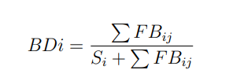

LITERATURE REVIEW – Contribution of human capital in economic development
Brain drain analysis of India by brain drain index
.
Scholars such as Mark Rosenzweig (2006)* have taken the lead in reinterpreting the data, utilizing
the World Bank Migration Database to introduce two metrics for analyzing the brain drain.
The first metric is as follows: W where BDi: This is the Brain Drain Index for the origin country i
∑F Bij: This denotes the count of individuals aged 25 and over who have received post-secondary education and were born in the nation i, presently residing in the nation j.
Si: This is the total number of tertiary-educated people residing in the origin country i
In the Brain Drain Index(BDI) for India, which is roughly 0.3846 suggests that India experiences a moderate level of brain drain
Considers both foreign-born residents educated in India and Indian residents educated abroad we calculate dual brain drain index
∑F BHij (the number of foreign-born residents educated in India and living in other countries) and Si (the total no of tertiary-educated individuals in India) and ∑SF Bij (the estimated range for the count of Indian citizens living in their home country who have received education in foreign countries
Based on world bank and governmental data on the information provided, the Dual Brain Drain Index (DBDi) for India is estimated to be approximately 0.2794
*Traditional Institutions Meet the Modern World: Caste, Gender, and Schooling Choice in a Globalizing Economy https://www.jstor.org/stable/30034337

Slide 9


LITERATURE REVIEW – Contribution of human capital in economic development
Role of human capital in India’s development
The Mankiw-Romer-Weil iteration of the Solow Model represents an enlargement that integrates the notion of accumulating human capital as a crucial factor in propelling economic progress.
In the Solow Model, which was formulated by Mankiw, Romer, and Weil, where
Y(t): Output or Gross Domestic Product (GDP) at time
K(t): Physical capital (machinery, buildings, infrastructure) at time
H(t): Human capital or knowledge at time
L(t): Labor or workforce at time
A(t): Labor-enhancing technology or total factor productivity at time
α: Output elasticity of capital, representing the share of income attributed to physical capital.
β: Output elasticity of human capital, representing the share of income attributed to human capital.
India possesses a significant measure of human capital, influencing economic development. A decrease in human capital leads to a corresponding decrease in overall economic output.
Skilled immigrants moving from less prosperous nations to the West without repatriating or investing in their home countries create a "human capital grant."
The grant, funded by the migrants' home governments, poses challenges as these skilled individuals may not contribute back to their countries, resulting in a potential loss of capital investment and benefits for the countries of origin.

Slide 10

LITERATURE REVIEW – Employment opportunities In India
Significant of Employment in economy
India faces challenges in providing job satisfaction for skilled labor due to high unemployment rates, reaching 7.1%, which translates to 53 million people unemployed as of December 2021.
The issue extends beyond job scarcity to a mismatch between individuals' skills and available opportunities, intensifying competition and limiting desirable job options.
Persistent factors like gender and caste discrimination further complicate the employment landscape, impacting individuals' access to opportunities.
Research on the Indian economy's dynamics, particularly the inverse relationship between unemployment and inflation, underscores the complexity of addressing these challenges and emphasizes the need for effective strategies to reduce unemployment and manage inflation.

Slide 11


LITERATURE REVIEW – Employment opportunities In India
Analysing work culture in India
The distinct work culture in India, characterized by hierarchical structures and indirect communication, contributes to the brain drain issue by stifling innovation and causing burnout.
The collectivist nature of Indian workplaces, prioritizing group interests, contrasts with Western individual-centric approaches, potentially affecting professionalism and work boundaries.
Job insecurity is prevalent in India, with almost half of employees feeling insecure, especially among Gen Z workers. This anxiety is exacerbated by economic instability and concerns about the impact of artificial intelligence on employment.
To address brain drain and job insecurity, fostering a more inclusive, innovative work culture and providing reassurance to employees about their value and future prospects are crucial for India's economic stability and growth.

Slide 12

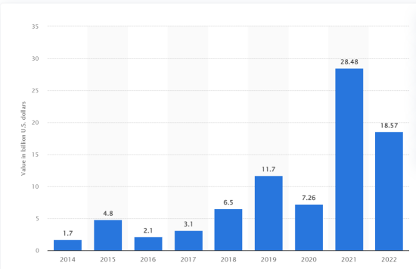

LITERATURE REVIEW – Analysis of Venture capital in India for Entrepreneurship
The relationship between venture capital and brain drain becomes evident as skilled individuals returning to India bring global networks and financial support, emphasizing the impact of skilled migration on the startup ecosystem.
The evolving trend indicates that venture capital, influenced by skilled migration, contributes to the global innovation scene, showcasing a shift from brain drain to brain gain and supporting entrepreneurial activities within a nation.
In the Indian venture capital landscape, emerging trends include a focus on early-stage ventures, the integration of advanced technologies, a rise in Corporate Venture Capital (CVC), increased global investment, and a growing emphasis on sustainability, bringing both opportunities and challenges in 2023
Figure: Value of venture capital start-up investment deals across India from 2014 to 2022 Source: Statista

Slide 13
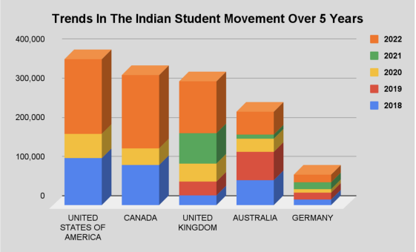
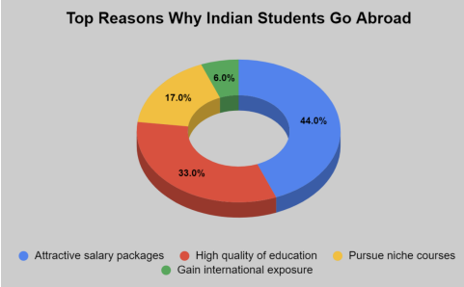
LITERATURE REVIEW – Indian education system and policies
India leads global immigration, with two-thirds of emigrants highly educated, highlighting a prevalent Brain Drain phenomenon
Dissatisfaction with the Indian education system's preparation for a globalized world is evident, contributing to a 7.9% unemployment rate and societal challenges.
Over 1.1 million Indian students study abroad, driven by dissatisfaction with domestic education, and destinations like the US, UK, Canada, Australia, and Germany are popular.
Reasons for studying abroad include multicultural experiences, attractive salary packages, high-quality education, pursuit of specialized courses, and international exposure, shaping a comprehensive perspective for Indian students.
Figure: : Reasons for students going abroad
Source: Oxford International Digital Institute
Figure: Number Of Indian Students Going Abroad Over The Past 5 Years Source: Data from Rajya Sabha by the Ministry of External Affairs

Slide 14
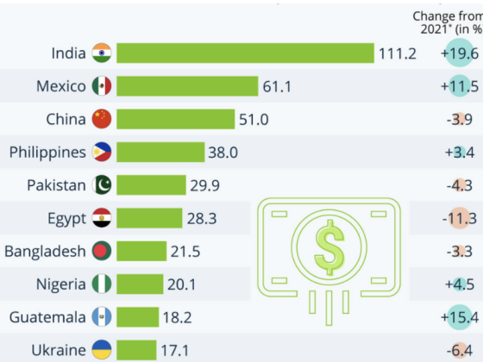
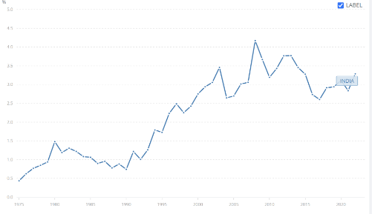
LITERATURE REVIEW – Remittances to India from foreign residents
India is a major recipient of global remittances, with an annual amount reaching around US$55.0 billion, and it consistently maintains a leading position, receiving approximately US$72.2 billion in 2015.
Remittances play a crucial role in the welfare of migrant families, the balance of payments in the home country, and the economic growth of developing nations, providing increased incomes, stable consumption patterns, financial resources, and knowledge for entrepreneurial endeavors.
The latest data indicates a substantial growth in remittance payments, with India experiencing a remarkable 19.6 percent increase in 2022, emphasizing the dynamic nature of the remittance landscape.
The upward trend in the percentage of GDP attributed to personal remittances from 1960 to 2022 underscores the enduring influence of international migration on India's economic landscape, showcasing migrants as essential contributors to the country's economic development.
Figure :Countries receiving the most remittances among low and middle income nations in 2022 in billion dollars
Source: : Knomad Via World Bank
Figure: Personal remittances recieved( percentage of GDP) - India Source: Word Bank

Slide 15

RESEARCH METHODOLOGY – Hypothesis of research questions
The main goal of this master's thesis is to delve into the complexities of brain drain, studying its dynamics and assessing its effects on the Indian economy
The central hypothesis that guides this study postulates that the ongoing brain drain phenomenon from India significantly contributes to economic downturns and simultaneous disruptions in family relationships.
In light of this, it is critical to acknowledge that the skilled workers who are departing the nation in search of better opportunities abroad are permanently staying abroad losing the citizenship since India doesn’t allow dual citizenship

Slide 16






RESEARCH METHODOLOGY – Methodology
Overview
Comprehensive survey analysis using World Bank statistics, government data, and survey responses.
Utilizes a mixed-methods approach, combining quantitative data with narrative descriptions for a holistic understanding of brain drain implications.
Survey Participants and Objectives
Surveys two distinct cohorts: individuals in India and those residing abroad. Focuses on factors influencing residency decisions, aiming to identify both push and pull factors affecting participants' choices.
Data Collection and Analysis
Designed survey instrument gathers demographic, professional, and migration decision data.
Administered through Microsoft Forms, the survey collected responses from a diverse range of 90 participants
Employs Python programming language for data analysis, utilizing Pandas, NumPy, and Plotly for thorough examination of trends and patterns. Descriptive analytics techniques reveal insights into the brain drain phenomenon.

Slide 17

RESEARCH METHODOLOGY – limitations of study
The survey's reliance on self-reported data introduces the potential for bias or inaccuracies, as participants may provide subjective opinions instead of objective facts.
The survey's sample may not be representative of the larger population in India affected by brain drain, limiting the broad applicability of the results.
The absence of open-ended questions in the survey hinders a thorough exploration of nuanced factors influencing migration decisions, limiting contextual understanding
Cultural, societal, and linguistic issues in India may pose challenges in interpreting survey responses, impacting the precision of comprehension regarding the phenomenon of brain drain.

Slide 18
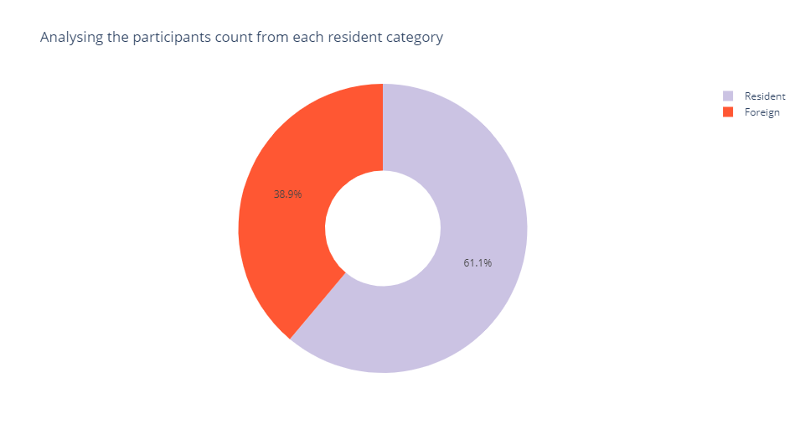
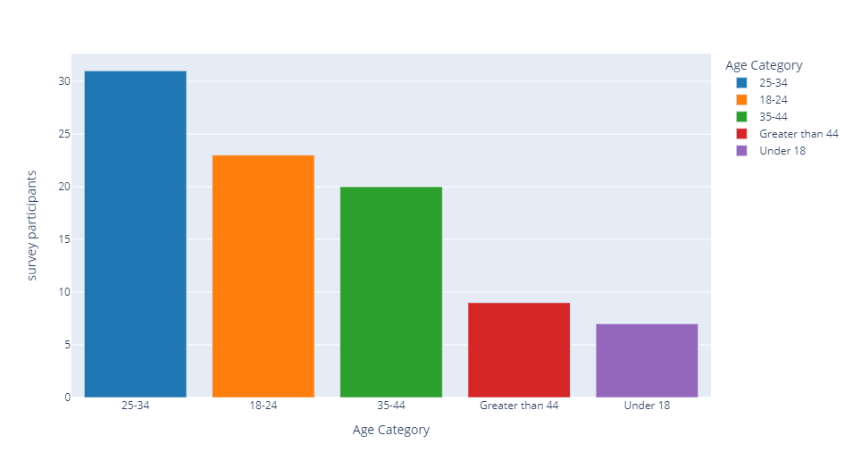
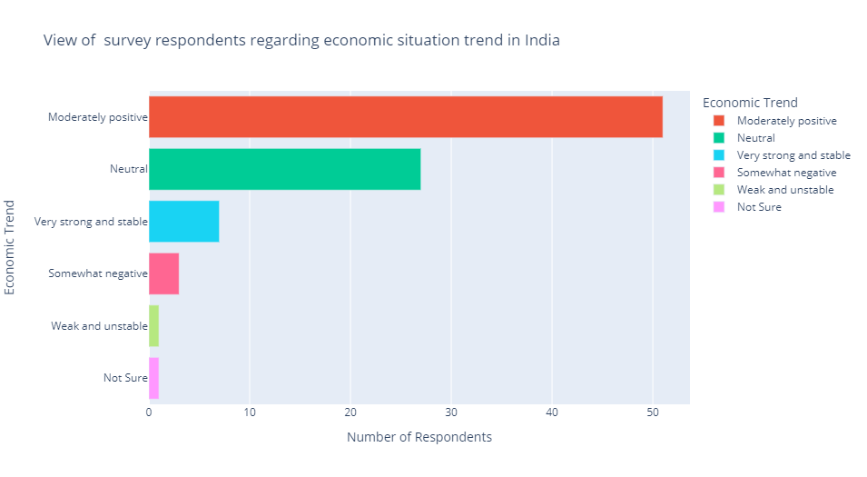
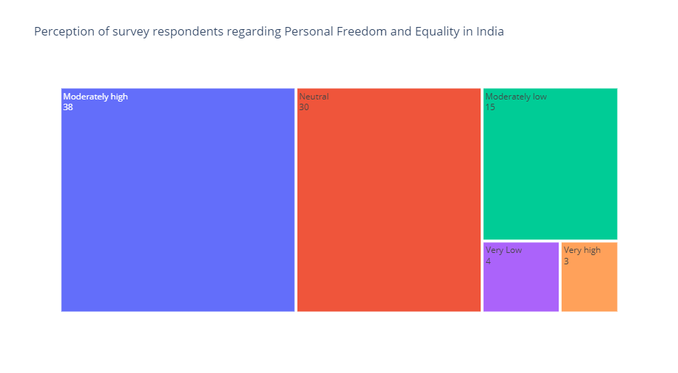
RESULT ANALYSIS OF SURVEY – General analysis
The survey reveals diverse employment statuses among participants: 48.9% actively employed, 37.8% in educational pursuits, 10% experiencing unemployment, and others retired, both in India and overseas.
Out of the survey participants 61.1% are staying at India and 38.9% are staying abroad which helps to understand the push and pull factors.
Mostly younger generation are participated in my survey study acroos all the survey participants.
All of them have very positive response for the ecoonomic growth in India and personal freedom

Slide 19
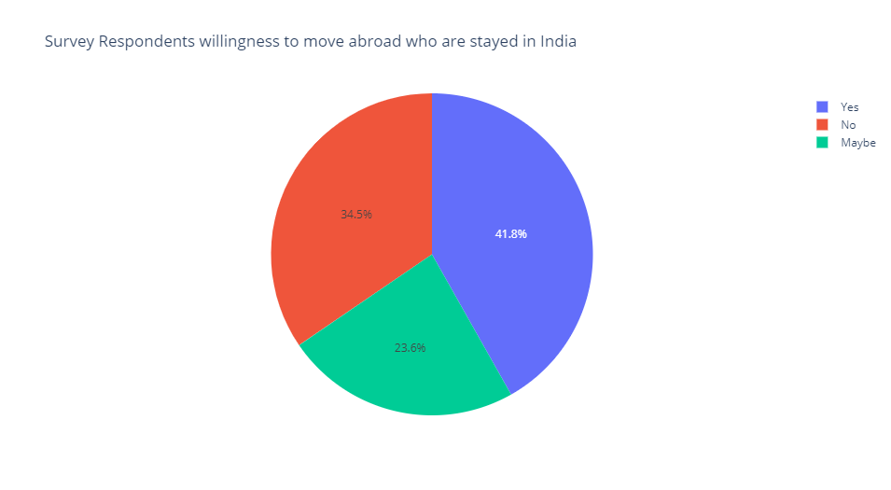
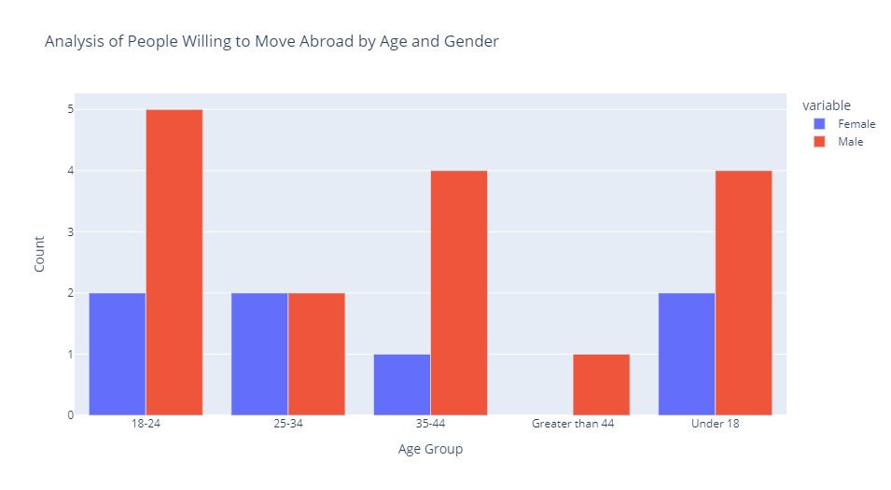
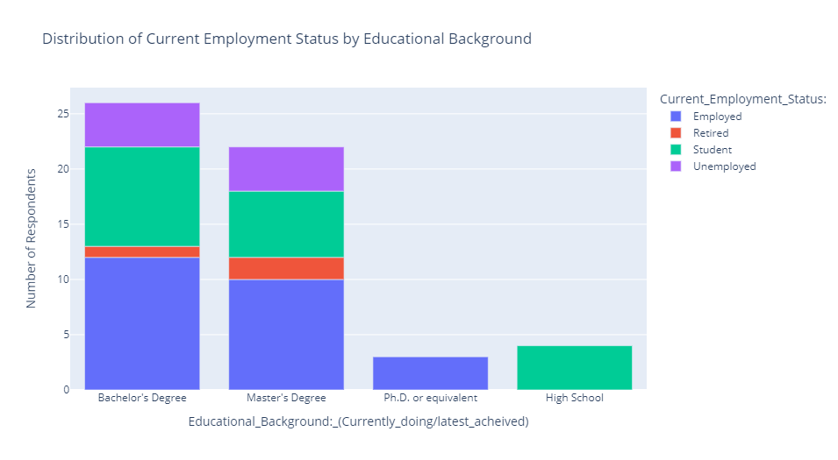
RESULT ANALYSIS OF SURVEY – Analyzing pull and push factors of Indian citizens who reside in India
Surveying 55 Indian participants residing in India, 41.8% expressed a desire to move overseas, while 34.5% lacked interest and 23.6% were uncertain about migration.
Gender differences were observed, with more males indicating a willingness to move abroad. This suggests potential connections with factors like career opportunities, familial responsibilities, or societal expectations.
Educational background analysis showed that the brain drain phenomenon, linked to the exodus of highly educated individuals

Slide 20
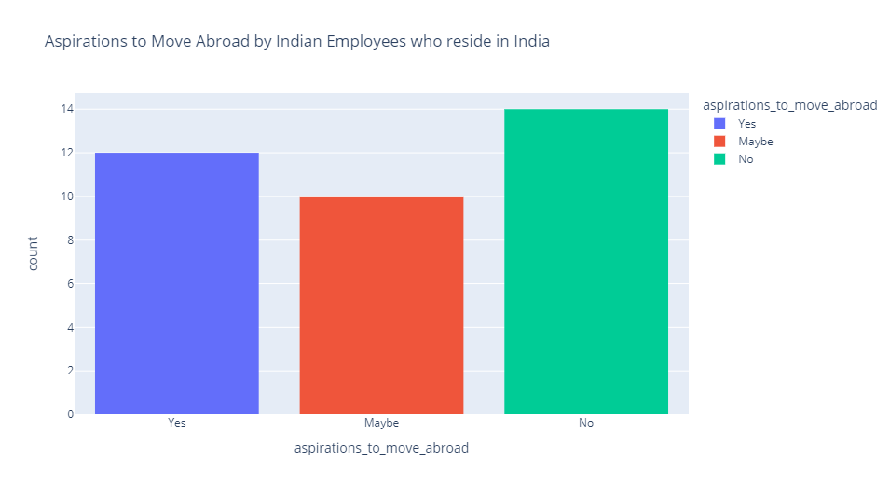
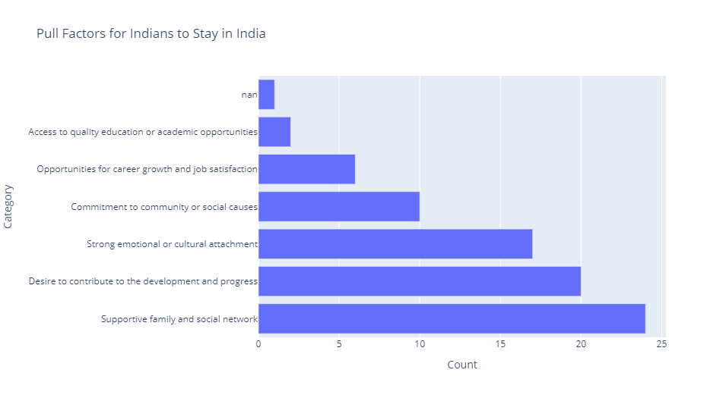
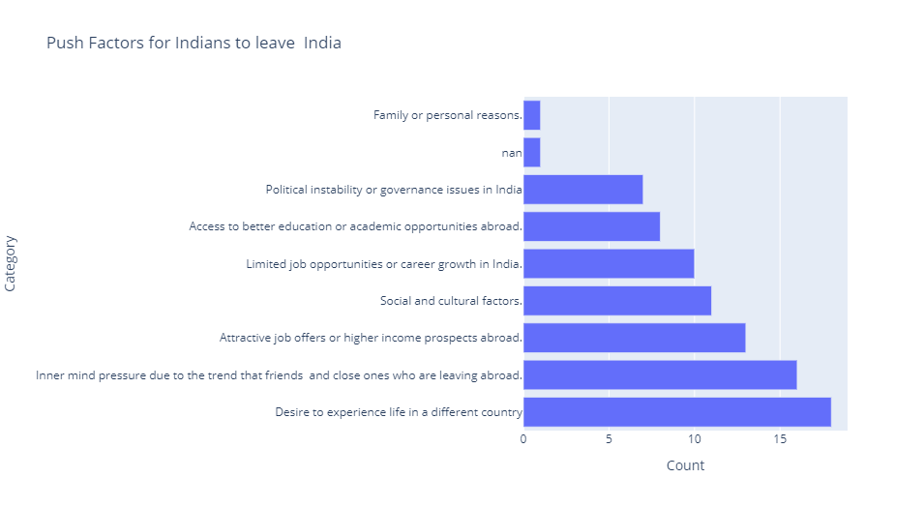
RESULT ANALYSIS OF SURVEY – Perception of Indian employees reside in India
A survey involving 36 respondents from various occupations, including IT specialists, government employees, healthcare workers, business owners, and retirees,
Among the respondents, 12 individuals considering migration don't strongly wish to stay in India, while 14 (38% of the sample) prefer not to move abroad, indicating a mix of sentiments
Factors influencing migration decisions are intricate, encompassing considerations like the standard of living, employment prospects, and both encouraging and discouraging elements, collectively shaping people's choices
Pull factors encouraging individuals to remain in India include supportive social networks, a desire to contribute to the nation, and emotional attachments.

Slide 21
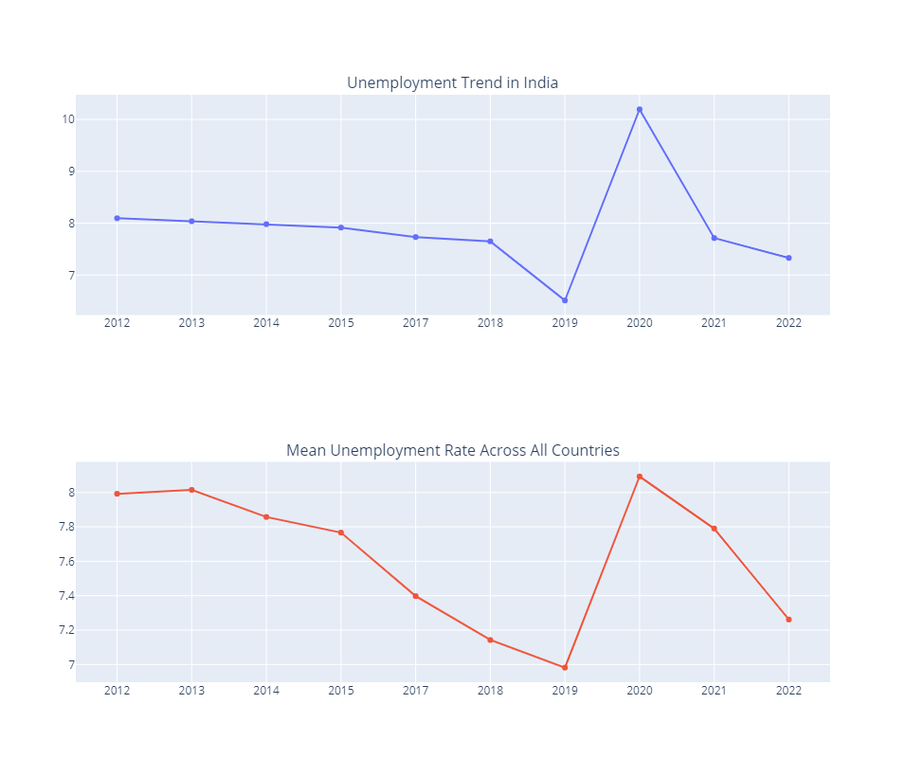
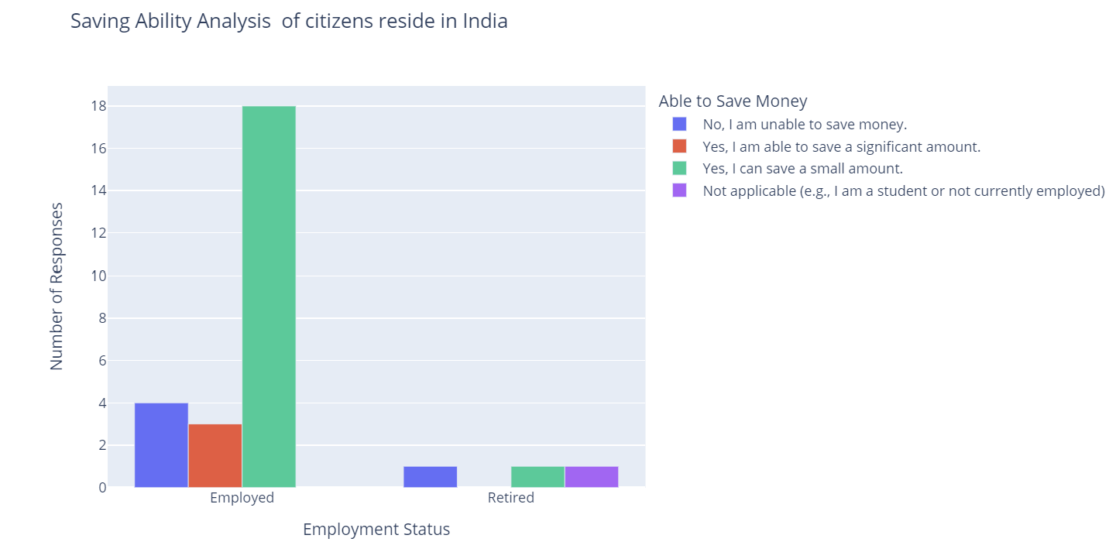
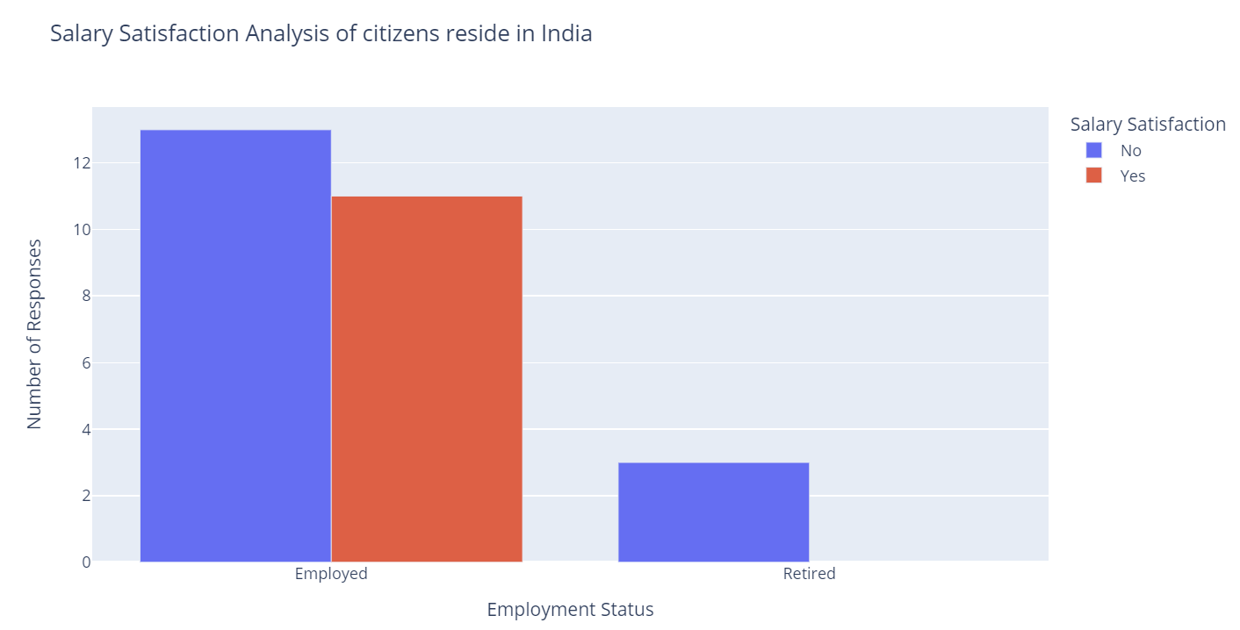
RESULT ANALYSIS OF SURVEY – Perception of Indian employees reside in India
Survey data is supplemented by an analysis of the unemployment rate in India from 2012 to 2022, revealing a mean unemployment rate of around 7% and an unemployment rate of India fluctuating between 7% and 8%.
The findings emphasize the need for nuanced strategies addressing the challenges of brain drain, considering the interplay between personal aspirations, societal commitments, and economic opportunities to retain talent, foster domestic growth, and mitigate adverse effects on India’s workforce and intellectual capital.

Slide 22
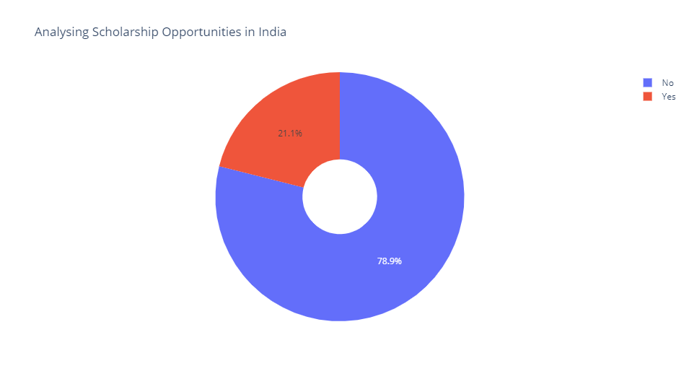
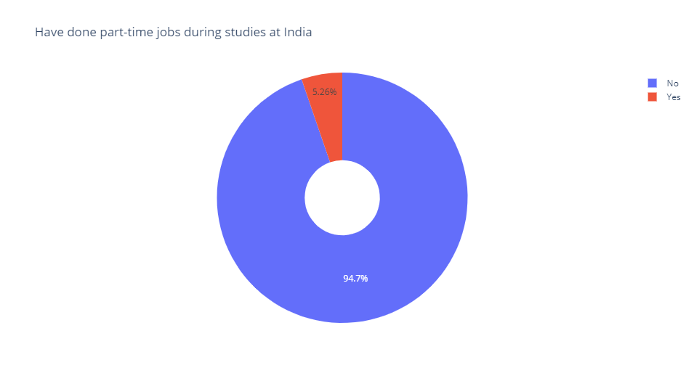
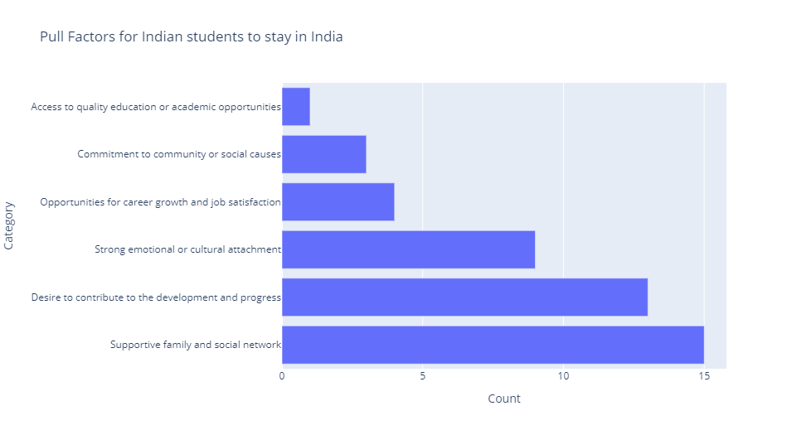
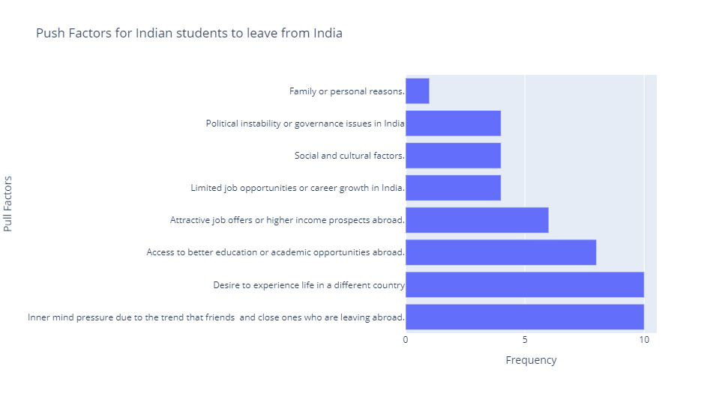
RESULT ANALYSIS OF SURVEY – Perception of Indian students reside in India
Among 19 surveyed Indian students, 11 express a strong desire to move to another country, prompting an examination of factors influencing this migration inclination.
A significant 78.9% of respondents cite limited access to scholarship opportunities as a financial constraint, impacting their ability to pursue studies abroad, especially as 94% face challenges in taking part-time work due to busy schedules.
Factors anchoring students in India are primarily familial and cultural, with a strong sense of commitment, patriotism, emotional and cultural attachments, and a desire to contribute to India’s development
Influences pushing students toward considering international moves include inner pressures from the migration experiences of friends or relatives, emphasizing the impact of social networks on decision-making. Additionally, the allure of new cultures and superior academic opportunities abroad plays a substantial role.

Slide 23
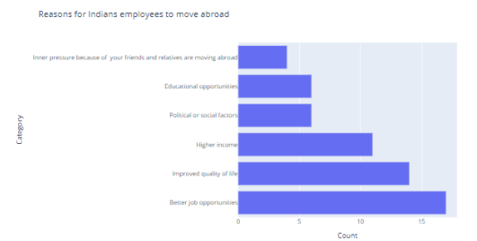
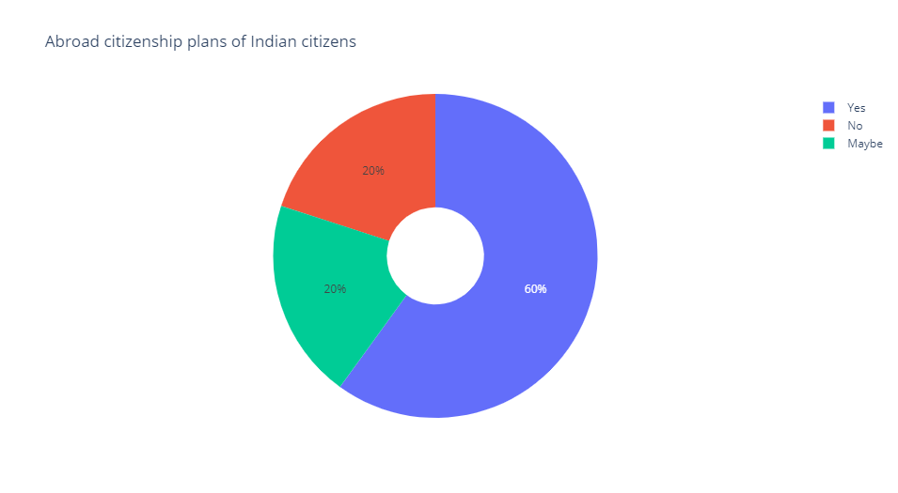
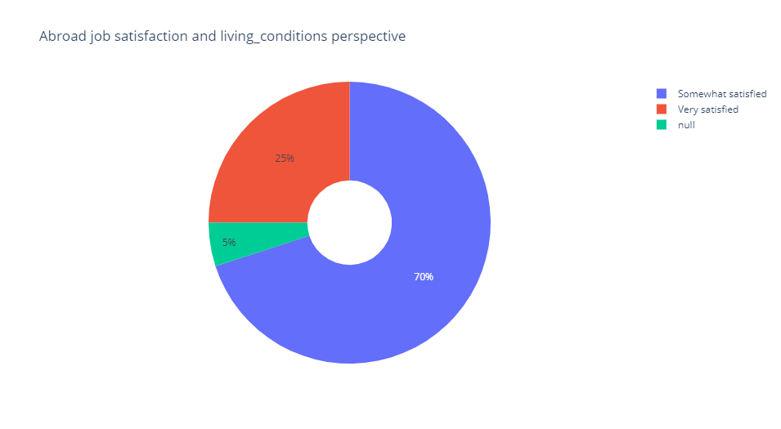
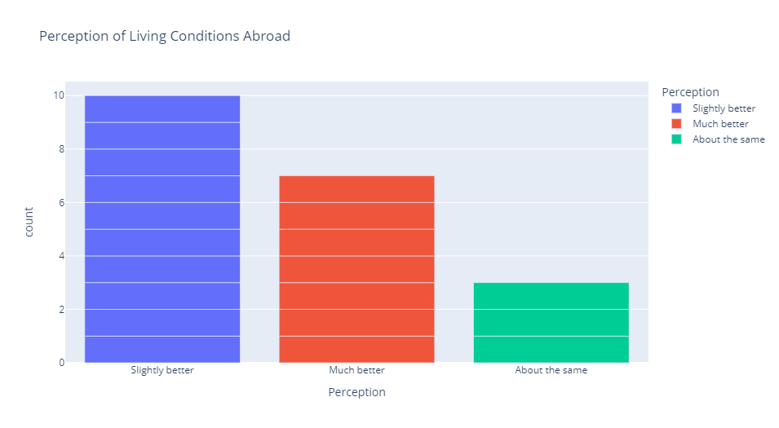
RESULT ANALYSIS OF SURVEY – Perception of Indian skilled workforce reside abroad
Overseas employment for Indian professionals is driven by the desire for better job opportunities, higher income, and an improved standard of living.
About 60% of participants express intentions to give up Indian citizenship for foreign nationality, highlighting the impact of global mobility on identity and loyalty.
Financial analysis reveals that a significant number of respondents can save money abroad, indicating a positive aspect of expatriate life.
Despite contemplating a change in citizenship, many participants express a continued inclination to invest in India, emphasizing the need for policies balancing talent retention and acknowledging global aspirations.

Slide 24
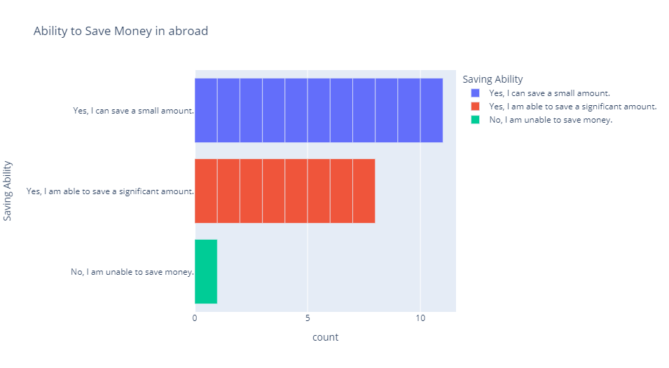
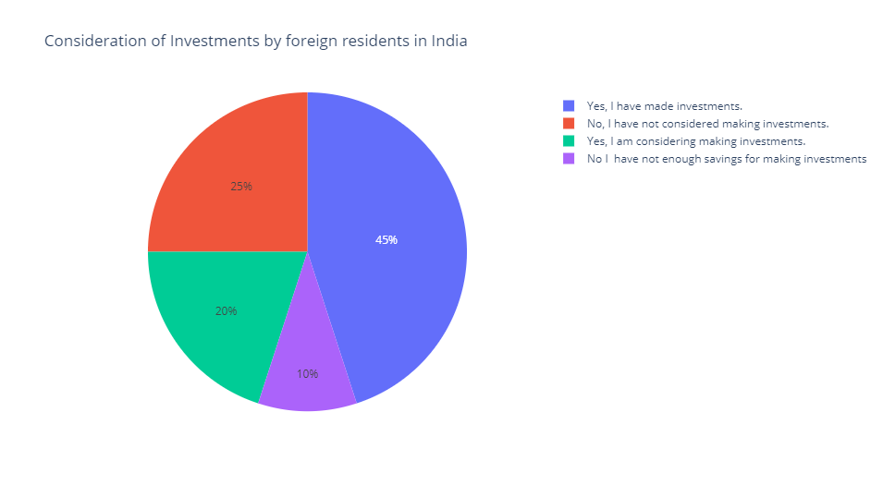
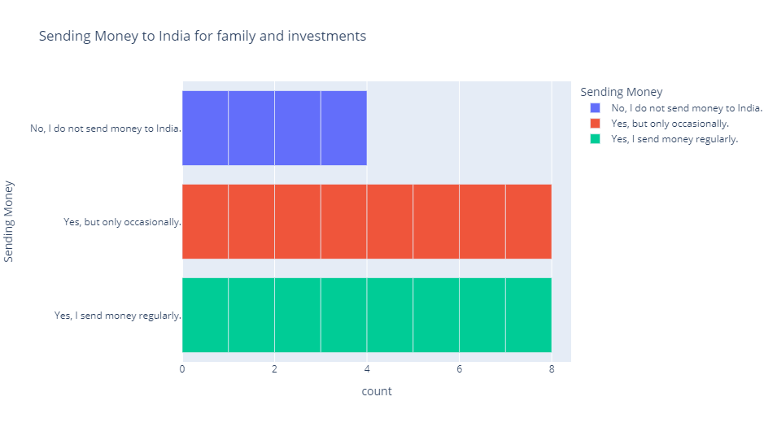
RESULT ANALYSIS OF SURVEY – Perception of Indian skilled workforce reside abroad

Slide 25
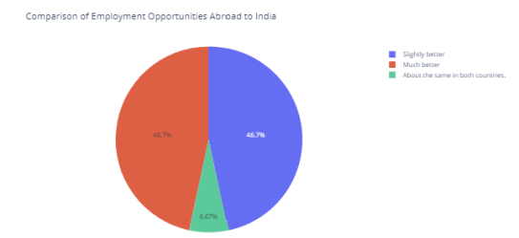
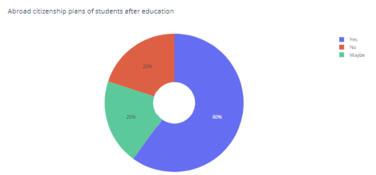
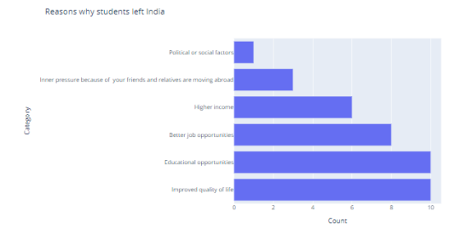
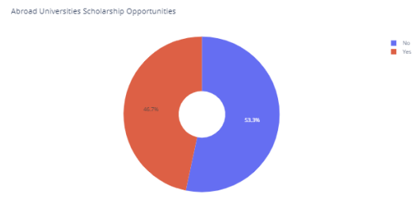
RESULT ANALYSIS OF SURVEY – Perception of Indian students studying abroad
Top destinations for Indian students studying abroad include the US, Canada, UAE, Australia, and the UK, known for their prestigious universities and diverse academic offerings.
Motivations for Indian students studying abroad include improving life quality, prospects for employment, and education. Sixty percent express a desire for foreign citizenship, indicating an inclination for a longer stay beyond academics.
Financial considerations are significant, with 53.3% securing scholarships and 80% obtaining part-time jobs or internships during their studies, showcasing the appeal of international institutions in providing financial support and practical experience.
Analysis includes factors such as plans for obtaining citizenship abroad, living conditions, work culture, and saving abilities, emphasizing the comprehensive considerations made by Indian students abroad.

Slide 26
RECOMMENDATIONS AND CONCLUSION
Indian students migrating abroad are motivated by improved educational opportunities, exposure to diverse international cultures, and a desire to enhance their overall quality of life.
Skilled Indian professionals choose to settle abroad due to better career prospects, the opportunity to experience different cultures, improved living conditions, a richer work culture, and an overall aspiration for a better quality of life.
While students and skilled workers have different motivations for migration, both groups share a strong desire to contribute to the progress and development of India, supported by a robust network of family and friends.
It is essential to develop nuanced strategies that not only address the diverse motivations for migration but also create an environment discouraging talented individuals from staying abroad by fostering a connection with India.

Slide 27


RECOMMENDATIONS AND CONCLUSION - Improving Indian education system
Enhancing International Exposure and Return
Collaboration with foreign universities represents another crucial facet, entailing partnerships, exchange programs, and dual-degree initiatives that incorporate international experiences into the academic curriculum.
Post-study assistance is of utmost importance, necessitating tailored job placement services and entrepreneurial support for returning students
Policies implemented by the government, such as tax breaks and the acceptance of degrees from other countries, can
encourage students to study overseas and then return to India to support its development.
Encouraging entrepreneurship in education curriculam
Embedding entrepreneurship directly into the academic curriculum equips students with essential skills like business planning, financial management, and market analysis.
Establishing on-campus incubators and innovation hubs provides students with dedicated spaces, resources, mentorship, and a collaborative environment to develop their entrepreneurial ideas.
Promoting a Culture of Innovation by fostering a culture that values creativity, risk-taking, and problem-solving is crucial. This involves engaging students in unconventional career paths, strengthening partnerships with industries, offering financial assistance, organizing competitions,

Slide 28


RECOMMENDATIONS AND CONCLUSION - Improving indian education system
Internship/Apprenticeship programs in Academia
Internships and apprenticeships are crucial in addressing brain drain by bridging the gap between academic knowledge and industry needs, providing practical experience that enhances students' employability.
These programs, when appropriately compensated, not only reduce reliance on student loans but also foster professional connections, motivating students to contribute their skills to the development of their home country, thus preventing the loss of intellectual capital.
Public/ private partnerships
Collaborative efforts between public and private institutions in higher education are crucial for addressing brain drain issues in India.
This partnership alleviates financial burdens, ensures quality education, and combines the flexibility of private institutions with the inclusivity of public ones, creating a sustainable and dynamic higher education sector for India's growth.

Slide 29

RECOMMENDATIONS AND CONCLUSION - Empowering Indian Skilled Workforce and Businesses
Enriching Indian Work Culture
Enhancing India's work culture involves creating a positive environment that values diversity, encourages open communication, teamwork, and a balanced work-life schedule.
Implementing work culture concepts inspired by European practices, like flexible schedules and discouraging excessive overtime, can lead to more fulfilling and enduring career paths for employees.
Enhancing competitive and high salary opportunities
India should aim to retain a skilled workforce by not only offering competitive salaries but also strategically investing in critical sectors like IT, AI, and healthcare, aligning with global standards and fostering innovation.
Beyond IT, sectors such as healthcare emphasize competitive compensation, benefits, and clear career paths, promoting internal promotions and tailored development programs to encourage skilled professionals to build long and fulfilling careers in India.

Slide 30


RECOMMENDATIONS AND CONCLUSION - Empowering Indian Skilled Workforce and Businesses
Remittance-Driven Brain Circulation Strategies
The rise in remittances from the Indian diaspora not only signifies financial support but also presents an opportunity to strategically channel funds for skill development programs, enhancing the competitiveness of migrants in the global job market.
Utilizing remittances for entrepreneurship, virtual collaboration, and improving living standards in migrants' home regions can foster economic growth, innovation, and create environments that encourage skilled professionals to consider returning to India.
Catalyzing Brain Circulation and Diaspora-Led Innovation in India’s Startup Landscape
International venture capital, attracting skilled individuals, plays a crucial role in India's startup scene and brain circulation.
Skilled immigrants actively engage in the entrepreneurial landscape, influencing venture capital trajectories, fostering diaspora involvement, and advancing economic growth through innovation in India.

Slide 31

RECOMMENDATIONS AND CONCLUSION
Future study scope
Explore how AI-driven predictive analytics can anticipate and reduce brain drain in India by creating models that predict the likelihood of highly qualified professionals leaving based on factors like education, career choices, and global trends.
Evaluate the impact of tailored interventions guided by AI predictions on retaining intellectual talent in India, considering the social, privacy, and ethical implications. This data-driven approach aims to proactively address brain drain challenges, influencing policies for talent retention in India.

Slide 32
THANK YOU

