Slide 1
Proxy Email
SMTP
(Honeywell SMTP server – smtp.Honeywell.com)
Outgoing Mail Account
(Niagara)
Mail
Mail
Proxy Server
(Fiddler)

Slide 2
LCBS-Progressive Web App
Progressive Web App Features:
Progressive
One solution
Installable
Works offline
App like
Safe
Discoverable
Re-engageable
Linkable

Slide 3
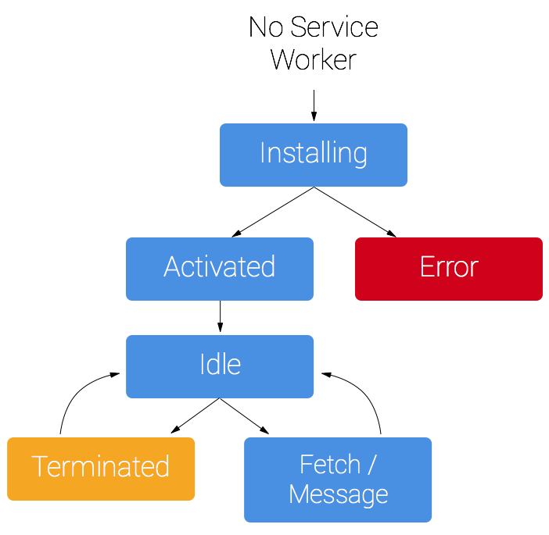
Service Worker

Slide 4
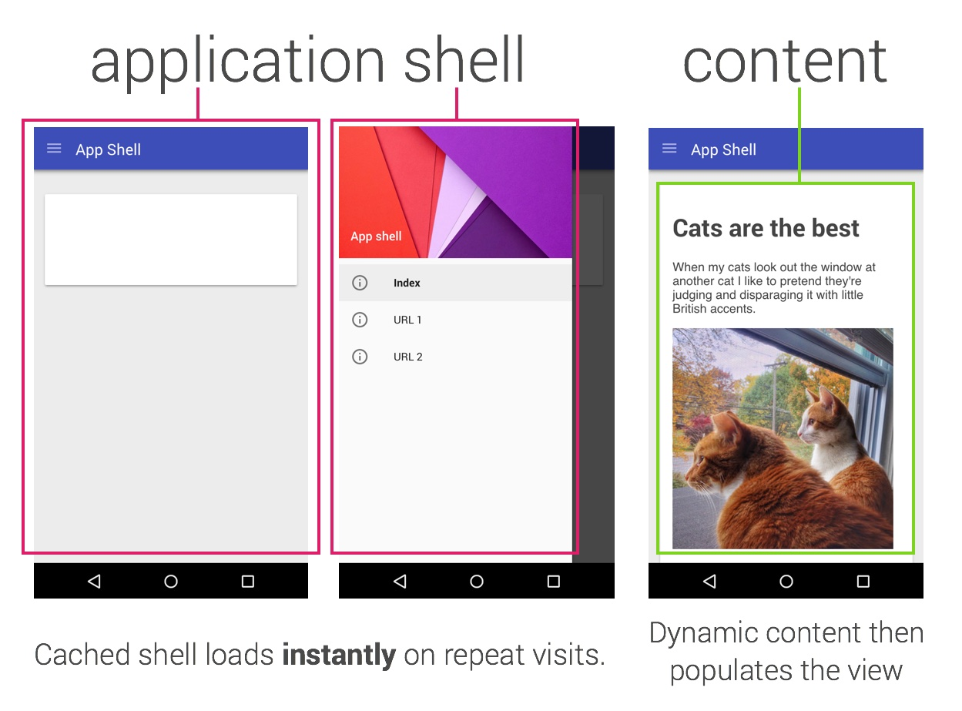
App Shell Architecture

