Slide 1

Feedback Analysis using GenAI Agent
Feedback Analysis using GenAI Agent is a powerful system that leverages a custom-built generative AI algorithm to analyze and summarize customer feedback or reviews. It provides businesses with deeper insights to improve products and services.

Slide 2
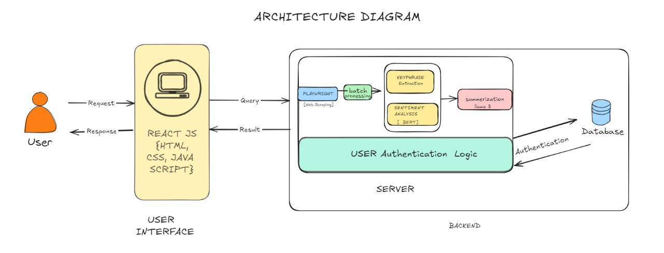

Slide 3
Key features to be implemented :
1. Text preprocessing and tokenization .
2. Sentiment analysis .
3. Key phrase extraction .
4. Summary generation using a custom
language model .
5. User interface for input and display of results .

Slide 4
Business Case: Improved Customer Understanding, Increased Efficiency
Need for Automation
Problem of Manual Feedback Analysis
Improved Decision-Making

Slide 5




Typical Users: Customer Service, Product Managers, Market Research
Customer Service Team
Respond to customer inquiries and issues more effectively.
Product Managers
Identify product improvement opportunities and roadmap priorities.
Marketing and Research analytics
Gain deeper insights into customer preferences and market trends.

Slide 6




How it Helps Users: Faster Feedback Analysis, Data-Driven Decisions
Accelerated Insights
Delivers actionable summaries and sentiments, making it easier to understand customer needs.
Saves Time
Automates manual processes, reducing the time spent analyzing feedback.
Enhances Decision-Making
Leverage customer data to make informed, data-driven business decisions.

