Slide 1
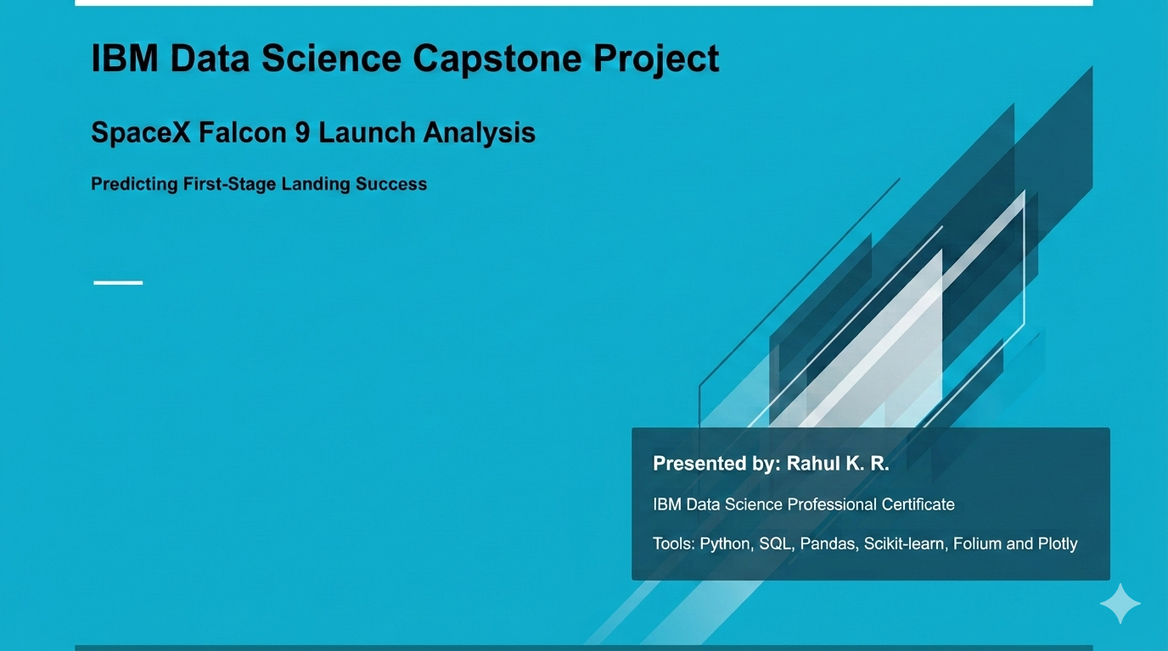

Slide 2
Executive Summary
Analyzed historical SpaceX Falcon 9 launch data.
Explored launch outcomes, payload characteristics and launch-site patterns.
Used SQL queries and interactive geospatial visualizations to investigate the data.
Developed a machine-learning classification workflow to study landing outcomes.
Combined data analysis and visualization to support evidence-based conclusions.
Project objective: Investigate factors associated with first-stage landing success and assess whether historical launch data can help predict outcomes.

Slide 3
Introduction and Business Problem
SpaceX uses reusable launch vehicles to reduce the cost of spaceflight.
The Falcon 9 first stage can return to Earth and be recovered for potential reuse.
Landing outcomes are influenced by launch and mission characteristics.
Historical launch data can be analyzed to identify patterns in landing outcomes.
Business question: Can historical launch information help estimate the probability of a successful first-stage landing?

Slide 4
Data Collection and Data Wrangling
Attempted to collect historical launch data from the SpaceX API.
Encountered connection errors during the API request and used available historical course datasets for analysis.
Inspected the data structure, column types and missing values.
Converted launch dates into datetime format.
Examined duplicate records and handled missing landing-pad information.
Prepared features and the target variable for subsequent analysis.
Dataset used in Notebook 3: 90 rows and 17 columns.
Tools: Python, Requests and Pandas.

Slide 5
Exploratory Data Analysis (EDA)
The analysis examined relationships between launch characteristics and landing outcomes.
Compared outcomes across launch sites.
Investigated flight number and landing outcome.
Examined payload mass distributions.
Used visualizations to identify possible trends and differences.
Explored whether launch characteristics may be associated with landing success.
Tools: Matplotlib, Seaborn and Pandas.

Slide 6
Data Analysis Using SQL
SQL queries were used to explore the SpaceX launch dataset.
Retrieved launch records and examined relevant fields.
Grouped records by launch site and outcome.
Investigated payload mass and other launch characteristics.
Used aggregation and filtering to summarize the data.
Compared SQL-based summaries with findings from the Python analysis.
Tool: SQLite.
Key findings: Insert two or three verified results from Notebook 5.

Slide 7
Geospatial Analysis Using Folium
Created an interactive map using launch-site coordinates.
Displayed launch locations with map markers.
Enabled geographic exploration of the launch sites.
Connected spatial information with the broader launch-data analysis.
Tool: Folium.
Purpose: Make the geographic distribution of launch sites easier to explore and interpret.

Slide 8
Interactive Visualization with Plotly
Developed interactive visualizations to explore launch outcomes.
Examined payload mass and launch-site categories.
Used interactive charts to support data exploration.
Designed the analysis to make comparisons easier for stakeholders.
Tools: Plotly and Python.
Dashboard purpose: Allow users to explore launch data and investigate patterns through interactive visual elements.

Slide 9
Predictive Analysis Methodology
Prepared input features and the landing-outcome target.
Split the data into training and testing sets.
Built classification models to predict the target outcome.
Used model evaluation methods to assess predictive performance.
Compared model results to understand their strengths and limitations.
Tools: Scikit-learn, Pandas and Python.
Important: The target label and feature rows must be correctly aligned before interpreting model performance.

Slide 10
Predictive Model Results
Model evaluated: [Insert model name]
Test accuracy: [Insert verified value]
Precision: [Insert verified value]
Recall: [Insert verified value]
F1-score: [Insert verified value]
Interpretation: Discuss how well the model identifies successful and unsuccessful landing outcomes, including the impact of any misclassifications.
Limitation: Results depend on data quality, target definition, feature selection and the size of the test dataset.

Slide 11
Conclusions and Key Insights
Integrated data collection, wrangling, SQL, visualization and machine learning into one analysis workflow.
Used exploratory analysis to investigate potential relationships between launch characteristics and landing outcomes.
Used interactive mapping and charts to make the dataset easier to explore.
Applied classification techniques to evaluate the feasibility of predicting landing outcomes.
Future improvements
Expand the dataset and validate target labels.
Compare additional classification algorithms and tune model parameters.
Evaluate models with cross-validation and appropriate performance metrics.
Incorporate additional mission and launch variables where available.
Overall conclusion: Historical launch data provides a foundation for studying landing outcomes, but predictive claims must be supported by validated model results.

Slide 12
Project Repository and References
GitHub repository
https://github.com/RAHULKR123456/IBM-SpaceX-Capstone
Project components
Eight Jupyter notebooks
Data collection and preparation
EDA and SQL analysis
Folium interactive map
Predictive analysis
Plotly visualizations
References
IBM Skills Network SpaceX Capstone course datasets
Historical SpaceX launch information from Wikipedia
SpaceX API, where accessible
Thank you

