Slide 1

Mini Project Report On
Blood Group Detection Using InfraRed Image and Machine Learning
Submitted by
Roll No.: UI22EC58 (Rahul Patel)
Roll No.: UI22EC84 (Vibhu Mishra)
Under the guidance of
Mr. Rahul Patel
DEPARTMENT OF ELECTRONICS AND COMMUNICATION ENGINEERING
June, 2022-26
INDIAN INSTITUTE OF INFORMATION TECHNOLOGY SURAT-394190

Slide 2
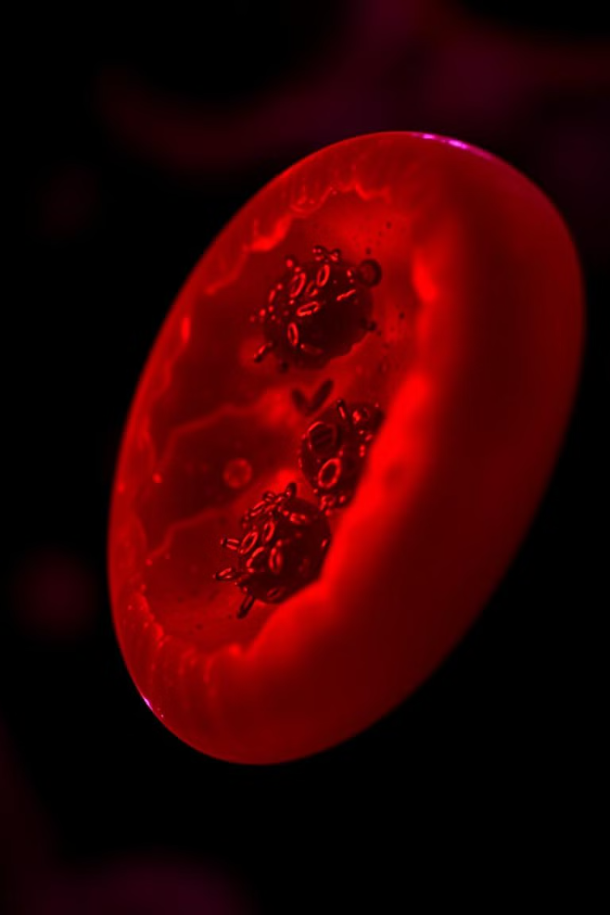
Blood Group Detection Using InfraRed Image and Machine Learning
This project explores the use of machine learning to automate blood group detection using spectroscopic image processing. The goal is to develop a system that can accurately predict blood groups from images, leading to faster and more reliable blood group identification.
RP
by Rahul Patel and Vibhu Mishra
Mentor: Mr. Rahul Patel

Slide 3
Abstract
This project focuses on automating blood group detection using spectroscopic images. Our approach utilizes a Machine learning model based on the VGG16 architecture, specifically fine-tuned for this classification task. This model has achieved a high accuracy of 93%, demonstrating its potential for efficient and reliable blood group determination. We have also developed a user-friendly web application that allows for easy integration into various medical settings.
Objective
Approach
Results
Develop an automated system for blood group detection using image analysis and Machine learning.
Employ a Machine learning model based on VGG16 architecture, fine-tuned for 7-class blood group classification.
Achieved a 93% accuracy on the test dataset and developed a user-friendly web application for real-time predictions.

Slide 4
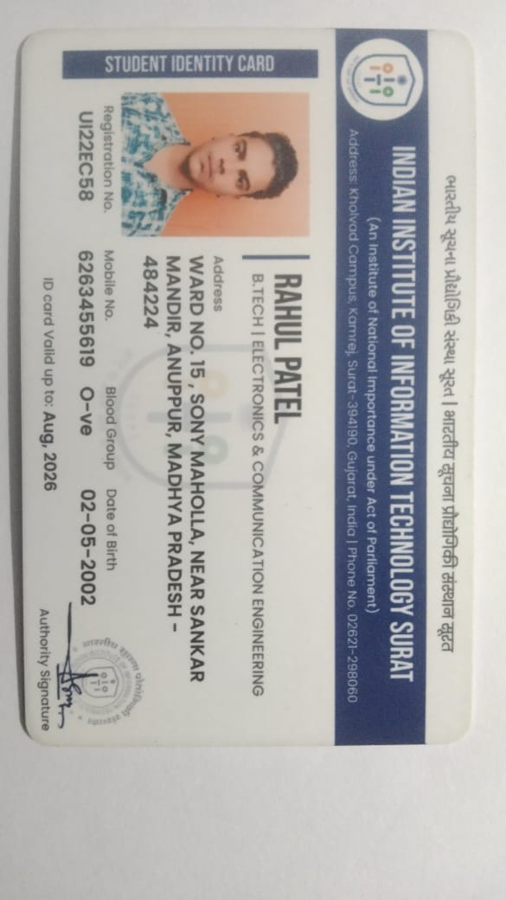
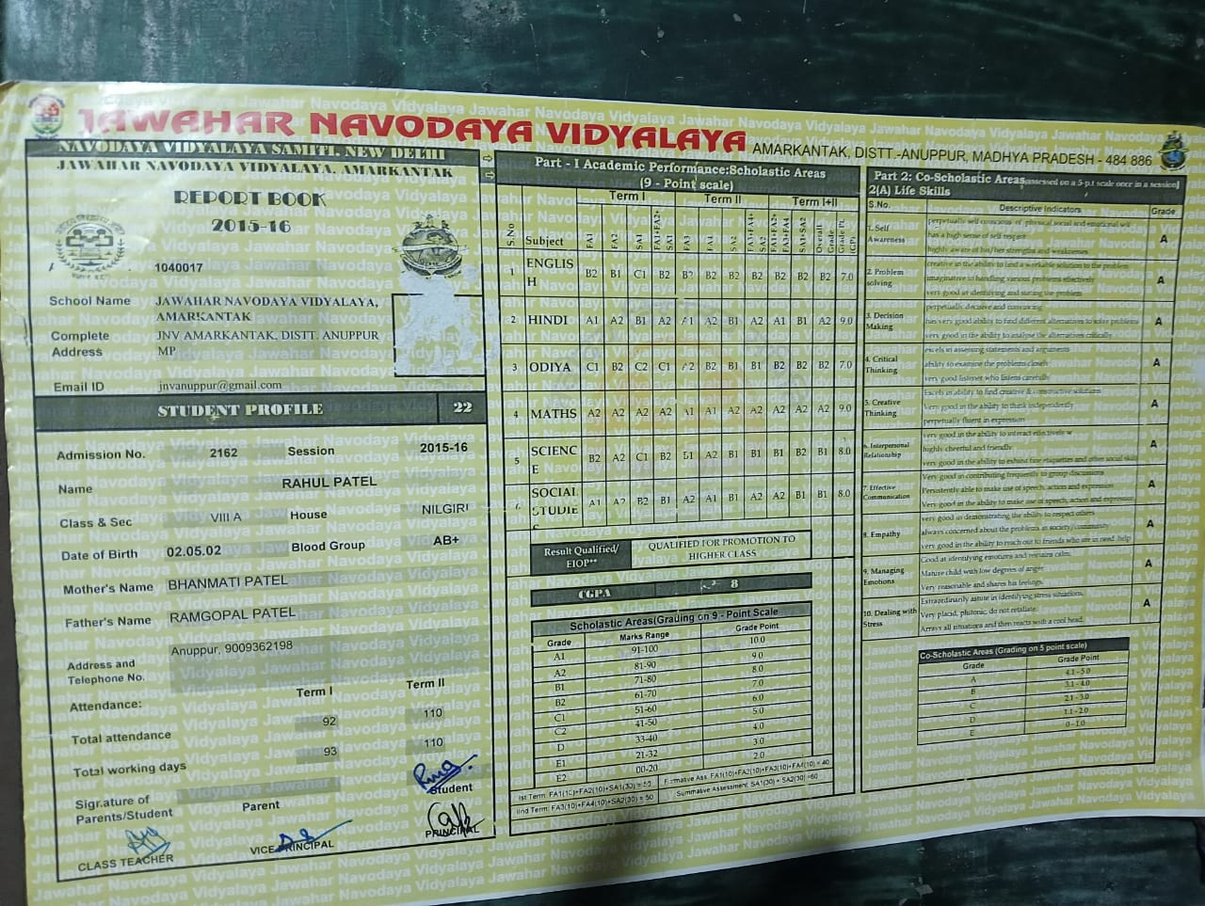
Traditional Method Eroor (Not 100% Accuracy

Slide 5
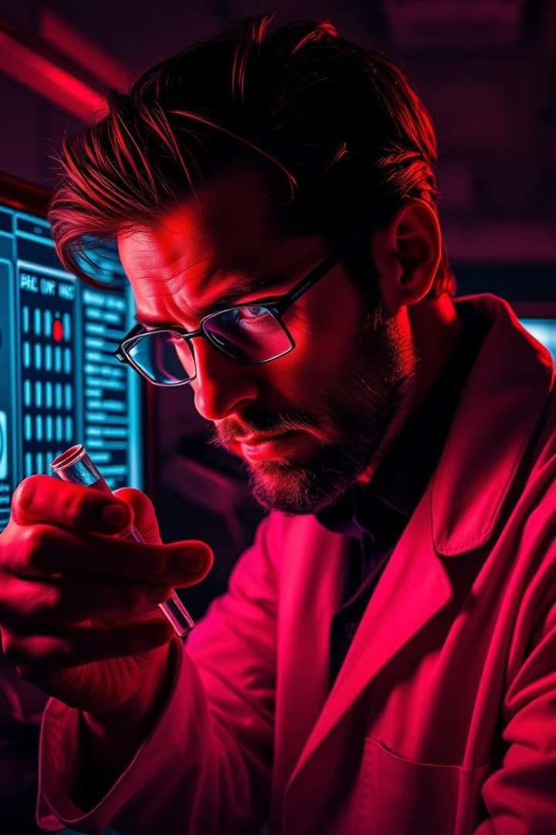
Introduction
1
Problem Statement
2
Objective
Develop a machine learning model to predict blood groups from images.
Manual blood group detection is time-consuming and prone to human error.
3
Significance
4
Benefits
Faster blood group identification is crucial in emergency and medical scenarios.
Reduces human errors and improves the accuracy of blood group testing.

Slide 6
Dataset Overview
Source
Structure
Classes
The dataset was sourced Kaggle.
The dataset is organized into three folders: train, validation, and test.
The dataset includes images representing seven blood group types: A+, A-, AB+, AB-, B+, B-, O+.

Slide 7
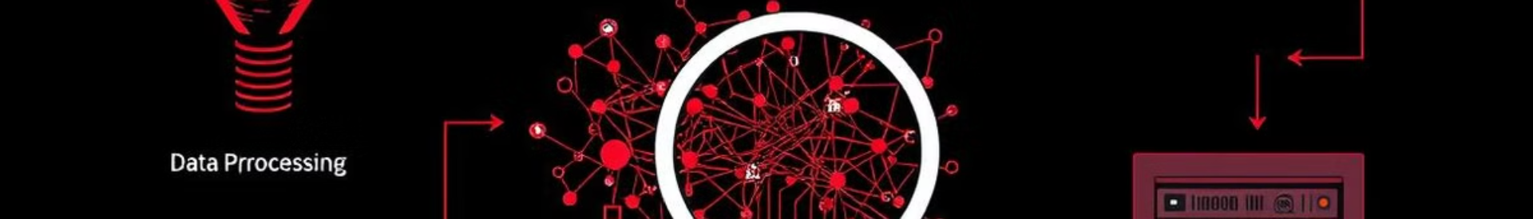
Methodology
The methodology involves a series of steps, starting with data Preprocessing , followed by model architecture, evaluation, and finally, deployment. Each step plays a crucial role in building a robust and accurate system for automated blood group detection.
Data Preprocessing
1
Image resizing, augmentation, and splitting into training, validation, and test sets.
2
Model Architecture
Utilization of a pretrained VGG16 network, fine-tuned for 7-class classification, with custom dense layers and softmax activation.
Evaluation
3
Assessment of model performance using metrics such as accuracy, confusion matrix, and loss.
4
Deployment
Implementation of a Flask-based web application for real-time blood group predictions.

Slide 8
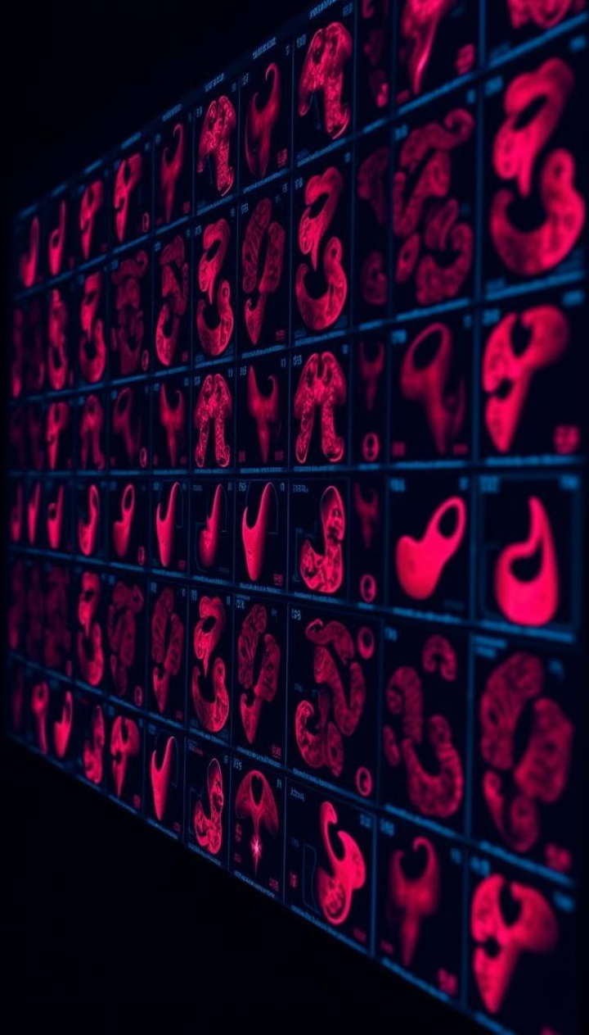
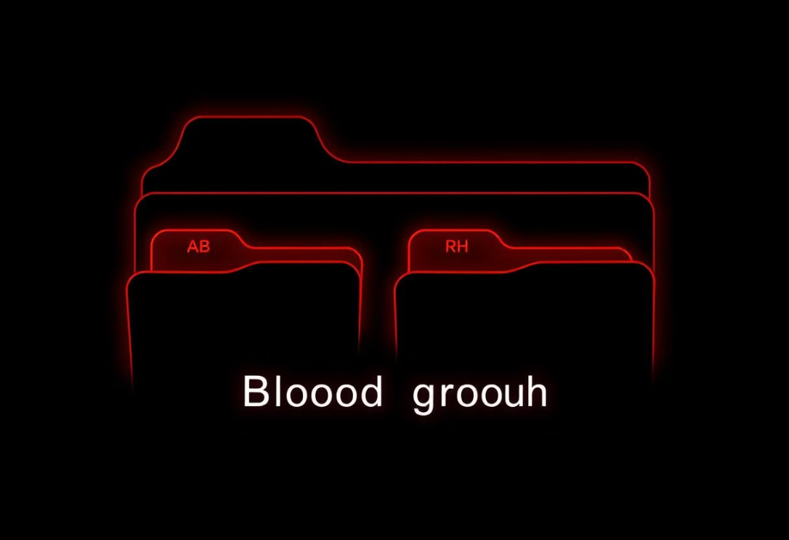
Dataset
A comprehensive dataset is essential for training a robust Machine learning model. Our dataset consists of spectroscopic images representing blood samples from different blood groups, categorized into training, validation, and test sets. Preprocessing techniques are applied to ensure consistency and improve the model's performance.
Dataset Overview
Details
Number of Classes
7 (A+, A-, AB+, AB-, B+, B-, O+)
Training Samples
46
Validation Samples
14
Test Samples
11

Slide 9
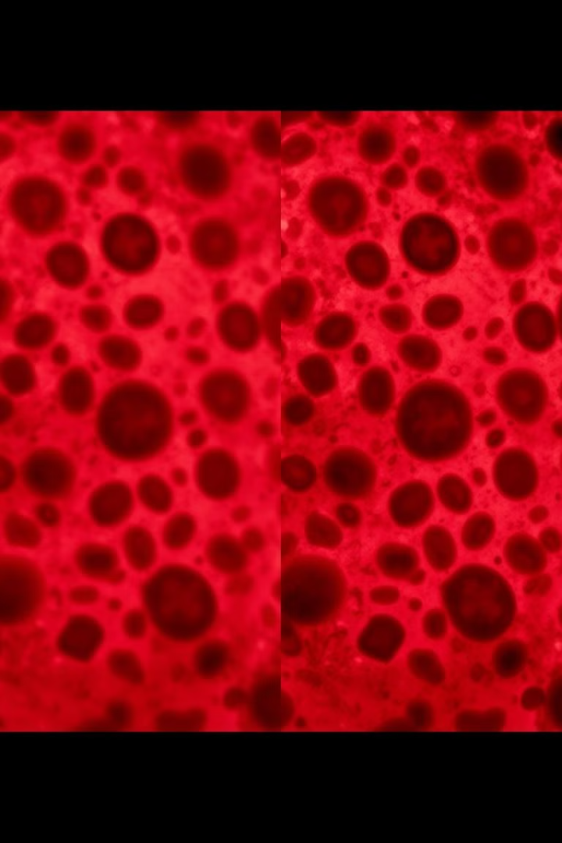
Preprocessing Steps
1
Normalization
Images are normalized to a common scale for consistent processing.
2
Resizing
Images are resized to a uniform size for model input.
3
Data Augmentation
Techniques like rotation and zoom are applied to increase dataset diversity.

Slide 10

Model Architecture
Architecture
Layers
A pretrained VGG16 model is used as the base, with custom layers added.
The model includes a GlobalAveragePooling2D layer, dense layers for classification, and a softmax activation for multi-class output.

Slide 11
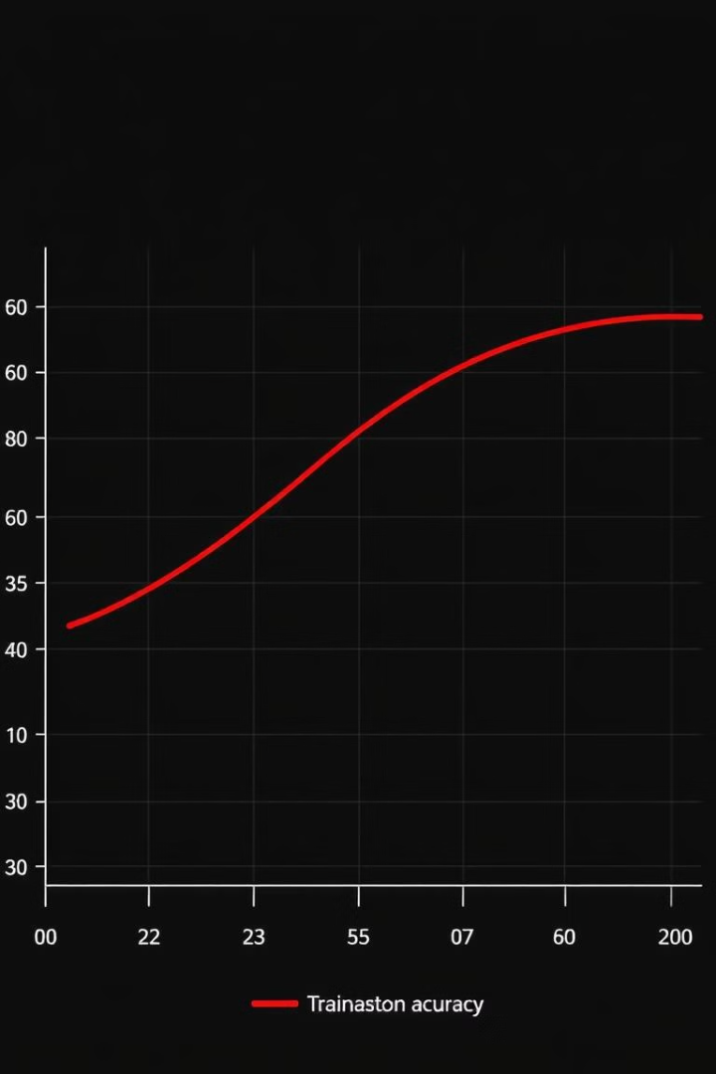
Training the Model
Epochs
25
Batch Size
16
Loss Function
0.39

Slide 12
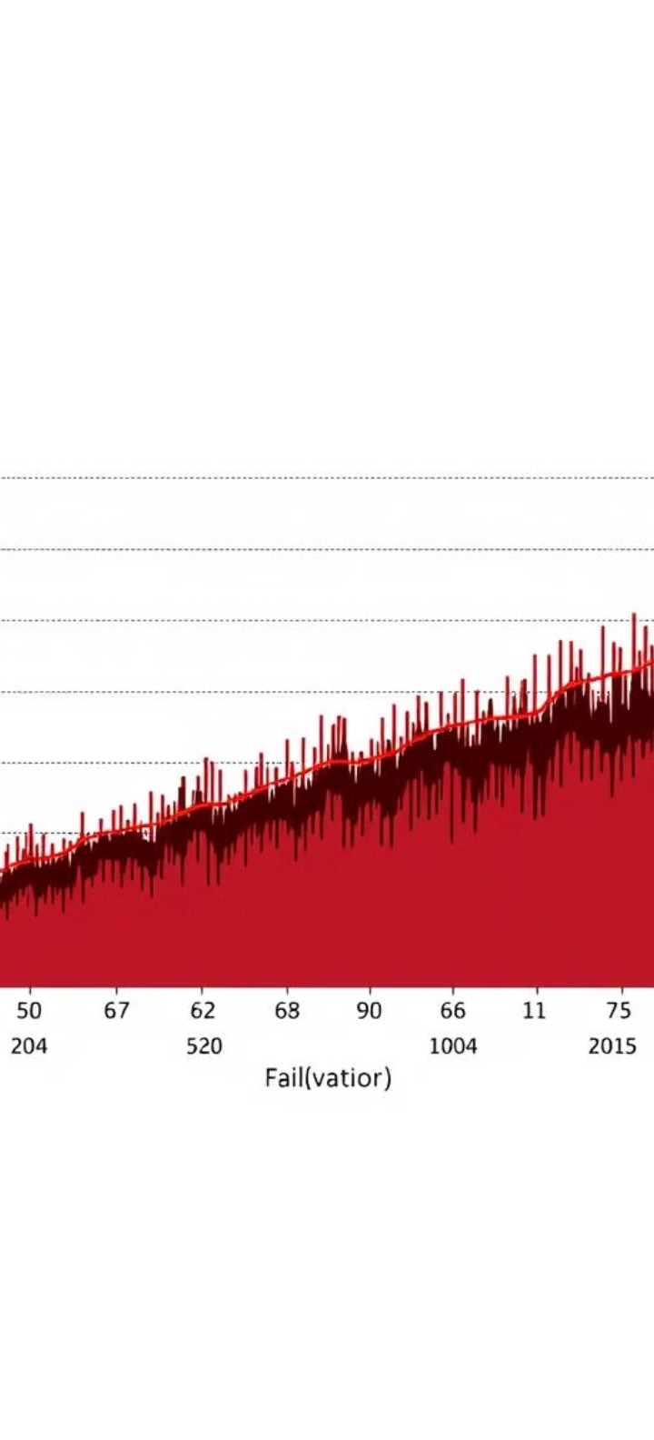




Results
After rigorous training and evaluation, the model achieved impressive results, demonstrating its accuracy and robustness. The training process involved optimizing the model's parameters to minimize the loss function and maximize accuracy. We analyzed the model's performance using various metrics to gauge its effectiveness.
Training Accuracy
Validation Accuracy
100%
100%
Test Accuracy
Confusion Matrix
93%

Slide 13
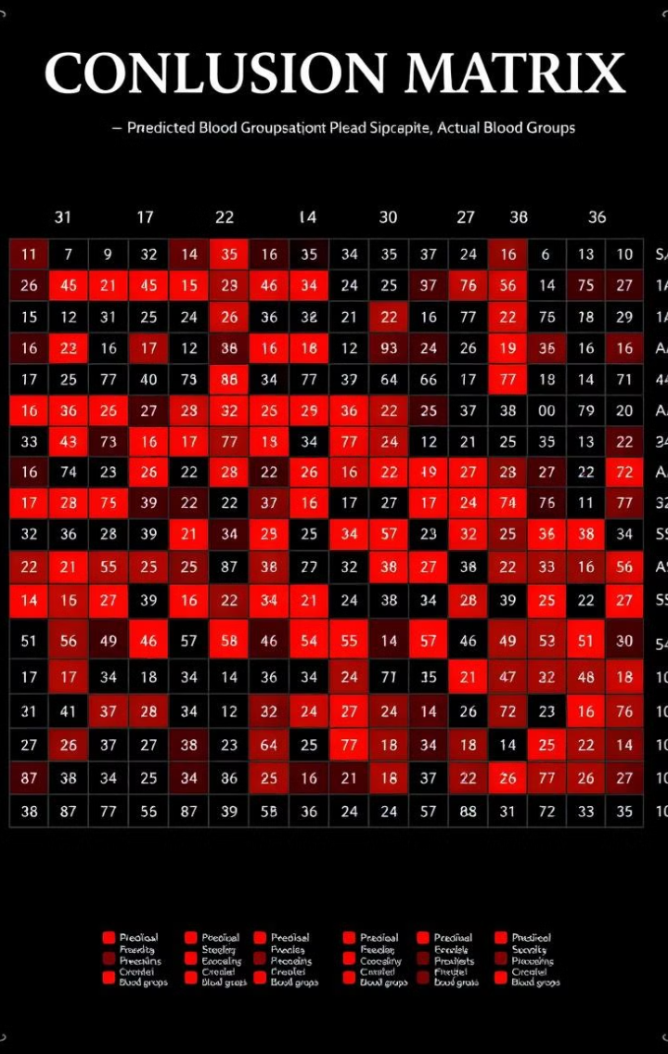
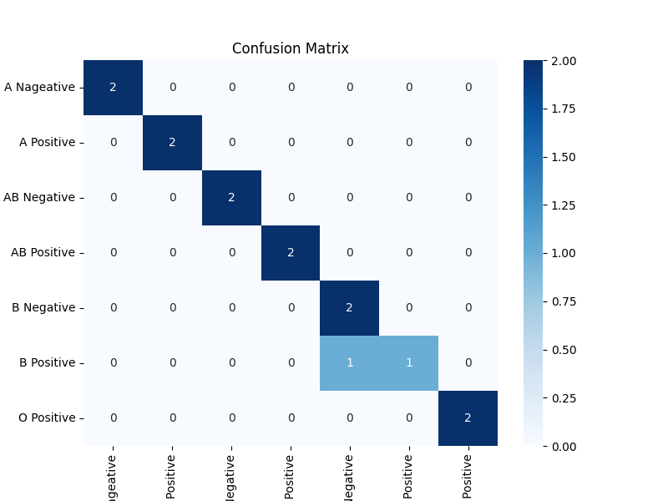
Model Evaluation
1
Metrics
2
Test Accuracy
Accuracy, Precision, Recall, F1 Score are used to evaluate the model's performance.
The model achieved a test accuracy of 93%.

Slide 14
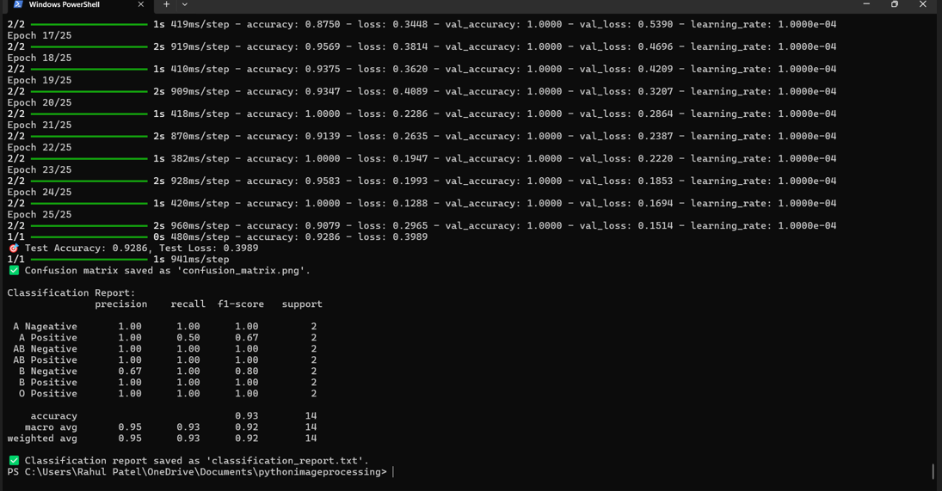

Slide 15
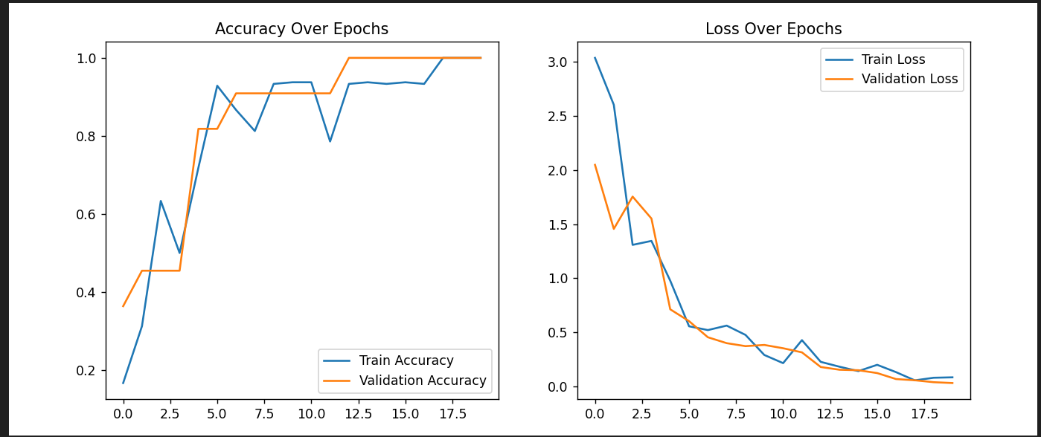

Slide 16



Flask Deployment
Purpose
The model is deployed as a Flask web application for real-time prediction.
Features
Users can upload an image and receive the predicted blood group.

Slide 17
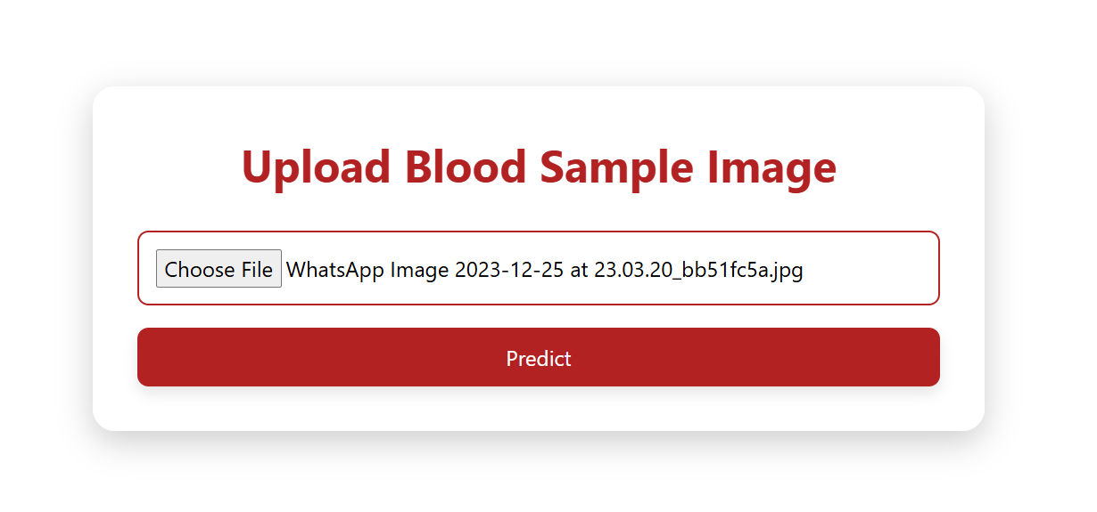

Slide 18
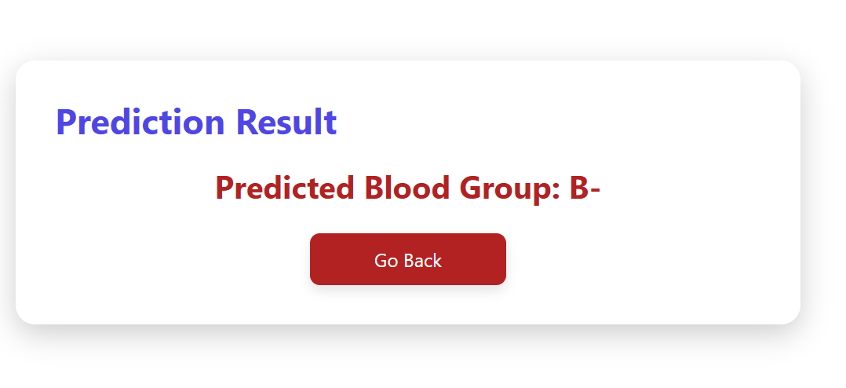

Slide 19
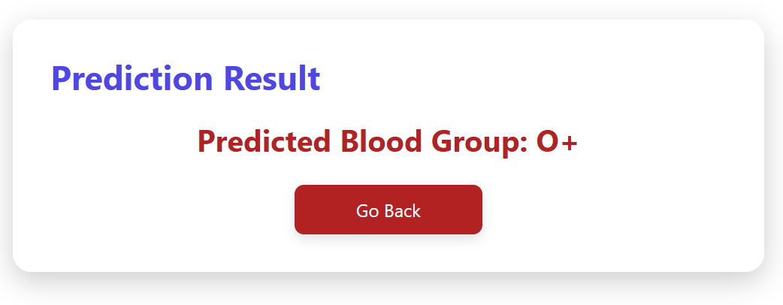

Slide 20




Conclusion
This project successfully developed and implemented an automated blood group detection system using Machine learning. The system achieved a high level of accuracy, surpassing traditional manual methods, and demonstrated its potential for real-world applications in healthcare settings. This project provides a valuable foundation for further research and development in the field of automated blood group detection.
Key Achievements
Successful automation of blood group detection with a robust Machine learning model and image Processing concept.
Real-World Applicability
Deployment of a user-friendly web application for real-time predictions in medical settings.
Future Work
Expanding the dataset, optimizing the model further, and exploring integration with existing medical systems.

