Slide 1
July 22nd 2018
Ecommerce – Real time stream Analytics
Devaki Sundara Chandrakala
Sini Menon Mohanraj Kanagaraj

Slide 2

About the Team
Name : Mohanraj Kanagaraj
Emp id: 165071
Project: Service Provider Interfaces
Design & Development
Account: Metropolitan Life Insurance
Technology: Microservices, JAVA, Python
Name : Mohanraj Kanagaraj
Emp id: 165071
Project: Service Provider Interfaces
Design & Development
Account: Metropolitan Life Insurance
Technology: Microservices, JAVA, Python
Name : Mohanraj Kanagaraj
Emp id: 165071
Project: Service Provider Interfaces
Design & Development
Account: Metropolitan Life Insurance
Technology: Microservices, JAVA, Python
Name : Mohanraj Kanagaraj
Emp id: 165071
Project: Service Provider Interfaces
Design & Development
Account: Metropolitan Life Insurance
Technology: Microservices, JAVA, Python

Slide 3
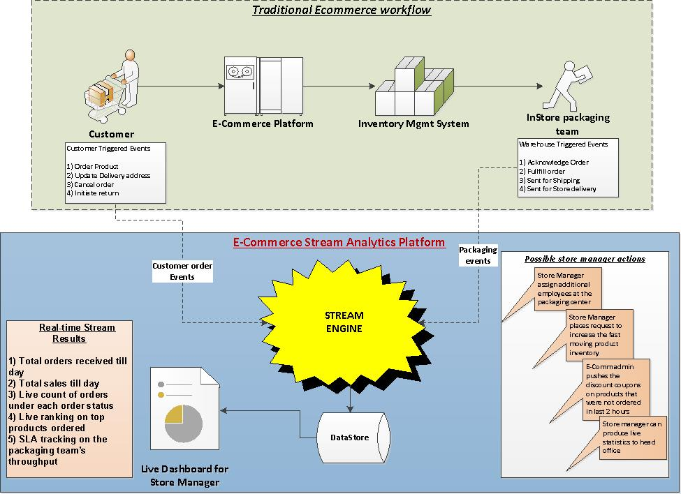
Use Case
Traditional ecommerce transaction events are enriched using a stream engine in real time to produce valuable statistics and data which in turn aid a retail store manager to run his store effectively and efficiently.
Stream Analytics results would help a store manager to
have up to date order & sales handy
live statistics on the order counts by product
real time view of the top trending products
keep the packaging team’s performance within SLA
full control of the store functioning

Slide 4
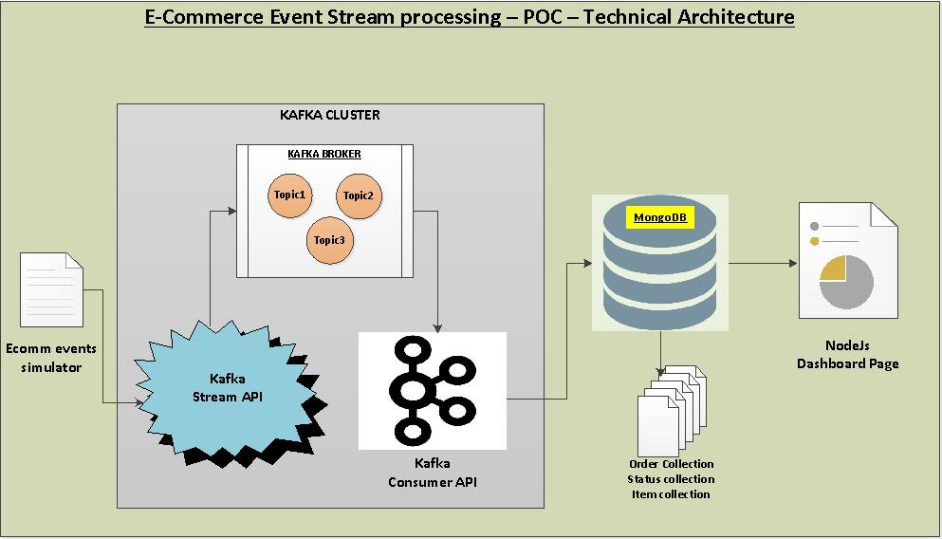
Technical Architecture
Ecommerce events were simulated using a Java application which keeps generating the events randomly
Kafka zookeeper & Kafka broker will have to be started to keep control of the topics to enable the streaming
Kafka stream API would connect to the event simulator to read the raw event in real time.
Later it sanitize and process this raw data into an useful dataset which then can be perished downstream.
Live Stream processed datasets are pushed into the meaningful topics of the running kafka broker.
Kafka consumer Java API would read these topics from the broker and connect to the running Mongo client to insert into respective Mongo Collections.
3 different Mongo collections namely Order, Status and Item collections are created by the consumer java API where the stream processed data are stored in real time.
Mongo collections would be continuously read by the NodeJS application to produce meaningful dashboard in a HTML page.

Slide 5
Live Dashboard results for the Store Manager
Dashboard Contents
Banner on total orders received
Banner on total Sales happened
Bar Graph showing the Pickup Vs Delivery order counts
Graph showing the count of orders in various order statuses
Graph showing the top 3 trending items based on order count
Graph tracking the orders count which are not picked by packaging team over a period of time.
Store Manager post actions from Dashboard results
Assign additional employees at the packaging section when more orders are going beyond SLA
Places additional inventory request for the top selling items
Instructs E-Comm Admin to push live discounts on those items where there are low volume of orders
Always have real-time data about the store functions which can be shared with the head office without much preparation or delay
Store manager remains to be on top of all the functioning of the store and can deduct the failure in near real time

