Slide 1
Sunday, July 22, 2018
Ecommerce – Real time stream Analytics
- powered by Apache Kafka & MongoDB

Slide 2




About the Team
Name : Devaki Sundaramurthy
Emp id : 190017
Project : Ecommerce-Congo
Account : Walmart
Technology : JAVA, Kafka, Message broker
Location : Bentonville – AR, USA
Name : Chandrakala Revensiddappa
Emp id : 176502
Project : RMT Development
Account : Metropolitan Life Insurance
Technology : Message Broker, WebMethods
Location : Bangalore, India
Name : Sini Cherukad Manayil
Emp id : 440590
Project : Ernt&Lego Horizon - Supply
Account : Lego
Technology : SAG WebMethods, JAVA
Location : Bangalore, India
Name : Mohanraj Kanagaraj
Emp id : 165071
Project : SPI Design & Development
Account : Metropolitan Life Insurance
Technology : Microservices, JAVA
Location : Chennai, India
2

Slide 3
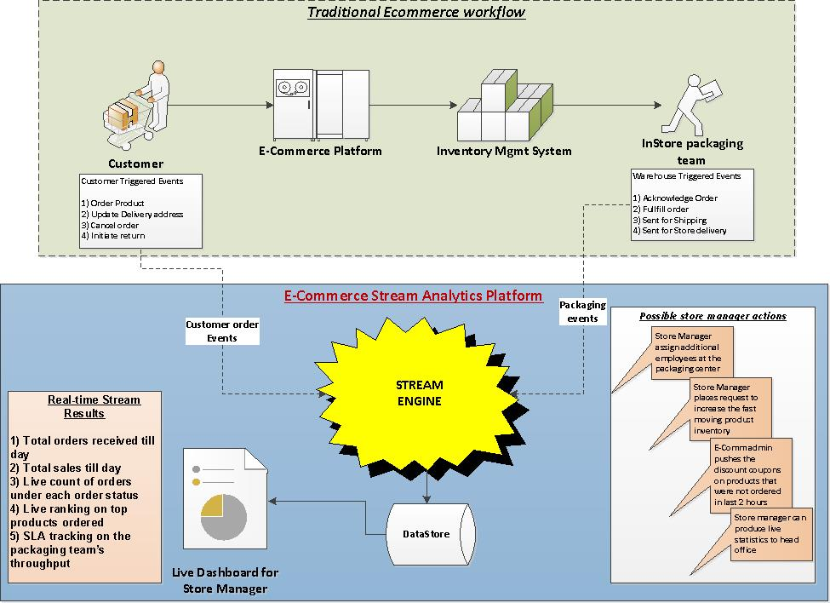
Use Case
Traditional ecommerce transactions are enriched using a stream engine in real time to produce valuable statistics and data which in turn helps retail store manager to run the store effectively and efficiently.
Real Time Stream Analytics would help a store manager to
have up to date order & sales handy
live statistics on the order counts by product
real time view of the top trending products
keep the packaging team’s performance within SLA
full control of the store functioning
3

Slide 4
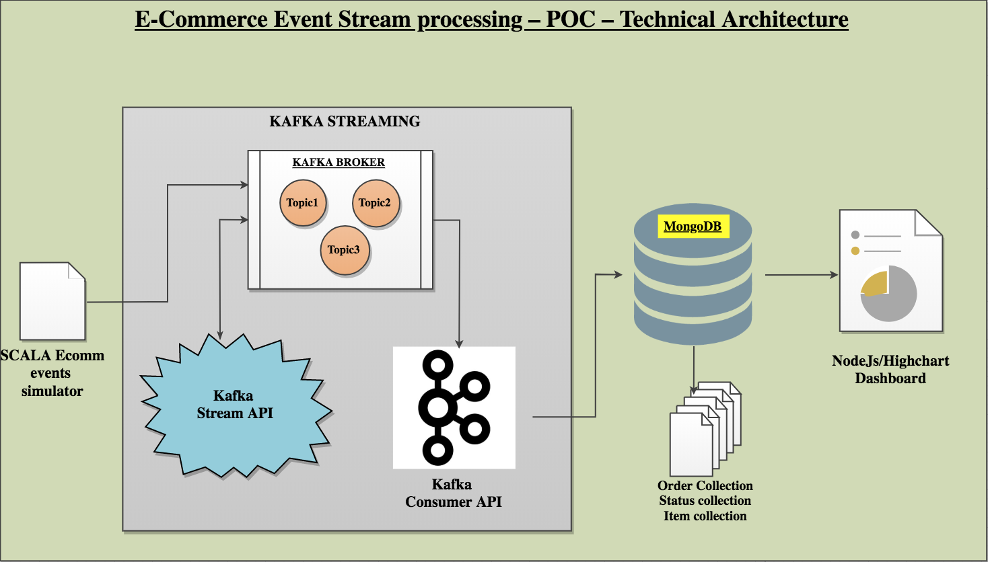
Technical Architecture
Technologies Used
JAVA - Scala - Kafka
NodeJS - Highchart - MongoDB
Ecommerce events were simulated using a SCALA application which keeps generating the events randomly
Event simulator would publish the events to the Kafka topics (Place Order & Order Status)
Kafka stream Java API would get the events from the topic simulator to read the raw event json in real time.
Later it sanitize and process this raw data into an useful dataset which can then be persisted downstream.
Live Stream processed datasets are pushed into topics of the running kafka broker.
Kafka consumer Java API would read these topics from the broker and connect to the Mongo client to insert into respective Mongo Collections.
3 different Mongo collections named Order, Status and Item will be created and stream processed data will be inserted in real time by the consumer java API.
Mongo collections would be read by the NodeJS application to produce Highchart dashboard UI.
KAFKA STREAMING
4

Slide 5
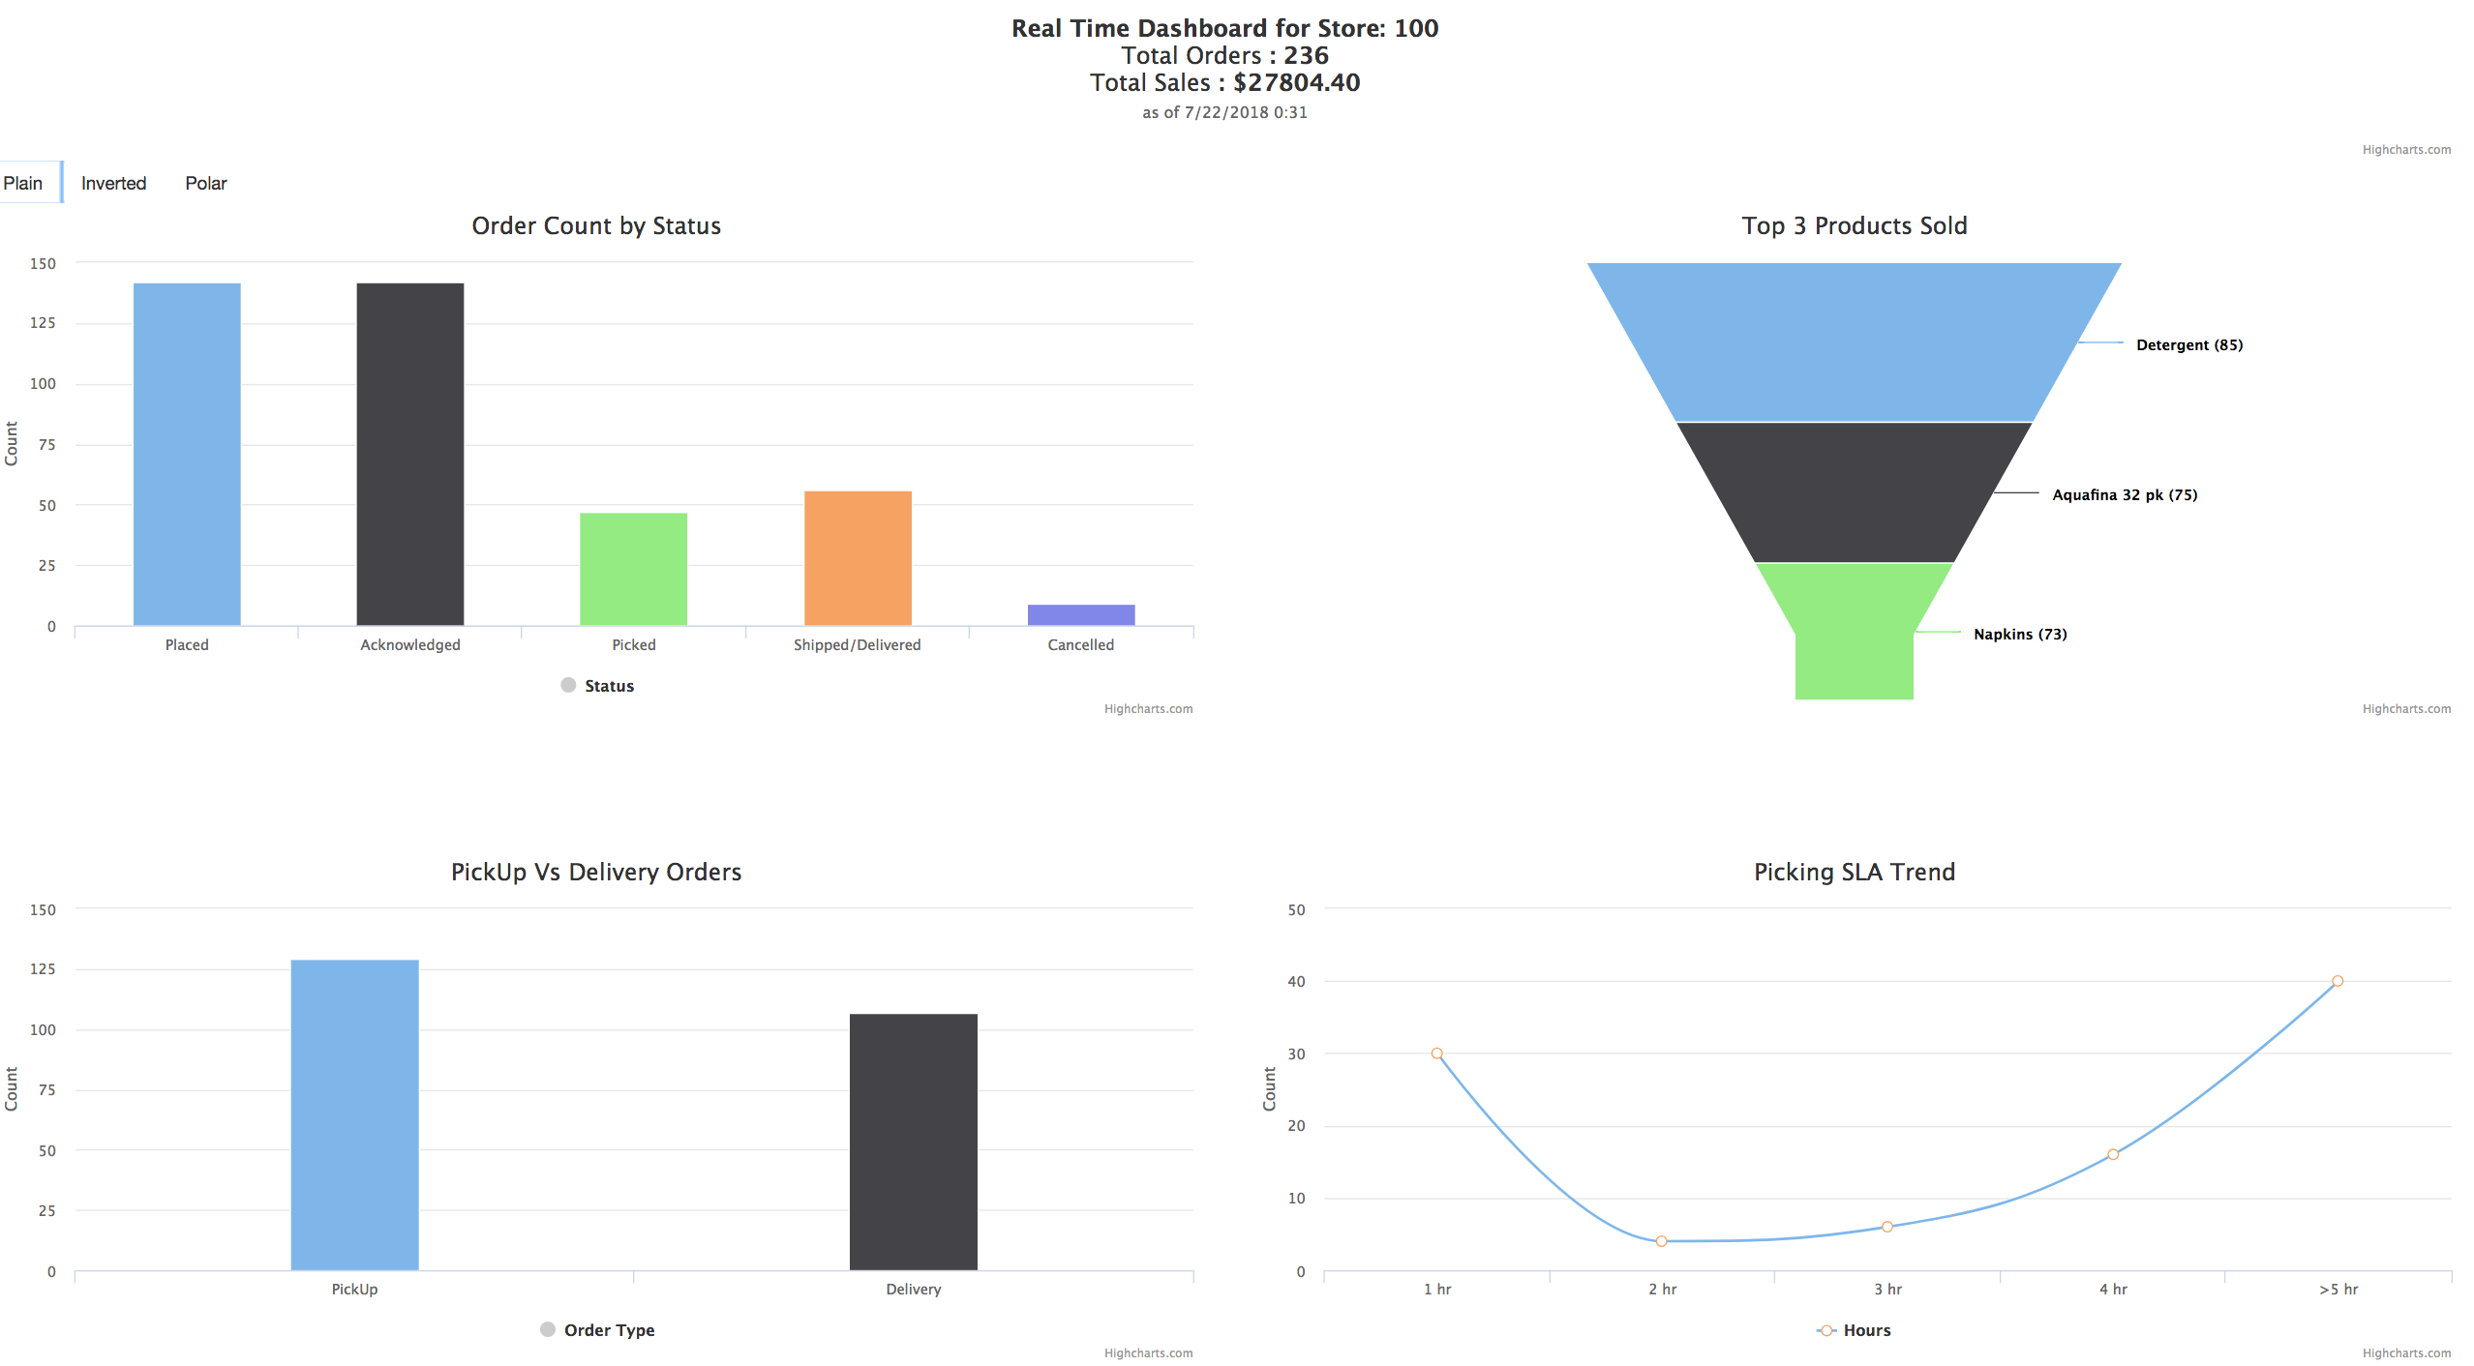
Real Time Dashboard for the Store Manager
Dashboard Contents
Total orders received
Total Sales happened
Count of orders in various order statuses
Top 3 trending items
Pickup Vs Delivery orders
Tracking the orders which are pending for picking.
How Real time stream results help the Store Manager??
Assign additional employees at the packaging section when more orders are going beyond SLA
Places additional inventory request for the top selling items
Instructs E-Comm Admin to push live discounts on those items where there are low volume of orders
Always have real-time data about the store functions which can be shared with the head office without much preparation or delay
Store manager remains to be on top of all the functioning of the store and increase productivity
5

Slide 6
Thank you
Devaki
Chandrakala
Sini
Mohanraj
https://github.com/RAI-POC/EcommRAI
6

