Slide 1
Friday, July 20, 2018
Ecommerce – Real time stream Analytics
- powered by Apache Kafka & MongoDB
Devaki Sundaramurthy Chandrakala Revensiddappa
Sini Cherukud Manayil Mohanraj Kanagaraj

Slide 2

About the Team
Name : Devaki Sundaramurthy
Emp id : 190017
Project :
Account : Walmart
Technology :
Location : Bentonville – AR, USA
Name : Chandrakala Revensiddappa
Emp id : 176502
Project :
Account : Metropolitan Life Insurance
Technology :
Location : Bangalore, India
Name : Sini Cherukad Manayil
Emp id : 440590
Project :
Account : Lego
Technology :
Location : Bangalore, India
Name : Mohanraj Kanagaraj
Emp id : 165071
Project : SPI Design & Development
Account : Metropolitan Life Insurance
Technology : Microservices, JAVA, Python
Location : Chennai, India

Slide 3
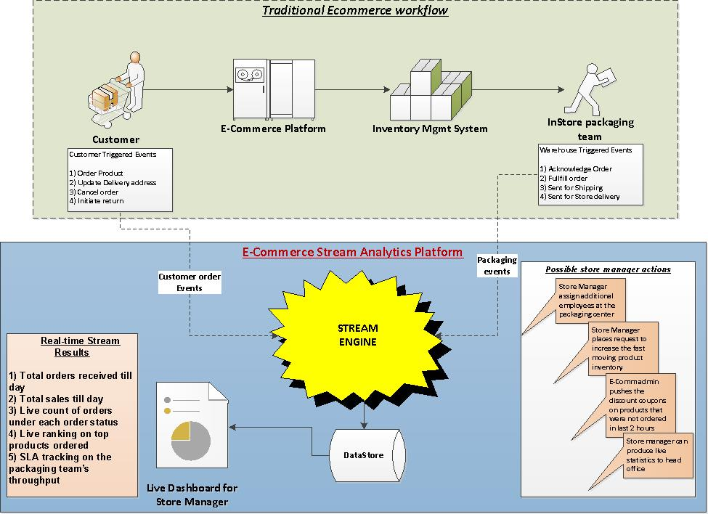
Use Case
Traditional ecommerce transaction events are enriched using a stream engine in real time to produce valuable statistics and data which in turn aid a retail store manager to run his store effectively and efficiently.
Stream Analytics results would help a store manager to
have up to date order & sales handy
live statistics on the order counts by product
real time view of the top trending products
keep the packaging team’s performance within SLA
full control of the store functioning

Slide 4
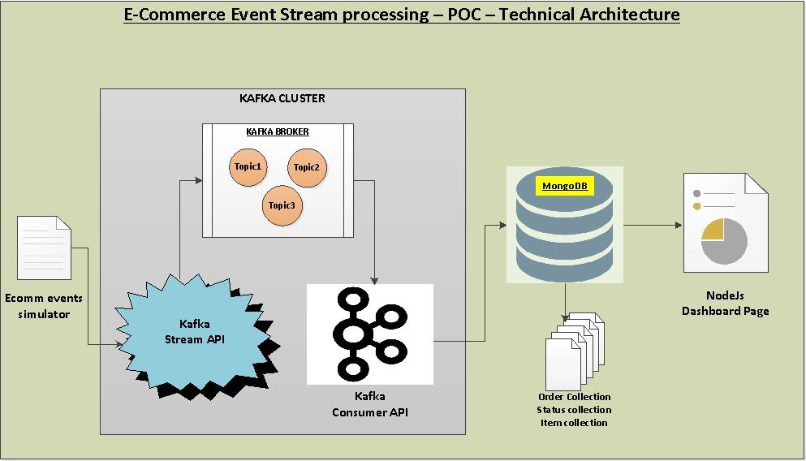
Technical Architecture
Ecommerce events were simulated using a Java application which keeps generating the events randomly
Kafka zookeeper & Kafka broker will have to be started to keep control of the topics to enable the streaming
Kafka stream Java API would connect to the event simulator to read the raw event json in real time.
Later it sanitize and process this raw data into an useful dataset which can then be persisted downstream.
Live Stream processed datasets are pushed into the meaningful topics of the running kafka broker.
Kafka consumer Java API would read these topics from the broker and connect to the Mongo client to insert into respective Mongo Collections.
3 different Mongo collections named Order, Status and Item will be created and stream processed data will be inserted in real time by the consumer java API.
Mongo collections would continuously be read by the NodeJS application to produce meaningful dashboard in a HTML page.

Slide 5
Live Dashboard results for the Store Manager
Dashboard Contents
Banner on total orders received
Banner on total Sales happened
Bar Graph showing the Pickup Vs Delivery order counts
Graph showing the count of orders in various order statuses
Graph showing the top 3 trending items based on order count
Graph tracking the orders count which are not picked by packaging team over a period of time.
How live stream results help the Store Manager post??
Assign additional employees at the packaging section when more orders are going beyond SLA
Places additional inventory request for the top selling items
Instructs E-Comm Admin to push live discounts on those items where there are low volume of orders
Always have real-time data about the store functions which can be shared with the head office without much preparation or delay
Store manager remains to be on top of all the functioning of the store and can deduct the failure in near real time

Slide 6
Thank you
Devaki
Chandrakala
Sini
Mohanraj

