Slide 1

FinLens: AI-Powered Financial Document Analysis & Comparison
Final Year Project

Slide 2

The Problem: Financial Literacy Gap
Real-World Scenario
Borrowers receive 30-page loan agreements filled with legal jargon — floating rates, foreclosure charges, prepayment penalties — and most only ask "What's the EMI?" before signing.
The Consequence
Unexpected penalties like ₹2 lakh early repayment charges, misaligned insurance coverage, and poor investment decisions that could have been avoided.
Root Cause
Financial documents are written by lawyers, not educators. Professional legal review costs ₹5,000–₹20,000 per document — inaccessible to most borrowers.

Slide 3


Why Existing Solutions Fall Short
Generic LLMs (ChatGPT)
Explains one document but cannot compare multiple offers, lacks personalization, and may hallucinate without complete context.
Bank Websites
Show only their own products — no cross-institution comparative analysis possible.
Financial Advisors
Expensive, not scalable, require manual consultation. Not accessible to the average borrower.
Research Gap
No automated system combines document understanding + personalization + comparative analysis + live market context.

Slide 4





FinLens Solution: The Financial Doctor Analogy
Just as a doctor diagnoses, compares treatment options, and prescribes based on your personal health profile — FinLens diagnoses your financial documents, compares offers, and recommends based on your financial profile.
Upload
Multiple loan offers, insurance plans, investment documents
Analyze
Extract key terms, compare against live market rates, personalize to user profile
Recommend
Match scores, trade-off analysis, and personalized reasoning — fully auditable
Key Innovation: A 4-agent agentic AI workflow — not a single LLM — ensures accuracy, auditability, and domain-specific reasoning.

Slide 5
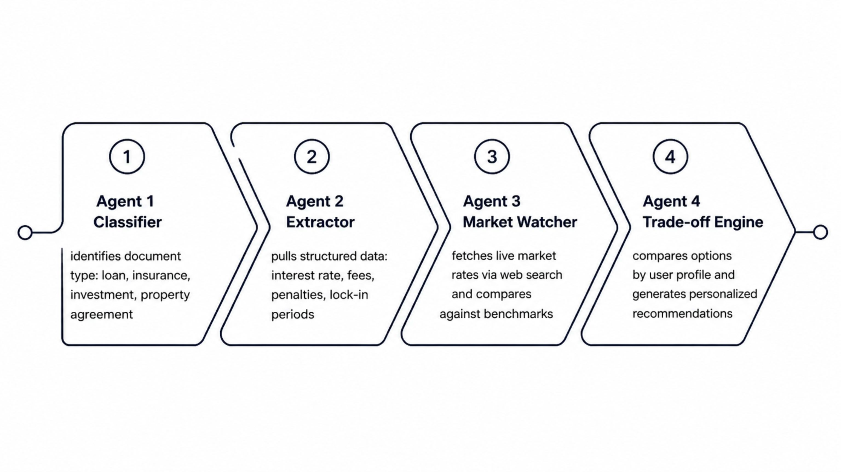
System Architecture: Four AI Agents

Slide 6
Why Agentic AI Over a Single LLM?
Modularity
Accuracy
Auditability
Each agent has one clear responsibility — easier to test, debug, and improve independently without touching other components.
Specialized prompts per task reduce hallucination. Structured outputs validated via Pydantic enforce schema correctness.
Every agent's reasoning is logged — professors and users can trace exactly why a recommendation was made.
Scalability
Reliability
New document types are added by creating new agents — no retraining of the entire system required.
Fallback mechanisms ensure continuity — e.g., Market Watcher uses a reference dataset if live web search fails.

Slide 7

Technology Stack & Justification
LangGraph
Orchestrates agent workflow; enforces correct execution order across all four agents.
Claude (LLM)
Understands complex legal/financial language; strong reasoning for nuanced trade-off analysis.
FastAPI + React
Lightweight backend handles uploads and routing; interactive frontend displays scores and comparisons.
Tavily + Pydantic
Live market data fetching + strict output validation to prevent malformed AI outputs reaching the database.
SQLite / PostgreSQL
Stores user profiles, documents, and full analysis history for auditability and session continuity.

Slide 8

User Flow & MVP Scope
Dashboard Output
Document Upload
Profile Setup
Agent Pipeline
Match scores, highlights, personalized recommendations
Upload financial PDFs for verification
Answer 5 questions: age, salary, EMIs, risk, goal
Classifier → Extractor → Market Watcher → Trade-off Engine
MVP is scoped to home loans and insurance plans — a realistic, achievable boundary for a semester timeline. The architecture is designed to extend to credit cards, mutual funds, and banking APIs in future phases without major restructuring.

Slide 9

Explainability & Auditability
Match Score Breakdown
92/100 — transparently composed: interest rate (30 pts), prepayment flexibility (25 pts), processing fee (20 pts), plus additional weighted criteria.
Evidence-Backed Highlights
"Loan A: Lowest EMI" — every highlight is backed by extracted data cross-referenced against live market comparisons.
Reasoning Transparency
"Choose Loan B if you plan to repay early" — recommendations explicitly explain the trade-off logic in plain language.
Full Audit Trail
Every extraction, market lookup, and comparison is logged with timestamps and source references — critical for the regulated financial domain.

Slide 10
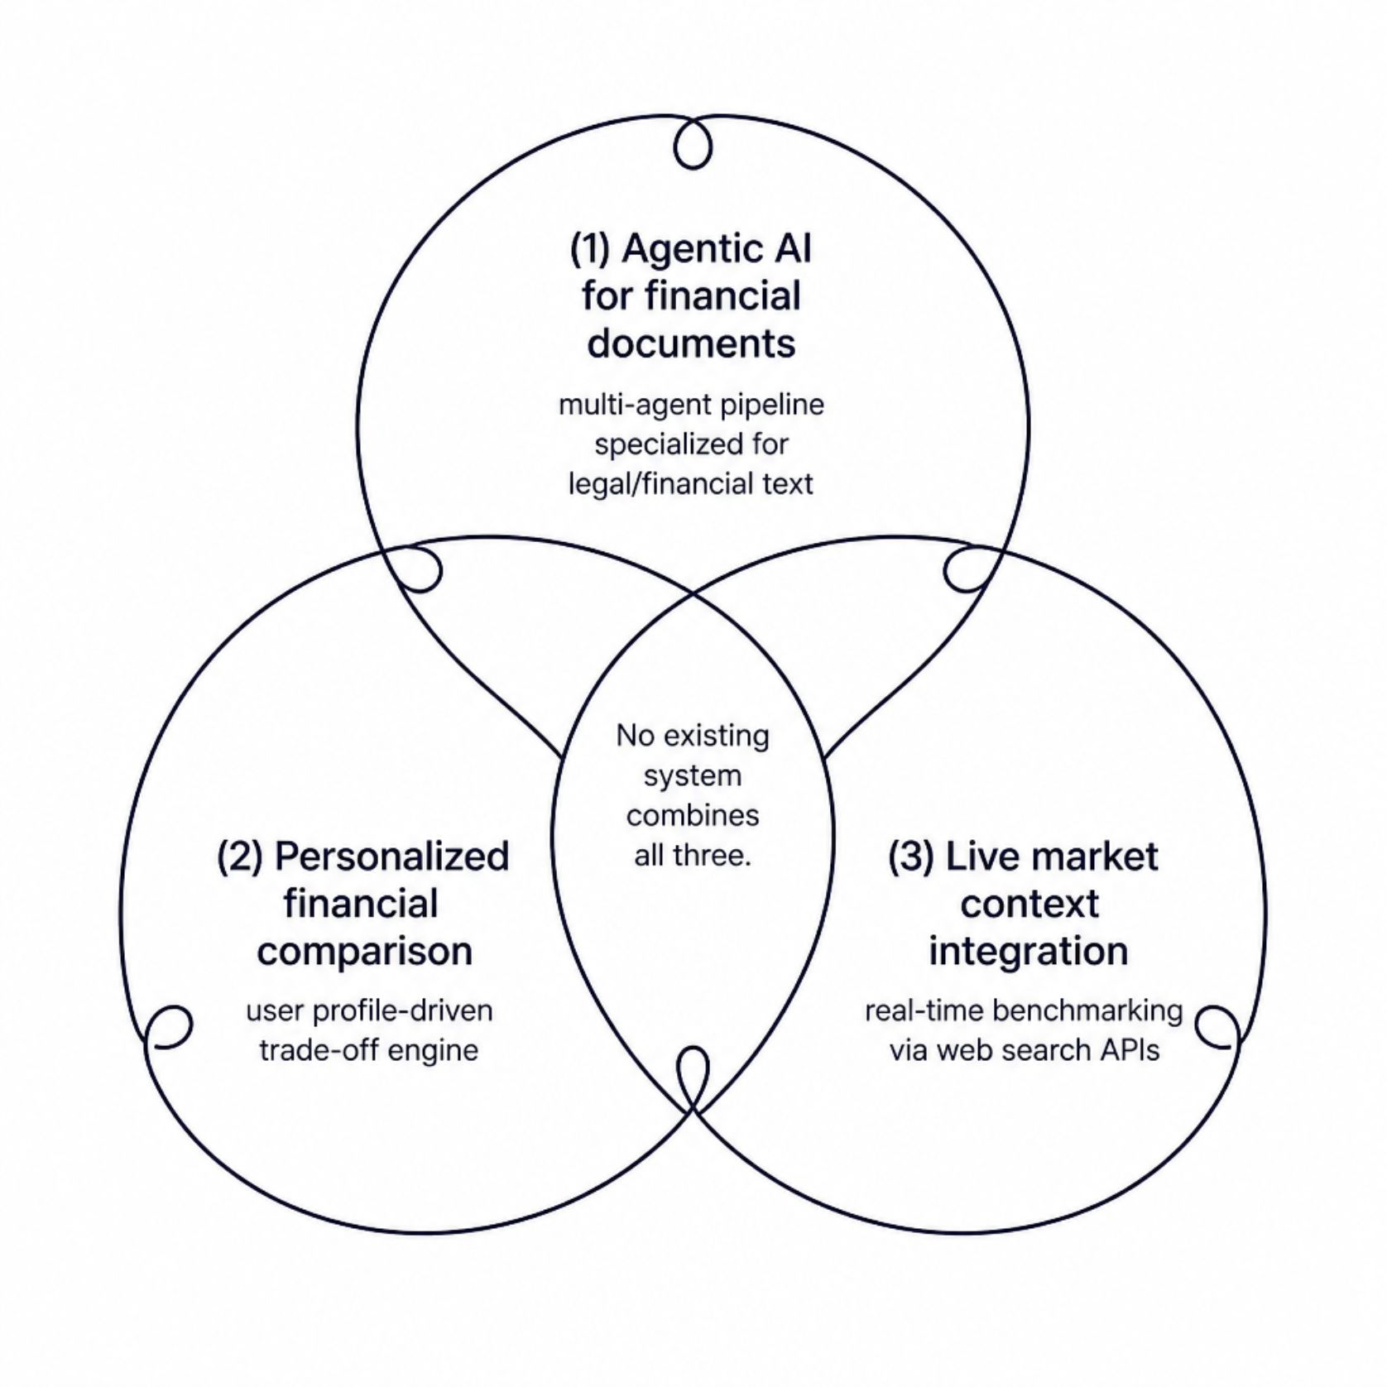
Feasibility & Research Contribution
Timeline
MVP achievable in 4–5 months: document classification, extraction, and basic comparison pipeline are independently deliverable milestones.
Research Novelty
Combines agentic AI + personalization + live market context for financial documents. No existing system does all three.
Scalability Path
Architecture supports new document types, banking API integrations, and B2B fintech partnerships without redesign.
Known Challenges
Handling document format variations (scanned PDFs, handwritten notes)
Ensuring extraction accuracy across diverse financial templates
Managing API rate limits for live market data

Slide 11

Live Demo Flow
Demo scenario: User uploads 3 home loan offers + 1 insurance plan and walks through the full agent pipeline in real time.
01
Classifier in Action
Watch the system automatically identify each document type — loan offer vs. insurance plan — without any manual tagging.
02
Extractor Output
See structured key terms pulled from unstructured PDF text: interest rates, processing fees, prepayment penalties, lock-in periods.
03
Market Watcher Benchmark
Live comparison — extracted rates benchmarked against current RBI-linked market rates fetched in real time.
04
Dashboard & Auditability
Match scores, side-by-side comparison, personalized recommendations — click any recommendation to trace extracted data, market benchmark, and full trade-off logic.

