Slide 1
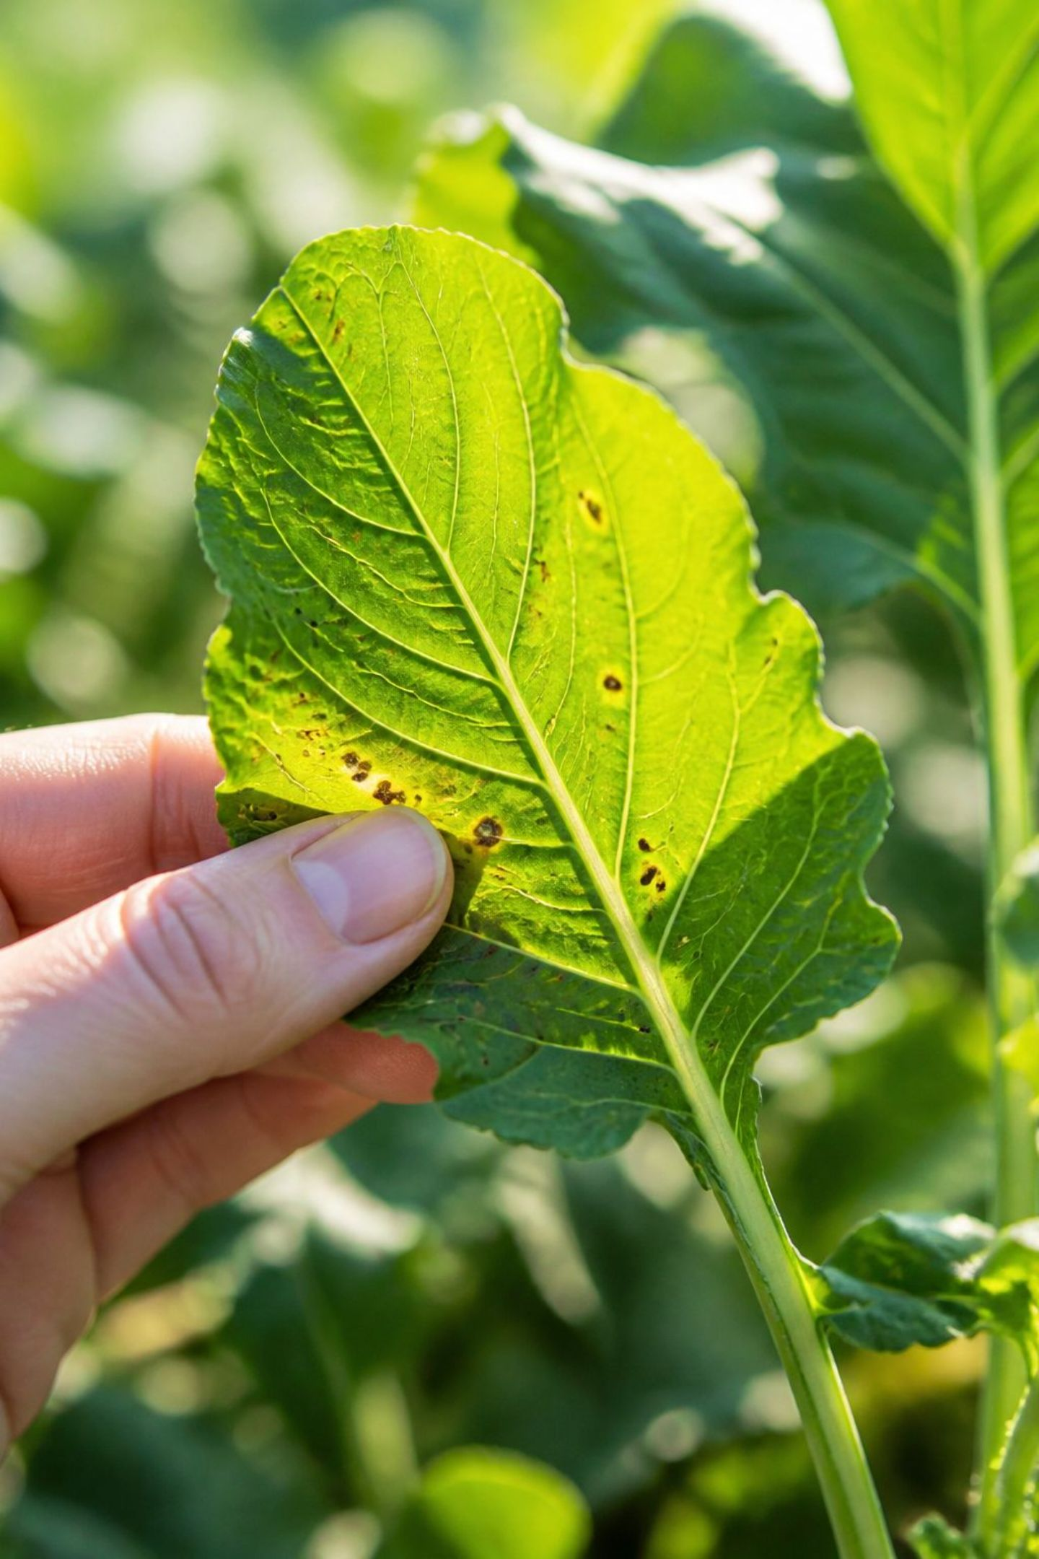
AI-Powered Multi-Agent System for Crop Leaf Disease Detection and Farmer Advisory
An intelligent, modular architecture for rapid diagnosis, risk assessment, and actionable recommendations — delivered to farmers in seconds.

Slide 2
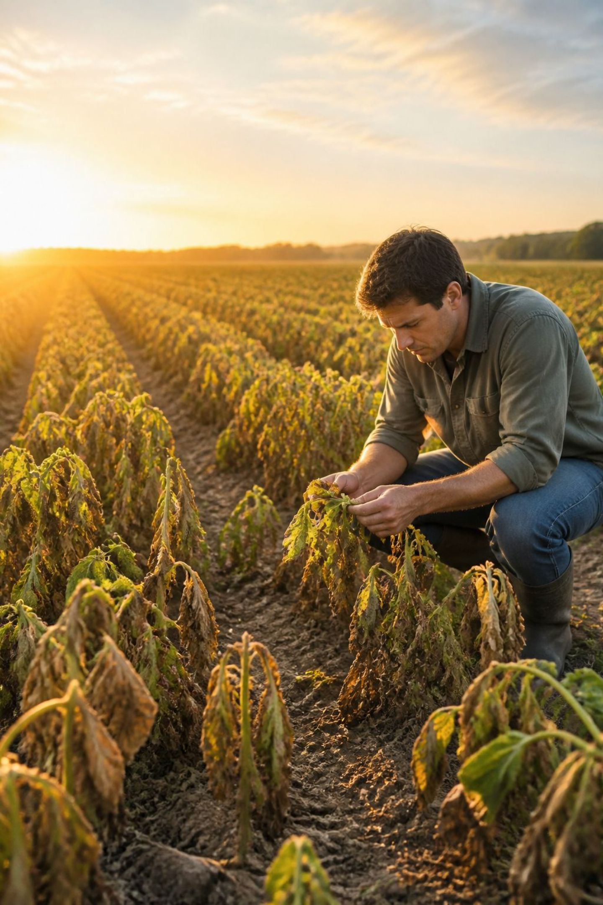
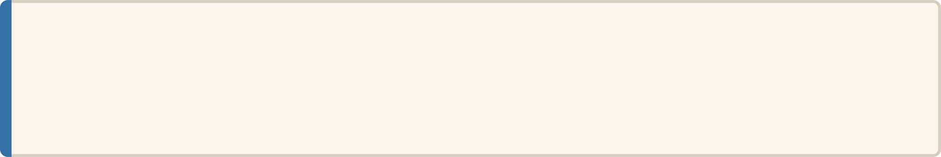
The Problem: Crop Losses and Diagnostic Delays
20–40% Annual Yield Loss
Crop diseases devastate global harvests every year, threatening food security and farmer livelihoods.
Late Diagnosis
Farmers frequently miss critical treatment windows, allowing disease to spread unchecked across entire fields.
Scarce Expertise
Agronomist consultations in rural areas are expensive, slow, and inaccessible for smallholder farmers.
Misidentification Risk
Wrong diagnoses lead to incorrect treatments — wasting resources, harming soil health, and worsening outcomes.

Slide 3
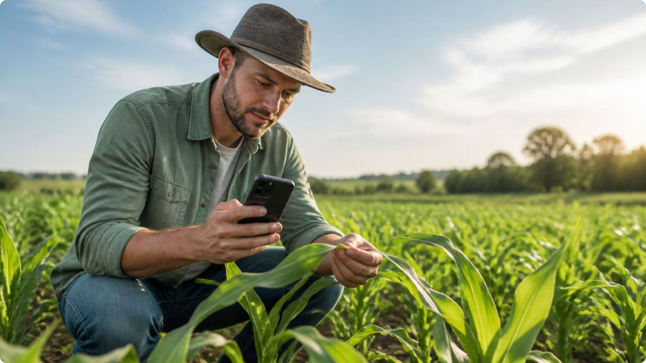
Motivation and Objectives
1
Rapid, Accurate Diagnosis
Enable disease identification from a smartphone photo in seconds, not days.
2
Environmental Context Integration
Incorporate weather, soil conditions, and crop growth stage into every risk assessment.
3
Farmer-Friendly Recommendations
Deliver actionable, confidence-scored advice that farmers can immediately act upon.
4
Continuous Feedback Loop
Monitor treatment progress through follow-up images and adaptive re-evaluation.

Slide 4
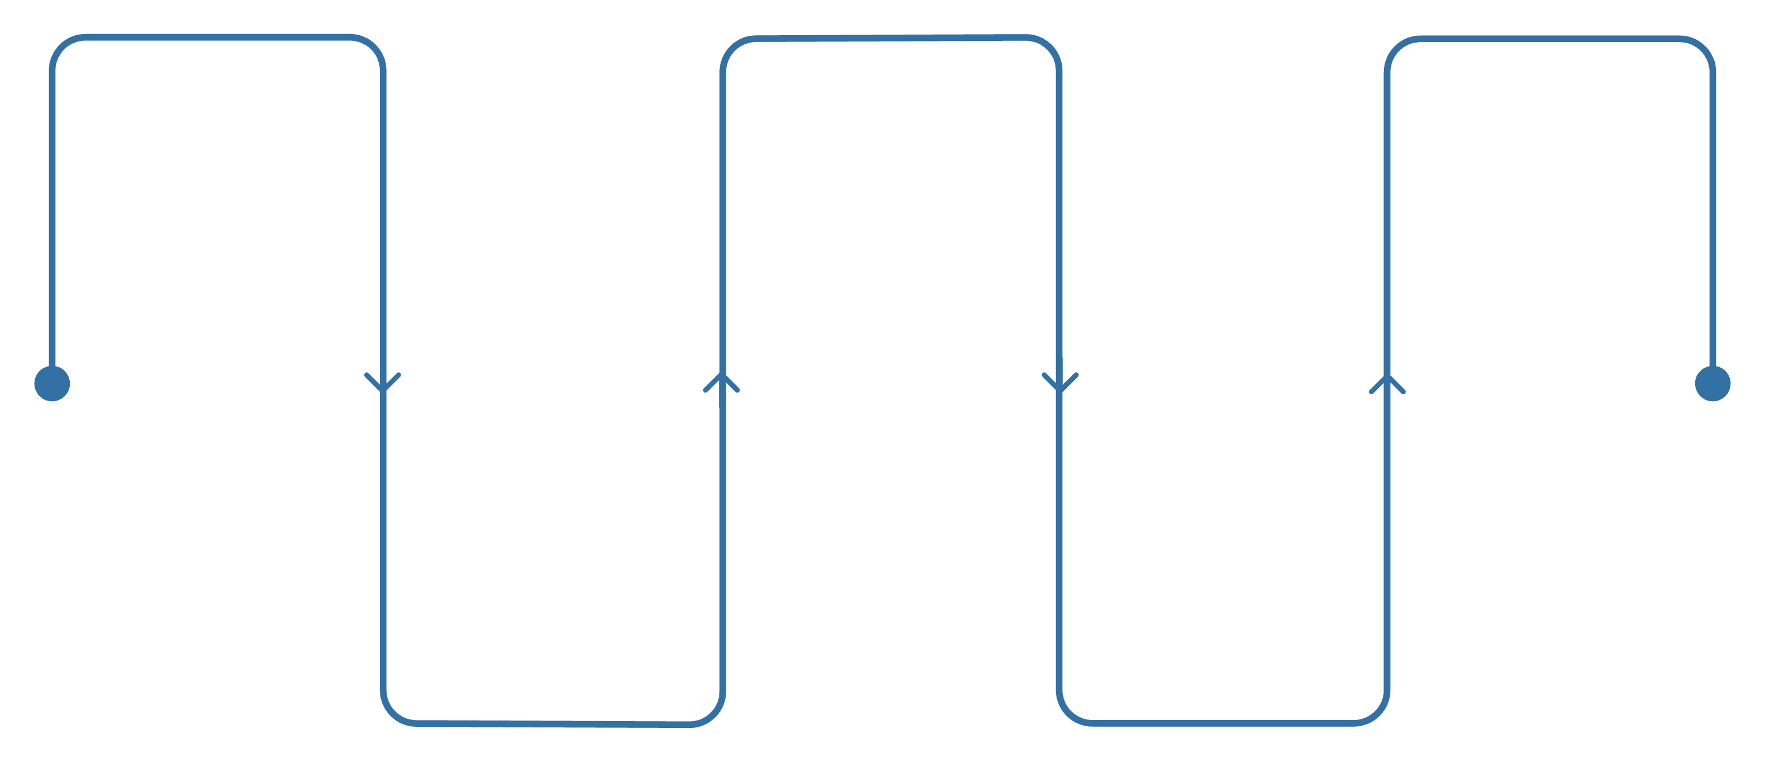
System Architecture: High-Level Overview
Upload
Parallel Processing
Recommendation
Farmer submits leaf image
Vision, Weather, RAG run
Deliver actionable advice
Orchestration
Risk Synthesis
Dispatches tasks to agents
Combine outputs into score
The Orchestrator coordinates all specialist agents, enabling parallel processing that reduces end-to-end latency to under 4 seconds. A Monitoring Agent closes the feedback loop as follow-up images arrive.

Slide 5
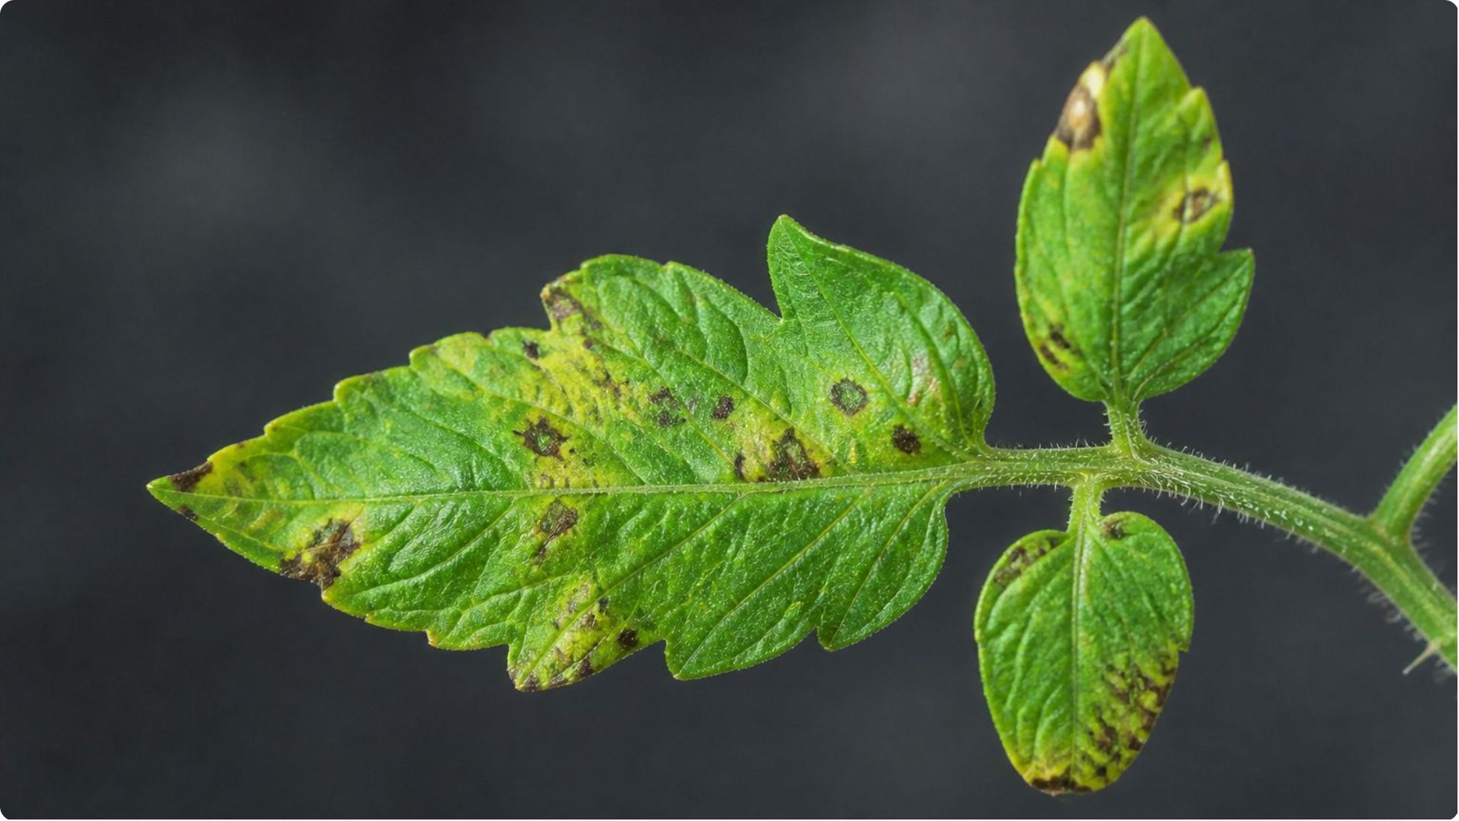
Agent Roles: Vision Agent
Function
The Vision Agent is the system's perceptual core — transforming raw leaf images into structured, quantified diagnostic outputs.
Input: Leaf image (JPEG/PNG) from farmer's device
Process: Convolutional neural network for image classification and object detection
Output: Disease label (e.g., early blight, late blight, leaf rust), confidence score (0–100%), and severity estimate (% leaf area affected)
Design: Trained on agricultural image datasets; outputs include uncertainty bounds for downstream agents

Slide 6
Agent Roles: Weather Agent & RAG Agent
🌦 Weather Agent
📚 RAG Agent
Input: Farmer's GPS location and date/time
Process: Queries weather API for current conditions and 7-day forecast
Output: Temperature, humidity, rainfall, wind speed — with disease-favorable conditions flagged
Design: Caches recent queries; alerts when conditions favor rapid disease spread
Input: Disease label from Vision Agent
Process: Semantic search across vector database of extension documents, treatment guides, and pesticide databases
Output: Treatment options, fungicide recommendations, application timing, and cost estimates
Design: Grounds all recommendations in peer-reviewed agricultural knowledge

Slide 7
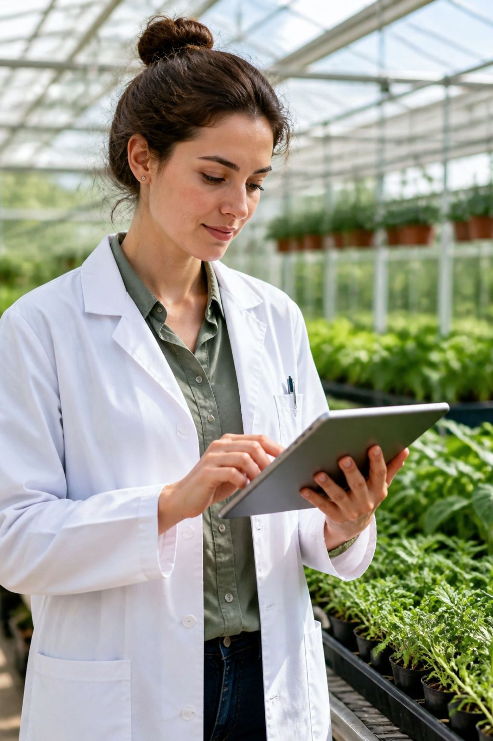
Agent Roles: Risk/Reason & Recommendation Agents
Risk/Reason Agent
Recommendation Agent
Synthesizes outputs from Vision, Weather, and RAG agents to assess overall risk severity — low, moderate, or severe — and estimate disease progression timeline. Acts as the analytical brain of the system.
Converts the risk assessment into clear, actionable steps (e.g., "Apply fungicide X within 48 hours"), urgency level, and a confidence justification. Outputs structured JSON for clean UI rendering.

Slide 8
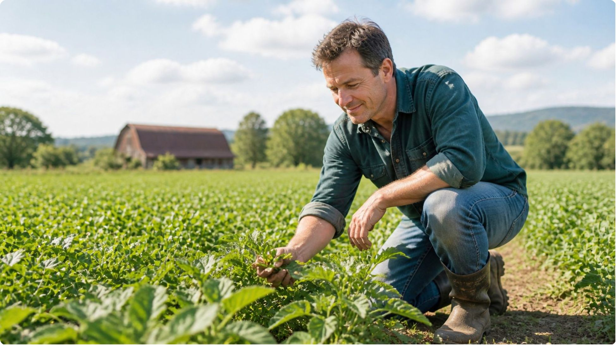
Agent Roles: Monitoring Agent
Closing the Feedback Loop
The Monitoring Agent transforms the system from a one-shot diagnostic tool into a continuous care platform.
Input: Follow-up leaf image plus full previous case history
Process: Compares current severity against baseline; computes delta (improvement or deterioration)
Output: Updated risk assessment and recommendation adjustment (e.g., "disease spreading — escalate treatment")
Design: Enables long-term case tracking and treatment efficacy measurement over time

Slide 9

Data Flow: Single Request Lifecycle
T = 0s
1
Farmer uploads leaf image. Orchestrator receives request and logs a unique case ID.
2
T = 0–2s
Vision, Weather, and RAG agents execute in parallel; each returns structured output independently.
T = 2–3s
3
Risk/Reason Agent synthesizes all outputs; computes risk score and disease progression estimate.
4
T = 3–4s
Recommendation Agent generates actionable advice. UI displays result directly to the farmer.
T = +Days
5
Farmer uploads follow-up image. Monitoring Agent compares severity and re-triggers the Risk/Reason Agent.
End-to-end diagnosis is delivered in under 4 seconds — from image upload to actionable recommendation.

Slide 10





Why Multi-Agent Architecture?
Modularity
Parallelization
Explainability
Each agent has a single, well-defined responsibility — making it easy to update, retrain, or replace without disrupting the entire system.
Vision, Weather, and RAG agents run simultaneously, cutting latency and delivering results in under 4 seconds.
Each agent's output is independently interpretable — farmers see why a recommendation was made, building trust.
Scalability
Robustness
Agents deploy independently and can be load-balanced based on regional demand spikes during disease outbreaks.
Failure of one agent (e.g., weather API outage) does not block the entire pipeline — graceful degradation is built in.

Slide 11
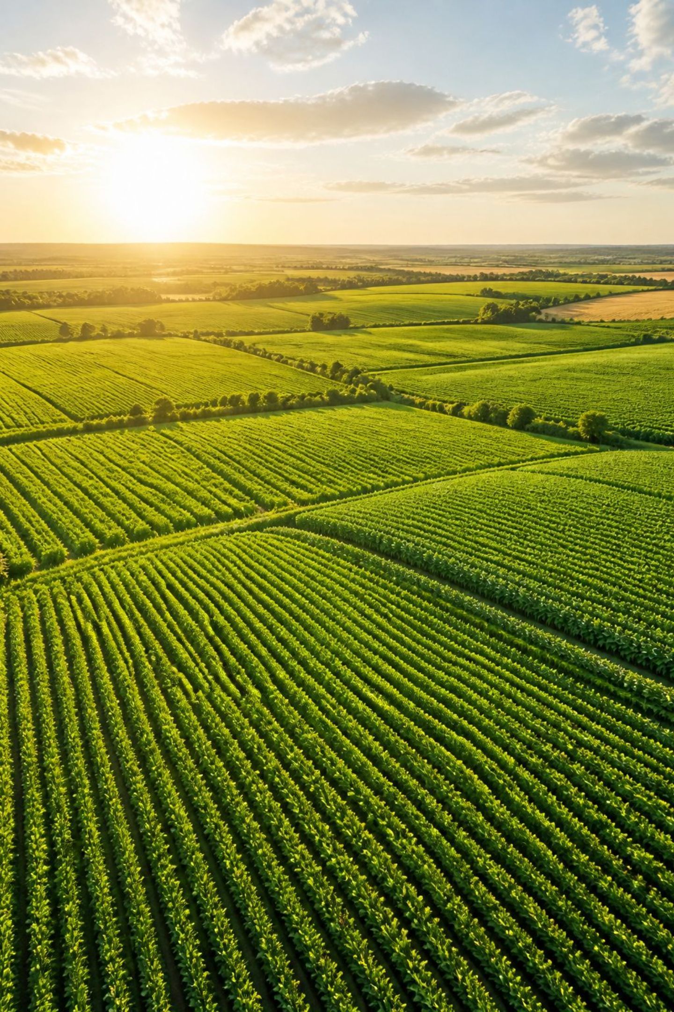
Summary and Research Contribution
What We Built
Key Contributions
A fully modular, multi-agent AI system that delivers sub-4-second crop disease diagnosis, integrates environmental context, and provides confidence-scored, farmer-actionable recommendations with continuous monitoring.
Novel Orchestrator–Specialist agent architecture for agricultural diagnostics
Integration of visual, meteorological, and knowledge retrieval signals into a unified risk model
Closed-loop monitoring enabling treatment efficacy tracking over time
Explainable, confidence-scored outputs designed for low-literacy, resource-constrained farming contexts

