Slide 1
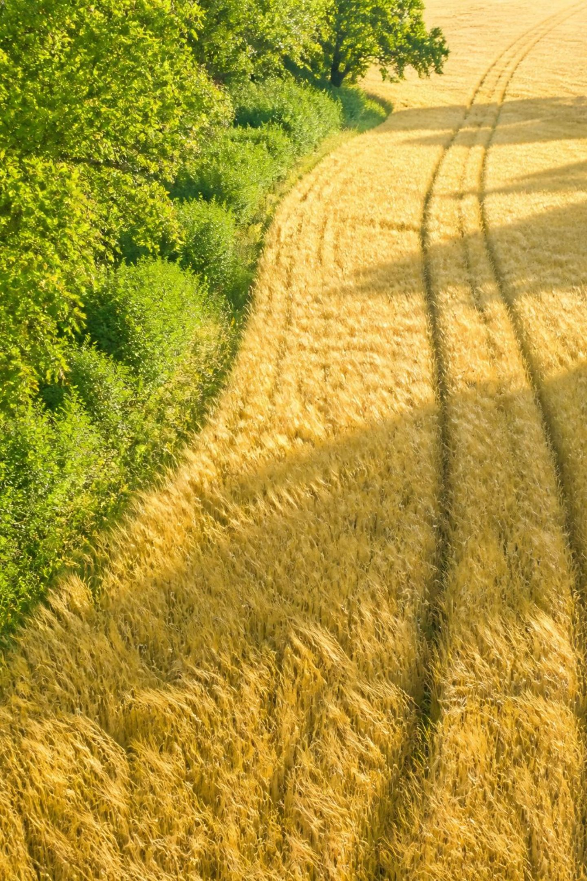
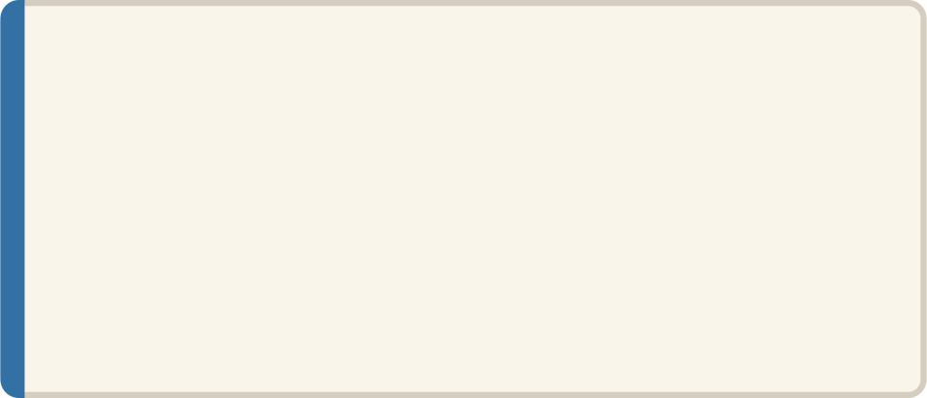
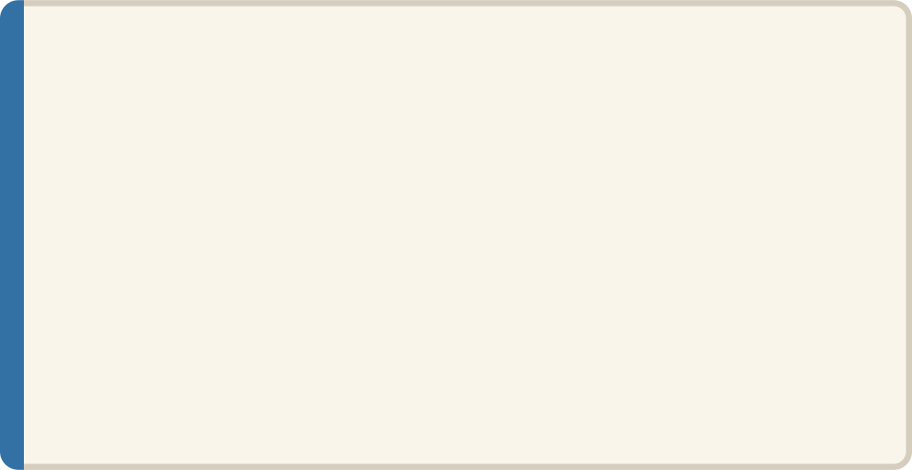
Agent Roles: Weather Agent
SYSTEM ARCHITECTURE
Design Principles
Input
Caches recent queries to minimize redundant API calls. Automatically alerts the Orchestrator when conditions — high humidity, warm nights, post-rain windows — favor rapid pathogen spread.
Farmer's GPS location, date/time stamp
Process
Queries weather API for current conditions and 7-day forecast
Output
Temperature, humidity, rainfall, wind speed; disease-favorable conditions flagged

Slide 2




Agent Roles: RAG Agent
RETRIEVAL-AUGMENTED GENERATION
Input
Process
Disease label received from the Vision Agent after image classification
Semantic search across a vector database of agricultural extension documents, treatment guides, and pesticide registries
Output
Design
Relevant treatment options, fungicide/pesticide recommendations, application timing, and cost estimates
Grounding in peer-reviewed knowledge prevents hallucination; retrieval is traceable to source documents

Slide 3

Agent Roles: Risk/Reason & Recommendation Agents
Risk / Reason Agent
Recommendation Agent
Synthesizes outputs from Vision, Weather, and RAG agents into a unified assessment. Assigns an overall risk level — low, moderate, or severe — and estimates the likely disease progression timeline.
Converts the risk assessment into clear, actionable steps — e.g., "Apply fungicide within 48 hours." Outputs urgency level and a plain-language confidence justification rendered via structured JSON for the farmer UI.

Slide 4

Agent Roles: Monitoring Agent
FEEDBACK LOOP
Compare Against Baseline
Compute Severity Delta
Align and contrast with initial image.
Calculate percent change in affected area.
Follow-up Image Uploaded
Update Risk & Adjust Recommendation
Attach new image linked to case history.
Revise risk score and treatment advice.
The Monitoring Agent closes the feedback loop by linking every follow-up image to its original case history. By computing the percentage change in affected leaf area over time, it enables long-term treatment efficacy measurement and triggers escalation when disease continues to spread despite intervention.

Slide 5
Data Flow: Single Request Lifecycle
T = 0s
T = 2–3s
T = +Days
Farmer uploads image; Orchestrator logs unique case ID
Risk/Reason Agent synthesizes all outputs; computes risk score and progression estimate
Follow-up image triggers Monitoring Agent; Risk/Reason Agent re-evaluates
1
2
3
4
5
T = 0–2s
T = 3–4s
Vision, Weather, RAG agents run in parallel; each returns structured output
Recommendation Agent generates actionable advice; result displayed to farmer

Slide 6

Why Multi-Agent Architecture?
Modularity
Scalability
Single responsibility per agent — update or replace without system-wide impact
Agents deployed and load-balanced independently based on demand
Robustness
Parallelization
Failure of one agent (e.g., weather API outage) does not block the entire pipeline
Vision, Weather, RAG run simultaneously — dramatically lower end-to-end latency
Explainability
Every agent output is interpretable — farmers see why each recommendation was made

Slide 7
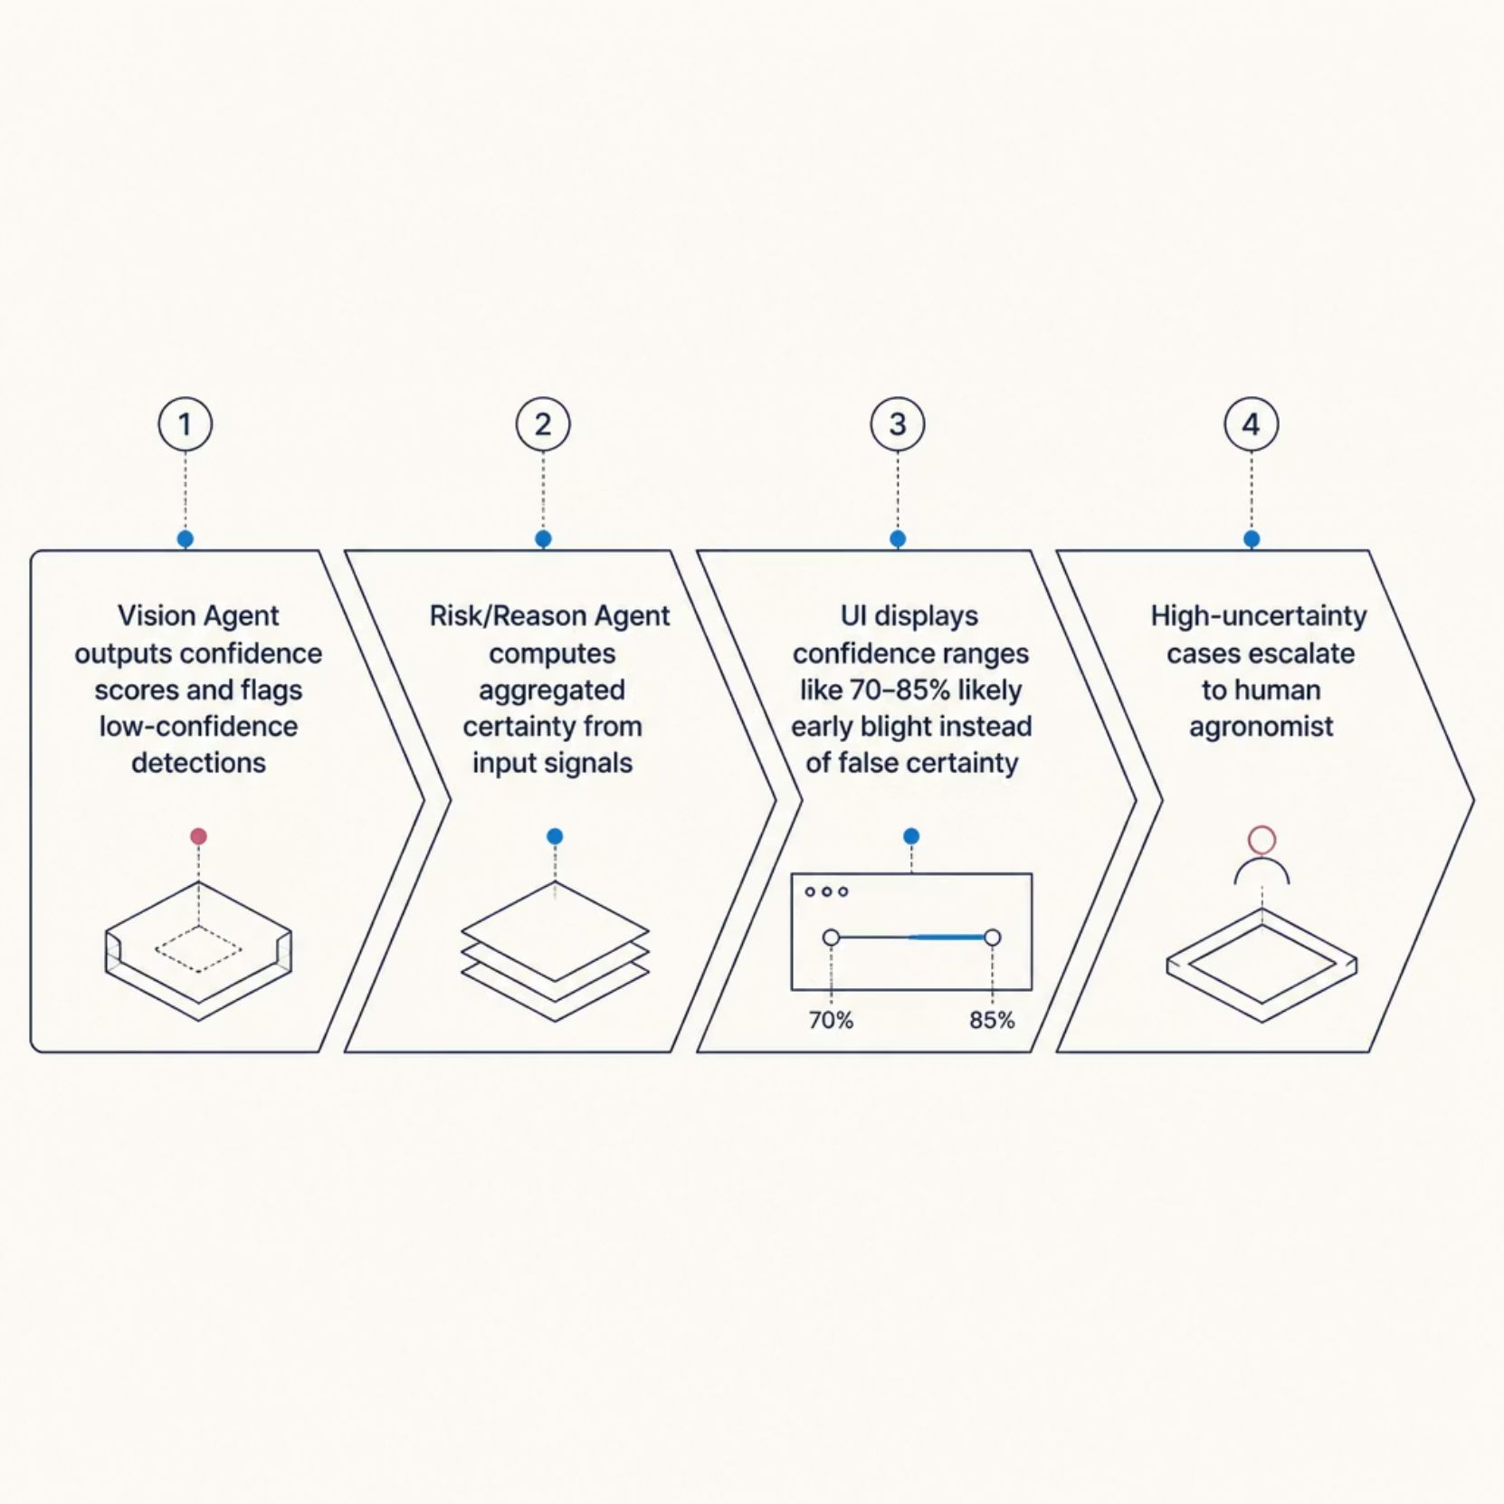

Handling Uncertainty and Confidence
Why Confidence Transparency Matters
Presenting confidence ranges — rather than false binary outputs — builds farmer trust and supports regulatory compliance. The system never overstates certainty: low-confidence detections surface a human agronomist for manual verification, ensuring safety in high-stakes decisions.
Uncertainty quantification is a core design principle, not a post-hoc addition.

Slide 8
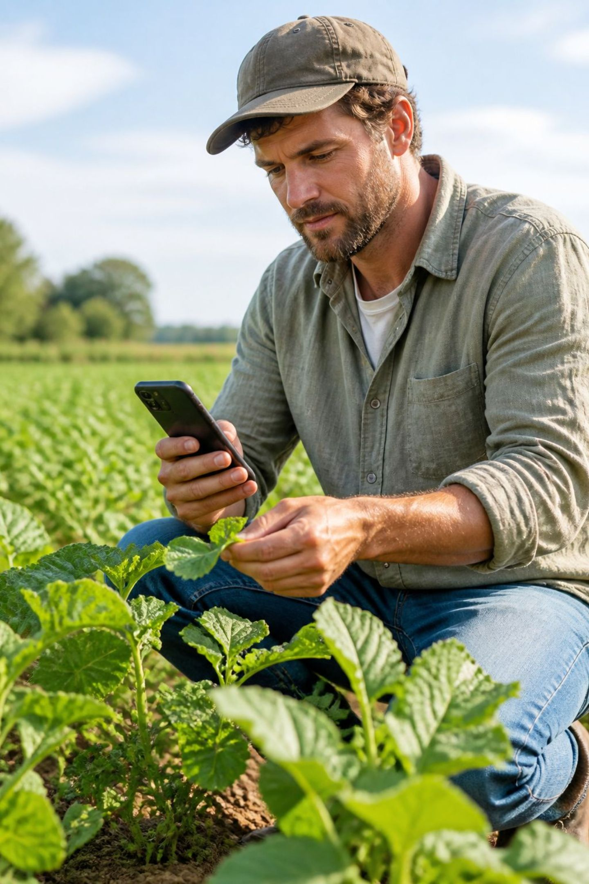
Monitoring and Feedback Loop
1
Case Tracking
Each farmer case receives a unique ID; all follow-up images are linked to the original baseline for longitudinal comparison.
2
Severity Trending
Monitoring Agent computes percentage change in affected leaf area across visits, generating a quantitative severity trajectory.
3
Adaptive Recommendations
If disease worsens despite treatment, the system escalates urgency or proposes alternative interventions informed by RAG knowledge.

Slide 9
Expected Challenges and Limitations
Image Quality
Disease Overlap
Poor lighting or resolution reduces Vision Agent accuracy. Mitigation: In-app guidance prompts farmers on optimal photo capture technique.
Visually similar symptoms across diseases increase misclassification risk. Mitigation: Confidence thresholds trigger agronomist escalation.
Regional Knowledge Gaps
Connectivity
RAG database may lack local treatment practices. Mitigation: Continuous curation with regional extension partners.
Rural intermittent internet disrupts real-time agents. Mitigation: Offline mode for image capture and lightweight on-device inference.

Slide 10

Future Scope
Near-Term Extensions
Long-Term Vision
Push-Based Monitoring: Proactive alerts when weather favors disease spread — no farmer input required
Multilingual Support: Recommendations in local languages with culturally adapted treatment advice
Offline Mode: Lightweight models for on-device inference in low-connectivity regions
Crop-Specific Tuning: Specialized models for wheat, rice, maize; region-specific disease prevalence weighting
Supply Chain Integration: Link recommendations to local pesticide availability and real-time pricing data

Slide 11

Conclusion
Scalable Diagnosis
Multi-agent architecture enables rapid, accurate, context-aware disease diagnosis at scale across diverse crops and geographies.
Farmer Trust
Transparency in confidence scoring and chain-of-reasoning builds trust and enables meaningful human oversight at every step.
Continuous Improvement
The monitoring feedback loop closes the advisory cycle, enabling treatment efficacy tracking and system-wide learning over time.
Democratizing Expertise
Expert-level agricultural advisory becomes accessible to resource-constrained farmers — bridging the critical agronomist gap at scale.

