Slide 1




HINDbr: Heterogeneous Information Network Based Duplicate Bug Report Prediction
Guanping Xiao¹, Xiaoting Du², Yulei Sui³, Tao Yue¹
¹Nanjing University of Aeronautics and Astronautics, China
²Beihang University, China
³University of Technology Sydney, Australia
13/10/2020
Microsoft Teams

Slide 2
Motivation
Duplicate bug reports often exist in bug tracking systems (BTSs), leading to unnecessary maintenance effort such as repeatedly discussing the same bug.
Existing efforts on automatically detecting duplicate bug reports heavily rely on the text similarity calculated with information retrieval (IR) techniques (e.g., TF-IDF).

Slide 3
Motivation
Modern BTSs introduce just-in-time (JIT) retrieval feature in their recent versions, e.g., Bugzilla 4.0.
The built-in JIT feature can suggest possible duplicates when a reporter is filling a bug (i.e., typing in the summary field).

Slide 4
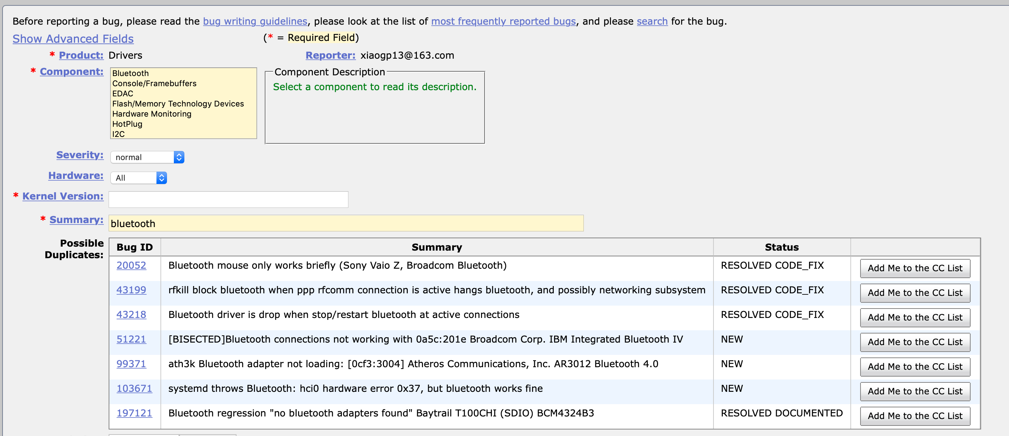
Motivation
JIT feature

Slide 5
Motivation
With the advent of the just-in-time (JIT) retrieval feature in modern BTSs, textual-based approaches become ineffective in detecting after-JIT duplicate bug reports¹.
The built-in JIT feature can suggest possible duplicates when a reporter is filling a bug (i.e., typing in the summary field), thereby reducing chances for submitting duplicate reports in the first place.
After JIT filtering, a substantial proportion of duplicate reports still exists in BTSs.
1. Rakha, M. S., Bezemer, C. P., & Hassan, A. E. (2018). Revisiting the performance of automated approaches for the retrieval of duplicate reports in issue tracking systems that perform just-in-time duplicate retrieval. Empirical Software Engineering, 23(5), 2597-2621.

Slide 6
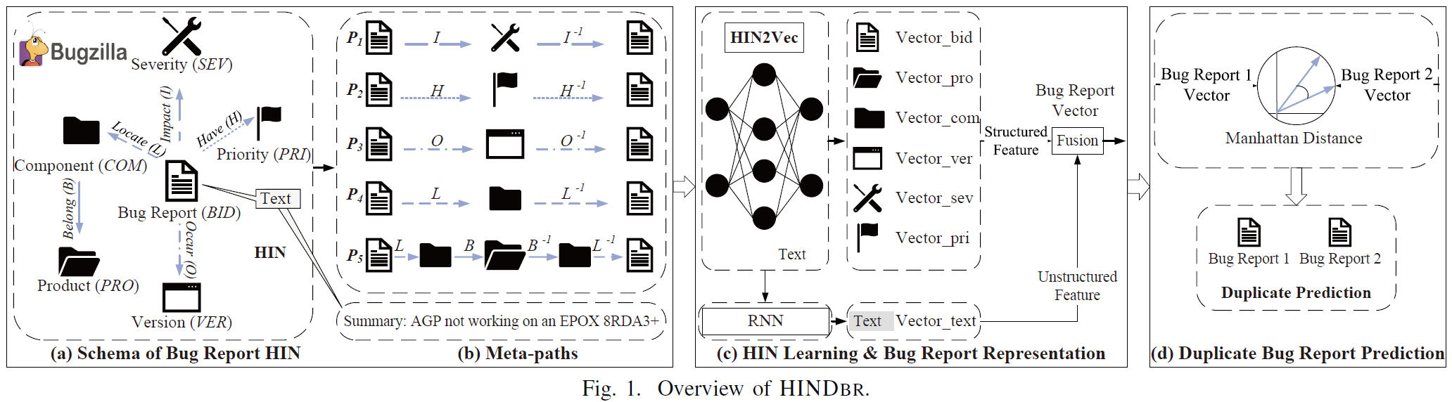
Motivation

Slide 7
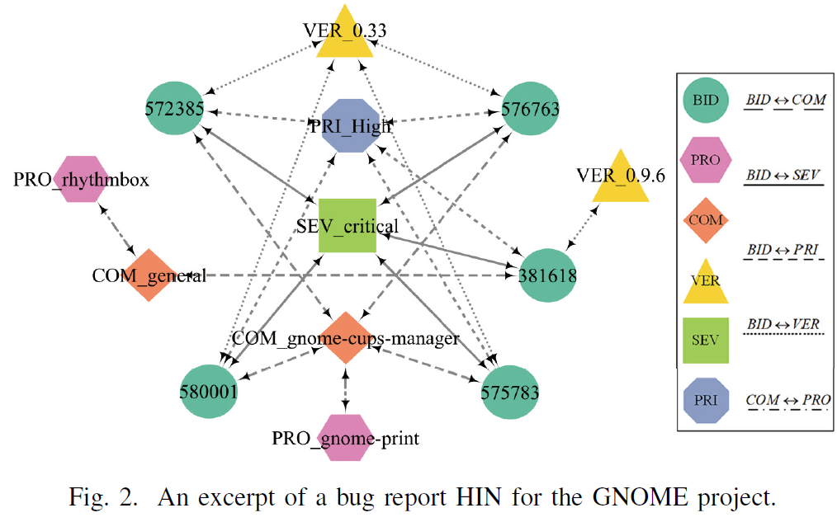
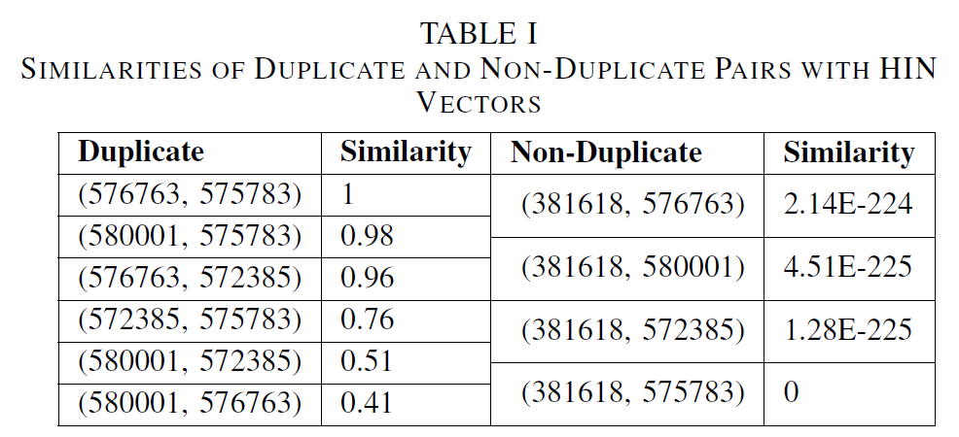
A Motivating Example

Slide 8
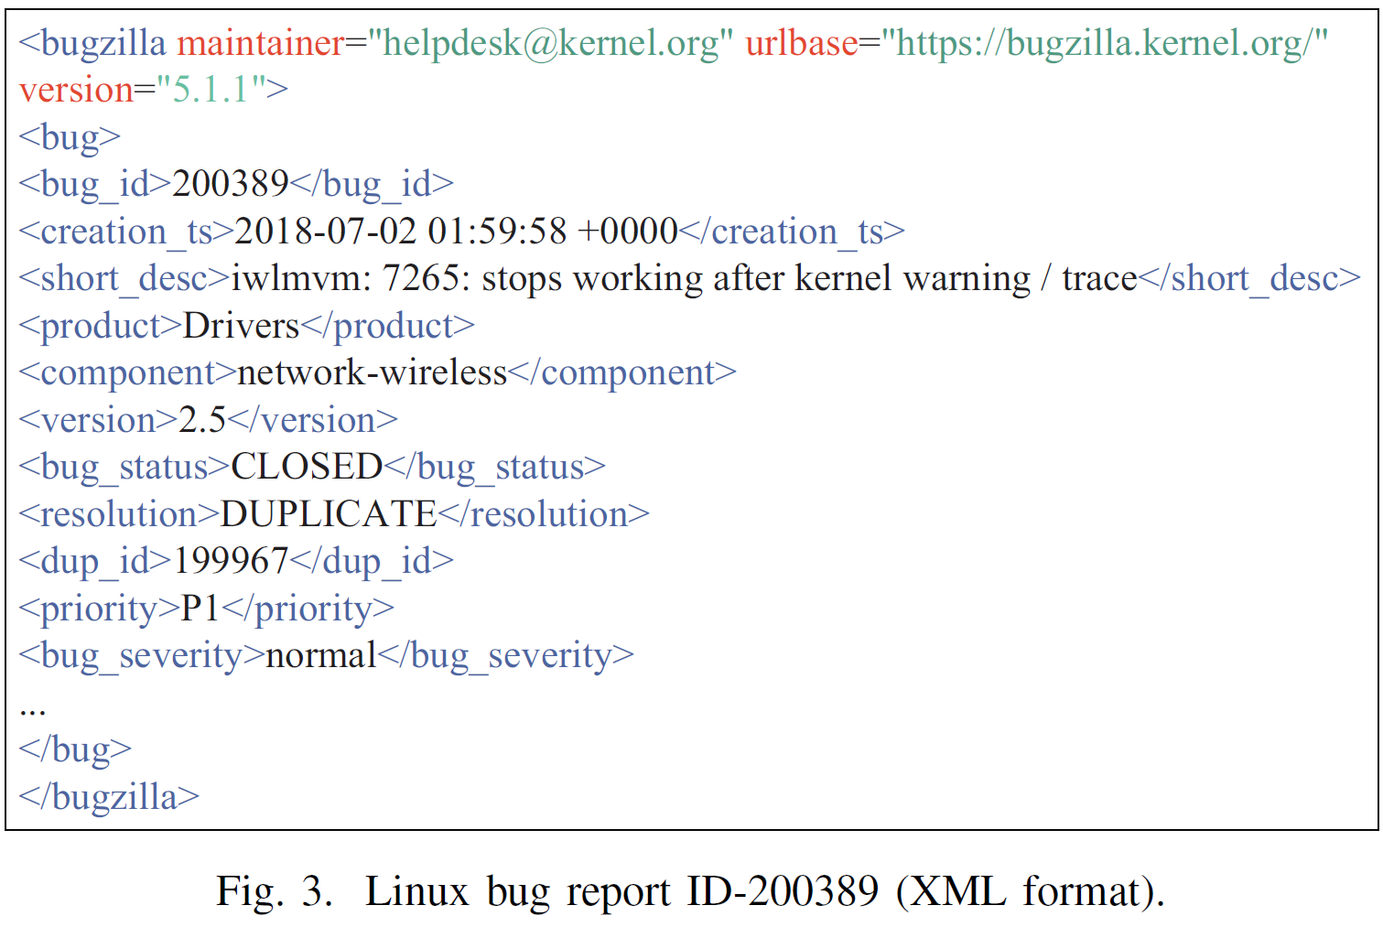
Background
Duplicate Bug Report Prediction

Slide 9
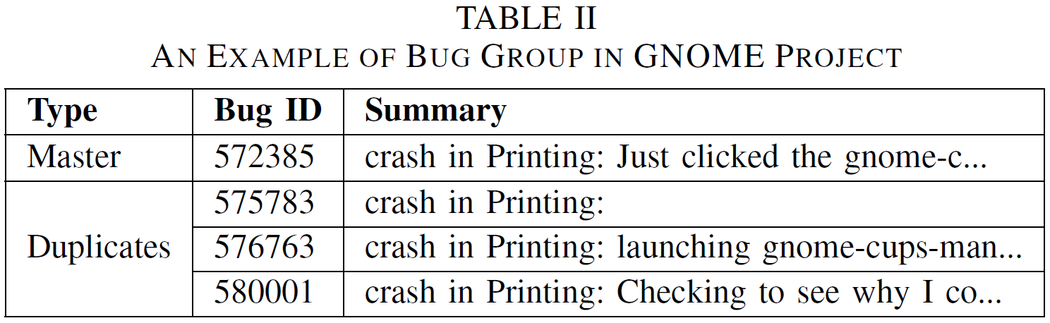
Background
Duplicate Bug Report Prediction

Slide 10
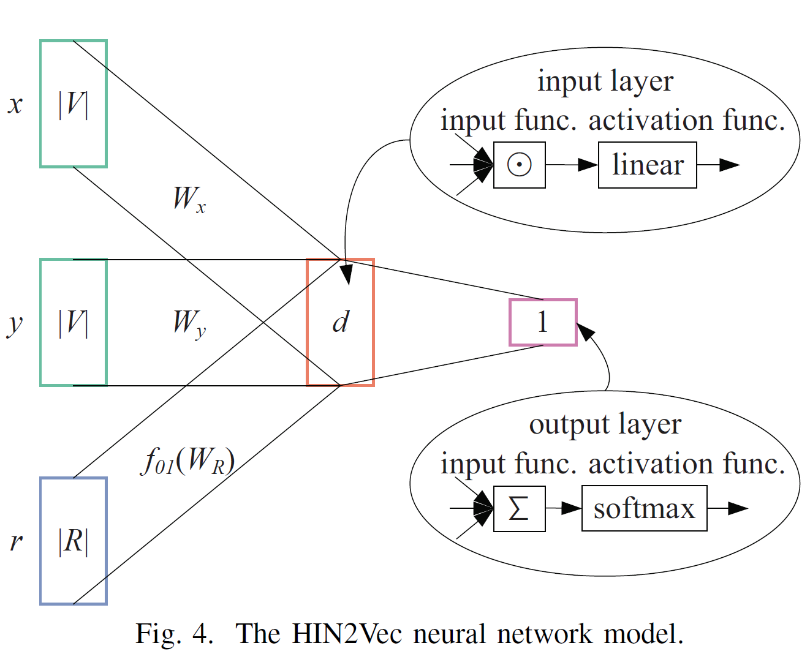
Background
HIN2Vec: a Network Representation Learning for HIN

Slide 11
Our HINDbr Approach
Constructing HIN for Bug Reports
Six Nodes: BID, COM, PRO, VER, PRI, SEV
Five Relations: R1: Bug-Component
R2: Component-Product
R3: Bug-Version
R4: Bug-Priority
R5: Bug-Severity

Slide 12
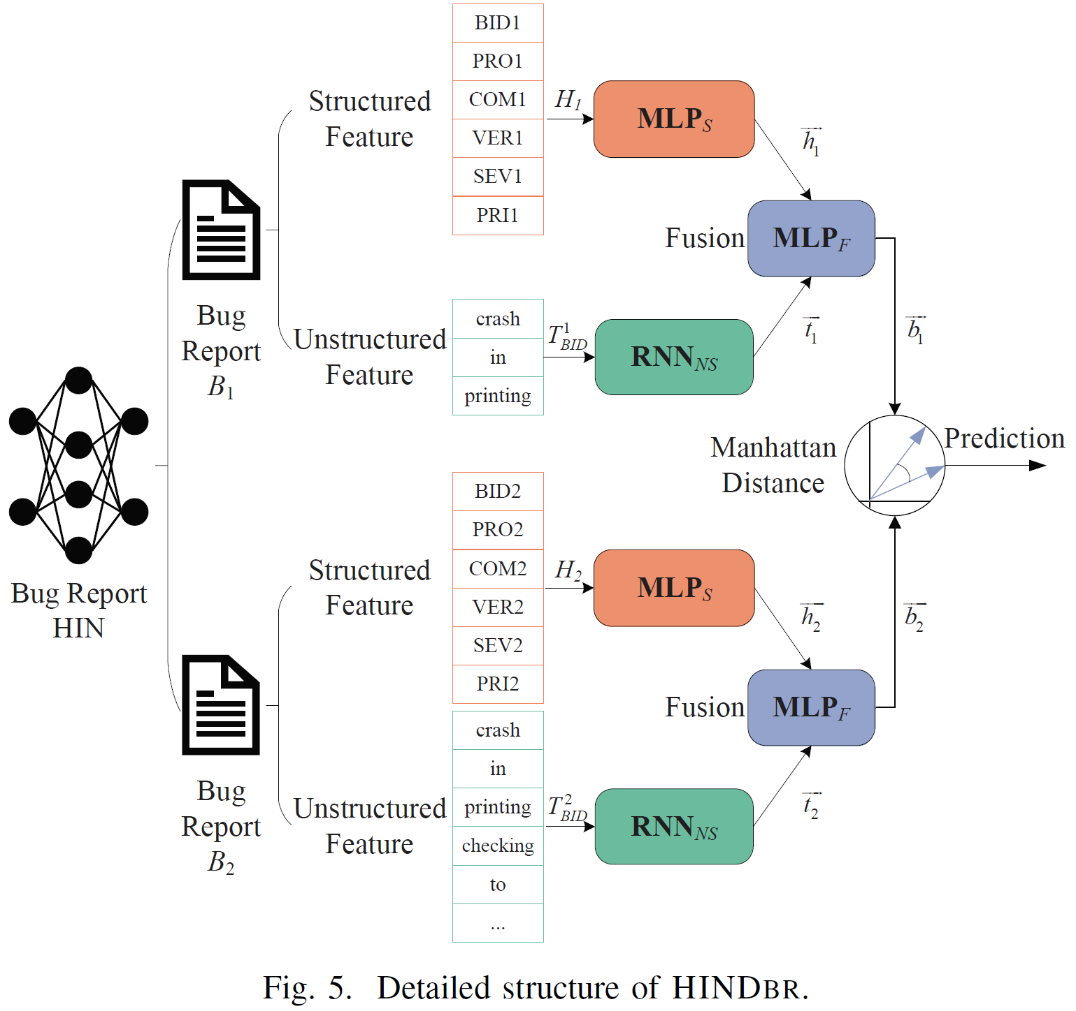
Our HINDbr Approach

Slide 13
Our HINDbr Approach
Bug Report Representation Module
Similarity Module

Slide 14
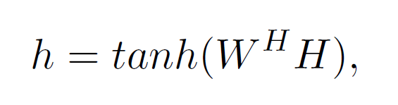
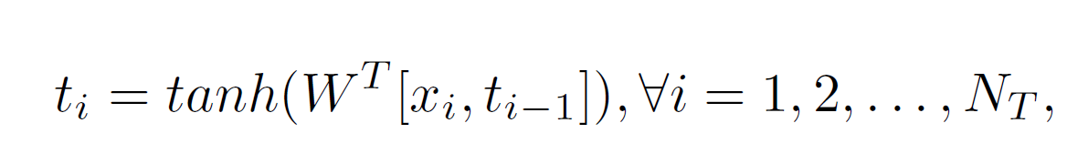
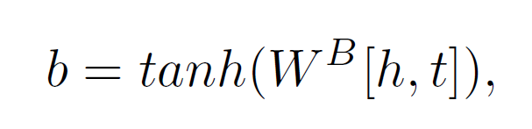
Our HINDbr Approach
Bug Report Representation Module
Structured Feature: MLP_{S}
Unstructured Feature: RNN_{NS}
Feature Fusion: MLP_{F}

Slide 15
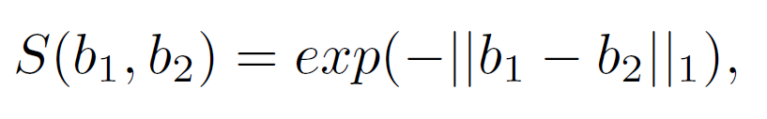

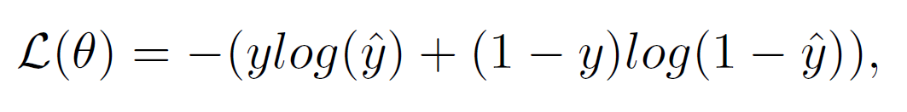
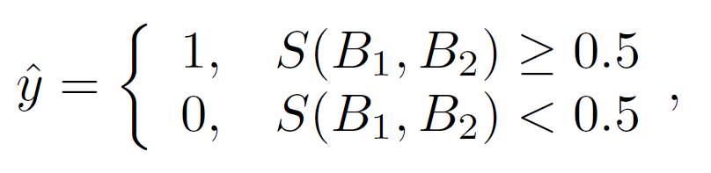
Our HINDbr Approach
Similarity Module
Manhattan Distance
Model Training: Training Instance . Label: 1 for duplicate
Loss Function: binary cross entropy loss
Similarity Threshold: 0.5

Slide 16
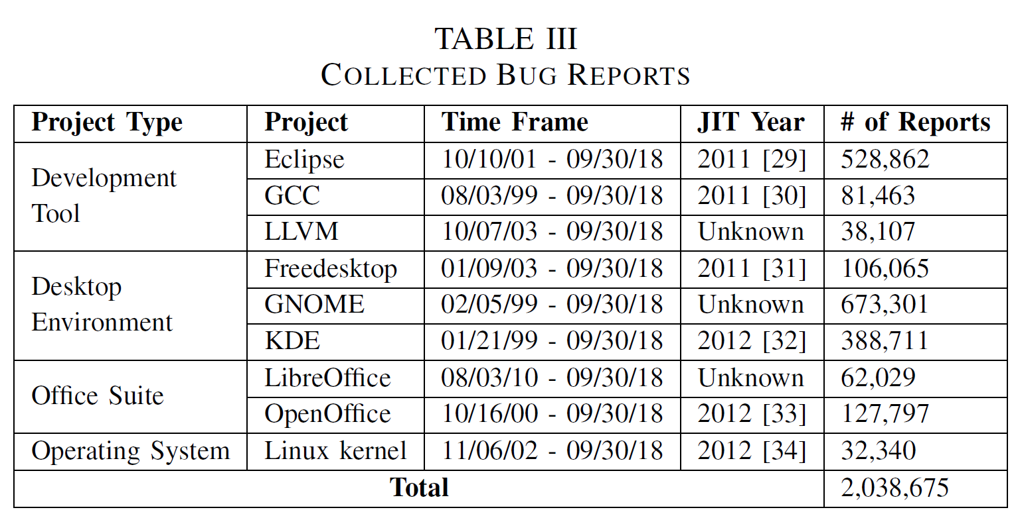
Data Collection & Aggregation
Data Collection

Slide 17
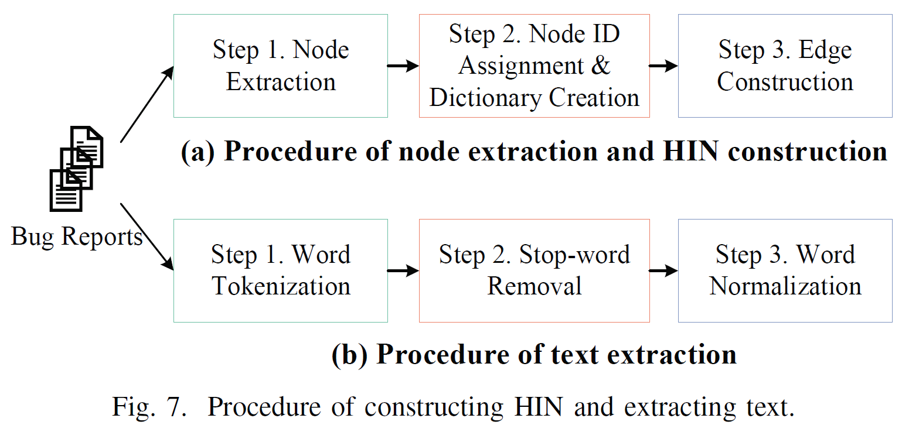
Data Collection & Aggregation
Feature Extraction
HIN Construction
Text Extraction

Slide 18
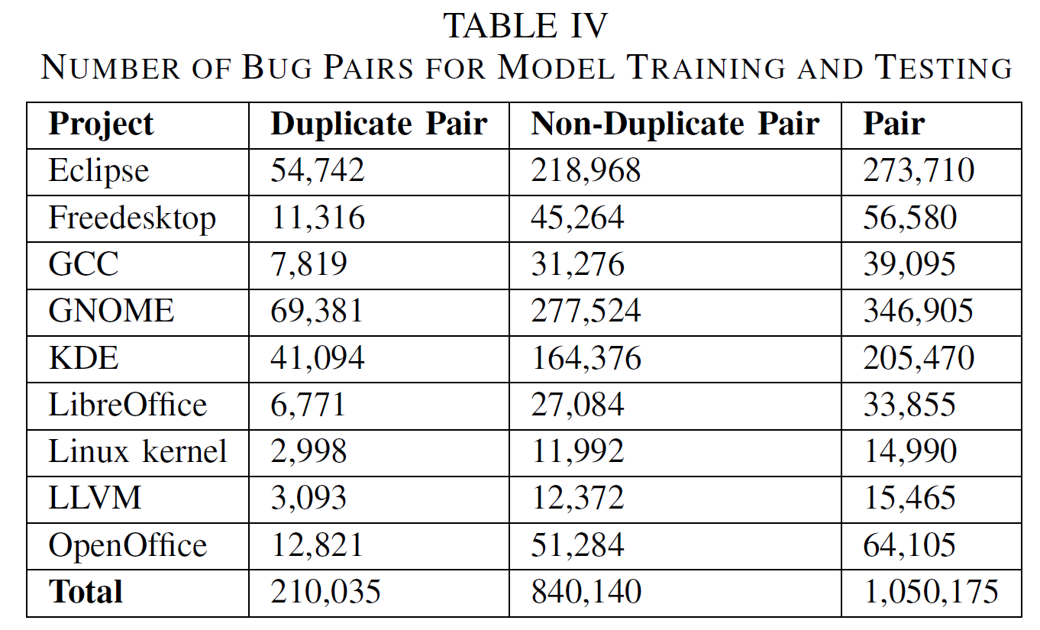
Data Collection & Aggregation
Bug Pairs Generation: Model Training and Testing

Slide 19
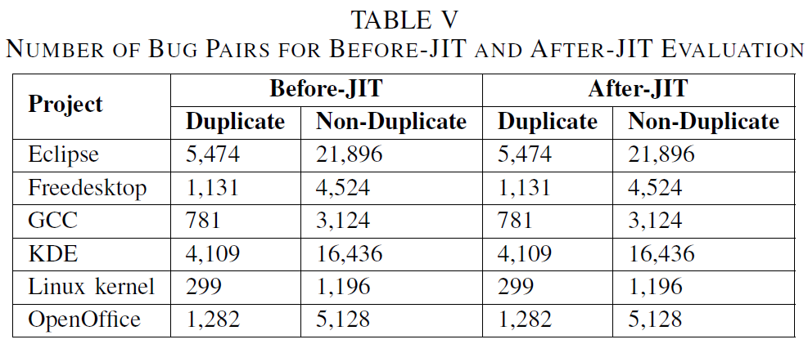
Data Collection & Aggregation
Bug Pairs Generation: Before-JIT & After-JIT Evaluation

Slide 20
Implementation Details
Settings of Pre-trained Embeddings
Word2Vec: d₁ – 100
HIN2Vec: d₂ – 128
Settings of Neural Networks in HINDbr
Text
HIN1 (no Text)
HIN2 (with Text)

Slide 21
Implementation Details
Settings of Model Training: Keras, Dell Precision Tower, RTX2080Ti
Training Parameters: epochs – 100; batch size – 128;
Stratified Cross-Validation Evaluation: 5-fold cross-validation
Dealing with Imbalanced Data: SMOTE + TL
Evaluation Metrics
Accuracy
Precision
Recall
F1 Score

Slide 22
Model Evaluation
Comparison Method
DLDbr: Text feature (Long: CNN + Short: LSTM)
Structure feature (Numerical Vectors)
Research Questions (RQs)
RQ1: HINDbr Effectiveness
RQ2: Impacts of Feature Settings
RQ3: Impacts of Before-JIT and After-JIT Duplicates

Slide 23
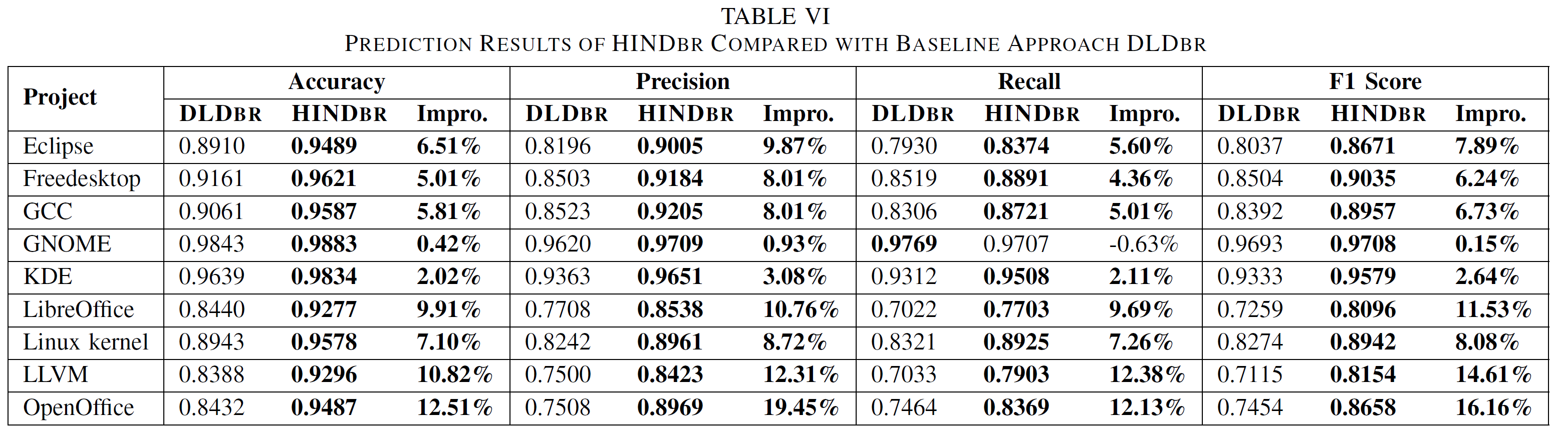
Model Evaluation
RQ1: HINDbr Effectiveness

Slide 24
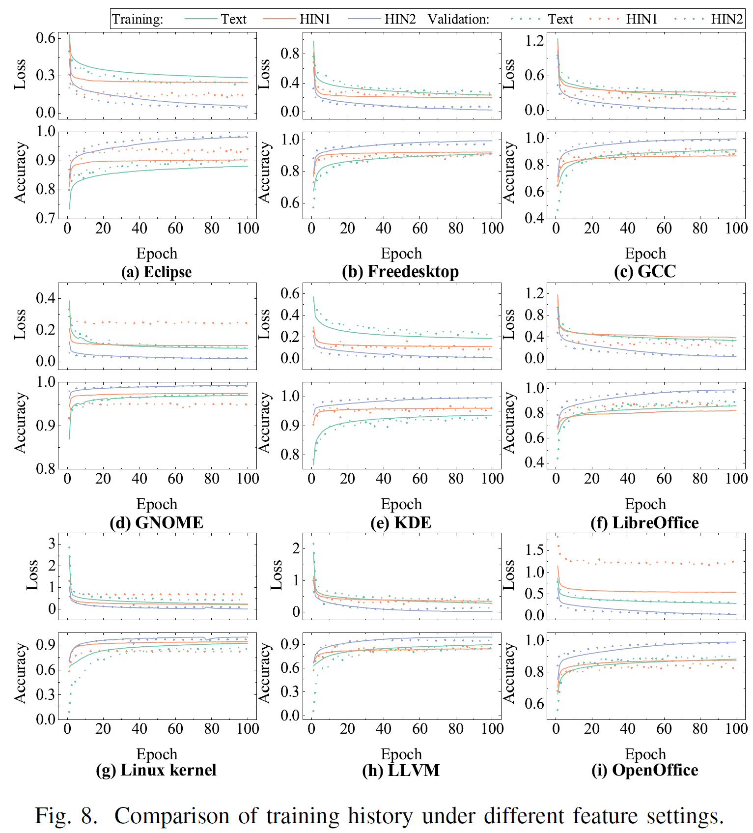
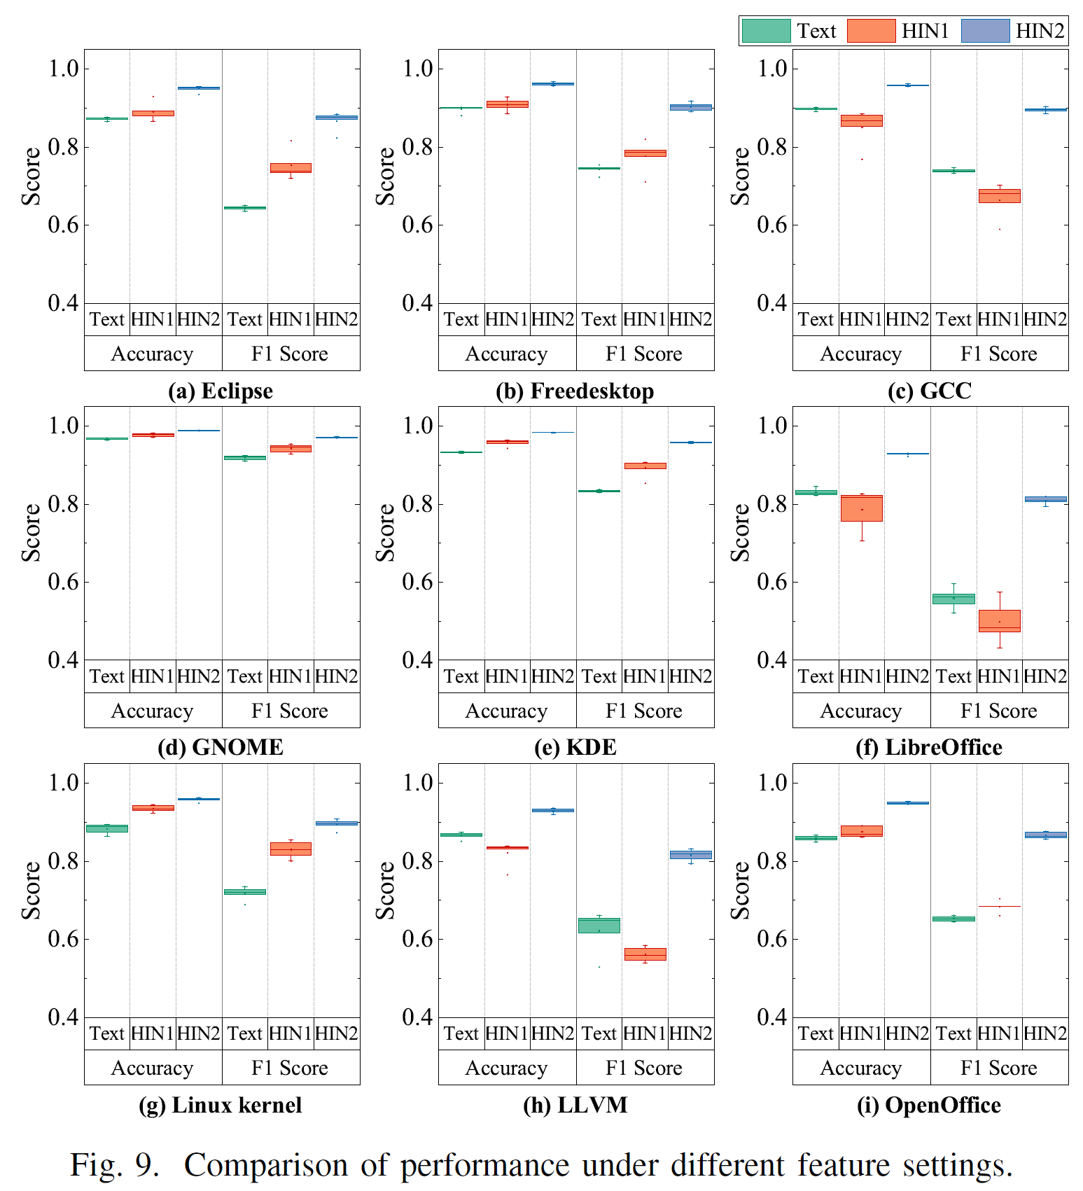
Model Evaluation
RQ2: Impacts of Feature Settings

Slide 25
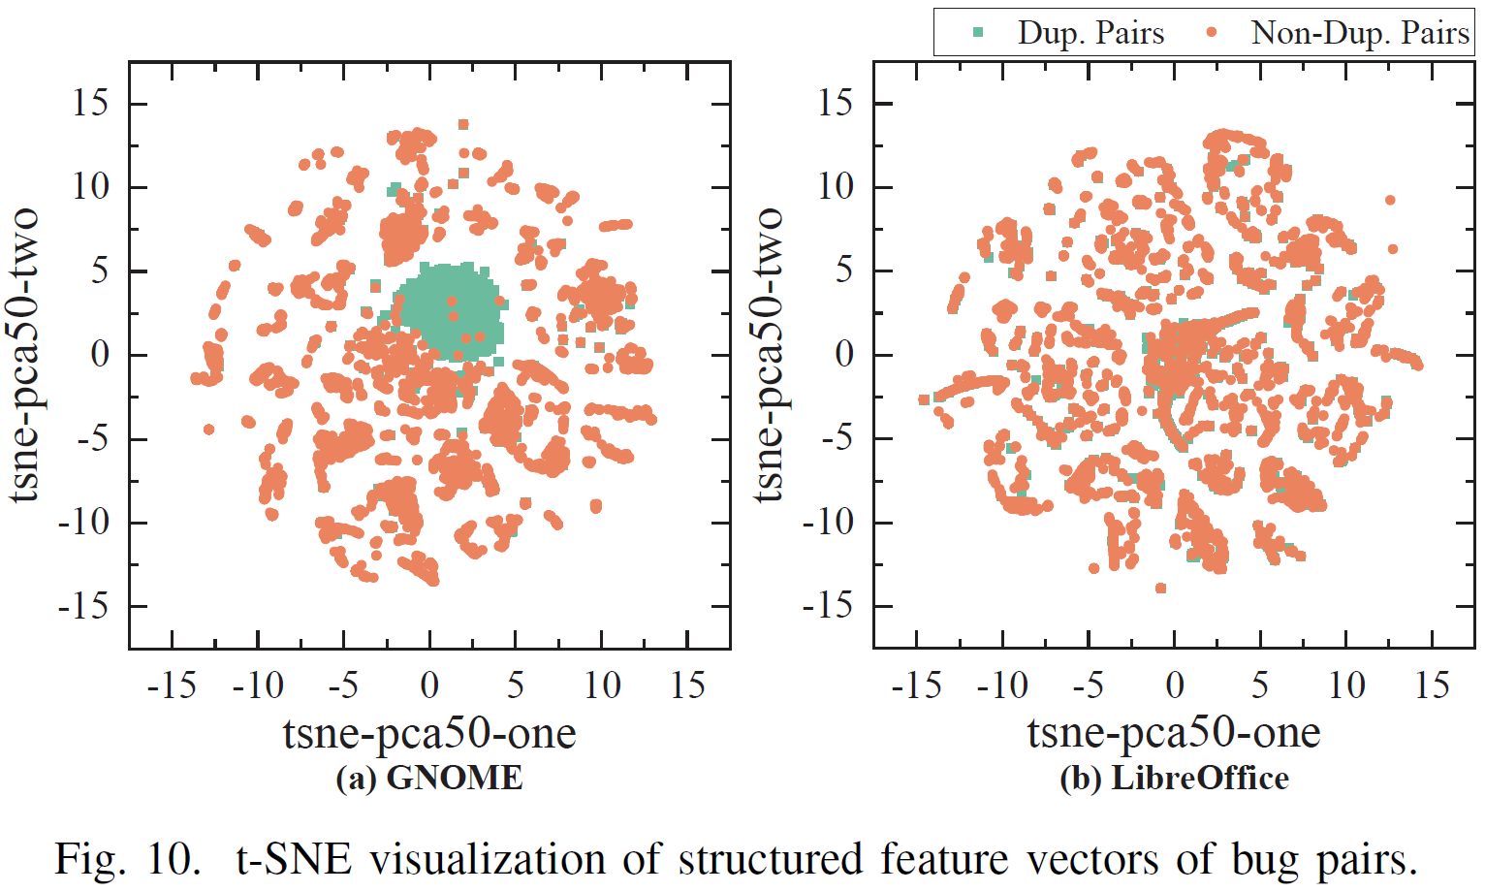
Model Evaluation
RQ2: Impacts of Feature Settings

Slide 26
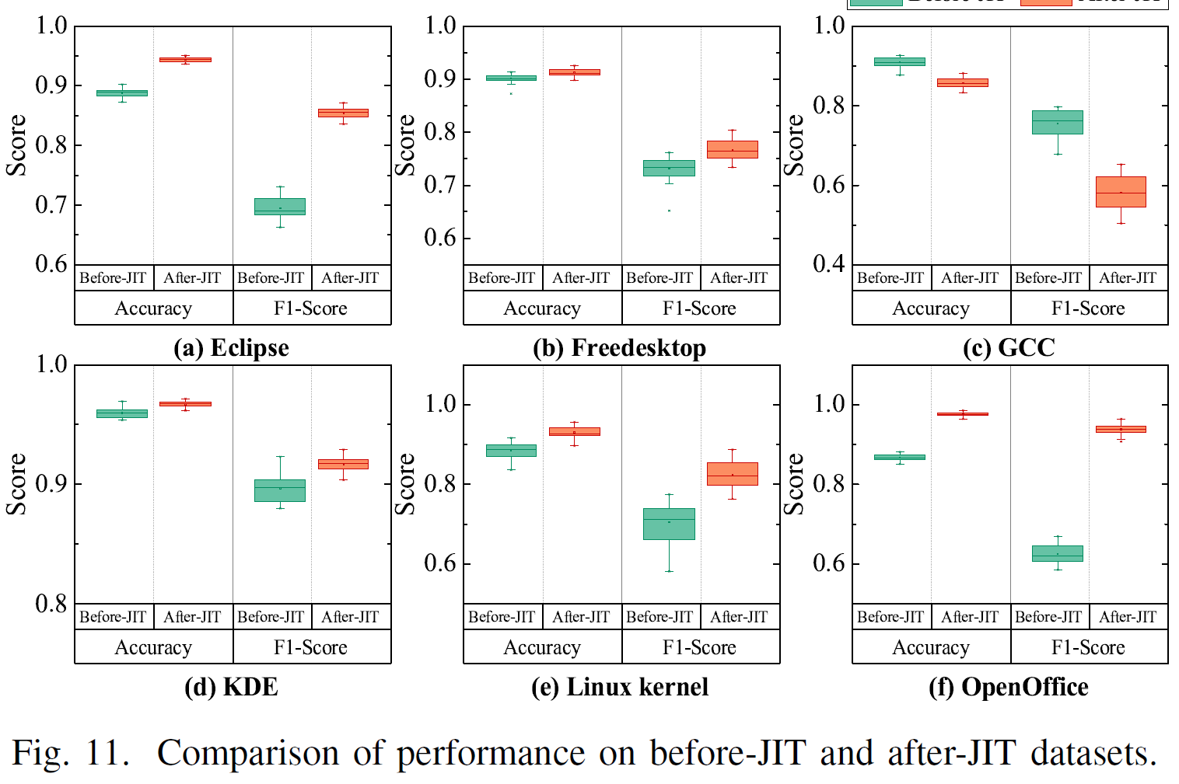
Model Evaluation
RQ3: Impacts of Before-JIT & After-JIT Duplicates

Slide 27
Thank you for your listening!
Q&A
https://guanpingxiao.github.io/

