Slide 1
Loan Defaulter Prediction System
Data Science Engineering Methods & Tools INFO 6105
Raj Sudharshan

Slide 2
Agenda
Analysis of Loan Defaulter Dataset
Premise/Problem Statement
Data Source & Description
Findings/Conclusion
Pre-processing/Data Exploration
Analysis, Training, Prediction

Slide 3
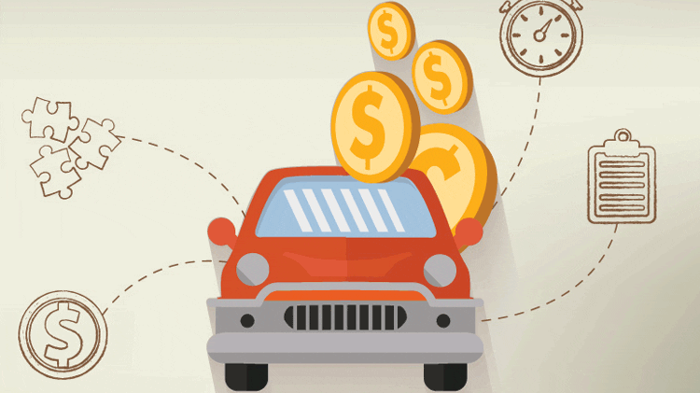
Get – Set – Go - Increasing automobile prices - Car loans account for 9% of all consumer debt.

Slide 4
Premise/ Problem Statement
Analyse
Analyse the dataset
Derive
Derive at best features relevant to predict the desired outcome
Explore
Explore different machine learning algorithms, runtimes, and accuracy.
Determine
Determine the best model to predict the target variable: LoanDefault Yes(1)/No(0).
To predict if a customer is a potential “Loan Defaulter” or not?
Notes:
Classification problem

Slide 5
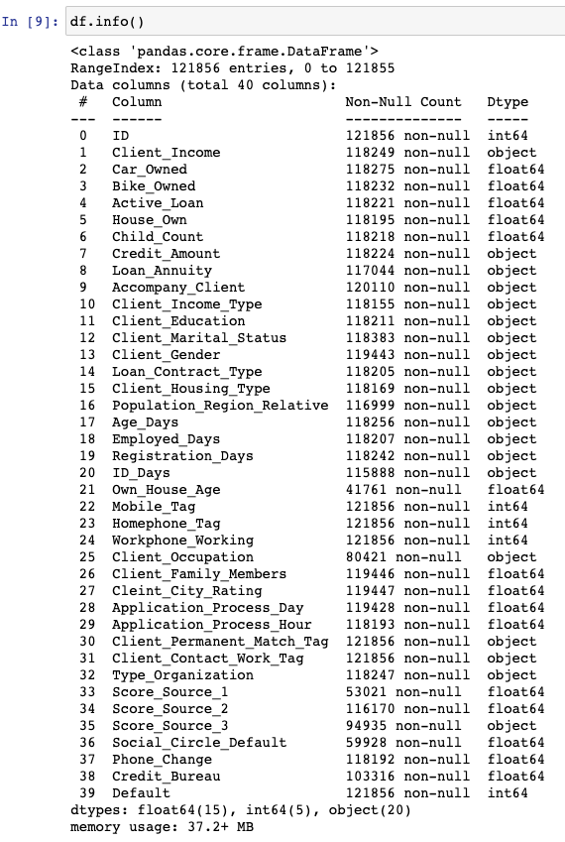
Data Source & Description
Dataset link:
Automobile Loan Default Train dataset
Raw Data Before Cleanup
121856 Rows, 40 Columns

Slide 6
Scope of Analysis
Analyzing the dataset by its features
Selecting best fitting and highly relevant features
Oversampling the dataset
Training & Prediction
Data Analysis
Data Insights
Feature Engineering
Training- testing split
Conclusion & Findings
Comparison
Data Training using different Algorithms
Data Processing

Slide 7

Pre-processing & Data Exploration

Slide 8
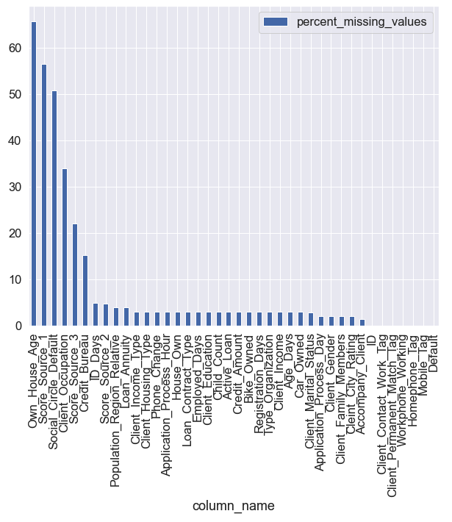
Null Values Treatment
Dropping columns where null values > 50%

Slide 9
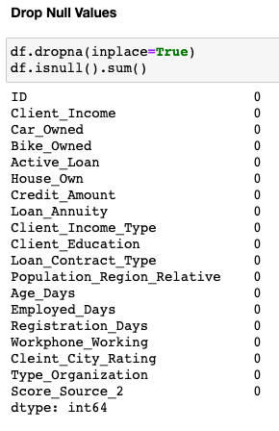
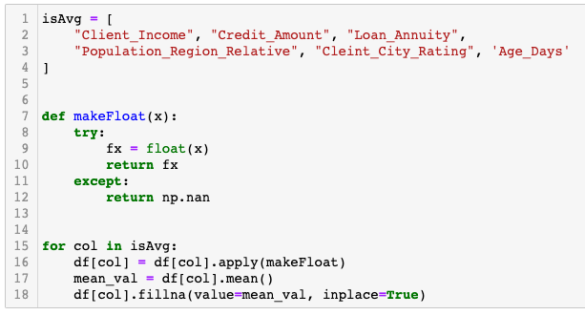
Imputing Null Values with Mean
Imputed null values in key columns with average values.
Resulted in zero null values in the dataset.
Notes:
Converted Object datatype into Float.
In case of errors, the cells were imputed with Null values.
On the right: Dropping rows with Null values.

Slide 10
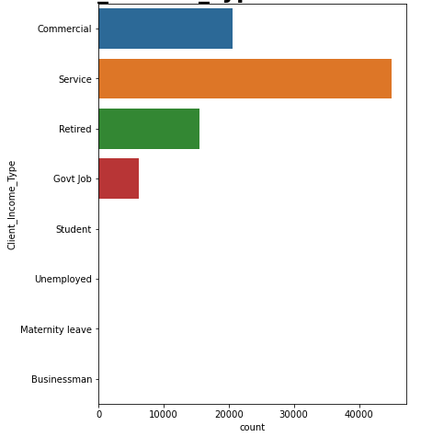
Data Distribution in Income Type
Calculating counts to understand Data Availability in Client Income Type Column
Shortlisting 4 relevant types
Thereby, dropping the rows for which data is negligible

Slide 11
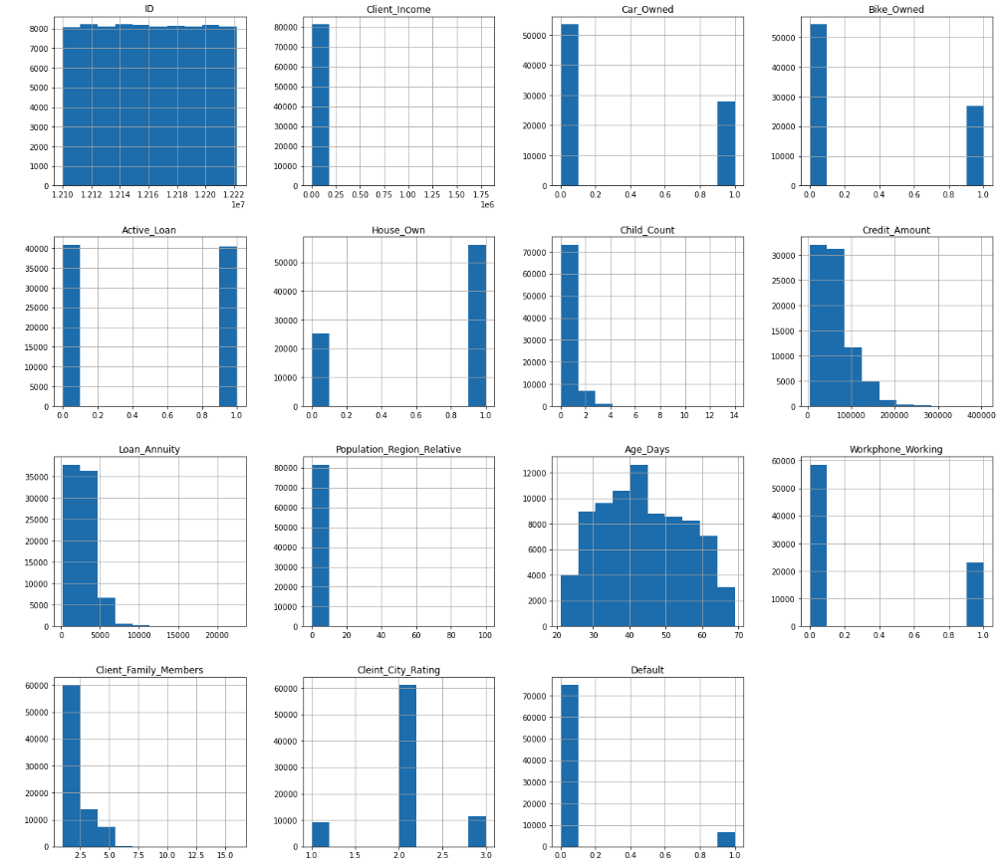
Data Distribution Using Histogram

Slide 12
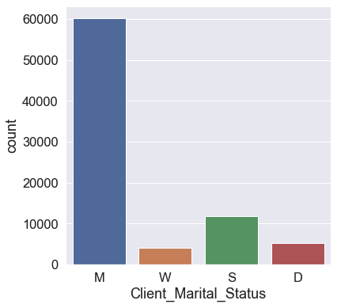
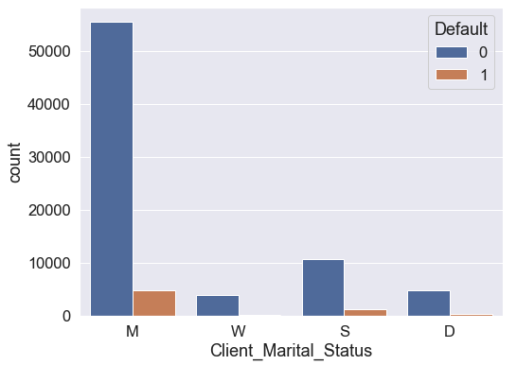
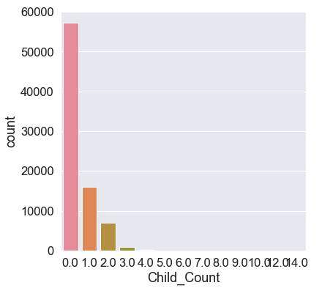
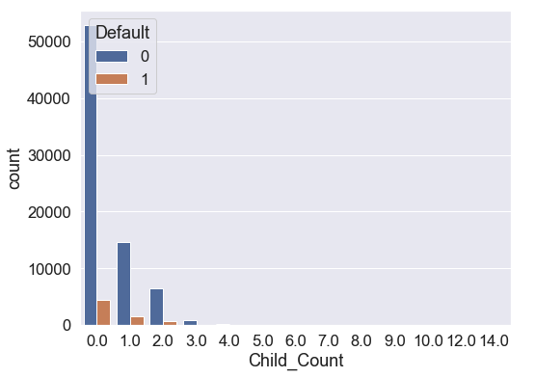
Client Marital Status & Child Count

Slide 13
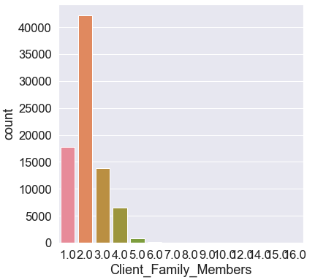
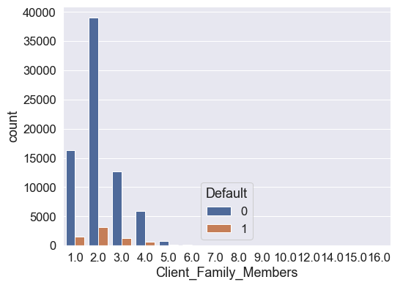
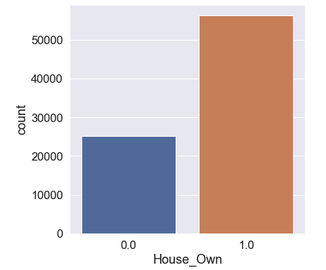
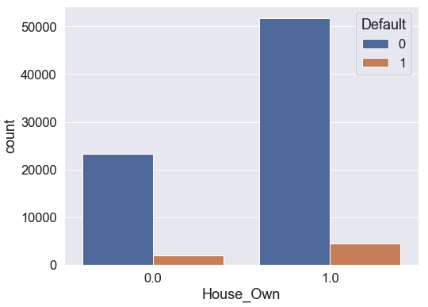
Client Family Members & House Owned

Slide 14
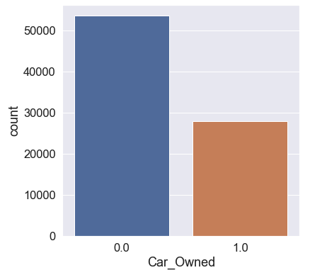
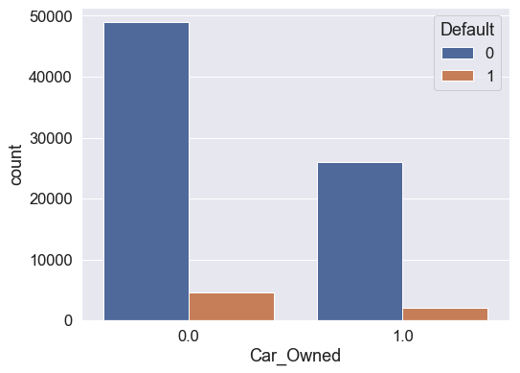
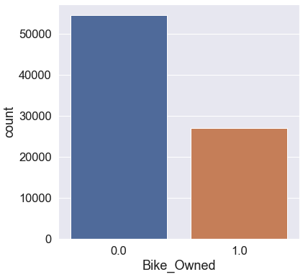
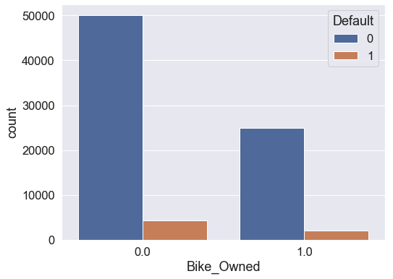
Car Owned & Bike Owned

Slide 15
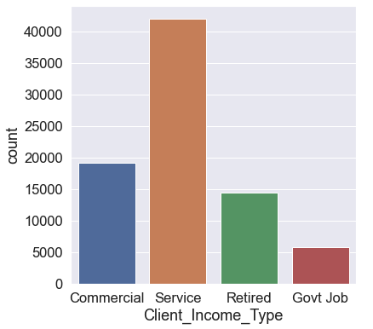
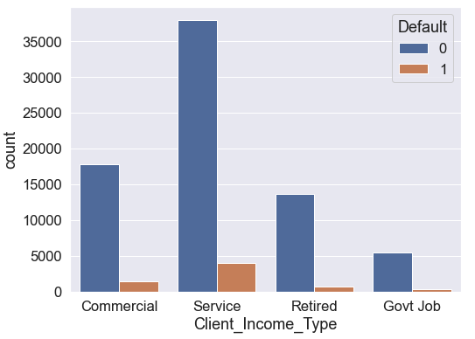
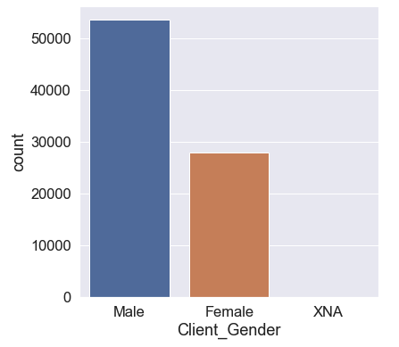
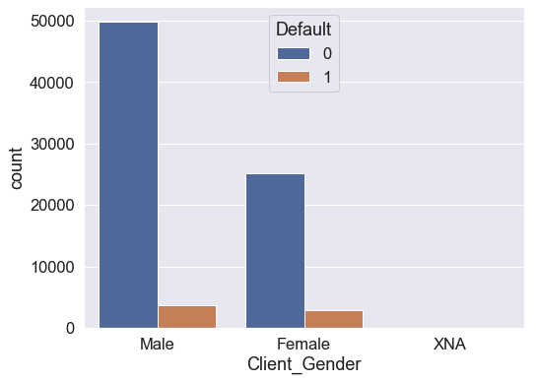
Client Income Type & Gender

Slide 16
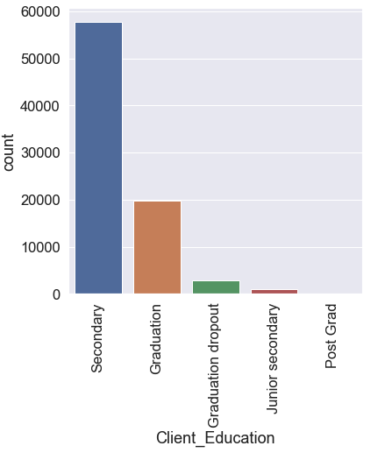
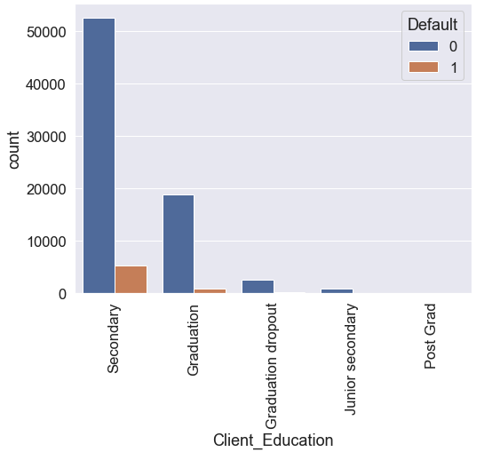
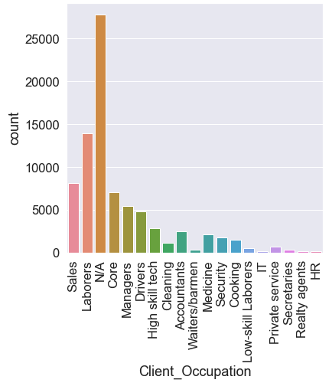
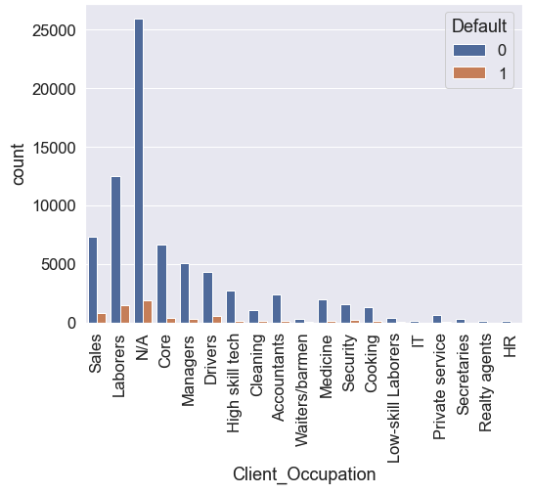
Client Education & Occupation

Slide 17
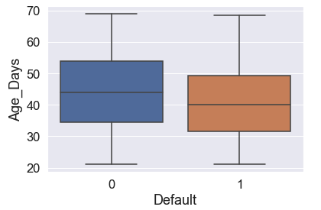
Age Days

Slide 18
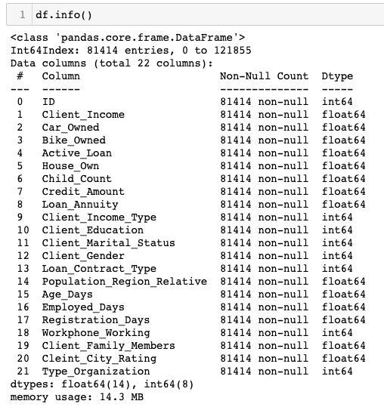
Cleaned Data
Cleanup Summary in short
No. of columns
Before: 40
After: 22
No. of Rows
Before: 121856
After: 81414

Slide 19

Analysis, Training, Prediction

Slide 20
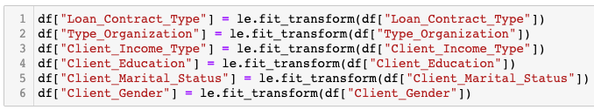
Encoding Data
Performing Fit Transform:

Slide 21
Loan Defaulters (in Zeroes and Ones)
0/1 | Description | Count
0 - NO | Not a Defaulter | 74845
1 - YES | Defaulter | 6569
Observation: A highly skewed dataset with approximately 92% Zeroes and 8% Ones.

Slide 22

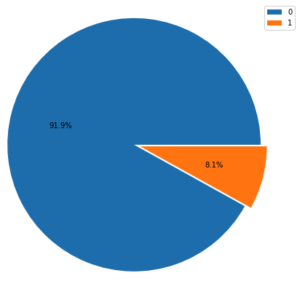
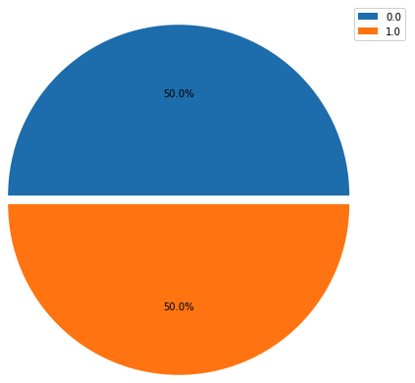
The Balancing Act
Using SMOTE library to oversample the minority class.
This has fixed the skewed dataset by duplicating the minority class and resulting in 50% in both classes.

Slide 23
Train-Test Split
Decision Tree
Logistic Regression
Gaussian Naïve Bayes
Random Forest

Slide 24
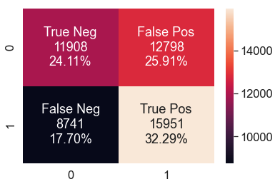
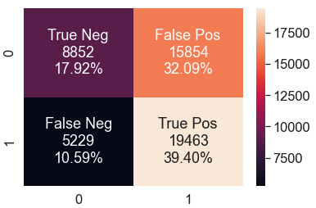
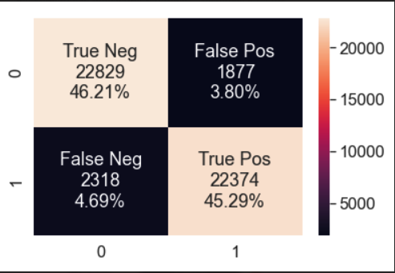
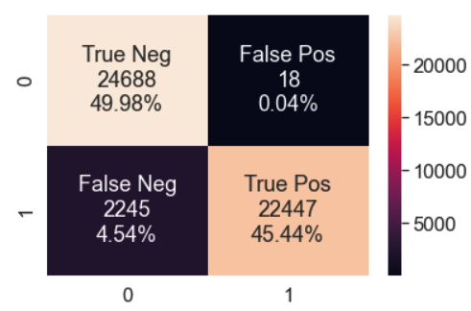
Confusion Matrix - Comparison
Logistic Regression
Naïve Bayes
Decision Tree
Random Forest

Slide 25
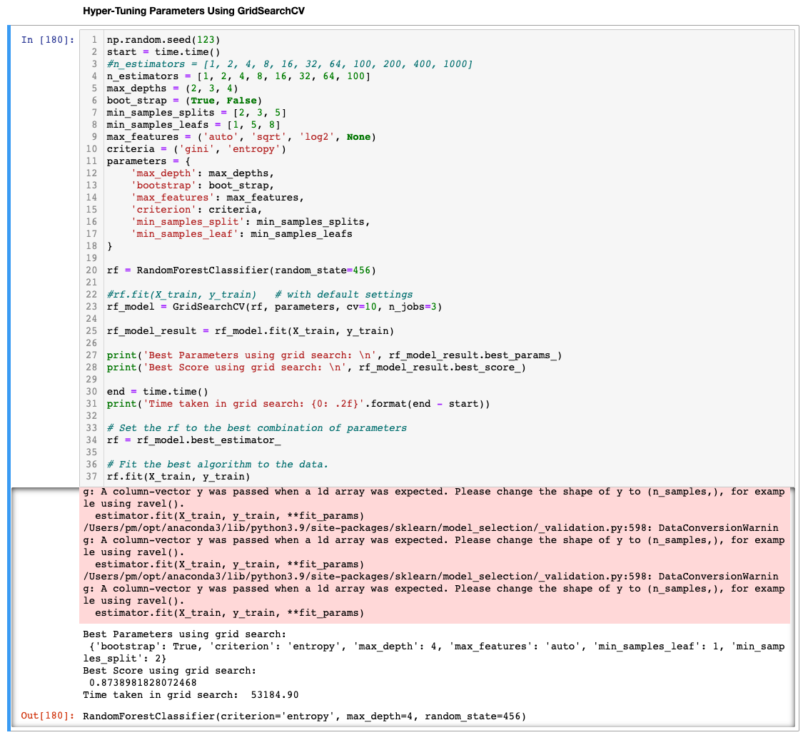
Hypertuning using GridSearchCV

Slide 26
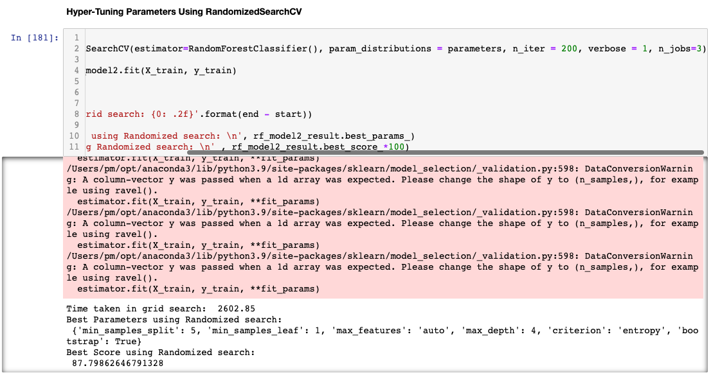
Hypertuning using RandomizedSearchCV

Slide 27

Findings & Conclusion

Slide 28
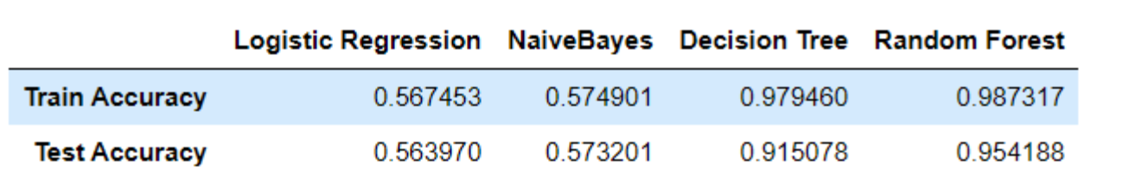
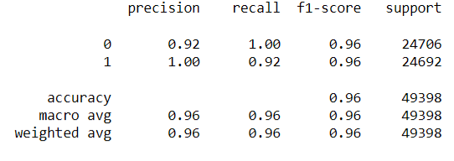
Findings & Conclusion
Amongst the four algorithms, Random Forest shows the highest accuracy of 96%
True Positive and True Negative are at 45.44% and 49.98% respectively
This concludes that Random Forest is the best Machine Learning Algorithm for this dataset

Slide 29
References
https://fortunly.com/statistics/car-loan-statistics/#gref
https://ycharts.com/indicators/us_auto_loans_delinquent_by_90_days#:~:text=US%20Auto%20Loans%20Delinquent%20by%2090%20or%20More%20Days%20is,long%20term%20average%20of%203.44%25.
https://towardsdatascience.com/a-look-at-precision-recall-and-f1-score-36b5fd0dd3ec
https://www.kaggle.com/datasets

Slide 30
Thank You

Slide 31
Report Summary
Data Science Engg. Methods & Tools - Loan Defaulter Prediction System
Project by: Raj Sudharshan (002100399)
Report Summary:
Importing Python Libraries/Statements
Reading the dataset
Analysing the Original Dataset
Understanding Basic information and stats about the dataset
Identifying Null values and irrelevant data
Pre-processing & Data Exploration
Deleting irrelevant columns.
Cleaning individual columns.
Removing Null values.
Histogram for all features
Correlation
Analyzing Categorical Features
Data Encoding and Analysis
Label encoding
GINI Importance
Balancing Skewed Dataset
Train, Test, Split the model
Logistic Regression
Naive Bayes
Decision Tree
Random Forest
Hypertuning - GridSearchCV, RandomizedSearchCV
Conclusion
Comparison of algorithms and its accuracy
Conclusion summary

