Slide 1




TransitOps
Smart Transport Operations Platform
Odoo Hackathon · Team: Velocity Labs · Date: 2026
Aditya Raj
Sujal Raj
Ayushi
Keshav Ranjan
Backend Lead
Badge: API, & Data Integrity
Frontend Lead
Badge: UI & Dashboard
Debugging & Testing
Badge: Support Developer
QA & Support Developer
Badge: QA & Reliability

Slide 2
Problem Statement
Current Industry Problems
Business Challenges
Spreadsheets
Paper Logbooks
Manual Dispatch
Manual Maintenance Tracking
Poor Expense Tracking
Lack of Operational Visibility
Scheduling Conflicts
Underutilized Vehicles
Missed Maintenance
Expired Driver Licenses
High Operational Cost
Traditional fleet management is inefficient, disconnected, and prone to human error.
Logistics Icons
Auditability
Visual markers for routes, vehicles, and status to improve situational awareness.
Replace paper trails with verifiable digital records.

Slide 3
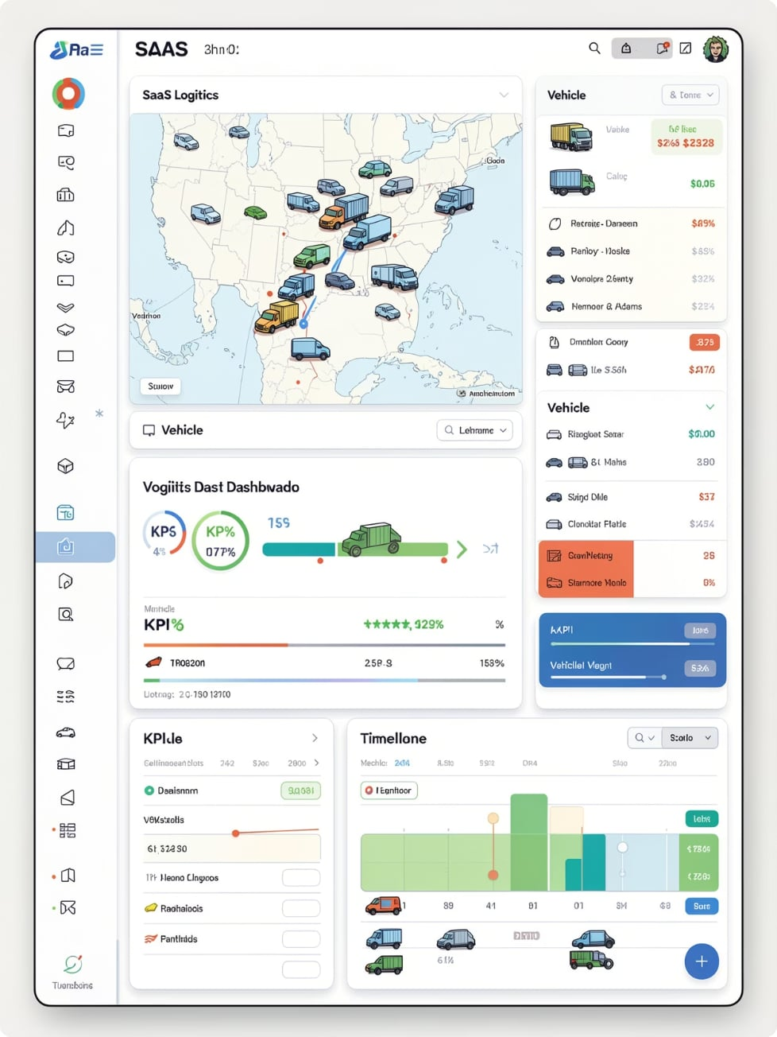









Our Solution
TransitOps
A centralized ERP platform that manages the complete transport lifecycle — from vehicle onboarding to analytics-driven optimization.
Authentication
Vehicle Management
Driver Management
Trip Management
Maintenance
Fuel Tracking
Analytics Dashboard
Reports
One Platform to Manage the Entire Transport Operation

Slide 4
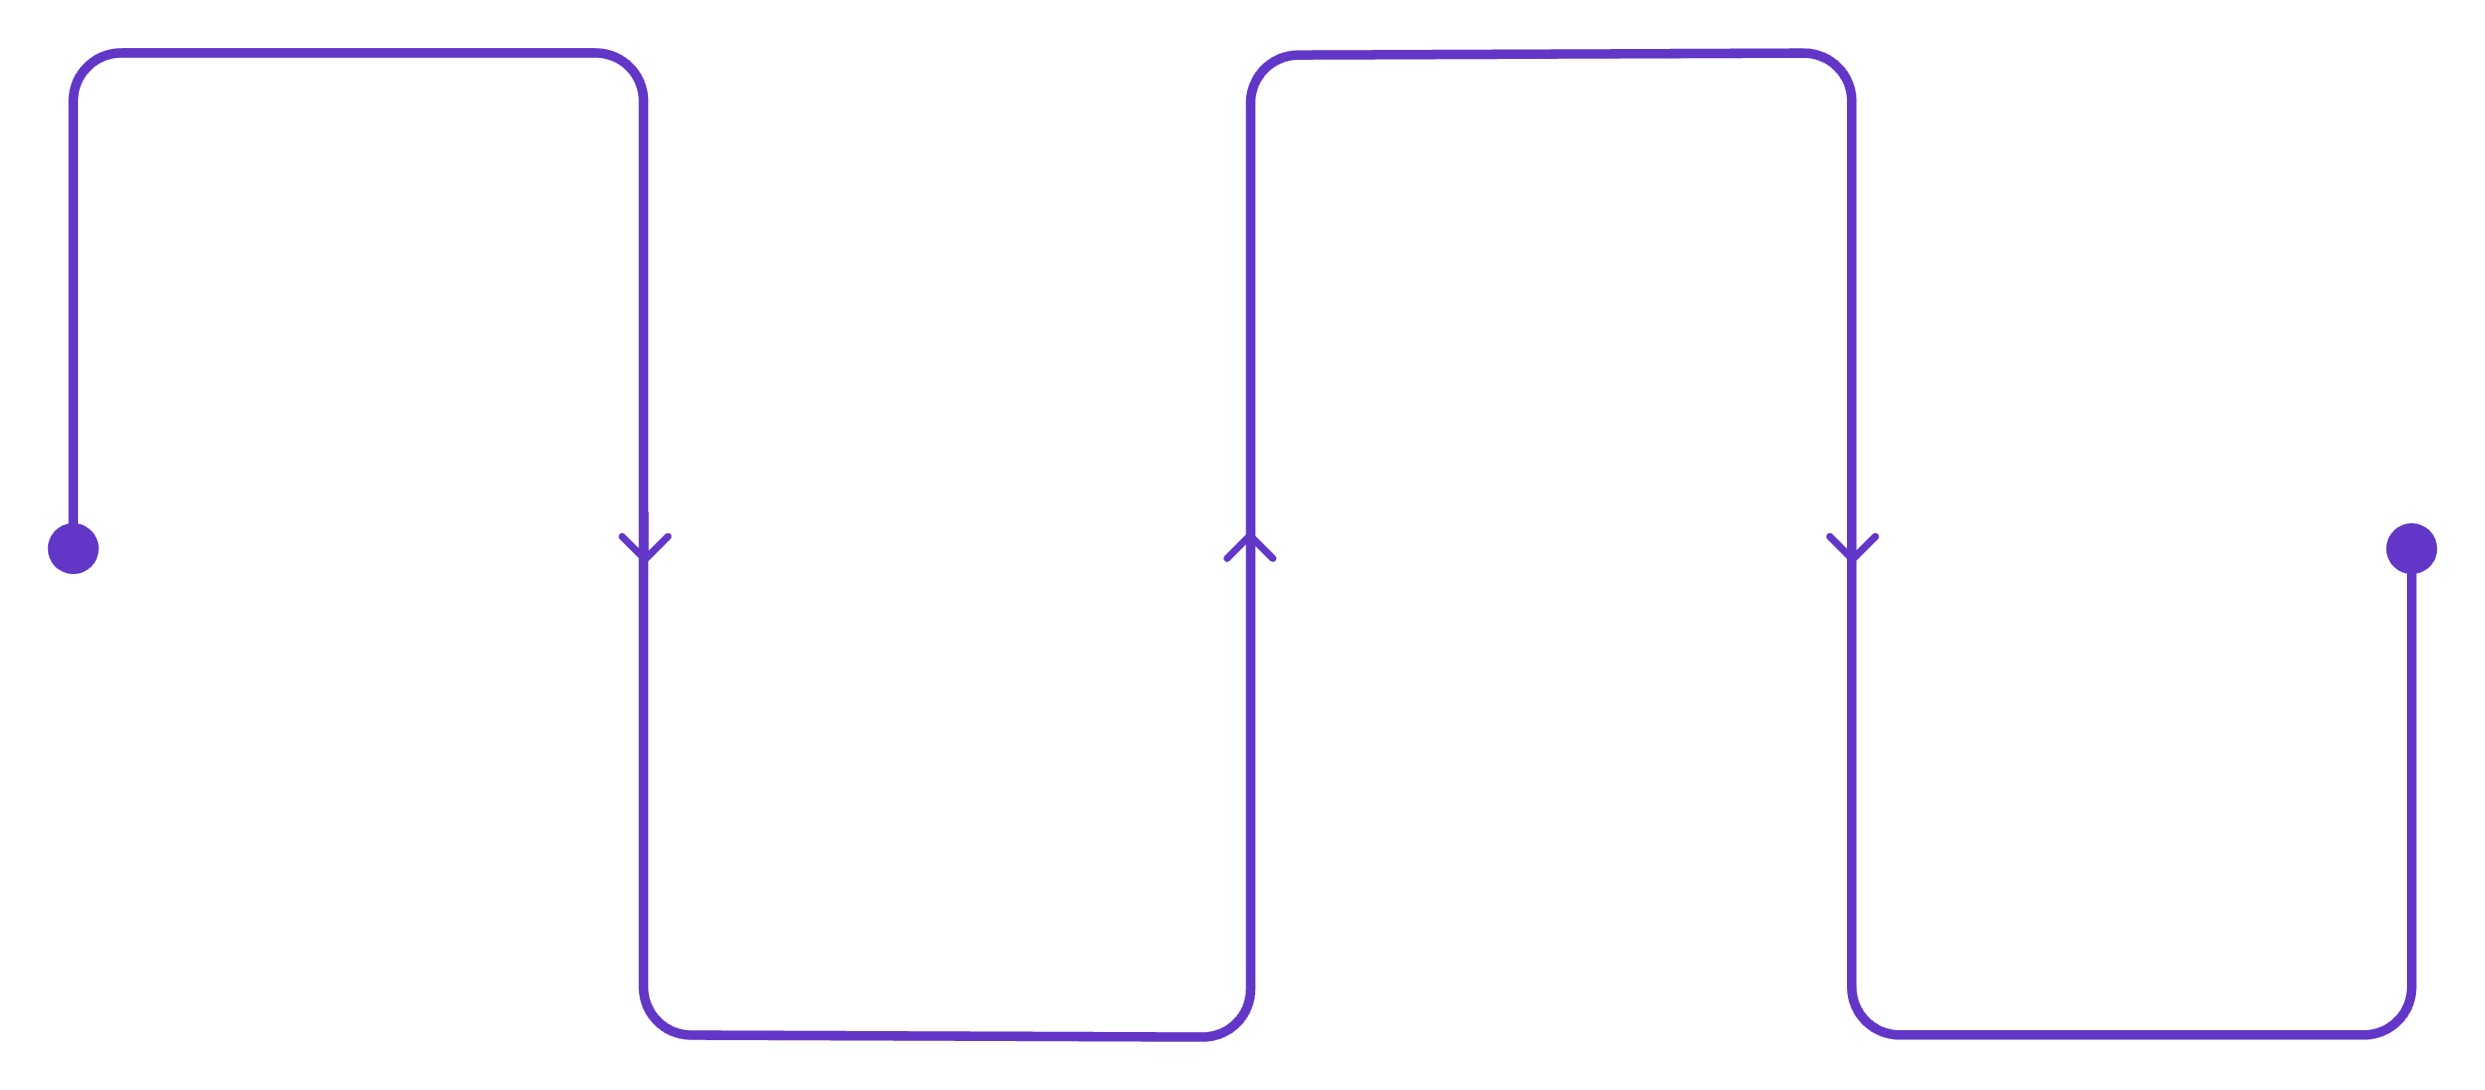
System Workflow
End-to-end vertical workflow mapping the user journey from login to insights.
Login
Register Vehicles
Authenticate and validate user
Add vehicle records with checks
Register Drivers
Dashboard
Overview and system alerts
Capture licenses and approvals
Each step enforces validation and triggers automated updates — reducing manual handoffs and errors.

Slide 5






Core Modules
Vehicle Management
Driver Management
Trip Management
Registration · Capacity · Odometer · Status
License Validation · Safety Score · Status
Dispatch · Cargo Validation · Live Status
Maintenance
Fuel & Expense
Reports
Service Logs · Repair History · Alerts
Fuel Logs · Operational Cost · Analytics
Fleet Utilization · ROI · Fuel Efficiency

Slide 6

Business Rules
Operational guardrails encoded as automated validations and dispatch logic.
✓ Unique Vehicle Registration
✓ Driver License Validation
✓ Cargo Capacity Validation
✓ No Duplicate Vehicle Assignment
✓ No Duplicate Driver Assignment
✓ Automatic Status Updates
✓ Maintenance Auto Blocks Dispatch
Available
Dispatch
Completed
On Trip
Automation enforces rules in real-time to minimize human error and idle time.

Slide 7
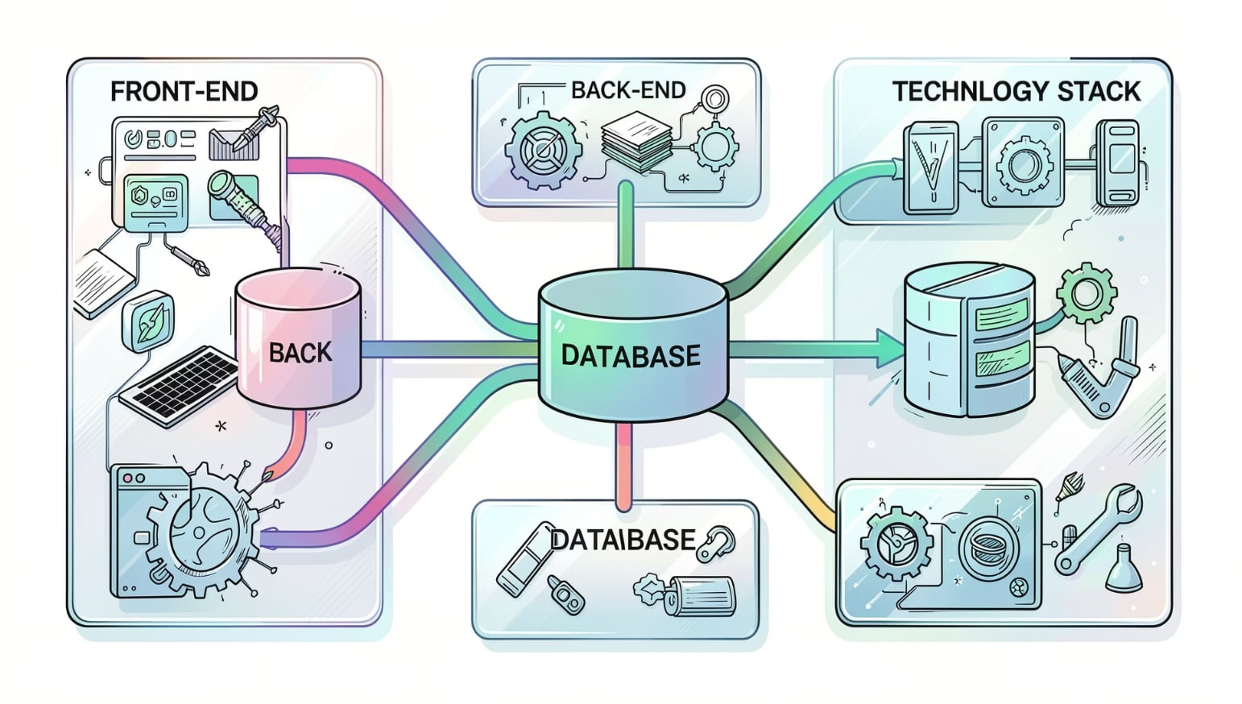
Technology Stack
Frontend
HTML5 · CSS3 · JavaScript(Vanilla java script)
Backend
Spring Boot (Java) · Authentication
Database
PostgreSQL / MySQL (relational storage)
Tools
Designed for modularity and integrations — ready for Odoo connectors and telematics APIs.
Git · GitHub · VS Code

Slide 8










Key Features
Authentication
Dashboard
Vehicle CRUD
Driver CRUD
Trip Management
Maintenance Workflow
Fuel Tracking
Reports
CSV Export
Search & Filters
Each feature is presented in a rounded glass card with focused micro-interactions and live KPI tiles.

Slide 9
Future Scope
Email Notifications
Automated alerts for maintenance, trips, and compliance.
PDF Reports
Printable, branded executive reports and export templates.
Dark Mode
Low-light UI for drivers and control rooms.
AI Route Optimization
Cost and time reduction using traffic-aware routing.
GPS Tracking
Real-time telematics integration and geofencing.
Mobile Application
Driver app for ELD, manifests, and status updates.
Predictive Maintenance
Sensor-driven alerts and lifecycle forecasting.

Slide 10


Thank You
Built with ❤️ for the Odoo Hackathon
Contact
Repo
team@velocitylabs.example
github.com/velocity-labs/transitops

