Slide 1
Legal Act and IPC Section Prediction System Using Complaint Text Analysis
Team No: 30
Team Members:
Raja Rajeswari R [22IT072]
Nivasshini R [22IT063]
Guide Name:
Mrs.S.Pudumalar

Slide 2
Overview
Problem Statement
Objectives & Constraints
Review I Comments/ Suggestions
System Design/ Diagram/ Flowchart
Methodologies to solve the problem
System Specifications
Implementation/ Intermediate Results
Journal/ Conference identified for publications
References

Slide 3
Problem Statement & Description
Background:
Due to limited access to legal experts at police stations, law enforcement personnel often lack the knowledge to accurately apply legal sections and acts when drafting FIRs. These errors can result in delayed or flawed investigations, which ultimately impact justice.
Problem:
The main challenge is that police officers, who may not be well-versed in legal details, make mistakes in identifying the right sections or laws to apply in the FIR, leading to incorrect processing of complaints. This can cause legal loopholes that may affect the overall investigation.
Solution:
An API End-Point that can quickly provide the relevant legal information (sections and acts) when officers input the incident details. This app would rely on a large legal database and ensure that each FIR is filed with the appropriate legal foundation, thereby reducing the likelihood of errors and improving the integrity of the investigation.

Slide 4
Objectives and Constraints
To develop an API endpoint that efficiently processes complaints or text inputs and accurately returns relevant IPC sections, legal acts, and case laws, thereby enhancing the speed and effectiveness of FIR filing.
To implement bilingual functionality in both Tamil and English, ensuring greater accessibility and ease of use for police personnel across diverse linguistic regions.
To significantly improve the accuracy of the existing model and optimize the system architecture through the integration of Natural Language Processing techniques, delivering more precise and reliable legal recommendations.
To enhance legal knowledge accessibility within police stations, particularly in regions with limited legal expertise, by providing access to everyone in requirement of legal assistance on FIR Drafting.
Constraints:
Data Availability & Annotation :Legal text datasets are scarce & require expert annotation.
Multilingual NLP Challenges (Tamil & English): Tamil NLP has limited pre-trained models & datasets compared to English.
Scalability & Performance Optimization Handling large IPC datasets & legal case laws in real-time is computationally expensive.

Slide 5
Review 1 - Comments
Reviewers Comments/ Suggestions | Action Taken/ Justifications
Implement bilingual support for English and Tamil. | We acknowledge the importance of making the system accessible to a wider audience, including Tamil speakers. Currently, we are in the process of implementing Tamil language support to ensure seamless user experience in both English and Tamil. Our approach includes integrating Tamil text processing and refining the UI to accommodate bilingual functionality.
Use official documents as the dataset. | While we understand the significance of using official datasets for authenticity and accuracy, such datasets are scarce and not readily available for public access. To ensure the reliability of our project, we have carefully selected a well-documented and credible source as our dataset. We are continuously exploring ways to incorporate any official datasets that become available in the future.

Slide 6
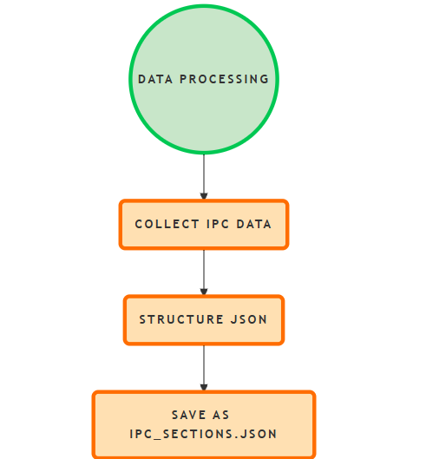
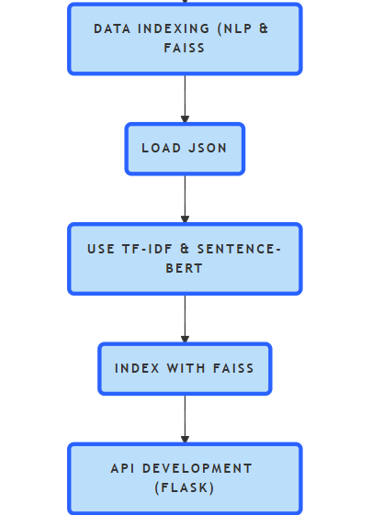
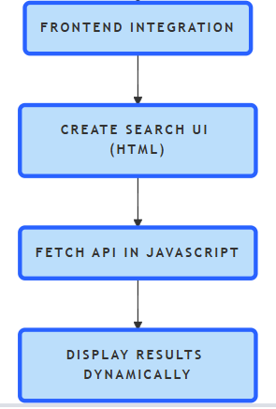
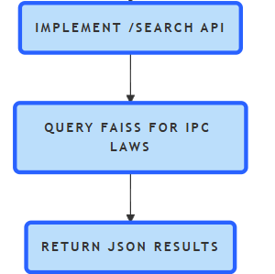
Design/ Diagram

Slide 7
System Specifications
Software | Version
Operating System | Windows 10/11, Ubuntu 20.04+, macOS
Python | 3.8 or higher
Flask | Latest version (Flask 2.0+)
Pandas | Latest version
FAISS | FAISS-CPU (or FAISS-GPU for better performance)
Sentence-BERT | all-MiniLM-L6-v2 (or a larger model for better accuracy)

Slide 8
Methodologies
1.Model Development:
i) Use Natural Language Processing (NLP) to allow the model to understand and interpret written inputs related to the complainant's case.
ii) Integrate machine learning algorithms to provide accurate and appropriate suggestions based on the details provided in the FIR.
2.User Interface (UI) and Experience (UX):
i) Design an intuitive and easy-to-use interface for law enforcement personnel with minimal training using the API End Point.
ii) Implement text input options and suit preferences.
3.Testing and Validation:
i) Conduct tests at a police station to assess the software's accuracy and efficiency.
ii) Use feedback from officers to continuously improve the system.

Slide 9
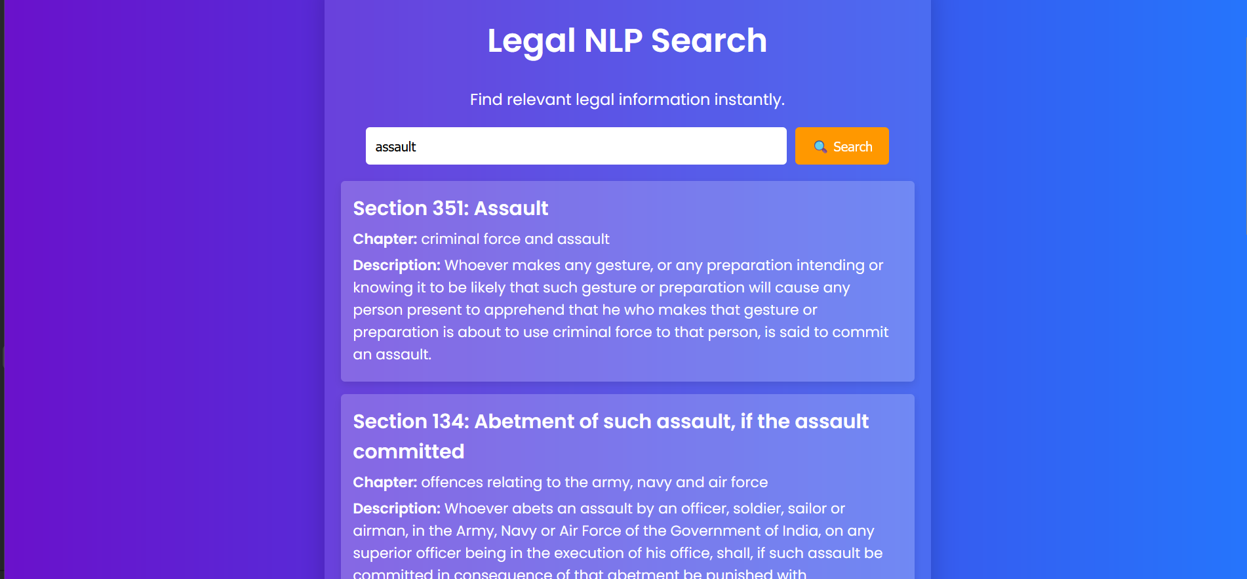
Intermediate Results

Slide 10
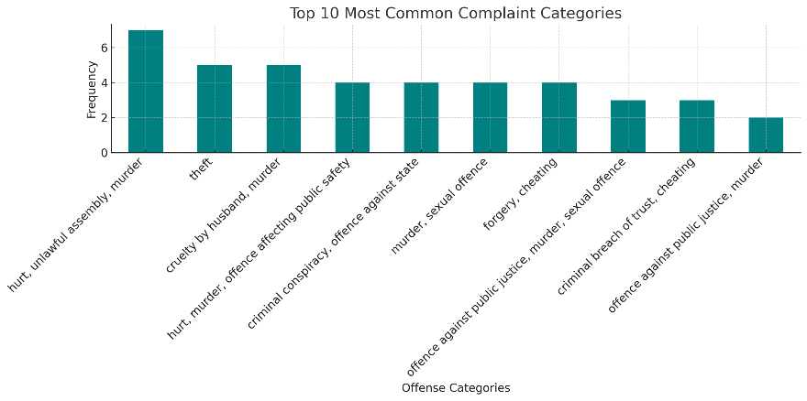
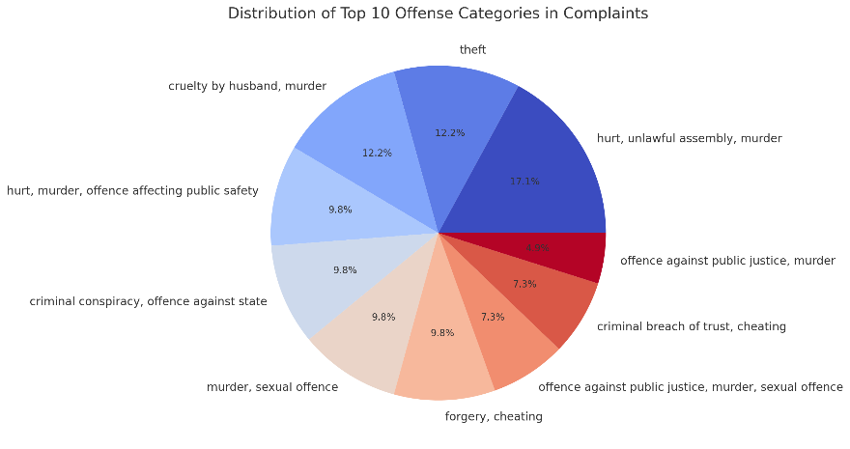
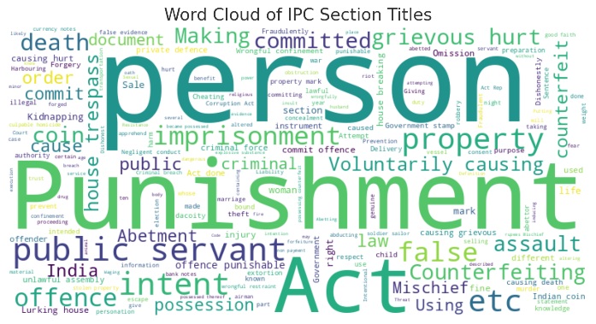
Intermediate Results

Slide 11
Journal/ Conference Identified
Sl. No | Title | Authors/ Affiliations | Journal Name, Year | _{Observations}
1 | Text similarity algorithms to determine Indian penal code sections for offence report | Ambrish Srivastav, Shaligram Prajapat | International Journal of Artificial Intelligence, Vol. 11, No. 1, March 2022 | Decision Support System (DSS) that uses NLP and text similarity algorithms to identify relevant IPC sections. It employs techniques like TF-IDF, cosine similarity, and word embeddings to enhance accuracy for legal professionals and users.
2 | JusticeAI: A Large Language Models Inspired Collaborative and Cross-Domain Multimodal System for Automatic Judicial Rulings in Smart Courts | Nagwan Abdel Samee, Maali Alabdulhafith, Syed Muhammad Ahmed Hassan Shah, Atif Rizwan | IEEE Access,2024 | This study presents the Cross-Domain Neural Knowledge Fusion (CDKF) system, enhancing judicial decision-making accuracy to 83% by integrating AI methodologies with ECHR data for smart court rulings.
3 | A Novel Method of Indian Penal Code Section Classification for Offence Incident Report | Ambrish Srivastav, Shaligram Prajapat | IEEE Access,2023 | This research proposes a novel corpus for the Indian Penal Code (IPC) to enhance text similarity analysis using various algorithms, aiming to improve classification of offences in legal documents through advanced NLP techniques.
4 | A Survey of Text Similarity Approaches | Wael H. Gomaa,Aly A. Fahmy | International Journal of Computer Applications (0975 – 8887), Volume 68 – No.13, April 2013. | This research introduces a two-staged NLP framework for sentiment assessment in Indian Supreme Court judgments.

Slide 12
References
Srivastav, A., & Prajapat, S. (2022). “Text similarity algorithms to determine Indian penal code sections” for offence report. International Journal of Artificial Intelligence, 11(1), March 2022
.J. Gao, H. Ning, Z. Han, L. Kong, and H. Qi, ‘‘Legal text classification model based on text statistical features and deep semantic features,’’ in Proc. FIRE, 2020

