Slide 1

COLLEGE ALUMNI CONNECT & MANAGEMENT SYSTEM
by
R.SUPRAJA
Roll No. 224G1A05B1
C.V.RAJASEKHAR REDDY
Roll No. 224G1A05C2
C.NARASIMHULU
Roll No. 224G1A0558
Under the guidance of
Dr. M.RANJIT REDDY, M.Tech., ph.D.
Professor
Department of Computer Science and Engineering
Srinivasa Ramanujan Institute of Technology
Autonomous
Rotarypuram Village, B K Samudram Mandal, Ananthapuramu – 515701.
2025-2026

Slide 2
Title Explaination
COLLEGE ALUMNI CONNECT & MANAGEMENT SYSTEM
The title “College Alumni Connect & Management System” represents a centralized digital platform for alumni engagement.
“Connect” indicates structured communication between students, alumni, faculty, and administrators.
“Management System” highlights organized handling of alumni data, feedback, mentoring, and events.
The system bridges the gap between alumni and the institution.
It supports long-term collaboration, career guidance, and institutional growth
Srinivasa Ramanujan Institute of Technology

Slide 3
Contents
COLLEGE ALUMNI CONNECT & MANAGEMENT SYSTEM
Abstract
Introduction
Software Requirements
Datasets/Modules
Implementation
Outputs
Conclusion
References
Srinivasa Ramanujan Institute of Technology

Slide 4
Abstract
COLLEGE ALUMNI CONNECT & MANAGEMENT SYSTEM
Introduction
A web-based system designed to connect students, alumni, faculty, and administrators through dedicated portals.
Research Gap
Existing alumni systems lack intelligent mentor matching and centralized interaction platforms.
Methodology Used
Developed using web technologies with an AI-based skill matching module for mentor recommendation.
Result
Improved student–alumni interaction, efficient data management, and faster mentor identification.
Conclusion
The system enhances alumni engagement and provides effective academic and career support.
Srinivasa Ramanujan Institute of Technology

Slide 5
Introduction
COLLEGE ALUMNI CONNECT & MANAGEMENT SYSTEM
The College Alumni Connect and Management System is a web-based application designed to connect alumni, students, faculty, and administrators.
It provides a centralized platform to store, manage, and update alumni and student information securely.
We chose this project because many institutions still use manual or outdated alumni management methods.
Existing systems lack proper interaction and structured data management.
This project addresses a real-time institutional problem and provides a practical solution.
It offers hands-on experience in web development, database management, and system design.
The project has high practical relevance, future scope, and academic value, making it the best choice among available projects.
Srinivasa Ramanujan Institute of Technology

Slide 6
Software Requirements
COLLEGE ALUMNI CONNECT & MANAGEMENT SYSTEM
Frontend: HTML, CSS, JavaScript, React
Backend: Python (Django / FastAPI)
Database: PostgreSQL
Development Tools: VS Code
Operating System: Windows
Srinivasa Ramanujan Institute of Technology

Slide 7
Datasets/Modules
COLLEGE ALUMNI CONNECT & MANAGEMENT SYSTEM
Student Module: Profile creation, skill entry, mentor requests
Alumni Module: Career updates, mentoring, job postings
Faculty Module: Monitoring interactions and feedback
Admin Module: User management, reports, system control
AI Skill Matching Module: Matches students with relevant alumni mentors
Srinivasa Ramanujan Institute of Technology

Slide 8
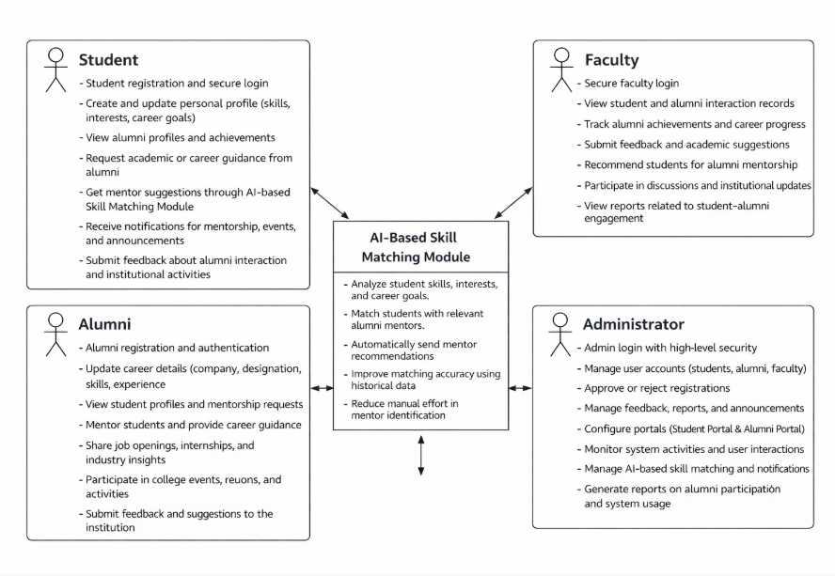
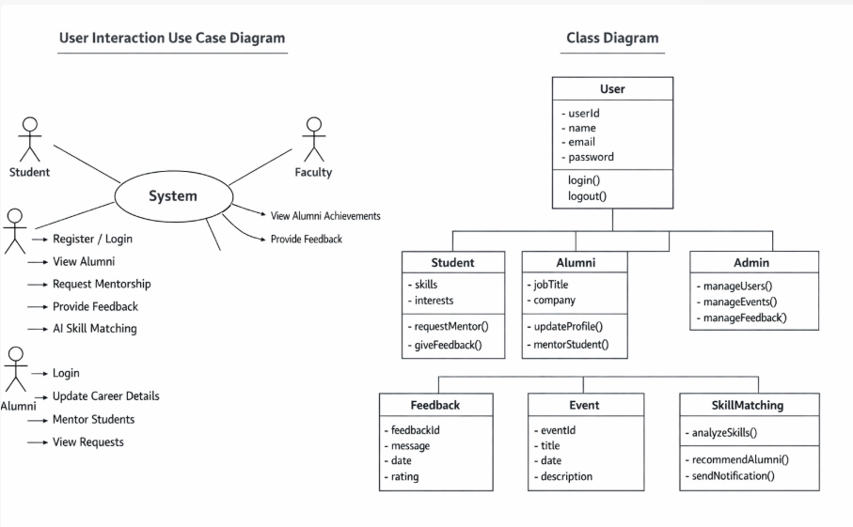
UML DIAGRAMS
COLLEGE ALUMNI CONNECT & MANAGEMENT SYSTEM
Srinivasa Ramanujan Institute of Technology

Slide 9
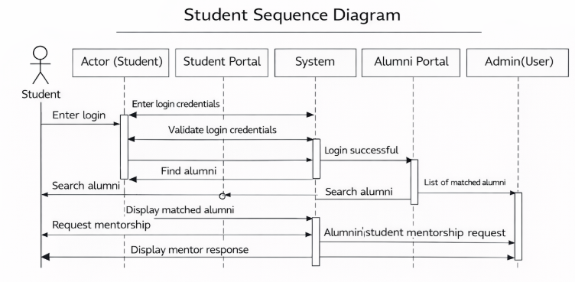
UML DIAGRAMS
COLLEGE ALUMNI CONNECT & MANAGEMENT SYSTEM
The student registers or logs into the system using secure authentication.
The student creates or updates the personal profile with skills, interests, and career goals.
The student requests mentorship through the AI-based Skill Matching Module.
The system analyzes student data and matches the student with suitable alumni mentors.
The system displays recommended alumni profiles and sends mentorship notifications.
The student interacts with alumni and submits feedback after receiving guidance.
Srinivasa Ramanujan Institute of Technology

Slide 10
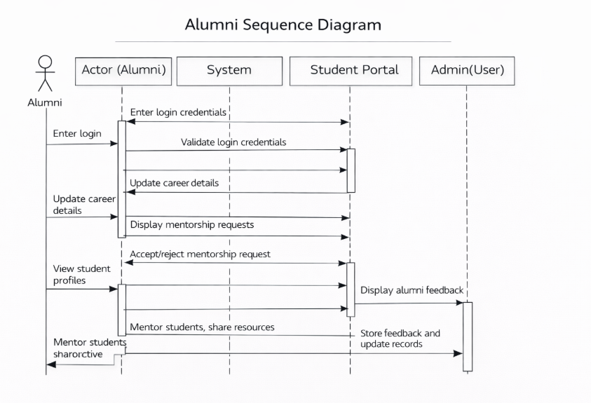
UML DIAGRAMS
COLLEGE ALUMNI CONNECT & MANAGEMENT SYSTEM
.
The Alumni actor enters login credentials, and the system validates them before granting access.
Alumni can update their career information, which is processed and stored by the system.
The system displays mentorship requests to the alumni, who can then accept or reject them.
Alumni can view student profiles, enabling them to provide guidance and feedback.
Alumni mentor students and share resources, contributing to student development.
Feedback provided by alumni is stored in the system, and records are updated for future reference.
Srinivasa Ramanujan Institute of Technology

Slide 11
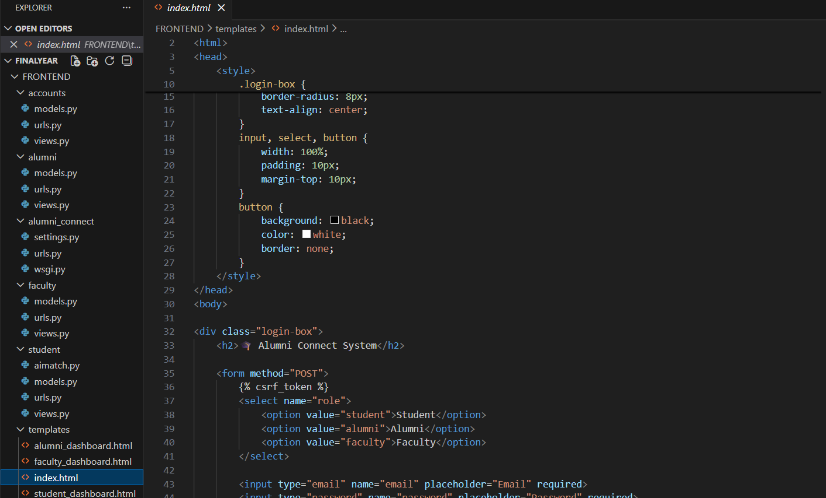
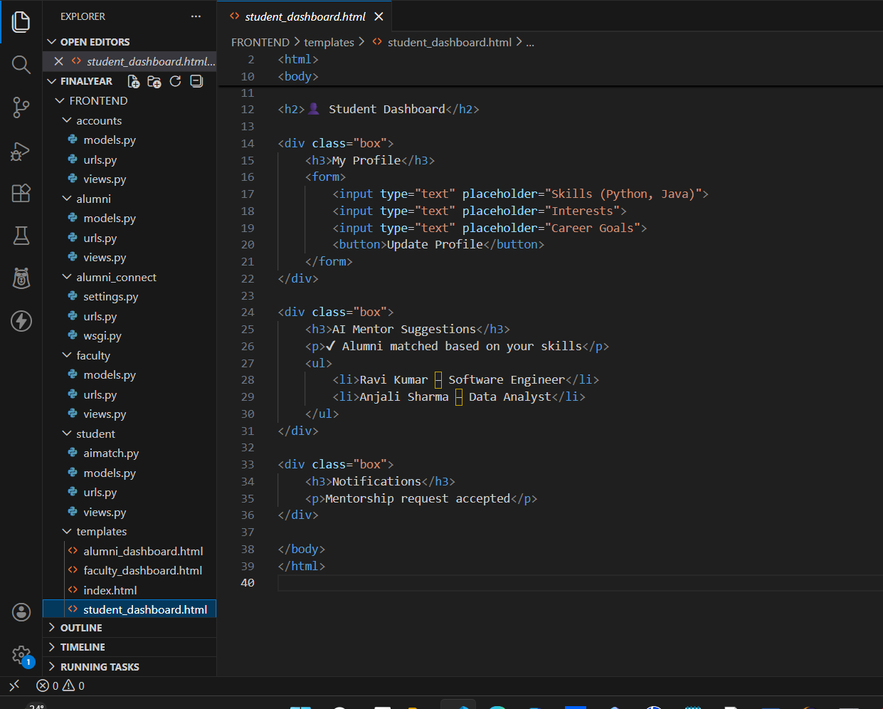
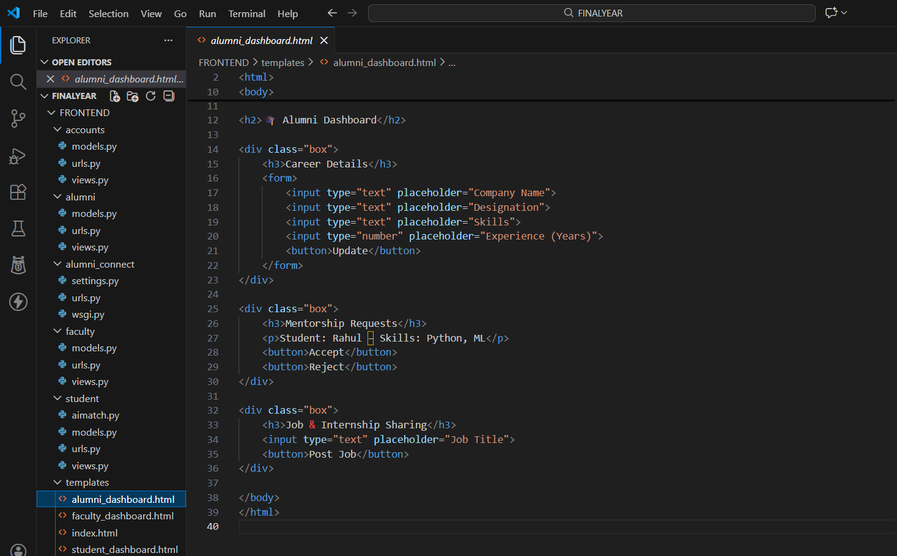
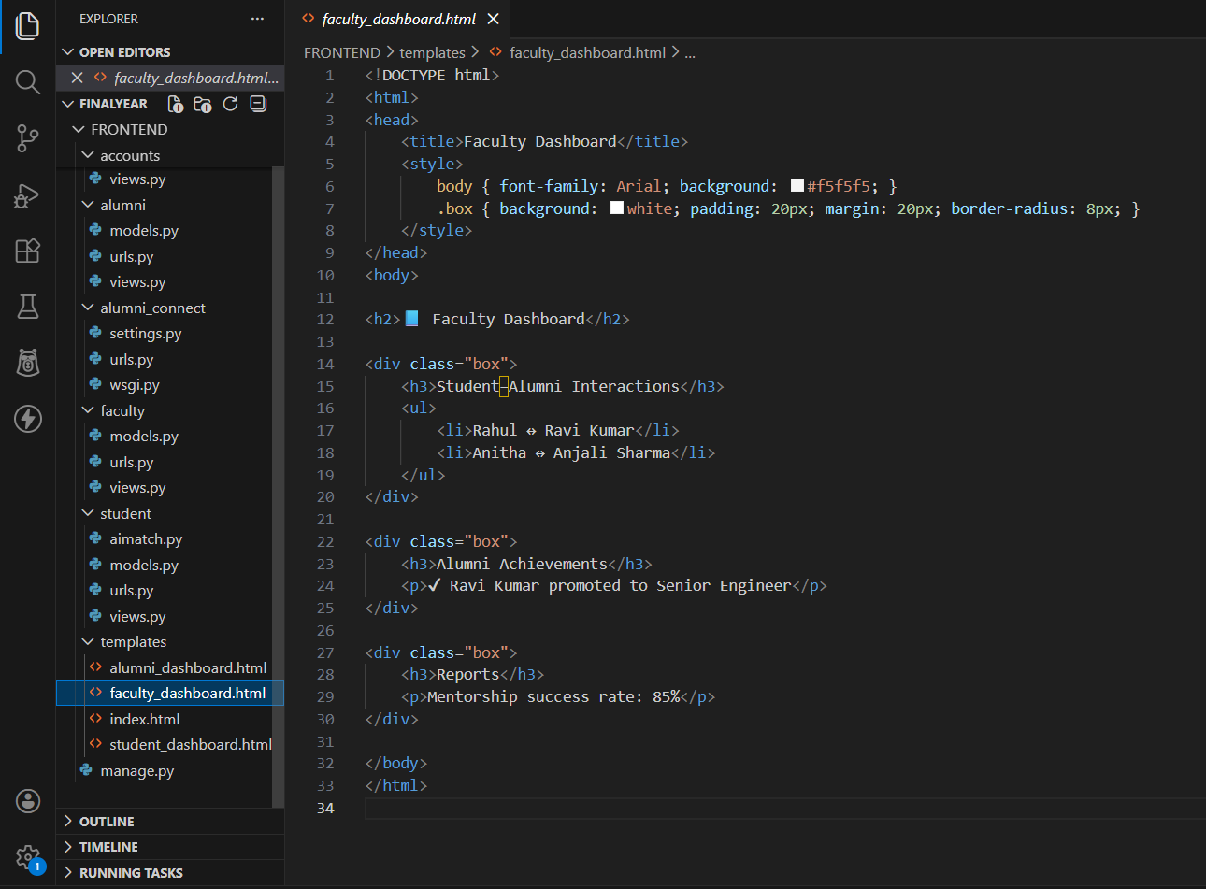
CODE SNIPPETS
COLLEGE ALUMNI CONNECT & MANAGEMENT SYSTEM
.
Srinivasa Ramanujan Institute of Technology

Slide 12
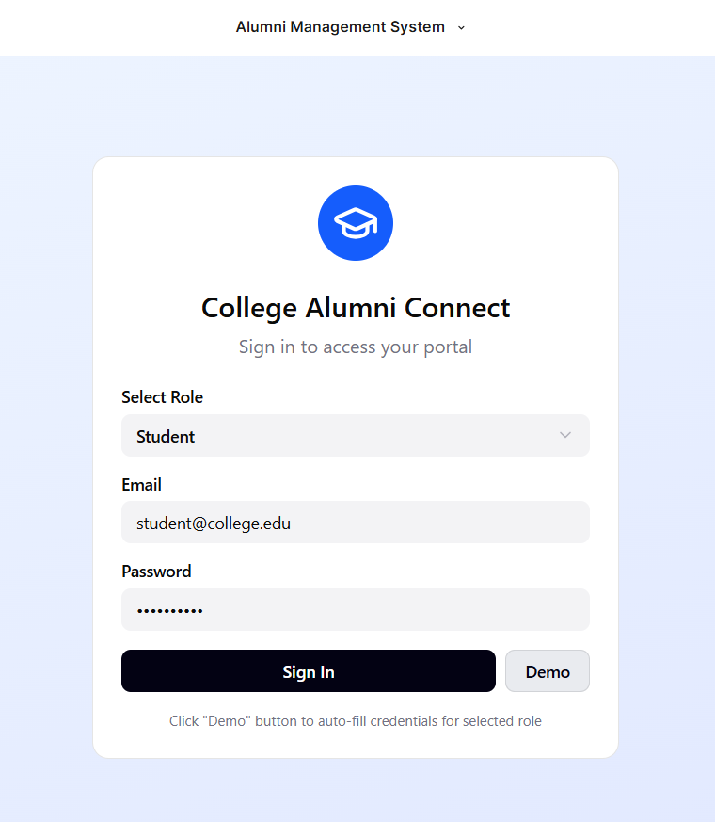
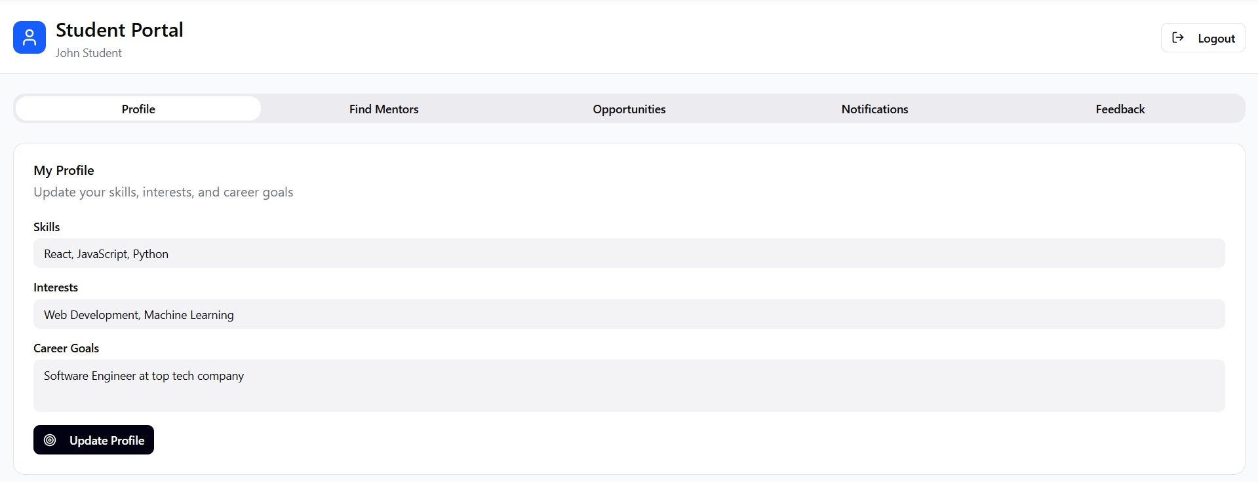
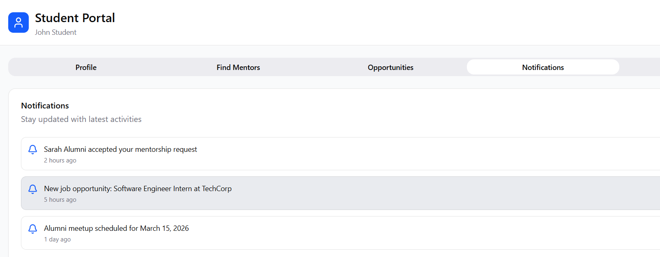
Outputs
COLLEGE ALUMNI CONNECT & MANAGEMENT SYSTEM
Srinivasa Ramanujan Institute of Technology

Slide 13
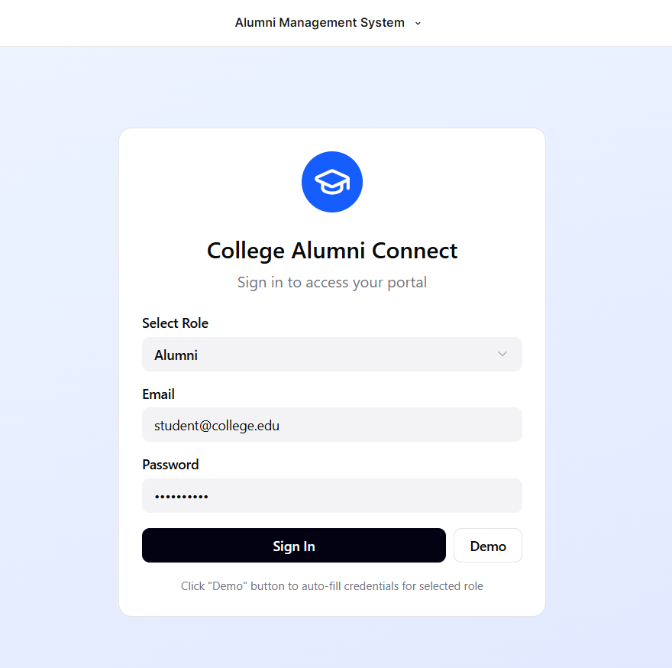
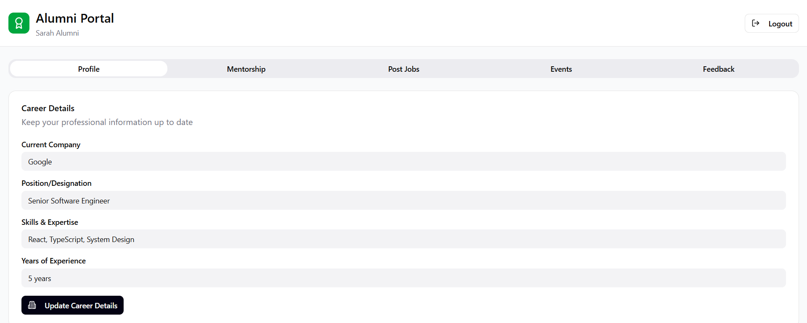
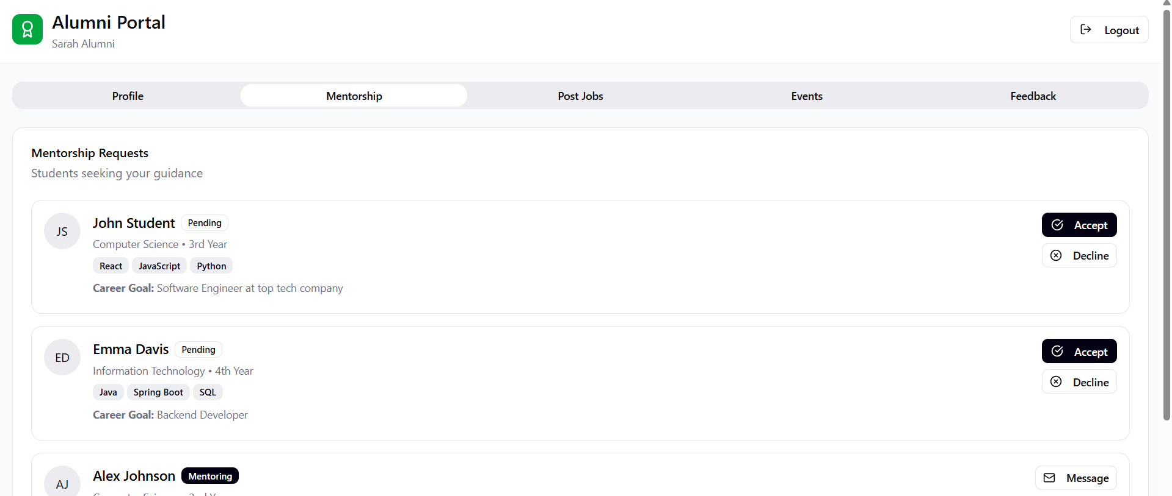
Outputs
COLLEGE ALUMNI CONNECT & MANAGEMENT SYSTEM
Srinivasa Ramanujan Institute of Technology

Slide 14
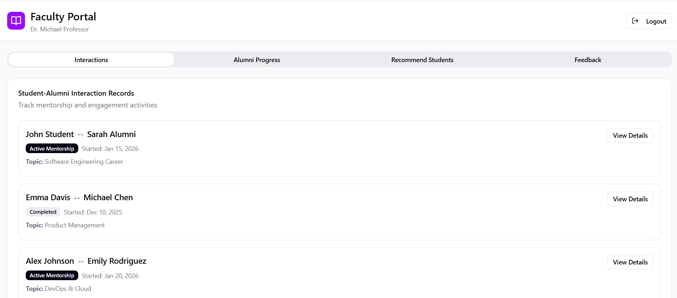
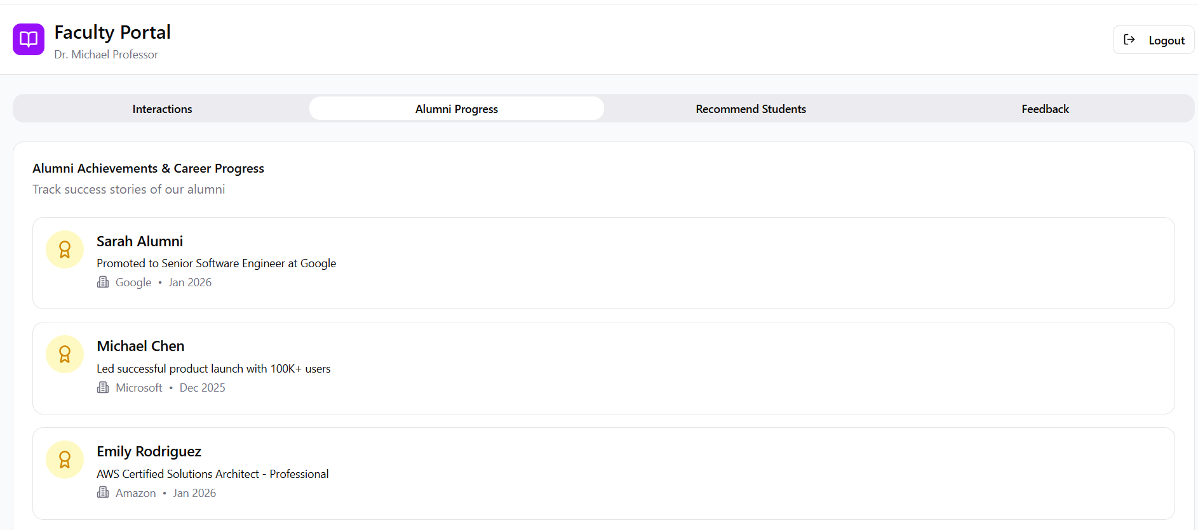
Outputs
COLLEGE ALUMNI CONNECT & MANAGEMENT SYSTEM
Srinivasa Ramanujan Institute of Technology

Slide 15
Conclusion
COLLEGE ALUMNI CONNECT & MANAGEMENT SYSTEM
The College Alumni Connect and Management System provides a centralized and efficient platform for managing alumni and institutional interactions.
The system improves communication, mentoring, and career guidance between alumni and students.
The AI-based skill matching module enhances mentor identification and student support.
The project reduces manual effort, improves data accuracy, and ensures secure system operation.
Future enhancements include mobile application development, advanced AI analytics, job portals, event management, and real-time notifications.
Srinivasa Ramanujan Institute of Technology

Slide 16
References
COLLEGE ALUMNI CONNECT & MANAGEMENT SYSTEM
Book
[1] R. Pressman, Software Engineering. McGraw-Hill, 2014.
Journal Article
[2] K. G. Jagtap et al., “Alumni Connect: Bridging Past and Present,” IJRPR, 2024.
[3] L. L. Occiano et al., “Web-based Alumni Management System,” IJRES, 2023.
Newspaper Article
[4] “Digital alumni platforms in universities,” The Hindu, 2023.
Technical Report [5] Software Engineering Practices for Web Systems, Technical Report, 2022.
Srinivasa Ramanujan Institute of Technology

Slide 17
Thank You
COLLEGE ALUMNI CONNECT & MANAGEMENT SYSTEM
Srinivasa Ramanujan Institute of Technology

Slide 18
Any Queries
Title
Srinivasa Ramanujan Institute of Technology

