Slide 1

COLLEGE ALUMNI CONNECT & MANAGEMENT SYSTEM
by
R.SUPRAJA
Roll No. 224G1A05B1
C.V.RAJASEKHAR REDDY
Roll No. 224G1A05C2
C.NARASIMHULU
Roll No. 224G1A0558
Under the guidance of
Dr. M.RANJIT REDDY, M.Tech., ph.D.
Professor
Department of Computer Science and Engineering
Srinivasa Ramanujan Institute of Technology
Autonomous
Rotarypuram Village, B K Samudram Mandal, Ananthapuramu – 515701.
2025-2026

Slide 2
Contents
College Alumni Connect & Management System
Title Justification
Abstract
Problem statement
Objectives of Project
Literature survey for objectives
Proposed Work -(Methods to be followed for proposed system)
References
GitHub Link
Queries
Srinivasa Ramanujan Institute of Technology

Slide 3
Title Justification
College Alumni Connect & Management System
The title “College Alumni Connect & Management System” reflects a platform designed to bridge the gap between alumni and the institution.
It emphasizes connection, enabling past and present students to stay engaged through structured communication channels.
The term “Management System” signifies an organized platform that efficiently handles alumni data, event coordination, communication, contributions, and networking.
This system supports the college in maintaining long-term relationships, collecting feedback, organizing reunions, and enhancing career support for current students.
Overall, the title clearly conveys the purpose: a centralized platform for managing, connecting, and empowering the alumni community.
.
Srinivasa Ramanujan Institute of Technology

Slide 4
Abstract
College Alumni Connect & Management System
The College Alumni Connect and Management System strengthens communication between Students, Faculty, Staff, Alumni, and Administrators through a unified Student Portal and Alumni Portal for efficient information sharing.
Alumni can share feedback, update career details, mentor students, and participate in institutional activities, while students and faculty can submit feedback, track alumni achievements, and seek academic or career guidance
.
Administrators securely manage user data, feedback, and portal configurations through the Admin Panel, ensuring smooth system operation.
The system includes an AI-based Skill Matching Module that analyzes student skills and goals, identifies the most relevant alumni, and automatically sends notifications to help students connect with suitable mentors.
Srinivasa Ramanujan Institute of Technology

Slide 5
Problem Statement
College Alumni Connect & Management System System
Colleges lack a centralized platform where students, faculty, staff, alumni, and administrators can effectively communicate and share information. Alumni data is often unorganized, making it difficult for students and faculty to access career guidance, mentorship, and institutional updates. Additionally, there is no efficient system to collect, manage, and verify feedback from users across the institution. Due to the absence of real-time interaction tools and structured communication channels, maintaining active alumni engagement becomes challenging. Furthermore, the lack of an AI-based mechanism to analyze student skills and automatically match them with suitable alumni mentors leads to missed opportunities for academic and career development.
Srinivasa Ramanujan Institute of Technology

Slide 6
Objectives of Project
College Alumni Connect & Management System
Objective 1:
To develop a centralized digital platform that enables seamless communication and collaboration among students, faculty, alumni, and administrators
Objective 2:
To organize and maintain a structured alumni database while providing tools for mentorship, feedback collection, and real-time engagement between alumni and the institution
Srinivasa Ramanujan Institute of Technology

Slide 7
College Alumni Connect & Management System
Literature Survey
No | Title | Author | Journal Name & Year | Methodology Adapted | Key Findings | Gaps
1. | Alumni Tracking System | Bhavesh Patil et al. | IJRASET, 2021 | PHP & MySQL based web application | Efficient storage and tracking of alumni data | No AI-based recommendations, lacks mentorship and career guidance features
2 | Alumni Connect Portal | D. Maya et al. | IJERT, 2022 | Web-based portal by authentication and communication modules | Improved alumni–student interaction and networking | No intelligent career guidance, no personalized mentoring system
3 | Web-Based Alumni Management | Leonard L. Occiano et al. | IJRES, 2023 | RAD model using PHP & MySQL | High usability and effective alumni data management | No AI-driven personalization or automation
4 | Alumni Connect Web Portal | Pranav Varma V. et al. | IJRPR, 2025 | Full-stack web application | Enhanced alumni–student engagement | Lack of intelligent recommendation system
B -09

Slide 8
Proposed System
College Alumni Connect & Management System
The proposed system is AlumniConnect, a centralized college alumni communication and management platform designed to streamline interactions between students, alumni, faculty, and administrators.
providing a single unified interface for managing profiles, sharing updates, accessing career guidance, and collecting verified feedback.
The platform is a web application developed using Django (Python) for the backend, HTML and CSS for frontend design, and PostgreSQL for secure, structured data storage. Key features include:
User registration and profile management for students, alumni, faculty, and
administrators.
Career guidance, mentorship programs, and event updates
Feedback collection and verification system for students and alumni
Admin dashboard for managing users, events, and communications
The system is responsive, secure, and provides a smooth, interactive experience on both desktop and mobile.
Srinivasa Ramanujan Institute of Technology

Slide 9
References
College Alumni Connect & Management System
[1] B. Patil, K. Gangwani, I. Wankhade, P. Satote, G. Saarkar, and G. V. Dahake, “Alumni Tracking System,” International Journal for Research in Applied Science & Engineering Technology (IJRASET), vol. 9, no. 6, pp. 1023–1027, 2021.
[2] D. Maya, R. Suwetha, E. Sonika, S. Subhashini, and S. Deepak Kumar, “Alumni Connect Portal,” International Journal of Engineering Research & Technology (IJERT), vol. 11, no. 5, pp. 210–214, 2022.
[3] L. L. Occiano, A. R. Santos, and J. M. Cruz, “Web-Based Alumni Management System,” International Journal of Research in Engineering and Science (IJRES), vol. 11, no. 3, pp. 45–52, 2023.
[4] P. Varma V., S. Reddy, and A. Kumar, “Alumni Connect Web Portal,” International Journal of Recent Publications and Reviews (IJRPR), vol. 6, no. 1, pp. 88–93, 2025.
Srinivasa Ramanujan Institute of Technology

Slide 10
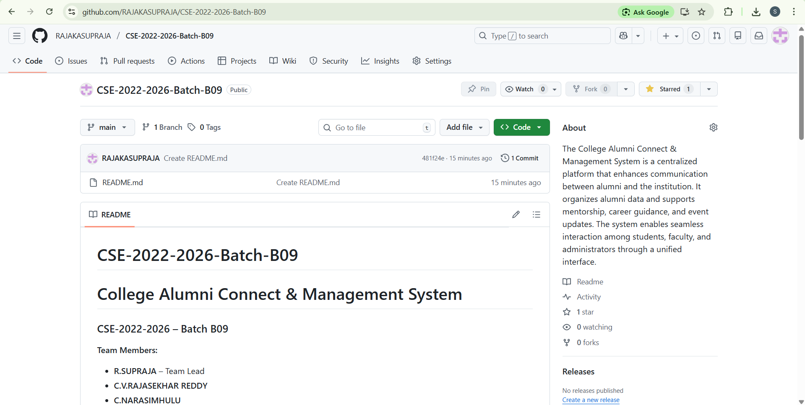
Git Hub Dashboards of each student
College Alumni Connect & Management System
link of the Github: https://github.com/RAJAKASUPRAJA/CSE-2022-2026-Batch-B09
Srinivasa Ramanujan Institute of Technology

Slide 11
Any Queries?
College Alumni Connect & Management System
Srinivasa Ramanujan Institute of Technology

