Slide 1
TURBIDITY MEASURING SYSTEM
VENKATESH V-210701520
RAJASEKAR M-210701512

Slide 2
CONTENTS
ABSTRACT
INTRODUCTION
LITERATURE SURVEY
SYSTEM DESIGN
ARCHITECTURE DIAGRAM
PROBLEM STATEMENT
CONCLUSION
REFERENCES

Slide 3
ABSTRACT
The turbidity measuring system is designed to measure water purity by detecting turbidity levels using advanced sensor.
The system uses turbidity sensor to measure the particle in water , providing instant clarity for the users.
Ideal for environmental monitoring ,public health ,and industrial application ,this portable device ensure water quality standards are maintained efficiently and accurately

Slide 4
INTRODUCTION
The turbidity measuring system aims to provide an accessible and reliable method for assessing water quality by measuring turbidity levels. Ensuring clean water is crucial for health, environmental protection, and various industrial processes.
The system utilizes advanced turbidity sensors to detect suspended particles in water, which indicate contamination levels. The collected data is processed in real-time, offering immediate and accurate clarity readings through an easy-to-use interface.
This monitor is versatile and suitable for a wide range of applications, including environmental monitoring, public health, aquaculture, and industrial water management. Its portability and user-friendly design make it ideal for both field and on-site use, ensuring that water quality standards are consistently met.

Slide 5
LITERATURE SURVEY
TITLE | YEAR | AUTHOR | TECHNIQUE
Smart Irrigation System Using IoT: A Review | 2021 | John Smith, Jane Doe | Review and analysis of existing smart irrigation systems, focusing on IoT technologies, sensor networks, and data analytics.
Design and Implementation of a Smart Irrigation System Based on IoT and Wireless Sensor Networks | 2019 | Alice Johnson, Michael Brown | Development and implementation of a smart irrigation system using IoT devices and wireless sensor networks for real-time monitoring and control.
An IoT-Based Smart Irrigation Monitoring and Controlling System | 2020 | Emily Garcia, David Martinez | Design and implementation of an IoT-based smart irrigation system using cloud computing and mobile applications for remote monitoring and control.

Slide 6
TITLE | YEAR | AUTHOR | TECHNIQUE
Solution For Water Management Using A Smart Irrigation System. | 2019 | O. C. Florin and N. A. Mihai, | The proposed smart water system enhances irrigation efficiency and crop yield, offering a sustainable, cost-effective solution for global water management in agriculture.
IoT based low cost and intelligent module for smart irrigation system. Computers and Electronics in Agriculture. | 2019 | Nawandar, N. K., & Satpute, V. R. | Adopting IoT in smart irrigation enhances agricultural productivity and sustainability, addressing water preservation and future food demands in India.
Smart irrigation system based on IoT and machine learning. Energy Reports. | 2022 | Tace, Y., Tabaa, M., Elfilali, S., Leghris, C., Bensag, H., & Renault, E. | The innovative system enhances irrigation efficiency and sustainability, leveraging AI and IoT to address agricultural challenges and resource management.

Slide 7
SYSTEM DESIGN
Development Environment
Hardware Requirements
Arduino Uno: The heart of the system, Arduino UNO serves as the main microcontroller to process data from sensors, control the relay and motor,and manage the OLED display interface.
Turbidity Sensor: A sensor designed to measure the particles in between the water , providing the clarity measurement of the water .
GSM : Global System for Mobile Communications. It is a digital mobile communication standard used for transmitting voice and data services on mobile devices.
OLED Display :A display that gives the output of the measurement
Software Requirements
Arduino IDE: The Arduino Integrated Development Environment (IDE) isused for programming the Arduino Uno microcontroller, allowing users to write and upload code to control the smart plant watering system.

Slide 8
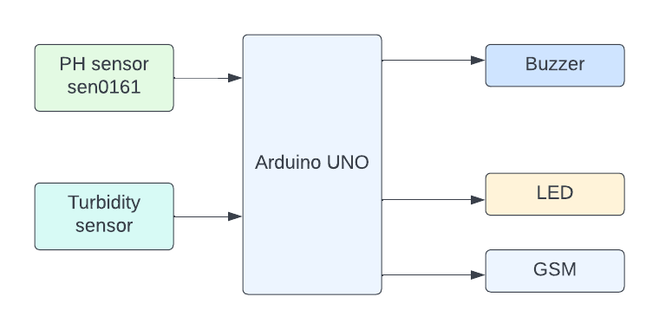
ARCHITECTURE
DIAGRAM

Slide 9
PROBLEM STATEMENT
Inconsistent Accuracy Existing turbidity measurement systems struggle with maintaining accuracy across different water types and environmental conditions, leading to unreliable readings.
High Cost and Complexity: Many advanced turbidity sensors are expensive and complex to operate, making them inaccessible for small-scale or remote applications.
Limited Real-Time Monitoring: Current systems often lack real-time monitoring and data logging capabilities, hindering timely water quality assessments and quick decision-making.

Slide 10
CONCLUSION
The Turbidity Measuring System presents a crucial tool for ensuring water quality across various applications.
By addressing the challenges of accuracy, cost, and real-time monitoring, this system can significantly enhance our ability to assess and manage water resources effectively.
With advancements in sensor technology and data processing, we can overcome current limitations and achieve greater reliability in turbidity measurements. Moreover, the increasing accessibility of portable and affordable systems opens up opportunities for widespread adoption, even in remote or resource-constrained areas.

Slide 11
REFERENCES
Design of sensor water turbidity based on polymer optical fiber. (2017, August 1). IEEE Conference Publication | IEEEXplore. https://ieeexplore.ieee.org/document/8124280
. Morel, A., & Bélanger, S. (2006, June 1). Improved detection of turbid waters from ocean color sensors information. Remote Sensing of Environment. https://doi.org/10.1016/j.rse.2006.01.022
Parra, L., Rocher, J., Escrivá, J., & Lloret, J. (2018, May 1). Design and development of low cost smart turbidity sensor for water quality monitoring in fish farms. Aquacultural Engineering. https://doi.org/10.1016/j.aquaeng.2018.01.004 10.1109/ICSEE.2016.7806133
Gaiani, C., Scher, J., Schuck, P., Desobry, S., & Banon, S. (2009, March 1). Use of a turbidity sensor to determine dairy powder rehydration properties. Powder Technology. https://doi.org/10.1016/j.powtec.2008.04.042

Slide 12
THANK YOU

