Slide 1
AI-Based Welding Defect Detection System Using Computer Vision
Real-Time Embedded Edge Inspection Pipeline via YOLOv8 Nano
Embedded AI Laboratory (Assignment 9) | Department of CSE (AI & ML), PCCOE
Date: Academic Year 2025-26
Scope: Transitioning manual welding quality control to an automated, low-latency edge-vision framework to detect structural surface defects in real time.

Slide 2
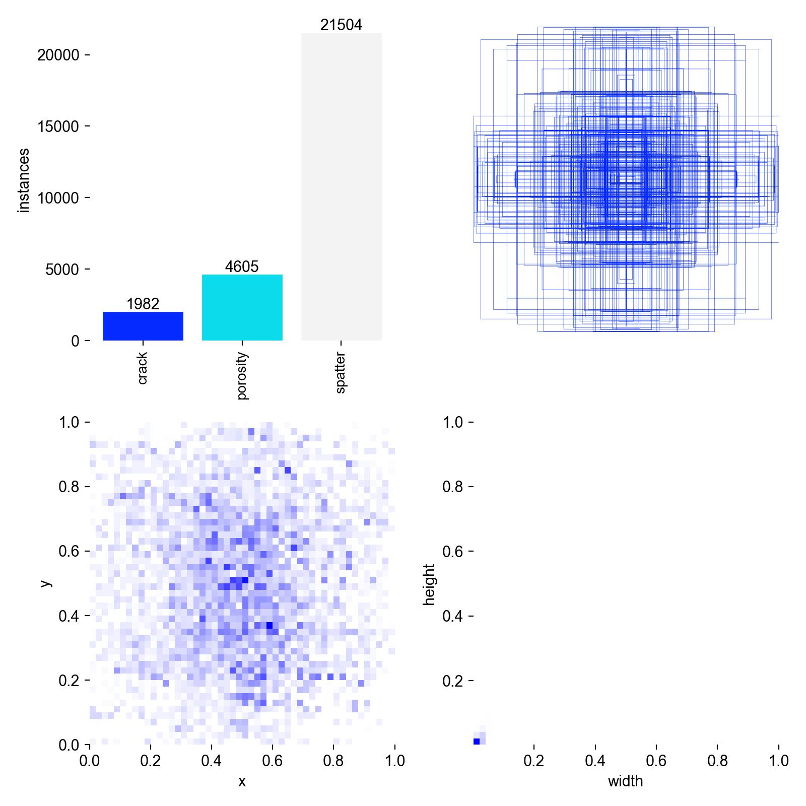
Dataset Selection & Architecture (Rubric: 2 Marks)
Dataset: Multi-Class Surface Weld Defect Dataset (Crack, Porosity, Spatter) from Kaggle.
Specifications: 640x640 normalized RGB inputs, YOLO-format coordinates [class_id, x, y, w, h].
Class | Train / Val | Description
Class 0: Crack | 1,982 / 273 | Narrow, high-contrast linear fissures along bead boundaries.
Class 1: Porosity | 4,605 / 152 | Clustered and isolated spherical gas voids trapped during cooling.
Class 2: Spatter | 21,504 / 1,734 | Dense, scattered molten metal droplets in heat-affected zone.

Slide 3
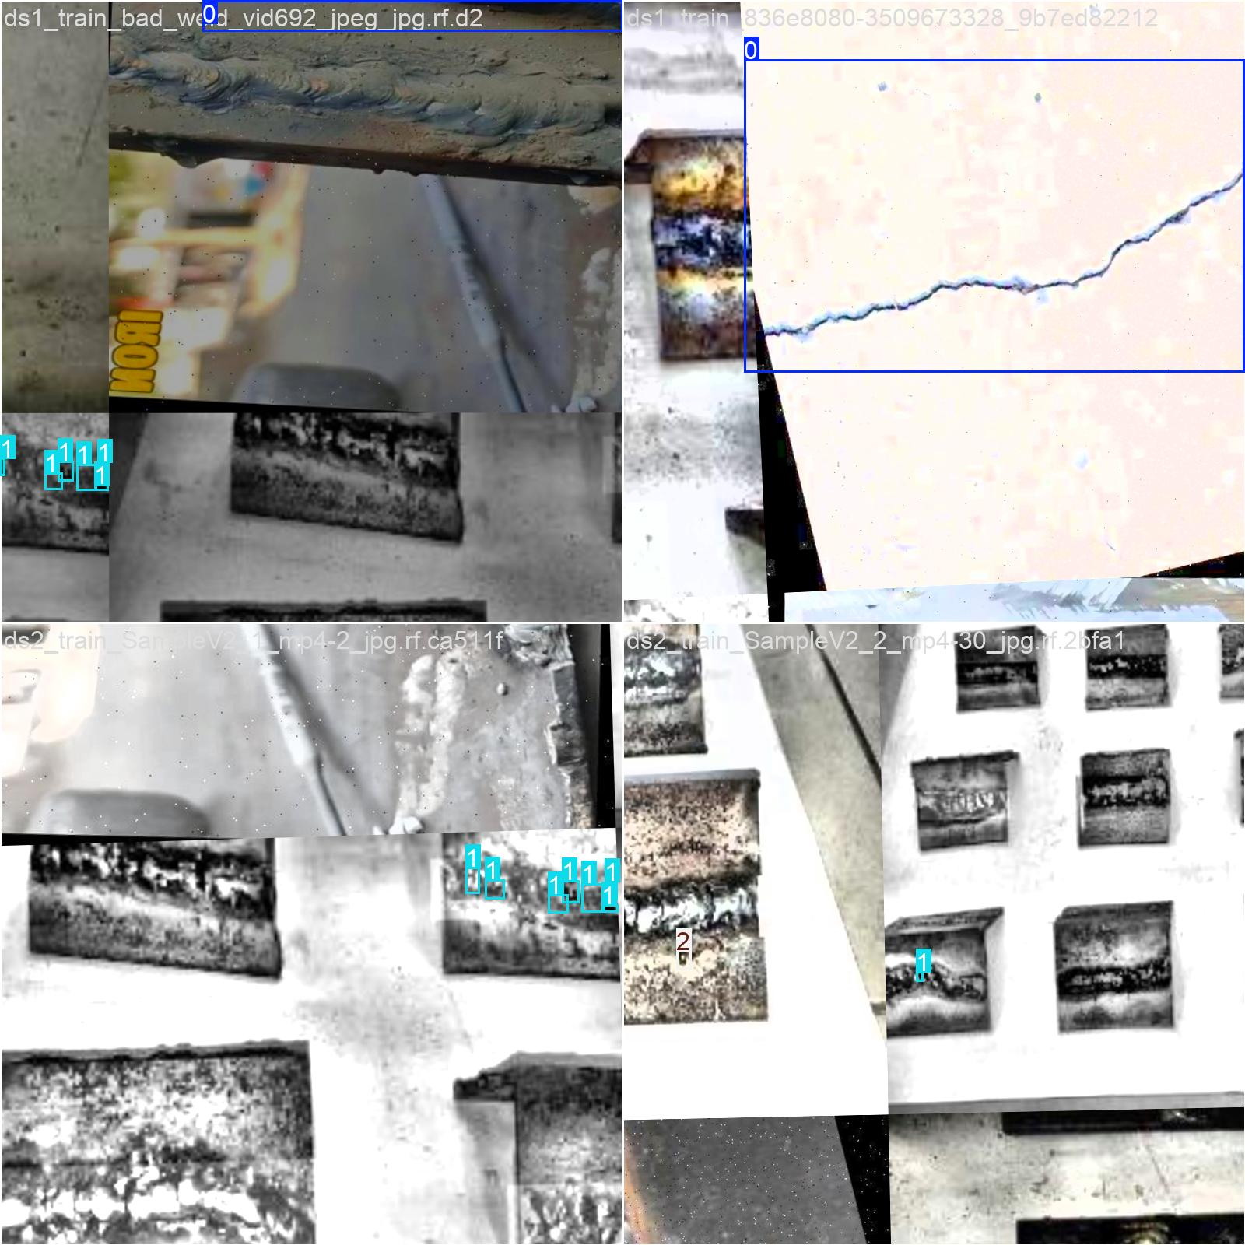
Sample & Data Explanation (Rubric: 2 Marks)
Morphologies & Root Failure Causes:
• Crack (Critical Structural Hazard): High-contrast directional fissures caused by severe thermal tensile stress or hydrogen embrittlement.
• Porosity (Density Discontinuity): Spherical cavities caused by trapped shielding gas (Argon/CO2) or moisture/rust vaporization.
• Spatter (Process Flaw): Molten metal droplets caused by excessive arc current, incorrect torch angle, or unstable wire feed.

Slide 4
Model Selection & Embedded Feasibility (Rubric: 2 Marks)
Architecture: Single-stage anchor-free YOLOv8 Nano (yolov8n.pt).
Single-stage rationale: Bypasses heavy Region Proposal Networks (RPNs), cutting latency from >80 ms to sub-10 ms.
Metric | Embedded Hardware Profile
Parameters | 3,006,233 (~3.0M) -> Fits within constrained edge SRAM/LPDDR4 memory.
Compute Complexity | 8.1 GFLOPs -> Minimal thermal load for fanless robotic enclosures.
Weight Footprint | 6.2 MB ('best.pt') -> Rapid boot and over-the-air updates from flash memory.
Frame Latency | 40.49 ms on CPU (~24.7 FPS); drops to <5 ms (>120 FPS) with TensorRT.
Target Deployment | NVIDIA Jetson Nano / Orin Nano, Raspberry Pi 5 with AI Hat.

Slide 5
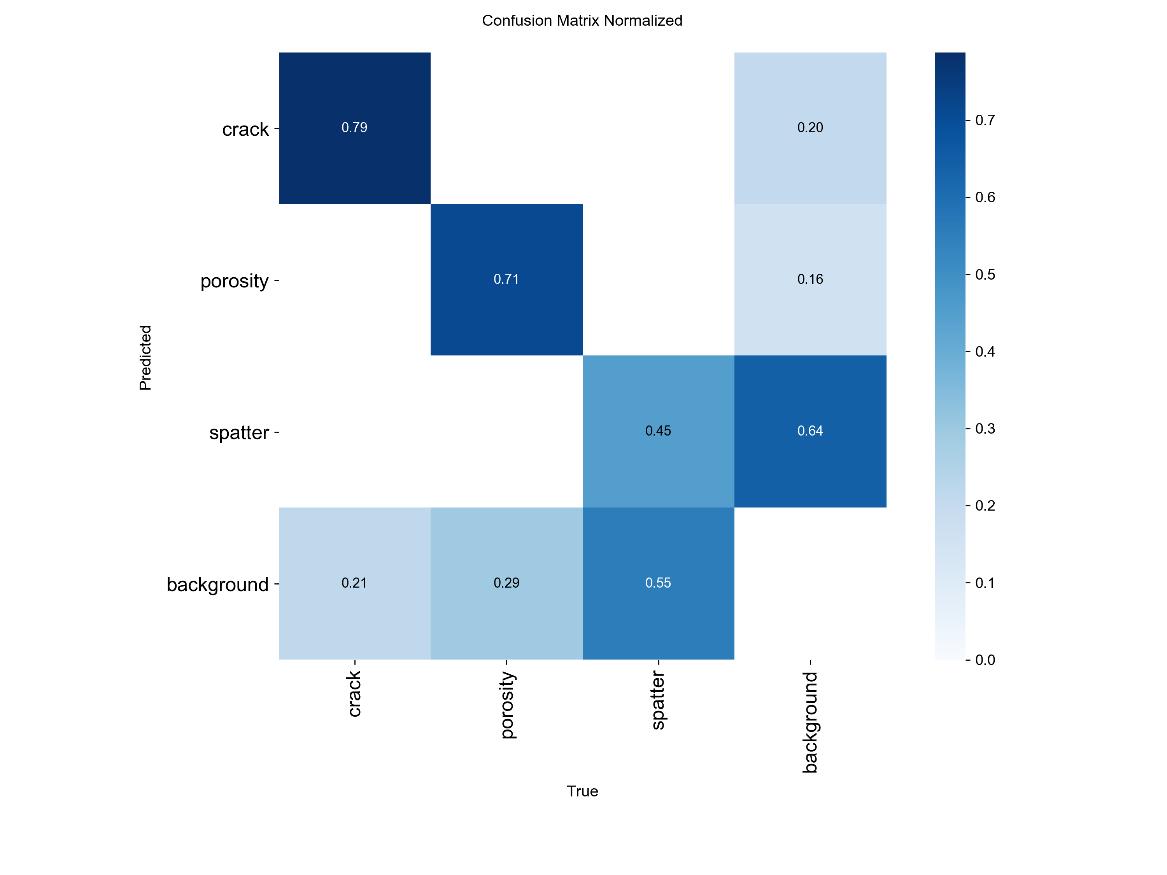
Quantitative Evaluation & Results Analysis (Rubric: 2 Marks)
Class | Instances | Precision | Recall | mAP@0.5 | mAP@0.5:0.95
Crack | 273 | 66.2% | 64.5% | 66.54% | 39.9%
Porosity | 152 | 59.8% | 52.0% | 51.85% | 21.6%
Spatter | 1,734 | 66.0% | 31.1% | 39.30% | 13.6%
Overall | 2,159 | 70.42% | 47.62% | 52.57% | 25.59%
Engineering Analysis:
• Crack Detection: Sharp contrast against reflective beads gives strong convolutional feature activations.
• Porosity Scaling: Resizing to 640x640 reduces micro-voids to single-pixel regions.
• Spatter Clustering: Dense droplets trigger NMS merging; surface roughness leads to false alarms.
• Operational Threshold: F1-confidence optimization identifies peak performance balance at Conf = 0.292.

Slide 6
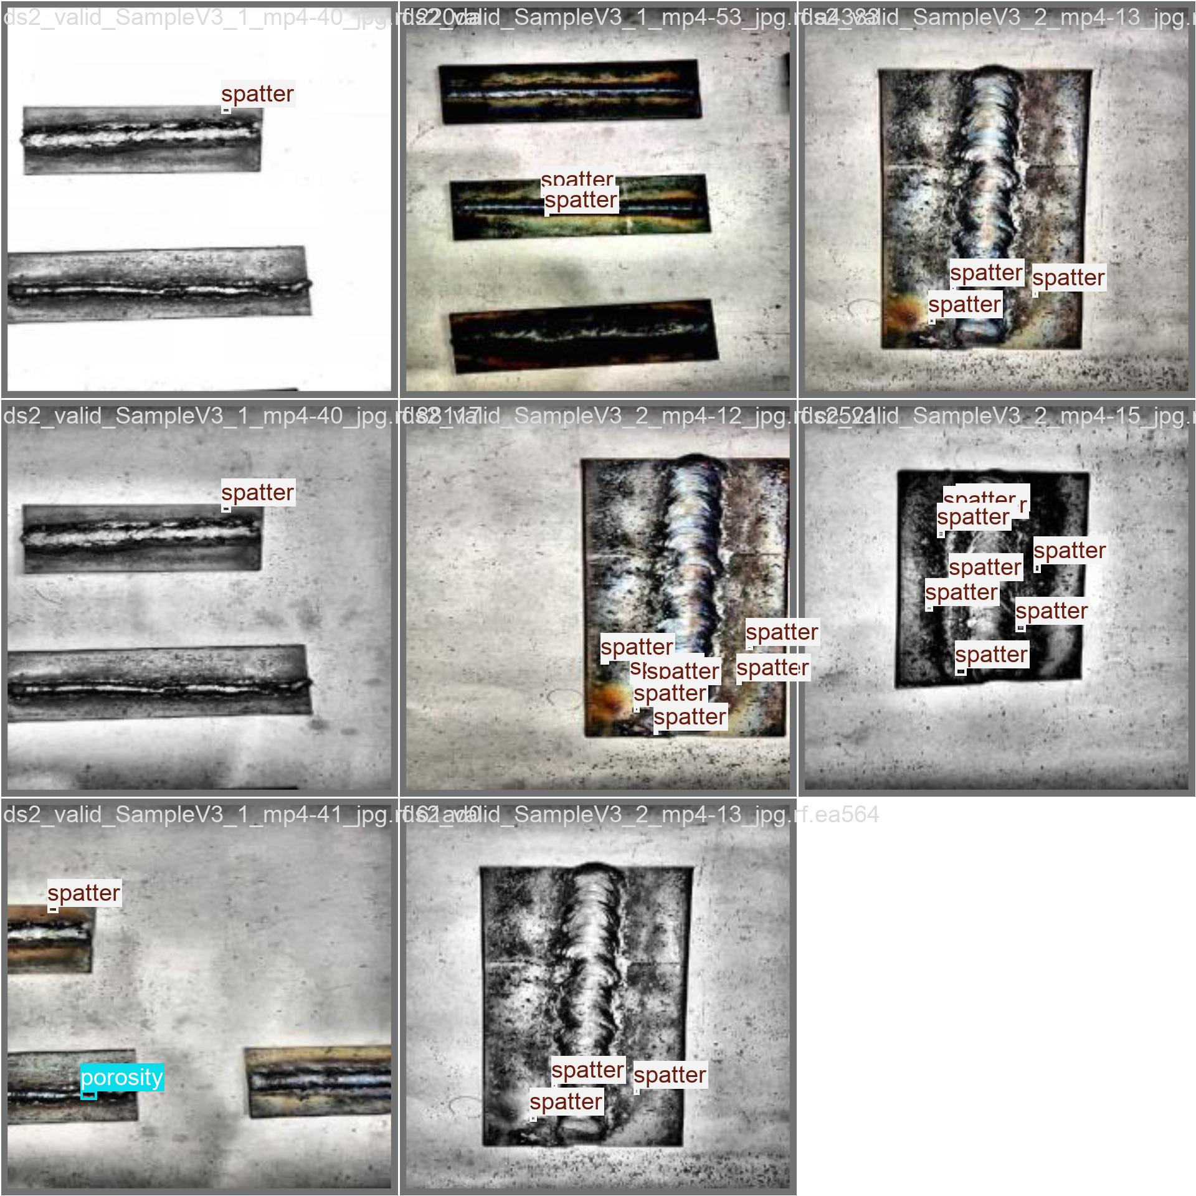
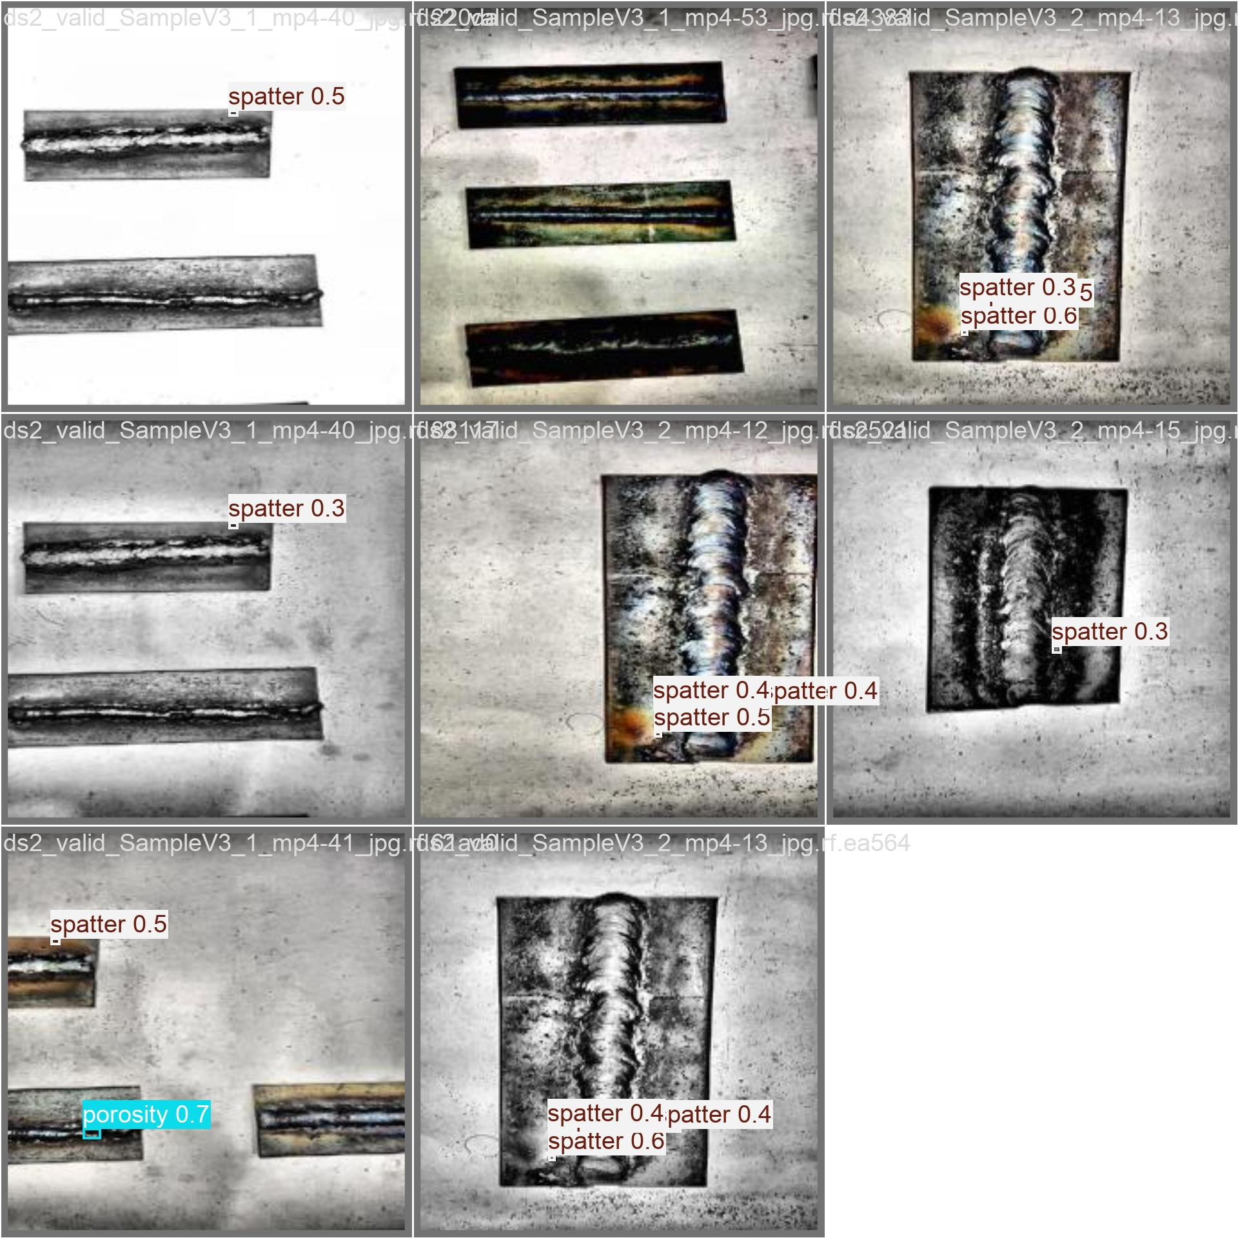
Visual Validation: Ground Truth vs. Autonomous Inference (Rubric: 2 Marks)
Ground Truth Labels
YOLOv8 Autonomous Predictions

Slide 7
Industrial Deployment Architecture & Conclusion
Production Flow: GigE Camera -> Edge SBC (Jetson/RPi5) -> YOLOv8n TensorRT Engine -> Digital I/O to PLC -> Automatic Torch Stoppage / Fault Logging.
Latency Assurance: Deterministic frame cycle guarantees zero-lag closed-loop control on 30 FPS production lines.
QA Impact: Eliminates subjective inspector fatigue and catches critical fractures before structural delivery.
Engineering Roadmap: Future integration of Sliced Aided Hyper Inference (SAHI) or 1024x1024 patch cropping for micro-porosity resolution.

