Slide 1
S&P GLOBAL & CRISIL CAMPUS HACKATHON 2026
SentinelRisk AI
Explainable financial event intelligence
and portfolio risk simulation
Bommaka Rajasekhar Reddy | IIT Dharwad
Prototype · Synthetic data · Explainable scenario modelling

Slide 2
01 · PROBLEM
The problem and our approach
• Financial news and social text are unstructured and arrive faster than manual review.
• Risk teams need structured sentiment, event type, severity and affected exposures.
• SentinelRisk normalizes text, scores sentiment, classifies events and emits validated JSON signals.
• One risk engine powers portfolio stress testing and tactical index rebalancing.

Slide 3
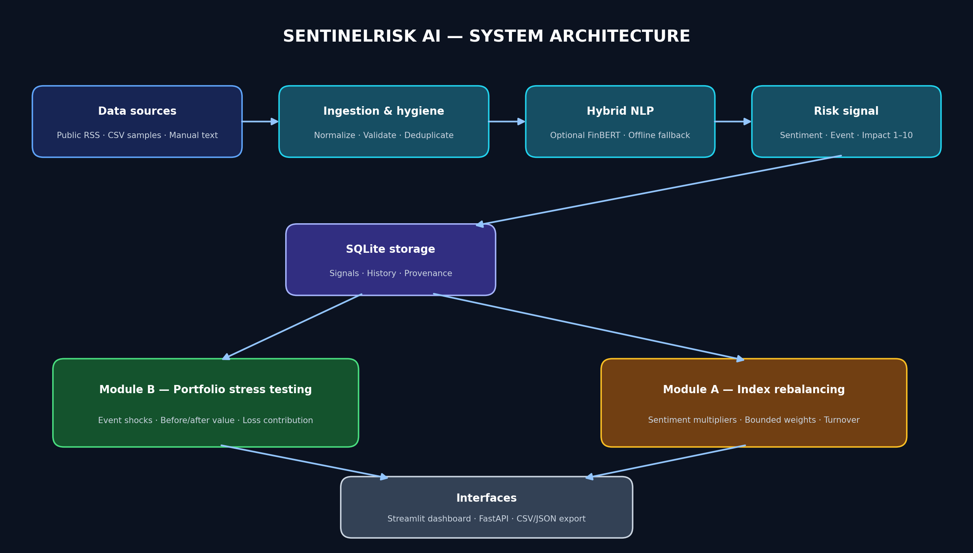
02 · SYSTEM DESIGN
Architecture and data flow

Slide 4
03 · ENGINEERING
Implementation highlights
• Hybrid sentiment: optional FinBERT plus offline lexicon fallback for reproducible demos.
• Transparent event taxonomy and weighted 1–10 impact heuristic with traceable reasons.
• FastAPI endpoints, SQLite persistence, Streamlit dashboard and CSV/JSON exports.
• Event-specific synthetic shocks and bounded index weights with validation invariants.

Slide 5
04 · EVIDENCE
Validation and measurable outputs
• Automated tests cover ingestion, sentiment, event classification, signal fields, API and financial invariants.
• Run the demo to produce risk signals, stress-test outputs and rebalanced index weights.
• Evaluation script reports metrics on a small synthetic labelled set.
• Do not interpret demo metrics as real-world performance; independent evaluation is required.

Slide 6
05 · FINANCIAL USE CASE
Potential domain impact
• Prioritizes events for analyst review using explainable scores and traceable reasons.
• Shows which synthetic positions drive scenario losses instead of presenting one opaque portfolio number.
• Supports what-if analysis with configurable thresholds and scenario assumptions.
• Can later connect to validated exposure data, governance and calibrated models.

Slide 7
06 · RESPONSIBLE DEPLOYMENT
Limitations and next steps
• Bundled data and holdings are synthetic; RSS availability varies by network.
• Keyword classification and offline sentiment are baselines and can miss context.
• Stress shocks are illustrative, not predictions; instrument valuation is simplified.
• Next: larger labelled evaluation, impact calibration, entity resolution, backtesting and realistic valuation.

