Slide 1

Pizza Sales
Database project
- By Rajashree Chatterjee

Slide 2
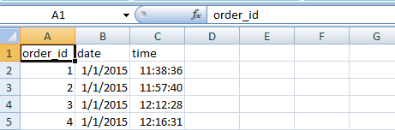


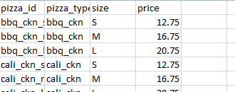
About the project :
There are total 4 database present in pizza-hut file
1. order_details
2. orders
3. pizza_types
4. Pizzas
Tries to solve queries using Mysql through the database
Orders :-
Order_details :-
Pizza-types :-
Pizzas :-

Slide 3
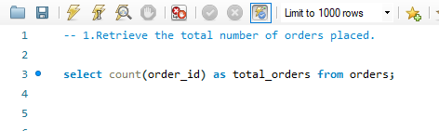
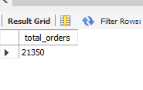
1. Queries:-
-- 1. Retrieve the total number of orders placed.
output-

Slide 4
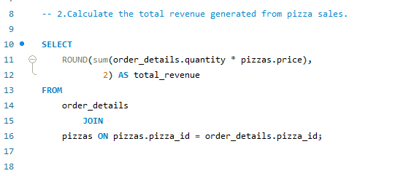

2. Queries:-
-- 2.Calculate the total revenue generated from pizza sales.
output-

Slide 5
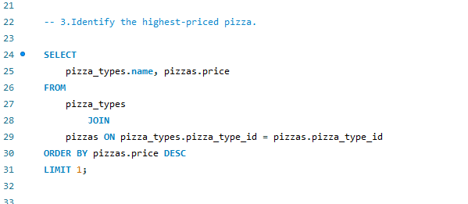
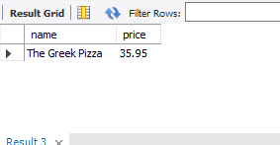
3. Queries:-
-- 3.Identify the highest-priced pizza.
output-

Slide 6
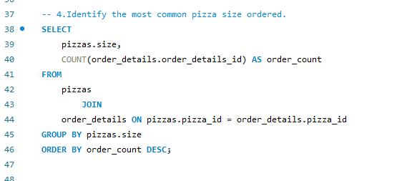
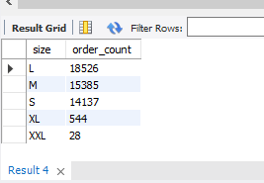
4. Queries:-
-- 4.Identify the most common pizza size ordered.
output-

Slide 7
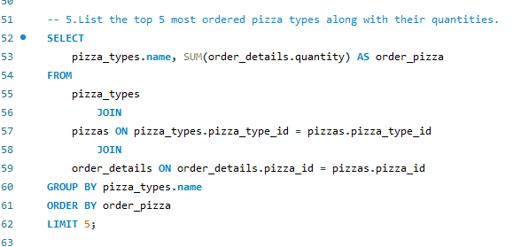
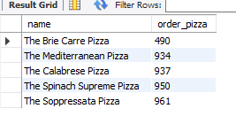
5. Queries:-
-- 5.List the top 5 most ordered pizza types along with their quantities.
output-

Slide 8
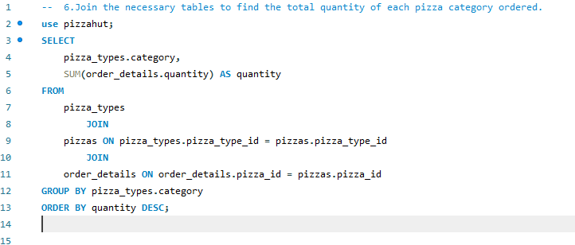
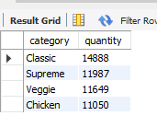
6. Queries:-
-- 6.Join the necessary tables to find the total quantity of each pizza category ordered.
output-

Slide 9
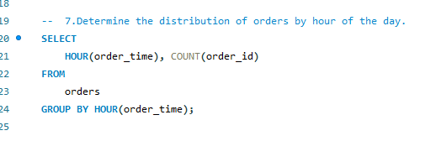
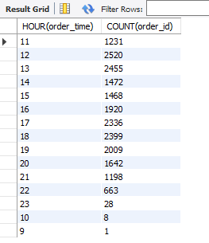
7. Queries:-
-- 7.Determine the distribution of orders by hour of the day.
output-

Slide 10
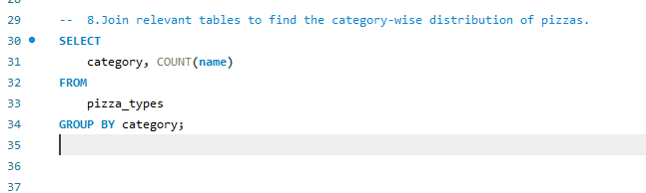
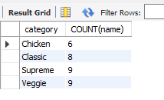
8. Queries:-
-- 8.Join relevant tables to find the category-wise distribution of pizzas.
output-

Slide 11
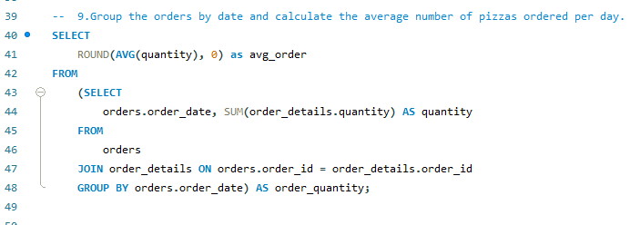
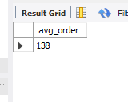
9. Queries:-
-- 9.Group the orders by date and calculate the average number of pizzas ordered
per day.
output-

Slide 12
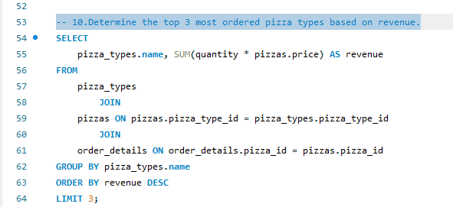
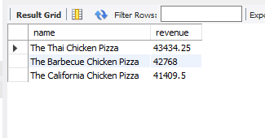
10. Queries:-
-- 10.Determine the top 3 most ordered pizza types based on revenue.
output-

Slide 13
Solved some queries using Mysql . Its helps to gathering knowledge and strive to run quires in optimal way . My first project on Mysql database . Tried to solve as my level best . It’s help to understand database and how it works…
Thank you …

