Slide 1
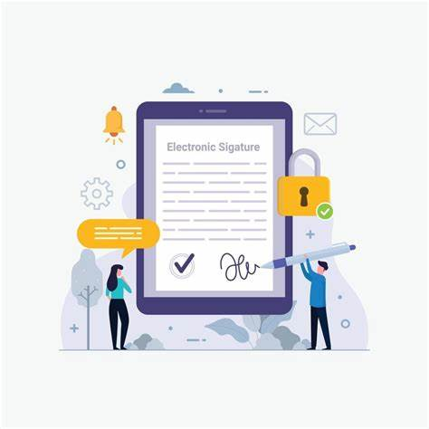
Online Signature Verification using Machine Learning Algorithms
Rajat Saini (S0I2UA)
Budapest University of Technology and Economics

Slide 2
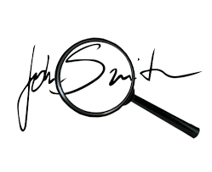
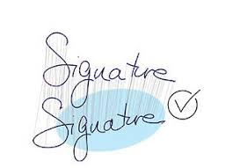
Problem & Motivation
Why Signature Verification?
Despite the rise of biometrics like facial or fingerprint recognition, handwritten signatures remain legally important—especially in banking, legal documents, and administrative systems.
Manual signature checks are prone to errors
and forgery.
ML provides an automated, scalable alternative.
Improves both security and efficiency in digital identity systems.

Slide 3
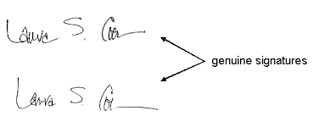
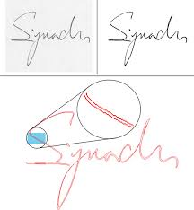
Signature Datasets Overview
Dataset | Samples | Features | Notes
MCYT | 20,000 | X, Y, P, al, az | Largest; averaged per SigID
SVC | 5,120 | X, Y, P, al, az | Clean format; ready to use
Chinese | 4,124 | X, Y, P | No orientation
Dutch | 7,056 | X, Y, P | Pressure focus
German | 1,778 | X, Y, P | Smallest

Slide 4
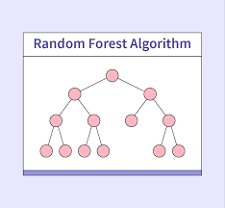
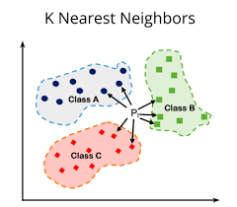
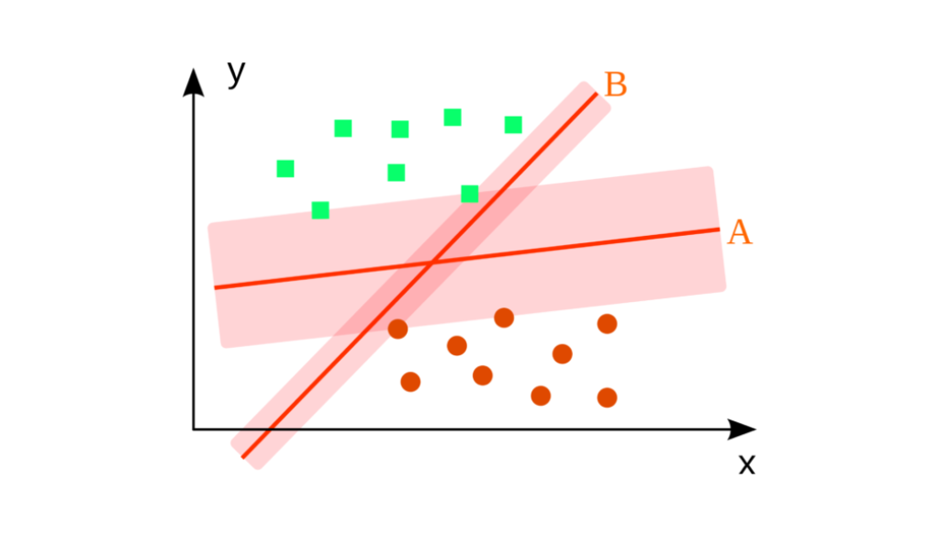
Model Comparison: ML Models & Evaluation
Models:
Random Forest – Best overall-it gave high accuracy and balanced error rates across all datasets.
K-Nearest Neighbors – Simple but slower on larger datasets
Support Vector Machine – High precision only on the Chinese dataset, higher FRR-which means it rejected more genuine signatures by mistake.
Metrics Used:
Accuracy, Precision, F1 Score, FAR, FRR, EER

Slide 5
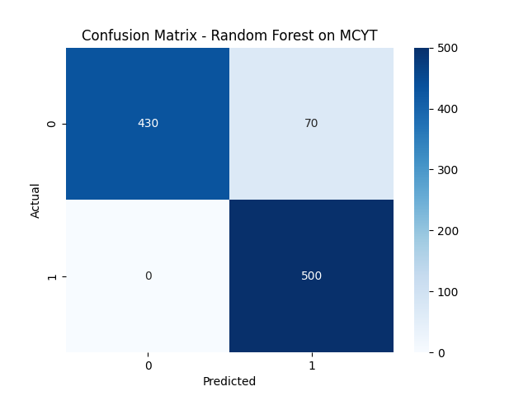
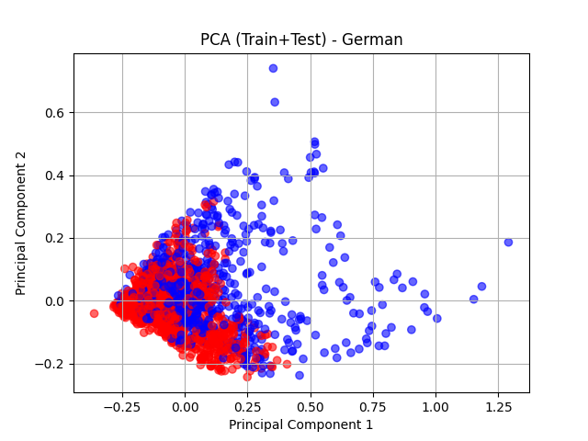
Results & Observations
Random Forest: 93% accuracy on MCYT with 0% FRR — most reliable overall.
K-Nearest Neighbors: Performed best on the Dutch dataset, with good balance of FAR and FRR.
SVM: Achieved highest precision on Chinese dataset, but had higher FRR on others.
German Dataset: Most challenging — all models had lower accuracy and higher error rates due to fewer samples and missing features.

Slide 6
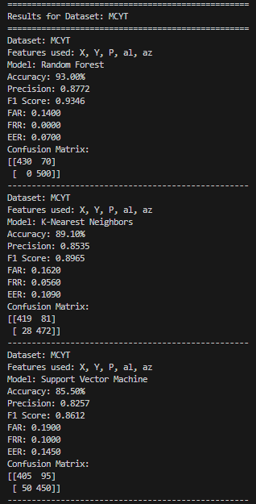
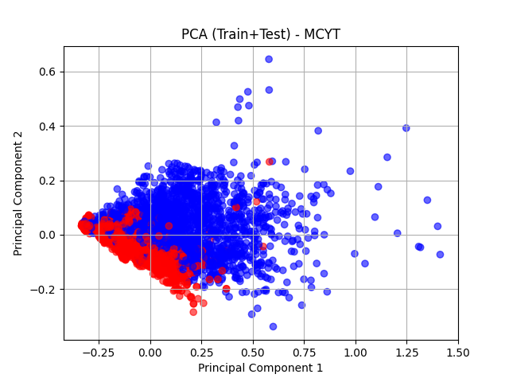

Slide 7
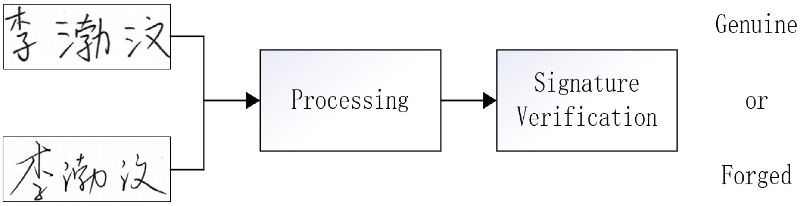
Conclusion & Next Steps
ML models can verify signatures accurately across datasets.
Random Forest outperformed other models - Random Forest had high accuracy and low errors, making it the most reliable model overall.
PCA + confusion matrix = effective evaluation.
Future Work:
Add time-series features (e.g., velocity)
Real-time verification system
Try deep learning (CNN/RNN)

Slide 8
THANK YOU !!

