Slide 1
Do you know what is most important thing in any Programming language ?

Slide 2
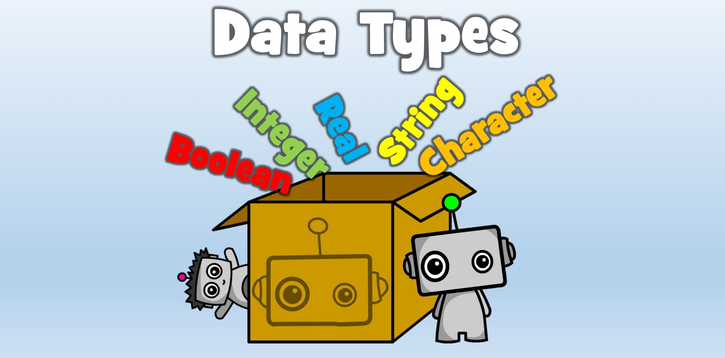

Slide 3
Data Types in JAVA
Java is a general-purpose and Statically typed programming language that is class-based, object-oriented.

Slide 4
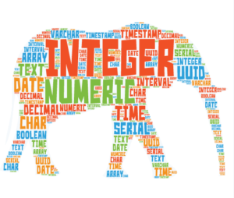
The data type of a value (or variable in some contexts) is an attribute that tells what kind of data that value can have.
What do you mean by Data Types ?

Slide 5
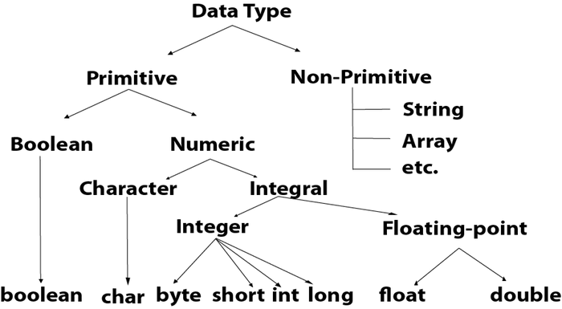

Slide 6
PRIMITIVE DATA TYPES
A primitive data type specifies the size and type of variable values, and it has no additional methods.

Slide 7
Can you name the primitives available in java ?

Slide 8
8 Primitives in java
Data Type | Default Value | Default size
boolean | false | 1 bit
char | '\u0000' | 2 byte
byte | 0 | 1 byte
short | 0 | 2 byte
int | 0 | 4 byte
long | 0L | 8 byte
float | 0.0f | 4 byte
double | 0.0d | 8 byte

Slide 9
boolean Data Type
The Boolean data type is used to store only two possible values: true and false.
Example: boolean one = false;
char Data Type
The char data type is used to store characters.
Example: char letterA = 'A'
byte Data Type
It is an 8-bit signed integer that can store integer values in range -128 to 127
Example: byte a = 10;

Slide 10
short Data Type
The short data type is a 16-bit signed integer that can range from -32768 to 32767
Example: short s = 10000;
int Data Type
The int data type is a 32-bit signed integer. Its valid range is -2,147,483,648 to 2,147,483,647
Example: int a = 100000;
float Data Type
The float data type is a single-precision 32-bit floating point.
Example: float f1 = 234.5f

Slide 11
long Data Type
The long data type is a 64-bit two's complement integer.
Example: long a = 100000L;
double Data Type
The double data type is a double-precision 64-bit floating point.
Example: double d1 = 12.3;

