Slide 1

DATA TYPE
CLASS AND OBJECTS

Slide 2
Class & Object
Constructor
Access Specifier
Method
Variable
CONTENT

Slide 3
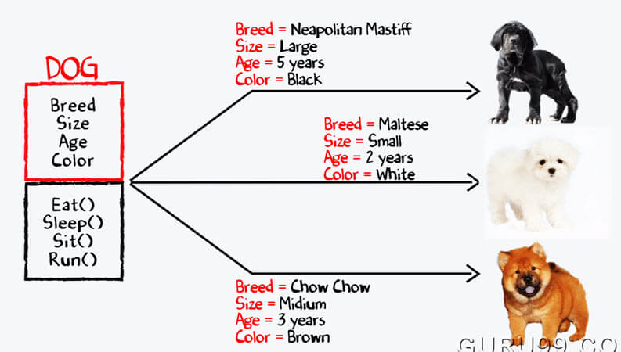
An Introduction to classes
A class is a building block of OOP.
It is the way to bind the data and its logically related functions together.
An abstract data type that can be treated like any other built in data type.

Slide 4
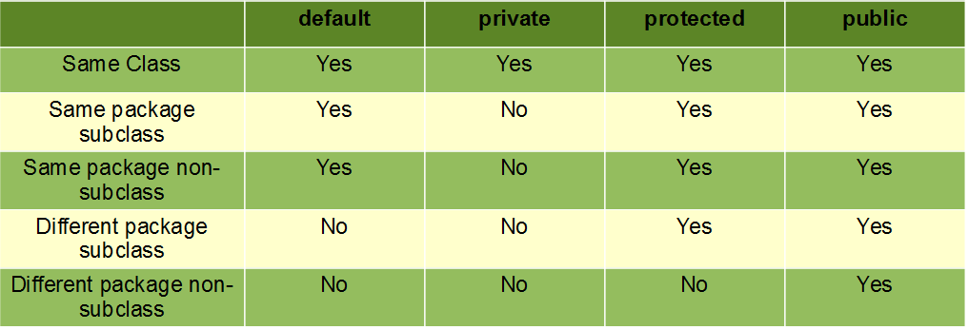

ACCESS SPECIFIER

Slide 5
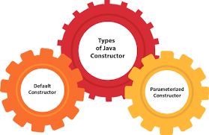
CONSTRUCTORS
Constructor is a block of code that initializes the newly created object.
A constructor resembles an instance method in java but it's not a method as it doesn't have a return type.
Constructor has same name as the class and looks like this in a java code.

Slide 6
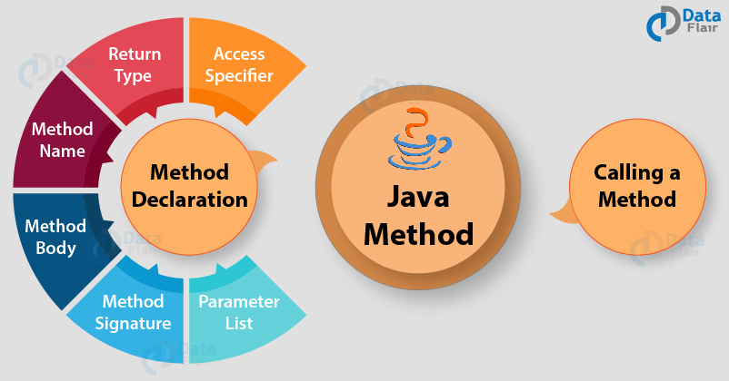
METHODS
A method is a block of code which only runs when it is called.
You can pass data, known as parameters, into a method.
Methods are used to perform certain actions, and they are also known as functions.

Slide 7
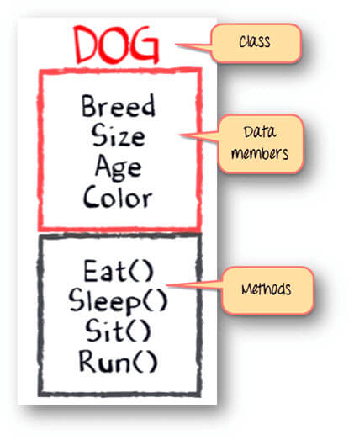
Introduction to objects
Object is an abstraction of real world entity
Objects are the variables/instances of classes.
An object is an entity that has attributes, behavior, and identity.

Slide 8
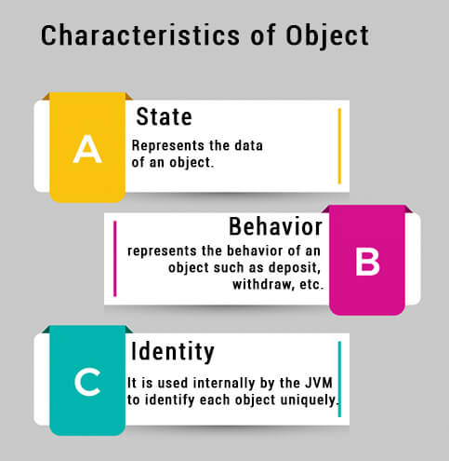
Characteristics of objects:
It can have its own copy of data members.
The scope of an object is determined by the place in which the object is defined.
It can be passed to a function like normal variables.
The members of the class can accessed by the object using the object to member access operator or dot operator(.).

Slide 9
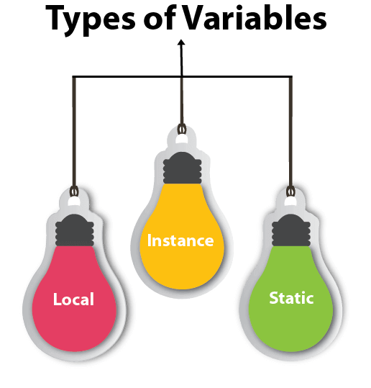
VARIABLES
Static or class variable is any variable declared with the static modifier of which a single copy exists.
Local variable in Java is a variable that's declared within the body of a method.
Instance variable is defined without the static keyword and are outside any method declaration are object-specific.

Slide 10

THANK YOU

