Slide 1
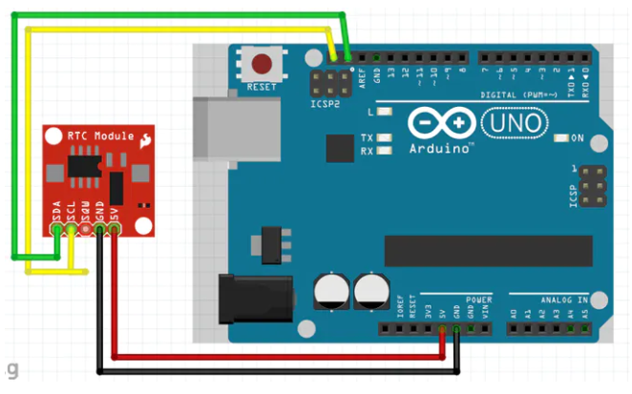
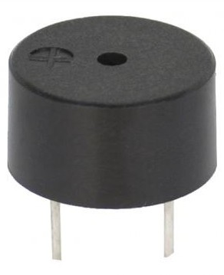
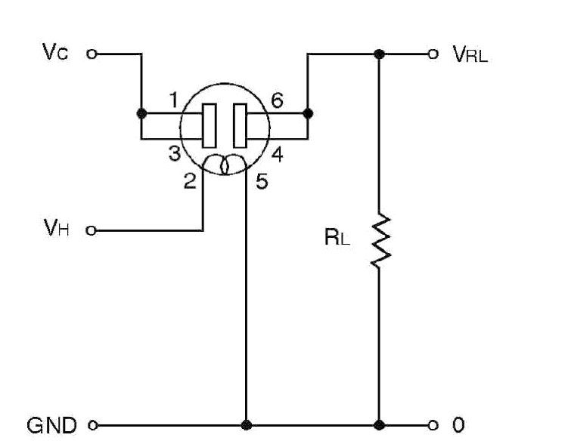
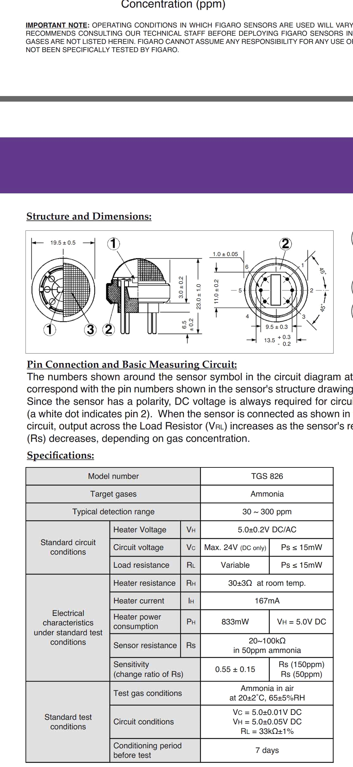
CIRCUIT DIAGRAM
Piezo Buzzer
(10)
GND
DC Supply
external
(A0)
Source:Arduino hub
+5V
TGS 826 Gas sensor

