Slide 1
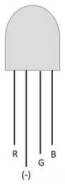
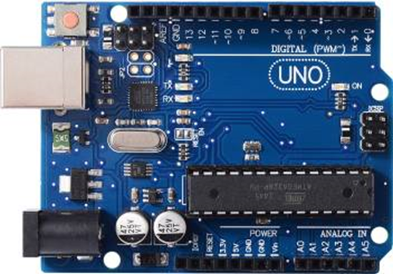

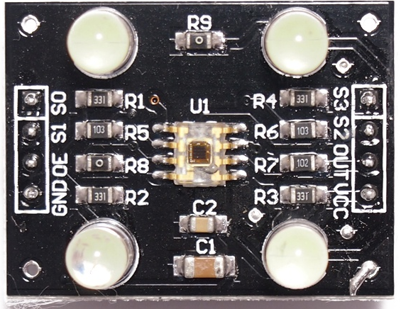
CIRCUIT DIAGRAM
Arduino
UNO R3
RGB LED
(9)
(11)
(10)
GND
(4)
(7)
(5)
(6)
RGB Color Sensor
(TCS3200)
(8)
GND
+5V

