Slide 1
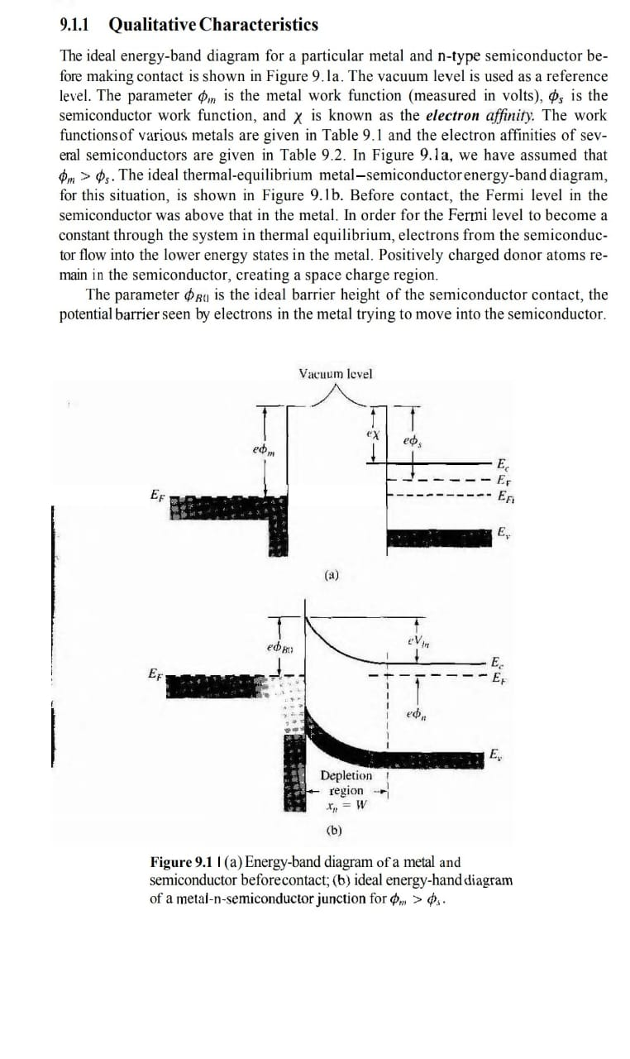
Metal-Semiconductor Heterojunctions
Metal and a n-type semiconductors.
In this case the
The Energy-band diagram of metal and n-type semiconductor

Slide 2

The energy-band diagram after contact
HOW??
Same electron potential across y-z plane

Slide 3

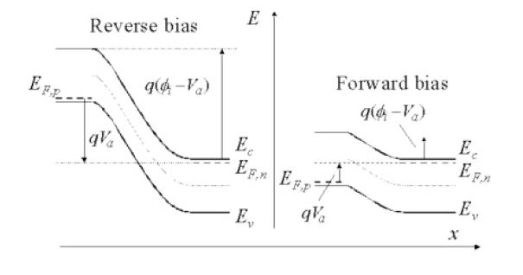
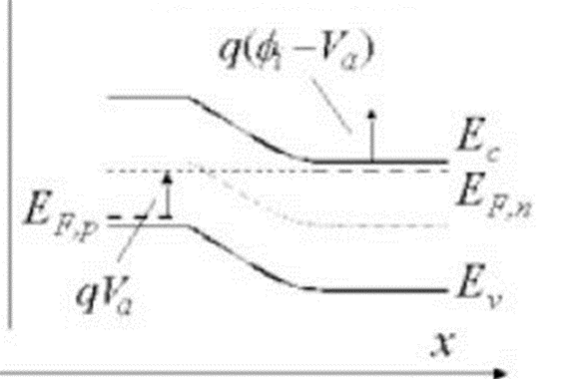
Now coming to the biasing:
E
x
x
FORWARD BIASING
REVERSE BIASING

Slide 4
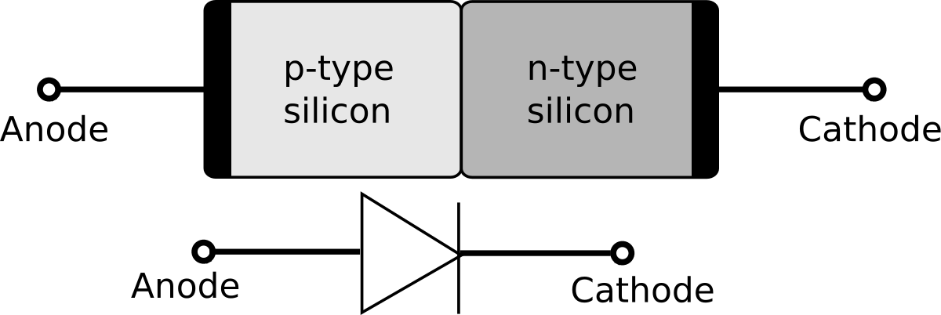
CONCLUSION:
The forward biasing should be given w.r.t. metal
for current flow.

