Slide 1
WELCOME
Good Morning Everyone, My name is Rajat, In am here to present my data analysis project on HR-Analyst.
The goal of this project was to analyze a Data Analyst dataset to determine the number of employees who have left the company. Using Python and Power BI, I extracted, cleaned, and analyzed the data to identify patterns and trends that can inform better decision-making.
In my analysis, I filled in missing values and applied other techniques to uncover insights and create meaningful visualizations. I then exported the data to Power BI to build clear and easy to understand dashboards and reports.
Today, I will share the key findings from my analysis and explain how they can help us determine which employees left the job. I will also guide you through some visualizations and show how they can be used to gain a deeper understanding of the data.
Thank you for joining me today. I hope you found this presentation useful and interesting.

Slide 2
We have Data of All Employes who left the Componies
We have a data of 1470 employee who left job.
The project focused on analyzing attrition in three departments.
9 job roles employees present in their.
Here we are 43 age group employee.
5 education field learning employee attrition job.

Slide 3
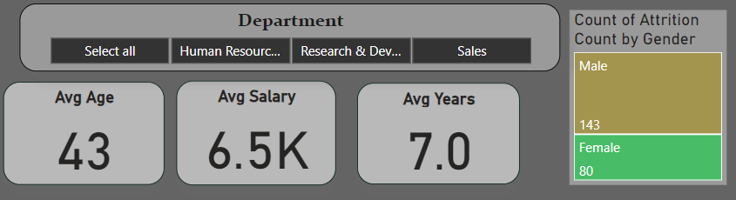


Lets First Understand The Dashboard
From Drawdown
Select Departments
This Tree-map show a Attrition count by age.
Here is a
Average Age of Employees
It show a Average Salary of employees
We can Total Year Duration.

Slide 4

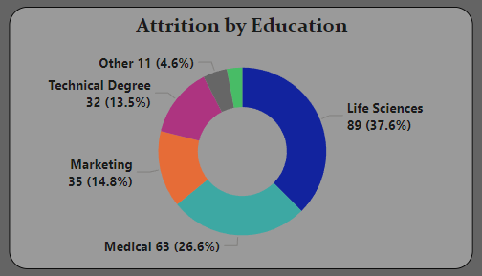
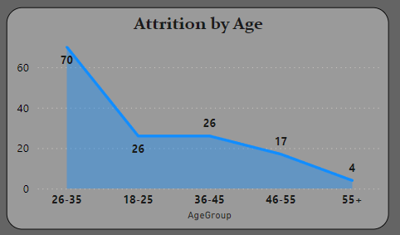


In the Attrition by Education we are able to see that with top 37.6% Attrition employees is given by one of them.
According to age group how many employees left the compony.

Slide 5

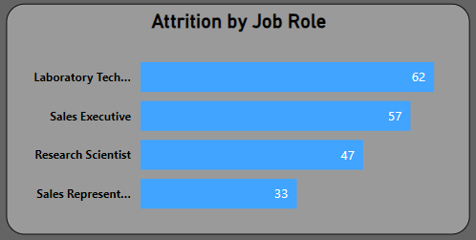
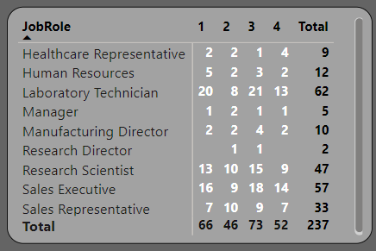


In Attrition by Job roles we can see that out of all Attrition Laboratory Technician has the maximum
we can see here a Attrition of employee, Job role with Job Satisfaction

Slide 6

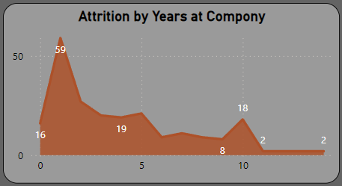
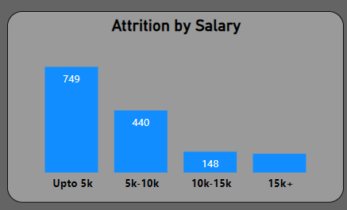


In this Tile we can see the Employees Attrition in which year is high at the Compony
Here we see a Attrition Employees Sallary present in which group

Slide 7
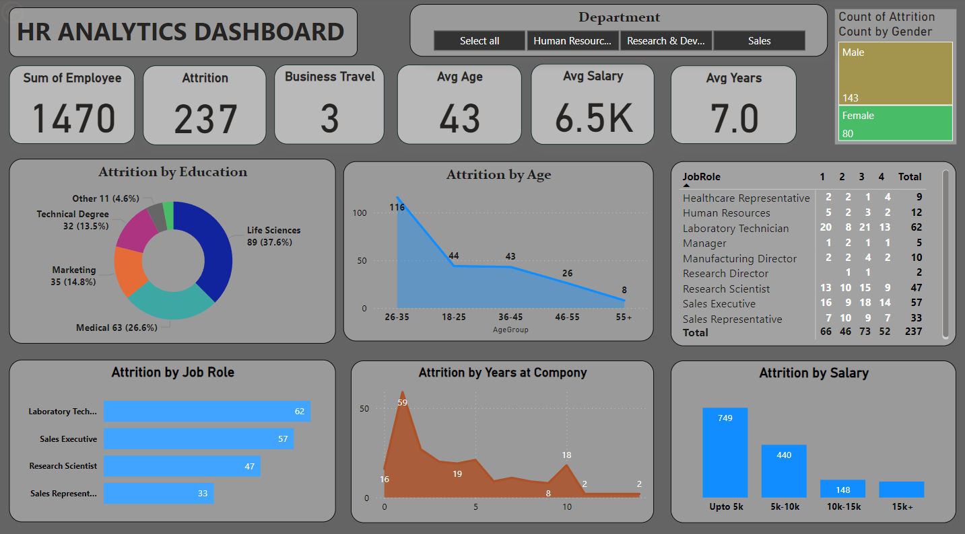
Now Our Dashboard Is Ready

Slide 8
Now We Understood the Dashboard Lets see the Dashboard On Power BI, Where We will see Reports

